Slide 1
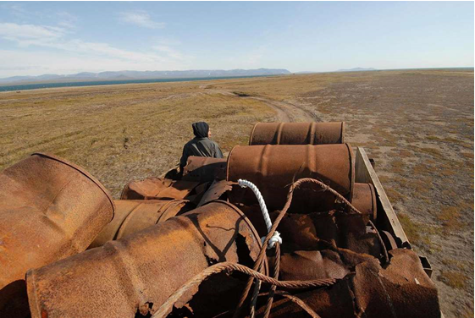


Brownfields, ANCSA Contaminated Lands, and What You Can Do
LEO Webinar - May 21, 2019
Joy Britt, Sr. Program Manager, ANTHC Contamination Support Program
Lisa Griswold, Environmental Program Specialist III, ADEC
Notes:
Introductions Lisa and Joy

Slide 2
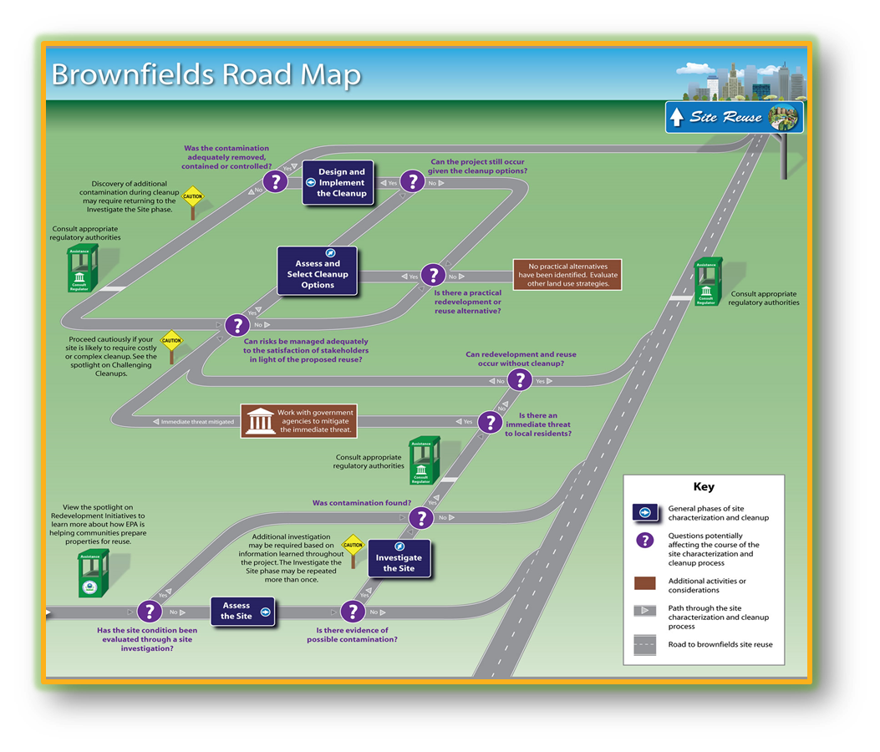
Presentation Road Map
Brownfields Introduction
How to Spot Contaminated Lands / Why it is important
ANCSA Contaminated Lands History
BUILD Act
What you can do
Resources
Notes:
Joy

Slide 3
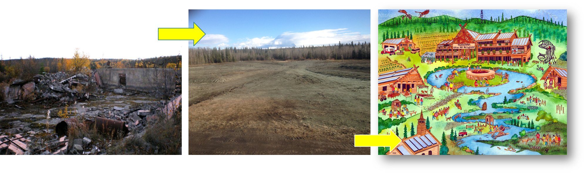
What is a Brownfield?
  “Real property, the expansion, redevelopment, or reuse of which may be complicated by the presence or potential presence of a hazardous substance, pollutant, or contaminant.” *Public Law 107-118(H.R. 2869)
  The perception of contamination keeps properties from being redeveloped. Once the “stigma” is gone, properties can be returned to productive use.
Notes:
Joy
Pics- Old Copper River School in Tazlina, remediated and re-use plan

Slide 4
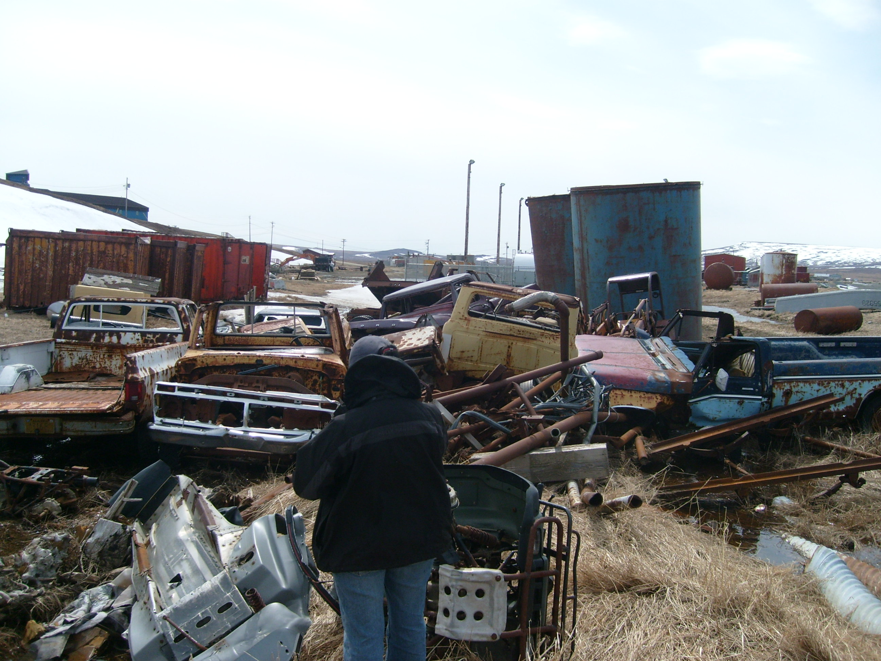
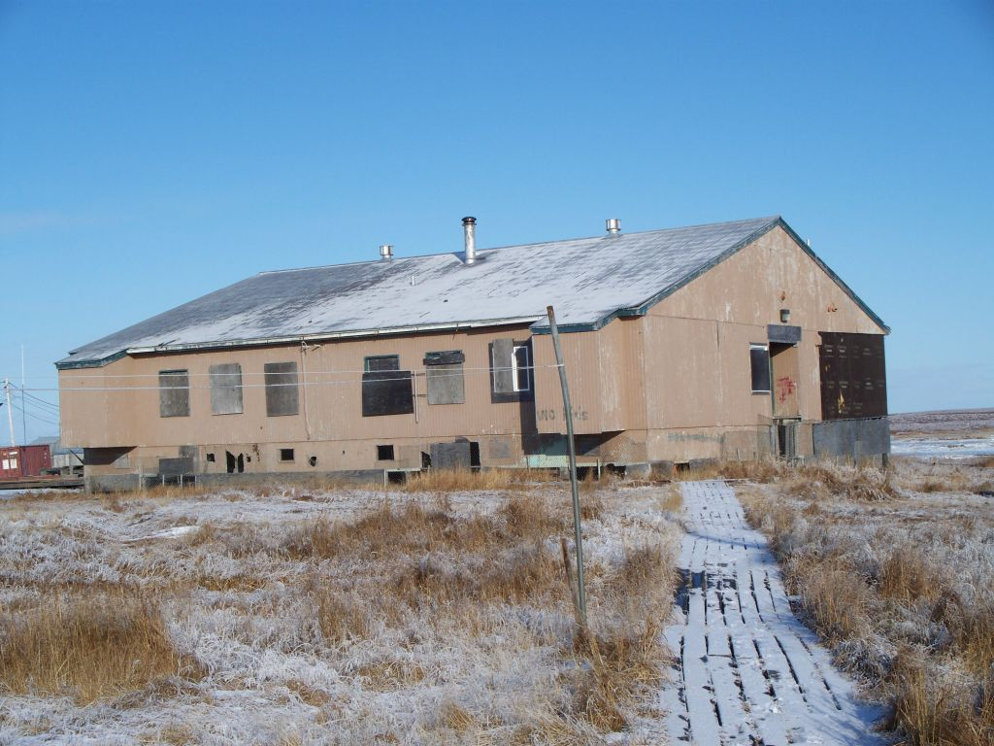
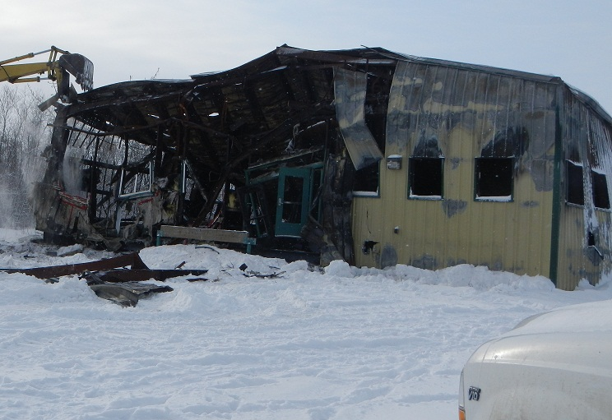
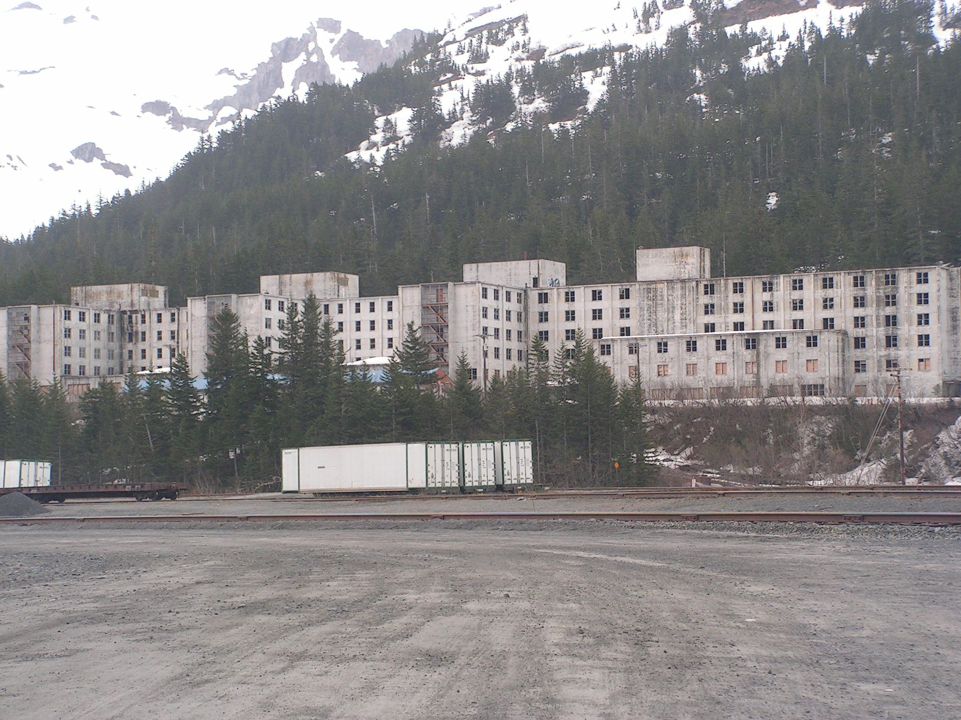
What types of Alaskan properties could be brownfields?
Tununak – Former Tank Farm
Abandoned tank farms
Old BIA schools
Formerly Utilized Defense Sites (FUDS)
Newtok – Old BIA School
Whittier – Former Army Barracks
Kwethluk – Burned Community Center
Notes:
Joy
Former dry cleaners
Former gas stations
Old canneries
Many more!
Note that FUDs has its own clean-up program and though FUDs can be considered a brownfield, only one pot of funding can be utilized.

Slide 5
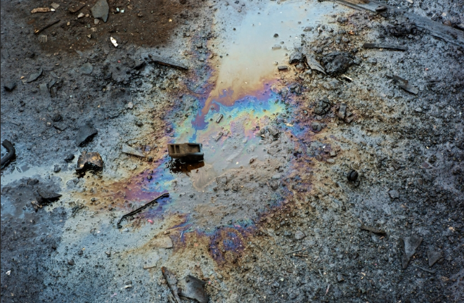
How to Spot a Brownfield / Contaminated Site
Discolored and stained soil
Odors
Absence of birds/animals
Minimal plant life /distressed vegetation
Erosion
Paint chips
Water- Sheen, foul smell/taste, turbidity
Notes:
Joy
So, now that you all have an idea of what a brownfield is, how do you know if a site in your community is contaminated and attention should be paid to it? Please note that not all forms of contamination are visible to the human eye. Some common pointers with contaminated land are:
Soil staining and discoloration as well as ‘slimy’ or ‘oily’ patches are generally a sign that there is an abundance of a substance that does not naturally occur in the soil.
Odor- When there is an abundance of a foreign substance trapped in the soil, it can sometimes (but not always) produce a distinctive odor. For example, a clear sign of petroleum contamination is the smell of oil whilst soils contaminated with a heavy metal like lead will not smell any different.
Absence of birds/animals- Soil contamination alters the metabolism of microorganisms and arthropods living in the soil and the chemicals they consume become more concentrated as they move up the food chain. The result of this is that soil contamination often wipes out predator or consumer species.
Minimal Plant life- contamination alters plant metabolism causing them to weaken and die. Distressed Vegetation are plants that are browned when they should be green or show signs of suffering.
Erosion - If a previously vegetated area is cleared through contamination, it has a secondary effect of soil erosion, as the vegetation is no longer present to protect the soil from being blown or washed away.
Paint Chips- A classic and obvious sign of lead contamination.

Slide 6

Impacts of Brownfields -
Why identify and reuse?
Environmental Benefits
-contaminant removal protects health and environment
-protects adjacent land from contaminant migration
Economic Benefits
-increase employment opportunities
-raise value of neighboring properties
Social Benefits
-improve community health, safety & security
-provide opportunity for traditional lifestyle activities
Notes:
Joy
Impacts of brownfields/ contamination are the reasons it is very important to identify them and report them.
Lisa will further drill down on health impacts for us.

Slide 7
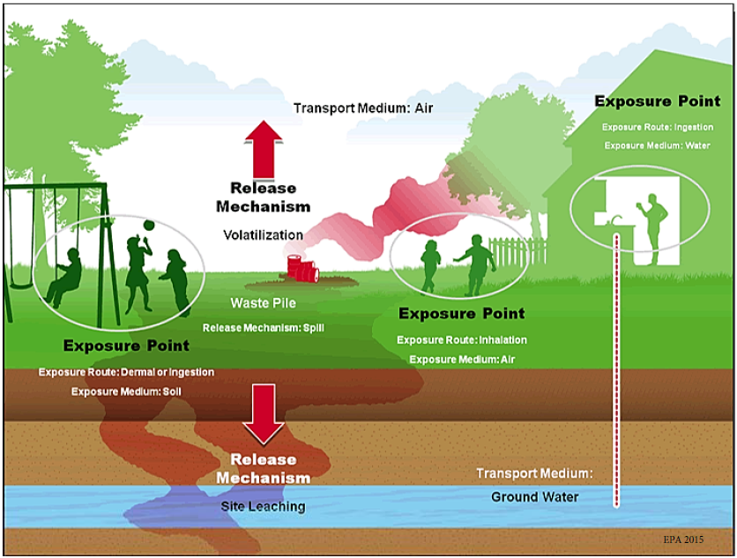
Contamination Effects on Health
Exposure routes:
Inhalation
Ingestion (eating or drinking)
Dermal (Absorption through the skin)
Amount of harm depends on:
The toxicity of the contaminant
The exposure route
The amount of the contaminant (dose)
Length of exposure
Notes:
Lisa

Slide 8

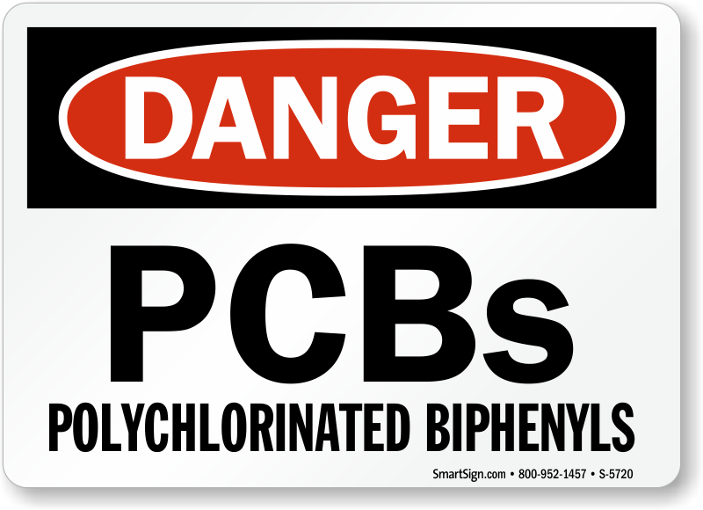

Petroleum
Common sources: tank farms and piping, home heating oil tanks
In the environment:
May evaporate,
May attach to soil or sediment
May be carried to surface water
May be carried to groundwater
Degrade naturally when exposed to oxygen, sunlight and soil bacteria
* petroleum degrades slowly in Alaska due to cold temperatures,
Winter snow cover
Concerns:
* Different types of petroleum have different types of health effects
Acute exposure: Headaches, nausea, skin irritation
Chronic exposure: cancer
Polychlorinated biphenyls (PCBs)
Common sources: Electrical equipment and hydraulic fluids, light ballasts
In the environment:
Strongly attach to plants, soil and sediment
Can migrate slowly to groundwater and surface water
Can migrate by evaporation and resettling through rain or snow
Can migrate through dust
Very persistent in environment as sun, oxygen and bacteria do not easily break them down
Concerns:
Chronic exposure: cancer
Notes:
Lisa

Slide 9
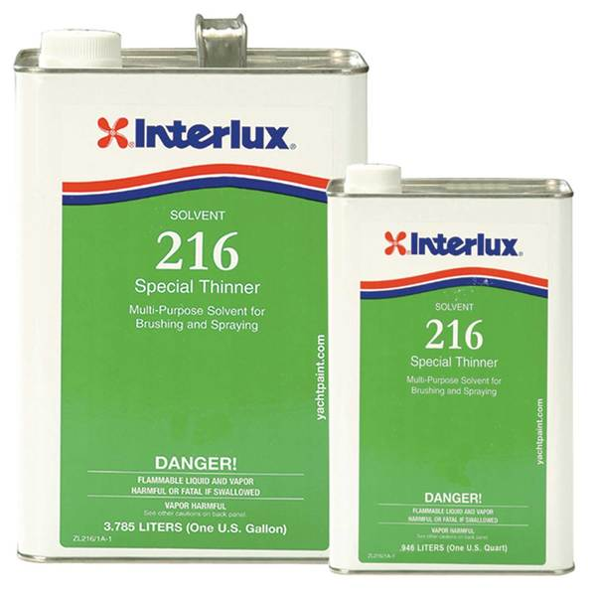


Metals
Common sources: batteries (lead and mercury), gasoline and paint (lead), mining (mercury) *some naturally occur
In the environment:
Can be found in soils
can be found dissolved in liquids
persistent
Concerns:
overexposure: nervous system disorders, brain damage, kidney damage, blindness and death
  * Some symptoms are reversible if detected soon enough
  * Any metal can be harmful to plants, animals and people if the exposure is high enough and the metal is in a form that can be absorbed
Solvents
Common sources: auto and equipment repair shops, drycleaners
In the environment:
May evaporate
readily dissolves in groundwater
Some Degrade naturally when exposed to oxygen, sunlight and bacteria
some are persistent
some degrade into more toxic contaminants
Concerns:
Acute exposure: dizziness, lightheadedness. memory loss, liver damage, coma or death may occur if exposure is severe
Chronic exposure: cancer
For specific contaminant information:
https://www.atsdr.cdc.gov/toxfaqs/index.asp

Slide 10


Impacts of Brownfields -
Why DON’T we identify and reuse?
Lack of Knowledge – about possible health issues or site itself
Don’t know what to do about it
Don’t have capacity or support
Fear
Time and RESOURCES…
Notes:
Lisa

Slide 11
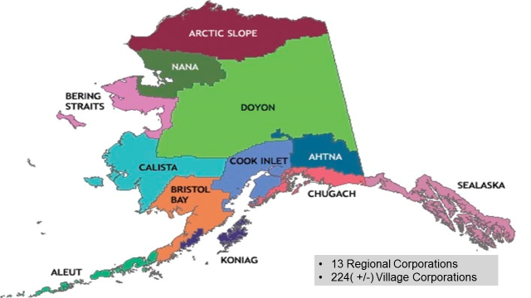
ANCSA Contaminated Lands – Brief History
Notes:
Joy
We have presented on brownfields and the important impacts of contaminated lands thus far. Now, I want to take us in another direction to help increase our knowledge of land ownership in Alaska (because owners are considered responsible parties of any contamination on their land), as well as understand how lands were divvied up after ANCSA.
---
Displayed on this slide and familiar to many of you are the 12 Regional Corps. There is a 13th corporation but it is considered “landless.” In 1971, the Alaska Native Claims Settlement Act –aka ANCSA established these regional corps as well as 200 plus Village Corps.
ANCSA outlines that the village corps own surface rights to land and Regional corps own the sub-surface rights, however ANCSA never gave a clear definition of surface and subsurface. This adds to the complexity of ANCSA in determining who can do what with the land.
Under ANCSA, The U.S. Department of the Interior, Bureau of Land Management was ordered to survey the areas selected or designated for conveyance to Village and Regional Corporations. Unfortunately many sites were conveyed contaminated.

Slide 12
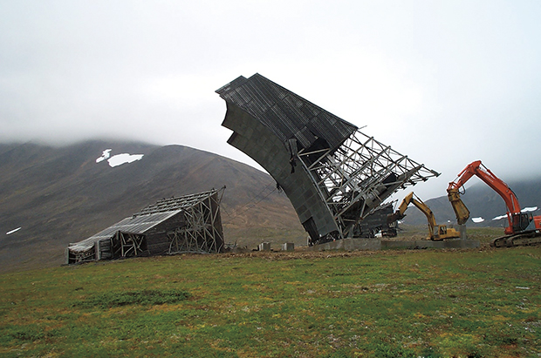
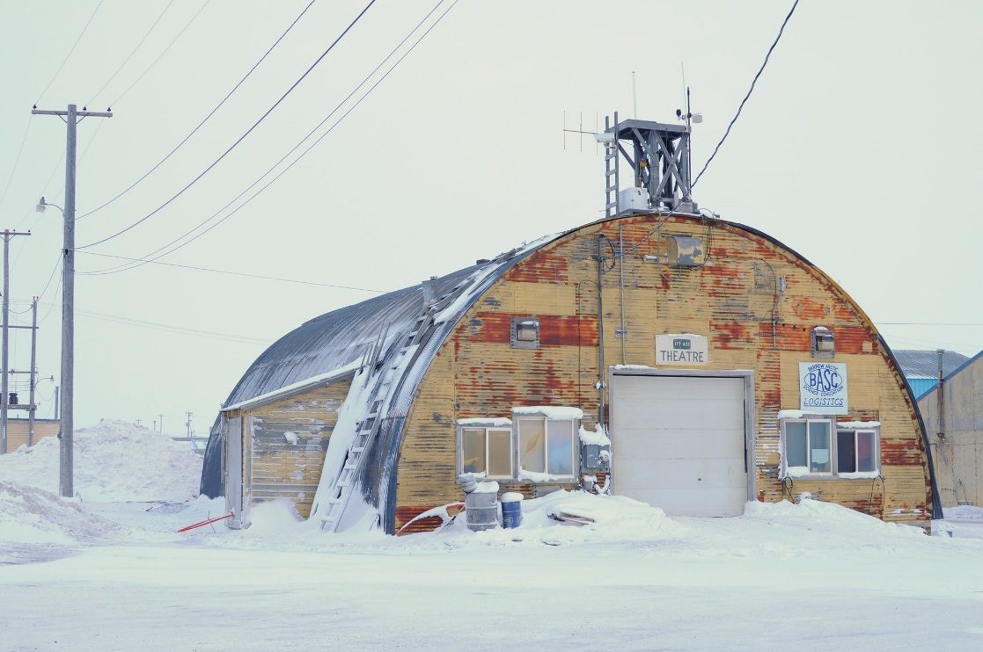
ANCSA Contaminated Lands
White Alice Communication Site
Northeast Cape St. Lawrence Island
Naval Arctic Research Lab Barrow
Notes:
Joy
During World War II and the Cold War, US military had a heavy presence in Alaska. There was a lot of environmental contamination left by these pre-ANCSA activities. Communication sites, tank farms, bomb impact areas, dumps, etc.
Through ANCSA, hundreds of these contaminated sites were conveyed the to the regional and village Corporations, and the effort to get them cleaned up has been going on for decades.
In the meantime, as you can imagine, Native leaders are concerned with the health and safety impacts of the contamination on local populations.
So, what has been done?

Slide 13
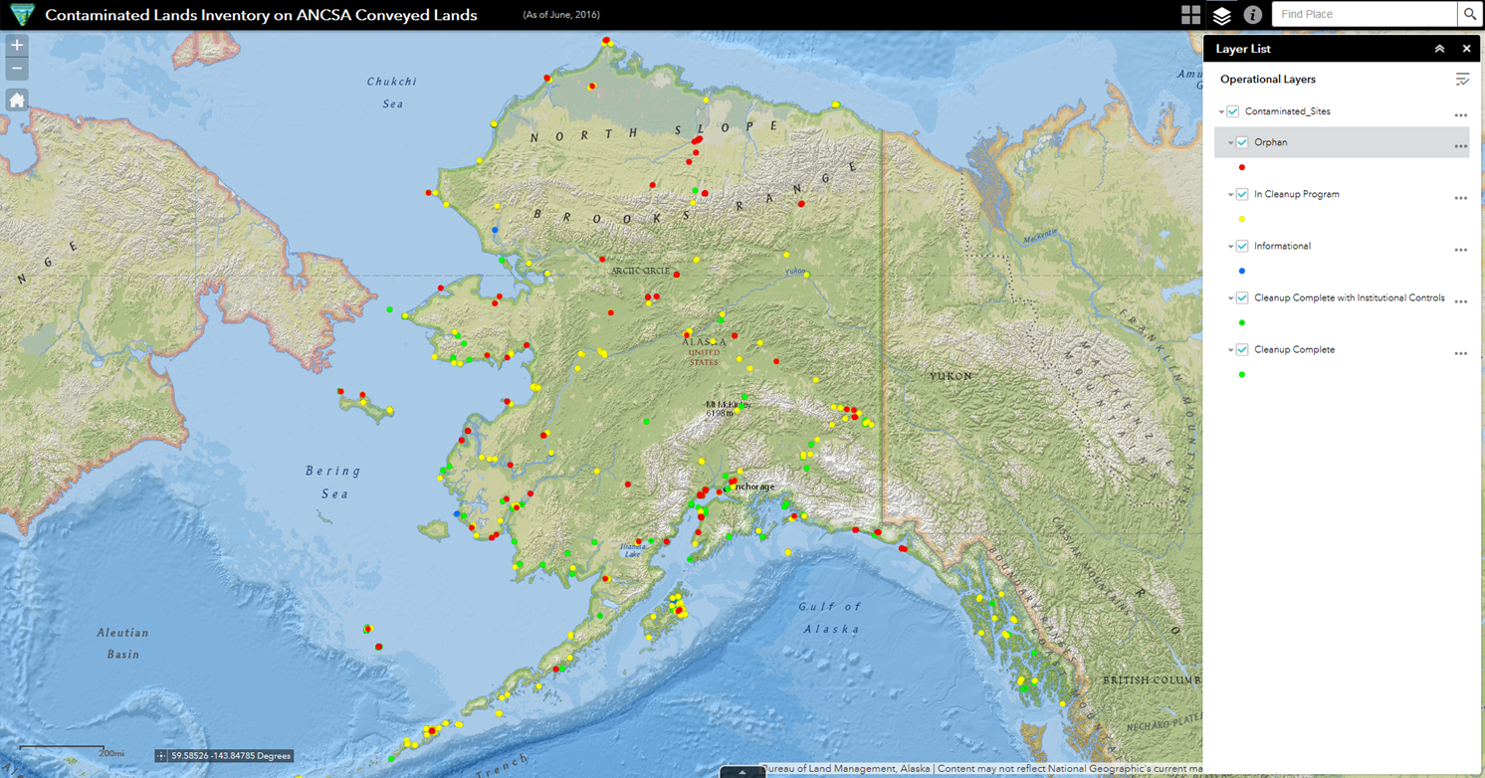
2016 BLM Report to Congress
Recommendations:
  ADEC should finalize the comprehensive inventory and implement a remedial action process
  Establish a formal contaminated lands working group
  Initiate site clean-up process
http://blm-egis.maps.arcgis.com/apps/webappviewer/index.html?id=3af8be2b154c440abf4efb3702b1df5d
Notes:
Joy
The BLM released its Report to Congress completing their identification of conveyed ANCSA contaminated lands by merging all databases that have information on ANCSA contaminated lands into one database (ADEC, FUDS, Air Force, FAA databases) and added BLM conveyance information to this webmap inventory.
This address is your most up to date inventory of ANCSA sites.
This report also offered the following three recommendations.

Slide 14
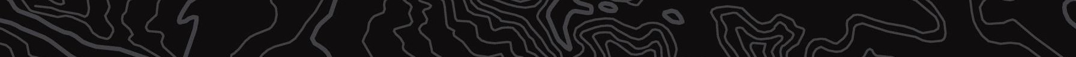

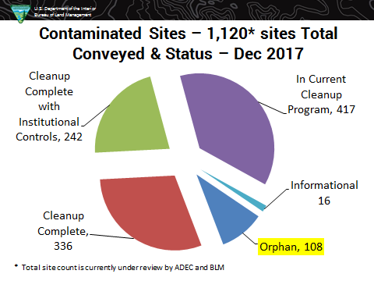
U.S. Department of the Interior
Bureau of Land Management
Contaminated Sites – 1,120* Total Conveyed & Status – October 2016
* Total site count and status are currently under review by ADEC and BLM
Notes:
Joy
This pie chart came from the 2016 report to congress.
In response to recommendation #1, ADEC is working very hard to verify these sites, especially the Orphan Sites number (Orphan sites are operationally defined as those sites not in existing cleanup programs), as many sites on this list are still being vetted.
* The most recent number provided by the ADEC of total sites in the ANCSA Inventory is 1146. So, sites are increasing because more are found and reported, as well as changes in their categories as many duplicates were found.

Slide 15
ANCSA Contaminated Lands Partnership Group Purpose
For Native entities to lead the action on:
Addressing sites identified in the ‘ANCSA Contaminated Lands Inventory on ANCSA Conveyed Lands’ aka the BLM Web Map
Address new sites that were not captured in the 2016 Report to Congress
Initiate the identification, verification, assessment, and clean-up of these sites
Notes:
Joy
In response to Recommendation #2 from the BLM report, the ANCSA Contaminated Lands Partnership Group was established in late 2017.
The purpose of the ANCSA PG is for…
2nd Bullet point- We acknowledge that there may be many more contaminated sites that were conveyed to ANCSA village and regional corporations and we want to be sure to capture all these sites.

Slide 16




Statement of Cooperation
Agencies
Notes:
Joy
As A Partnership Group we work closely with all of these entities to fulfill recommendation #3 – initiate site clean up process.
And, the most exciting part for Alaska Corporations as landowners is now, they need not worry about being held liable for land conveyed contaminated!

Slide 17


The Brownfields Utilization, Investment, and Local Development Act (BUILD Act)
Enacted on March 23, 2018
Reauthorized EPA’s Brownfields Program
Amended the original Brownfields law
  2002 Small Business Liability Relief and Brownfields Revitalization Act
Made changes to our brownfields grants, ownership and liability provisions, and state and tribal response programs
Notes:
Lisa

Slide 18
BUILD Act
AK Native Village/Regional Corporation Liability Protection
Alaska Native Village Corporations and Alaska Native Regional Corporations that acquired title to property from the U.S. Government under the Alaska Native Claims Settlement Act are excluded from the CERCLA definition of ‘owner/operator’ and are therefore exempt from CERCLA liability for any previous contamination at the property provided that the Alaska Native Village Corporation or Alaska Native Regional Corporation did not cause or contribute to the contamination. Entities that satisfy these conditions are eligible for Brownfields services.

Slide 19
BUILD Act
More Redevelopment Certainty for Governmental Entities
Local or state governments that take control of a contaminated site no longer has to be an “involuntary” acquisition.
Allows control through law enforcement activity, bankruptcy, tax delinquency, abandonment, or other circumstances
Notes:
Section 101(20)(D) is

Slide 20
BUILD Act
Prospective Purchasers and Lessees
Bona Fide Prospective Purchaser definition was amended to include language related to those who have tenancy or leasehold interests in the facility.
Petroleum Brownfield Enhancement
Removed the language and requirement that petroleum brownfield sites be “of relative low risk” in order to be eligible for funding.
Notes:
Section 101(20)(D) is

Slide 21
BUILD Act
Expanded Eligibility for Non-Profit Organizations
Non-profits (including LLCs and community development entities that are non-profit) can now apply for all brownfields grants (including assessment and RLF grants).
- IRS 501(c)(3)
Certain Publicly Owned Brownfield Sites
Publicly owned sites acquired prior to January 11, 2002 can receive brownfields grant funding as long as the entity is not responsible for the contamination.
Notes:
Section 101(20)(D) is

Slide 22
BUILD Act
Grant Applications
New ranking criteria focusing on renewable energy or any energy efficiency projects and waterfront developments (adjacent to a body of water or a federally designated flood plain).
Allowing Administrative Costs for Grant Recipients
Entities are now able to use up to 5% of grant awards on administrative costs.
Notes:
prioritize grant funding for sites that would facilitate renewable electricity from wind, solar, or geothermal energy; or any energy efficiency improvement project at a brownfield site.

Slide 23
BUILD Act
Increased Funding for Cleanup Grants
Increased the cleanup grant funding amount to $500,000 per site; eligible entities can also request a waiver to $650,000 per site, based on the anticipated level on contamination, size, or ownership status of the site.
Multipurpose Brownfields Grants
Grant authority for Multipurpose Grants (assessment and cleanup combination) was increased up to $1,000,000. No more than 15% of the total appropriation can be awarded to Multipurpose Grants.
NEW GRANT TYPE
Notes:
Section 101(20)(D) is

Slide 24
BUILD Act
Small Community Technical Assistance Grants
Authorized a new grant program for states and tribes to provide training, technical assistance, or research for small communities (<15,000), Indian tribes, rural areas, and disadvantaged areas. Maximum of $20,000 per community and one per state/tribe.
*****Current EPA State/Tribal Response Program Grantees were eligible – fund request was due 12/14/18*****
Funding
Authorizes the competitive grants to $200 Million for FY 2019 through 2023
Authorization is not appropriation, which is done by Congress yearly
Notes:
Section 101(20)(D) is

Slide 25
What you can do!
If you see a contaminated site, report it on LEO! Immediate response- please call 1-800-478-9300 .
Share what you have learned today about the BUILD Act and liability relief!
Join the ANCSA Contaminated Lands Partnership Group!
Report Sites that are not on the ANCSA BLM Webmap!
Notes:
Joy
So how do we tie all of what we have presented to you today into what you can do in regards to contaminated sites?
** LEO- As the climate changes, our environment changes. You are the experts in your community and view first hand changes in your land caused by climate change and erosion. Contaminated sites that have been sitting dormant for many years may suddenly appear due to erosion. You can use LEO to communicate your contamination concerns. Let us know through posting pictures, GPS locations, and anything that can be impacted by this potential contamination –land, wildlife, water, food, or safety. LEO will reach out to experts to assist you with these concerns. Please also remember that if there is an oil spill or action that requires immediate attention, please contact the Alaska Spill Response Hotline- 1-800-478-9300

Slide 26
Resources
(1) Assessment Grants
(2) Cleanup Grants
(3) Revolving Loan Grants
EPA
(4) State Tribal Response Program
(5) Other Grants (Job Training, Area-wide Planning, Multipurpose)
(6) Targeted Brownfields
Assessments (TBA) and Targeted Assistance for Brownfields (TAB)
Notes:
Lisa

Slide 27
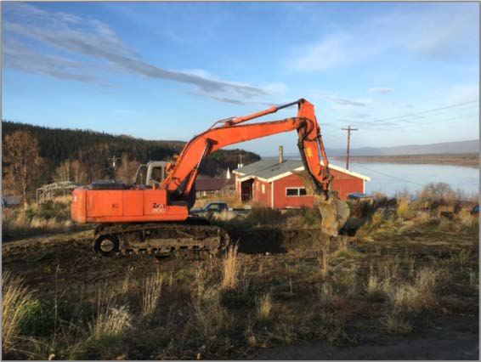
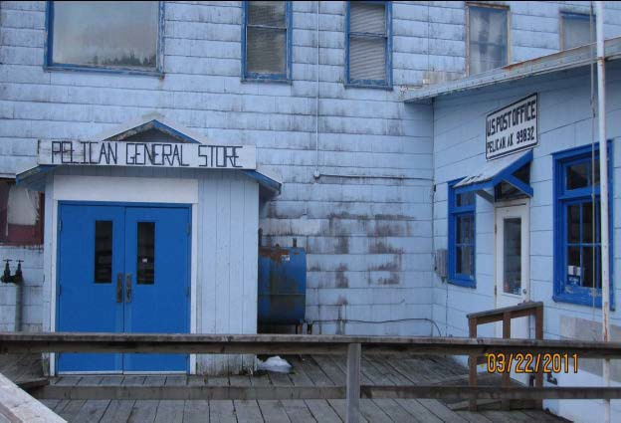
ADEC Brownfield Assessment and Cleanup
(DBAC service)
ADEC provided Resources
Assessment or cleanup for eligible brownfield properties
Eligible entities: federally recognized tribes, regional and village native corporations, municipalities, & local governments
Competitive statewide
October 15th – March 1st
For additional details please visit:
http://dec.alaska.gov/spar/csp/brownfields/
Notes:
Lisa

Slide 28
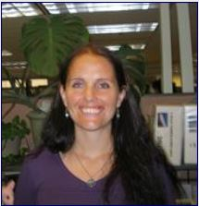


Thank you!
Joy Britt
jdbritt@anthc.org
907-729-5630
Lisa Griswold
Lisa.griswold@alaska.gov
907-269-2021
This presentation would not be possible without funding from the EPA.

