Slide 1
Yup’ik Resilience
Strength of Alaska Native Mini-Series, the Yup’ik People
Grace Petersen
8/27/2021

Slide 2
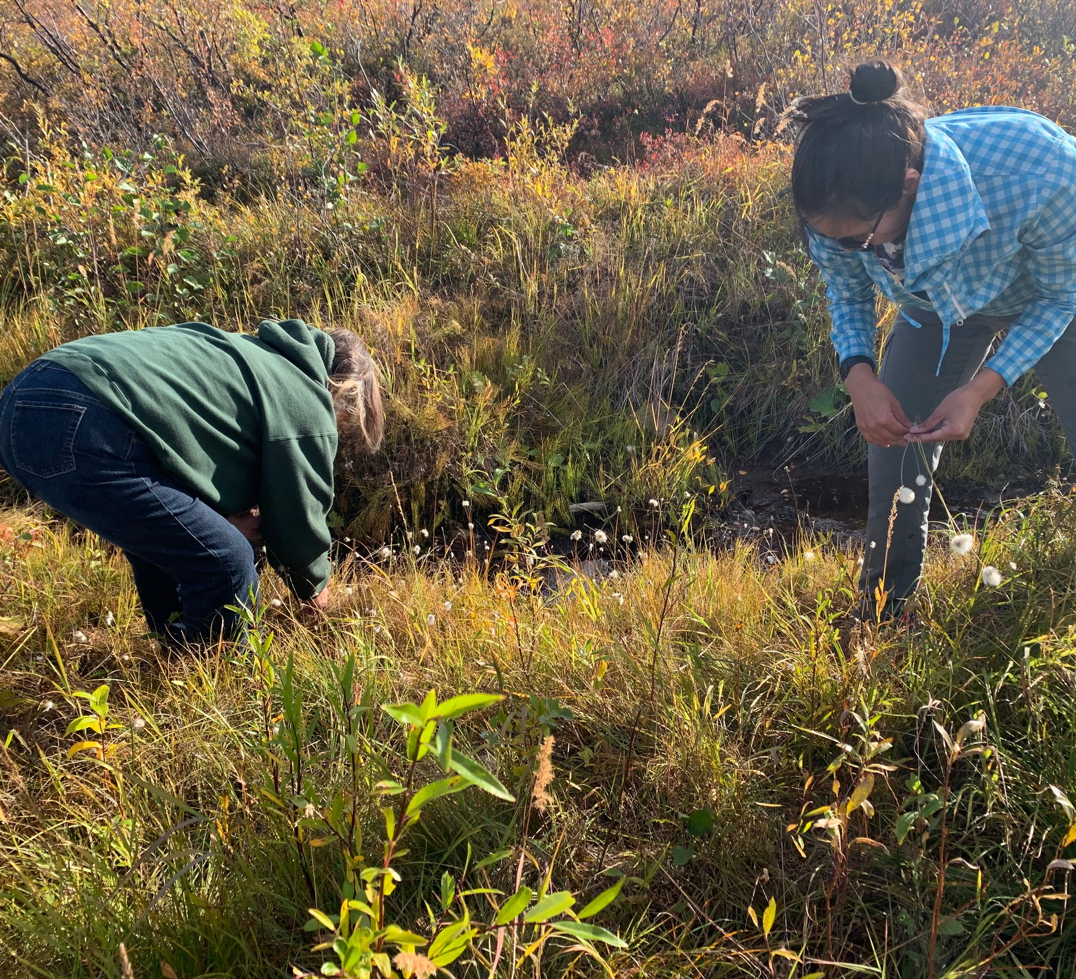
Cama’i, Welcome
Nuna, the Land
Yupiit, the People
Wiinga-llu, Me
Yupiugukut, We are Yup’ik
The Great Death
Wangkuta ilakuktut, We are Family
Notes:
Singular- Yuk, plural Yupiit
We believed in the awareness of all things. So bring your awareness to where you are, what your environment feels like, smells like, what your emotional/mental/physical state is. Take a moment and set aside any distractions.

Slide 3
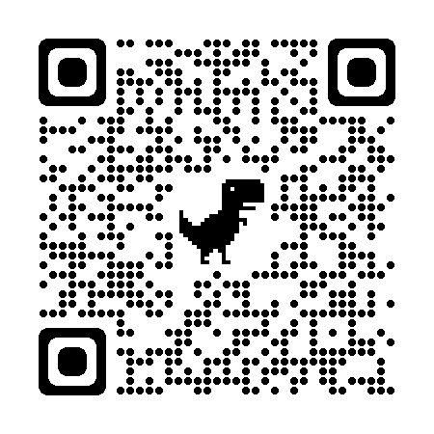
Nunamta Ellamta-llu Ayuqucia What Our Land and World is Like
Via the Yup’ik Environmental Knowledge Project
Notes:
Ella- “awareness” or “sense” also “weather” “world” ‘outdoors” ‘universe”
Nuna- land
Lowland delta of the Yukon-Kuskokwim (roughly the size of Kansas), we boast to have the largest population of AK Natives in the state, this area is cross-cut by historical and administrative boundaries, including two dialect groups, 3 major Christian denominations, 5 school districts, 2 census areas, and 3 Alaska Native Claims Settlement Act (ANCSA) regional corporations. The subarctic tundra environment means a diverse array of flora and fauna, millions of birds nest and breed in the wetlands. Annual migrations of herring and salmon are a staple in our diet, as well as seal, walrus and beluga whales. The 4-leggeds include moose, caribou, bear, fox, otter, hare, muskrat, and beaver. Edible greens and berries also contribute to our survival in this region.
“We Yupiit are like Animals and the Land is our Dish”- sharing is caring, harvesting, sharing, and the consumption of food from the land are important markers of what it means to be Yup’ik and the ways in which we see ourselves as different from our other human counterparts.

Slide 4
Ilaput Nunaput-llu, Our Families and Communities
More than 26,000 Yup’ik live in 56 villages in SW Alaska
Prior to Alaska Territorial law- families were spread in thousands of smaller camps and villages
Community and family ties remain defining features of what it means to be a Yup’ik person
Notes:
Territorial law in the 1950s required that school-aged children receive a classroom education, hence the establishment of permanent year-round communities; this was a profound change to Yup’ik family and community life. Prior to the imposed Territorial law, Yupiit family groups lived together in segregated residences where the men would stay in the qasgi (communal men’s house) and smaller sod homes for the women and children.
There were spring, fall, and fish camps depending on the gathering needs.

Slide 5
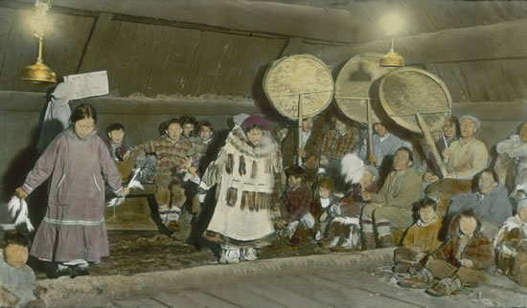
Qasgi, The Men’s House
When I was old enough to go to the qasgi my mother would say, "Okay, go over to the qasgi and try to steal something." She apparently meant that when I listened to men teaching, though the instructor wasn't talking directly to me, if I learned something, it would be something that would help me over and over for the rest of my life.
--Paul Kiunya, Kipnuk
Qasgi in Kwigillingok from the Martin Family Collection
Notes:
The men’s house also served as a gathering space, for ceremony and sweat/steam baths. Men had a place within a social structure in the qasgi- and life above ground mirrored that of the natural world. Yupiit people believed that sea mammals lived in a large qasgit, or underwater home, and viewed their treatment by people based on what they saw through a fire pit located centrally in the human’s qasgi. Women were allowed in the men’s house for ceremonies and feasts. The qasgi was a learning space, and that is what we are doing now.

Slide 6
Wiinga Yupiugua, I am Yup’ik
Why me?
Blood quantum and the Bureau of Indian Affairs
Aware and alive- in the skin of my ancestors,
“being Yup’ik is about how you do things, how you think about who you are, and your relationship to the world around you.”
Notes:
My story, like yours, begins before me: My mother raised me Russian-Orthodox. Historically the Russian-Orthodox priests and missionaries arrived in 1840s, followed by Morvians (1885 in Bethel), and the Jesuits in 1888. More on this later…
Being half kassaq, or half white, and raised in urban (Fairbanks is urban) Alaska meant that there are certain impacts of colonialism that have affected my relationship with who I am.
“Who? You??” story
Much of my childhood, being Yup’ik meant using an uluaq, taking a steam bath, going to fish camp, picking berries, and getting teased by cousins. Looking back now, I see how that makes me very much Yup’ik, but it has helped to learn from others much wiser than me.

Slide 7
Yuuyaraq, outlined the Yup’ik way of living in this spiritual universe. The law by which we lived. Qanruyutet, the wise words and instructions that provided moral guidance.
by Harold Napoleon, 1988
Notes:
Children were told to observe speakers carefully, “learners must always observe their teachers very carefully.”
[take a moment, 5 deep breaths and prepare your mind to focus, set down any distractions.]
Young listeners were instructed to employ all their senses when attending to the elder’s words to allow them place what they heard in their minds, children were instructed to “thingify” knowledge. As in knowledge could be something they stole and put into their pockets. Even before children gained awareness, parents and grandparents talked to them, giving them instruction in a loving way. The potent combination of words and love, ideally permeated Yup’ik education—Yup’ik teachers blurred thinking and feeling, reason and emotion.

Slide 8
Yuuyaraq, the way of being a human being
Unwritten but it governed all aspects of a human being’s life like:
correct behavior between family members and the community at large;
the way of thinking and speaking about all living things;
correct hunting and gathering protocols, and;
It encompassed the spirit world
Notes:
The importance of speaking about and listening to the traditional morals reveals a culturally specific educational philosophy that includes the Yup’ik views of personhood, the power of the human mind, the relation of thought to action, and the connection between instruction and experience.
Children might not understand what was said but were told that later in life, when they had experienced what had been once described tot hem, they would remember what they heard. Words themselves were not sufficient to produce understanding, but they were given the reassurance that they would know how to behave.
Yupiit considered learning to be a lifelong experience, “when you die, you are still learning.” A person also learned by watching, trial and error, and via consequence of their actions, “we are in charge of our own lives.”

Slide 9
Yuum-gguq Umyugaa Tukniuq, They Say a Person’s Mind is Powerful
Umyuaq or umyugaq, mind or mental activity
A person’s gratitude is powerful
A person’s hurt feelings are also powerful
Notes:
Yup’ik people did not strictly separate a person’s reason and emotion, thoughts or desires. They did not equate the concept of mind with disembodied reason, set off from bodily passions that was the rational mind’s job to control. Everyone had a mind. Your merit as a human being was based on how you chose to use your mind.
The Yupiit viewed the human mind as inherently powerful, capable of pushing others (and yourself) toward positive and negative outcomes. If we anger a poor person, it can push us toward a negative circumstance, but if a poor person is grateful, it is like they are pushing us toward our own happiness (i.e. animals are more available to hunters)
The Yupiit lived in a world where even bones and dirt were sentient and aware of the human’s and their interactions. Elder Frank Andrew once described how a person would be impervious to sickness if he handled refuse and unclean things, “They say everything had awareness, because the waste cannot clean up after themselves and do things on their own, they feel gratitude toward the person who moves them to a place where people will not step on them. Their gratitude settles on the body of the person who does the task and gives him strength. That person will encounter good health and sickness will not permeate his body.” Moreover, animals viewed a person who would do the “dirty work” as extremely bright and not at all frightening, and they willingly approached that person.
The various outcomes of handling the trash, waste, and what we would now call “dirty work”, or “germs” were nuanced and important to Traditional Yupiit society.
One of the most powerful and fundamental admonitions in Yupiit culture was the treatment of elders and orphans: to be generous and compassionate towards them derives from the understanding of the power of the human mind.

Slide 10
Qanruyutet
Ellam Yua, the Person of the Universe, is always watching, you are ultimately responsible for our own actions and choices.
Cooperate
Act with Compassion and Restraint
Express Gratitude
Tie up your Anger
Be Respectful
Demonstrate Friendliness and Love
Envy and Suffering are a part of the human condition
Live in Peacefulness
Notes:
A person’s mind is vulnerable- aka watch how you speak to children, Yupiit mental health – a person’s mind could help or harm oneself. “They say a person’s mental power is so great it can easily overwhelm you.”
The advice was to talk to people about your problems, “one who keeps secrets will only heal if he speaks of them.” “they say it can help to reveal your problems to animals. While a person should not gossip about other’s, it can be helpful and lifesaving to speak of one’s own condition and feelings.”
Cooperation: working together with one mind vs. doing your own thing (ie being a part of the community not just an individual)
Compassion and restraint: what goes around, comes around “there are no perfect people, but we always hope the best for everyone”
“We talk to you because we love you,” meaning, we give you this advice passed down from generation to generation because we care about you and we know there is healing power in guidance that is enriched with kindness and compassion. Compassion did not have to be asked for in order to be given.
Humility: “when you go to another village, even if you own nice clothing, use only your soiled work clothes. You will be embarrassing if they feel that you are trying to be superior.” Elders do not lack fine things, rather their compassion for others prevents them from flaunting their wealth.
Expressing gratitude: Quyana for the land, the animals, the people “they say the gratitude of an unfortunate person is very strong, but that a rich person is not very grateful.”
Anger: a person who acted with compassion elicited gratitude of those who helped and their powerful minds pushed that person in a positive direction. The opposite can be true. “They said all people are the same, my mind is like yours. All people become angry easily, a person who can control their anger by not retaliating or fighting back means a more powerful positive outcome than succumbing to retaliation.”
Love involved action and was not described as a self-contained virtue or an abstract value. People who demonstrated loving feelings attracted good fortune.
Envy and suffering were inevitable and could be spun into positives, but were ultimately regarded as emotions to control as to lead you to a more peaceful life.

Slide 11
Yuut tuqurpallratni, When a Great Many Died
“The Yup’ik people of today are not culturally the same as their forebearers.
They are, however, linked to the old through the experience of the Great Death.
One was wiped out by it, the other was born out of it and shaped by it.
It is from this context that we have to see the modern Yup’ik. It is only from this context that we can begin to understand them.”
-Harold Napoleon
Notes:
My ancestors were besieged by diseases like smallpox, measles, chicken pox, colds, and the influenza epidemic at the turn of the century. They attributed the diseases to evil spirits and their own weakness. They blamed themselves and their way of life. My people abandoned themselves and their way of life as a result. My people resigned themselves to Christianity. I don’t want to go down some rabbit hole where I talk to you about all the ways colonization has beget so many socio-economic pitfalls. That only bestows guilt and pity. We are not to be pitied. I can understand how my people became withdrawn and silent about the tragedy that they endured, our culture’s foundation rests upon strong positive emotions and the belief that we are ultimately responsible for any consequence, good or bad.
Impact of Colonialism: my people had a traditional sensitivity to the spirit world, so it was not a far-leap for them to understand the message of Christian responsibility and accountability. Children were taught to listen to their teachers, when the majority of elders (cultural teachers) were gone, they looked to the priests and BIA teachers to guide them.
In 1916 the US Bureau of Education regional superintendent, John Henry Kilbuck revealed that most Kuskokwim River Yup’ik lived in log cabins heated by cast-iron stoves, ate homegrown turnips and potatoes, had Western clothing, received education and healthcare as well as Christian teachings from federal employees and missionaries. My mother tells stories of her garden’s turnips, she remembers the one-room cabin she shared with her father and siblings. She went to several residential schools. She lost her mom during the birth of a sibling. She lost her father to colon cancer. She has survived many “textbook” events in the colonization of the Yup’ik people. She was telling me about her parents this summer, and I remember her voice distinctly as she told me that, “we used to play out and see the imprints of where all the houses used to be. There used to be a lot more families, way more than just a couple hundred.”

Slide 12
Wangkuta ilakuktut, We are Family
Notes:
I am a big sister to Angutaq, Ida Petersen, and little sister to Choda, Richard Nicolai. My mother, aana, is Rebecca Nicolai, Luqaq from Kwethluk, Alaska. My father, ataa, is John Petersen from Owatonna, Minnesota.
The way in which we map our family structure is important to understanding the Yup’ik view of not just what it means to be family, but what it means to be human.

Slide 13
Compassionate human relations, including the sharing of traditional knowledge, are thus seen to be at the heart of contemporary Yup’ik survival and essential to non-Natives’ understanding of the Yup’ik.
Notes:
Quick gloss-over the years: the Alaska Native Claims Settlement Act of 1971 creates social and political organization in the region: Association of Village Council Presidents, Yukon/Kusko Health Corp, Calista, etc. and the oil tax royalties from ANCSA create a shift in the regional economy. Subsistence harvesting coupled with a dependence on public sources of income (aka the government) limits the economic diversity in the region. Many Yup’ik still see themselves living in a highly structured relationship with the resources of their environment, not merely surviving off them.
the painful realties of domestic violence, substance abuse, sexual violence, residential schools, cultural genocide/assimilation, and Western-imposed poverty stripped us of so many happy endings for our people state-wide. Thankfully, my people have responded to these social problems with urgency- our resolve to retain our uniqueness as Yupiit has resulted in contemporary Yup’ik efforts on maintaining control of land, resources, and local affairs; improving residents’ health and spiritual well-being; and finding our way back to cultural and linguistic traditions. The road is long, but present Yup’ik leaders, teachers, and community members seek to enhance their cultural identity while they simultaneously seek to reduce dependency on public monies.

Slide 14
Tuqluucaraq, The way of Addressing One’s Relatives Atmak, Agayulirta, A’lla
One-to-one relationship between the namesake and the person who was named.
Tuqluun, a system that encourages closeness among relatives.
Notes:
The way in which we map our family structure is important to understanding the Yup’ik view of not just what it means to be family, but what it means to be human.
One of our biggest values was understanding a detailed list of variations on kinship terms. This upheld the close-familial relational structure- even from village to village. Knowing your relations was a system that freed people as they traveled, they knew who their relatives were so they knew who they could ask for help, depend on, and trust. There were rules for who among your kin you spoke to, how you spoke to them, and who you could tease. Yup’ik see themselves as a part of a wide network of kinsfolk, spread through the region and beyond. When they meet someone for the first time, the conversation centers on who their parents are and how they are related.

Slide 15
Wangkuta ilakuktut, We are Family
Notes:
The world contains no others, only persons.
As I learn and share about our past, it’s important for me to look forward and one cannot heal in a vacuum. It is important to share my feelings, to educate people on who we are and the joy that we share with each other simply by being alive.
We are taught to share everything: from food to our homes, our resources, and our knowledge. We believe, even today, that everyone is deserving of compassion. Elder Paul John summarized his view of Yup-ik and non-Yupik people: “It would be much better if we understand each other and not fight or resist each other. If we integrate teachings, our knowledge will be greater.” It is critical to delineate similarities while affirming differences, to recognize our shared humanity and re-evlauate our special place in history. Emphasize the similarities, explain them, validate them, and put us on equal footing.
There is an elaborate world that we are missing out on when we focus on the primacy of Western culture.

Slide 16
In what ways do you see historical and contemporary Yup’ik culture manifest itself in your communication with, and care of, Yup’ik people?
Notes:
Roadblocks in care: who is considered “family”
Traditional foods
Language barriers
Communication styles
One-way street of the perception of “knowledge”
Methods of learning
In other words, what have you learned today and how will that impact the way you treat Yup’ik people who come to you for healthcare?
How does this all relate to YOU? Our Elders and children are our most valuable resource, the care you provide my People in the healthcare industry is incredibly relevant to our future. We are all humans, so in my culture, we are family.

Slide 17
Yuraq, Dancing
Notes:
The Yupiit shamans and spiritual leaders carved masks for our special ceremonies that were held in the qasgi, masks were a way to create balance and connection with the spirit world. Many of our important ceremonies were banned during the onslaught of Christianity. That is not to say there is not a revitalization!

Slide 18
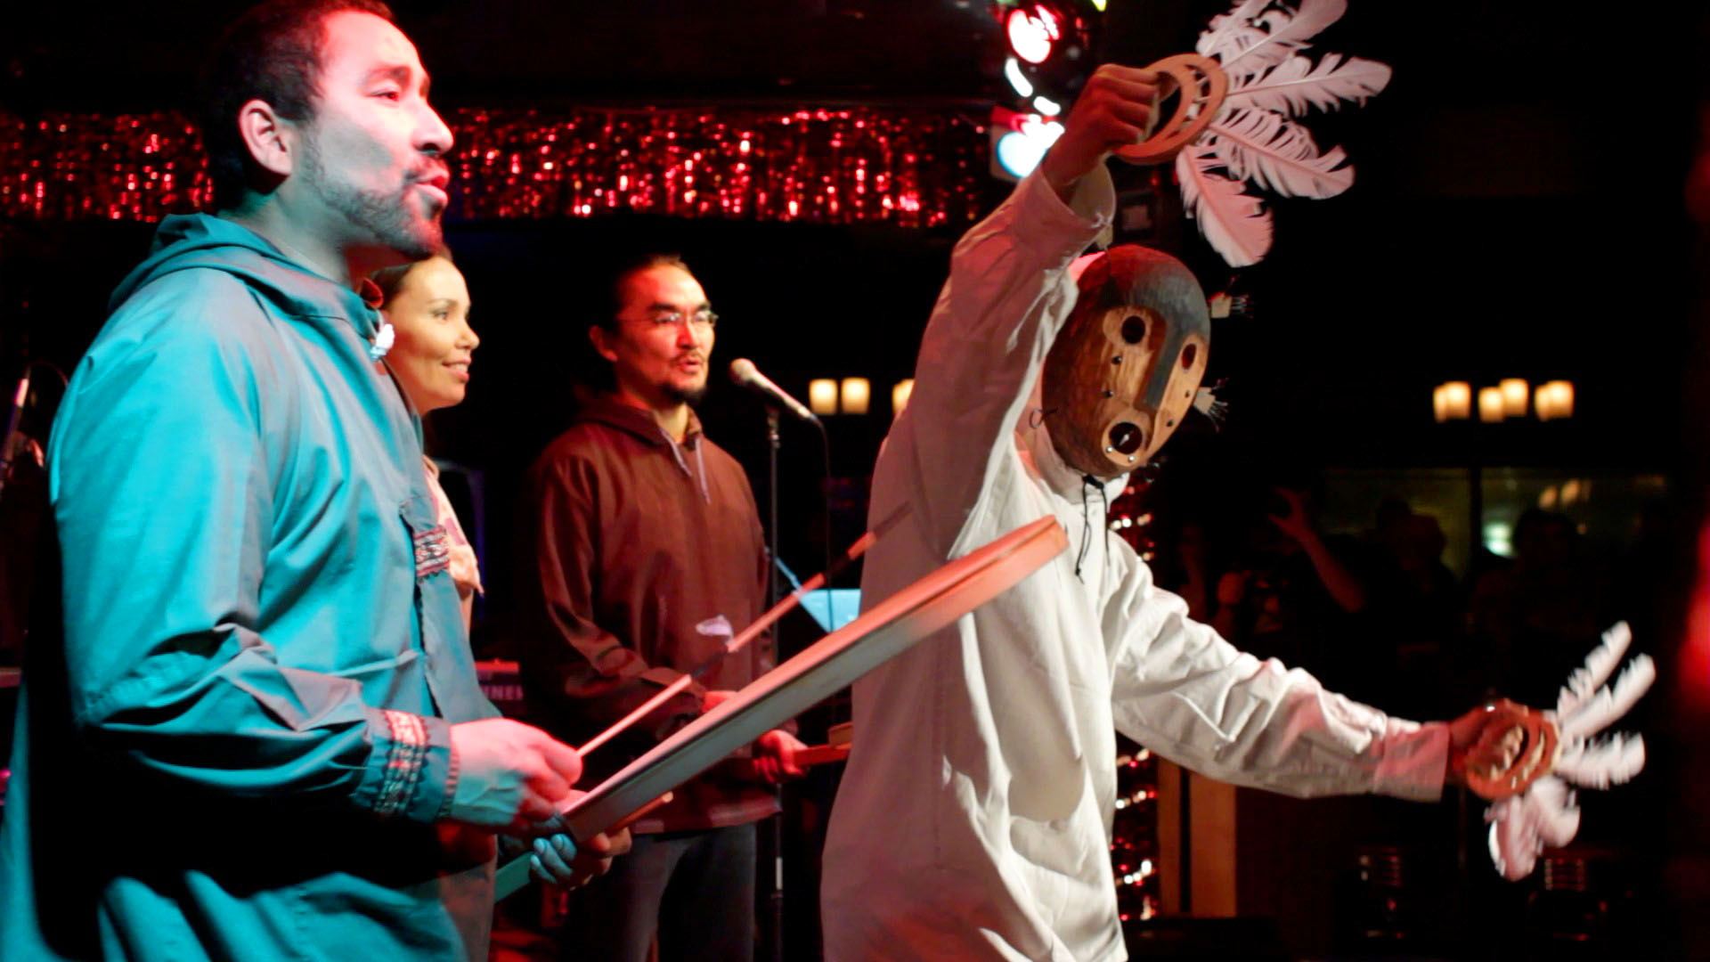
Yuraq Preserved
Tarvarnauramken: Blessings In A Time Of Crisis
Notes:
My family, my kin, celebrating Yup’ik joy, Yup’ik tradition, Yup’ik healing, and Yup’ik values through song and dance.

Slide 19
Tarvarnauramken: Blessings in a Time of Crisis
Notes:
This song is considered to be a healing song and this video was produced during what we thought was the height of the Covid-19 pandemic (2020).
I’m sure you’ve heard by now, the phrase, “Kill the Indian, Save the Man.” Our Alaskan history is no different from the actual to cultural genocide Indigenous people face world-wide. I may not be “the most Yup’ik” human you’ve ever encountered, but my existence is resistance. I have not always been proud of who I am or where I come from but today, I wear my ancestor's skin. I am who I am because of them.

Slide 20
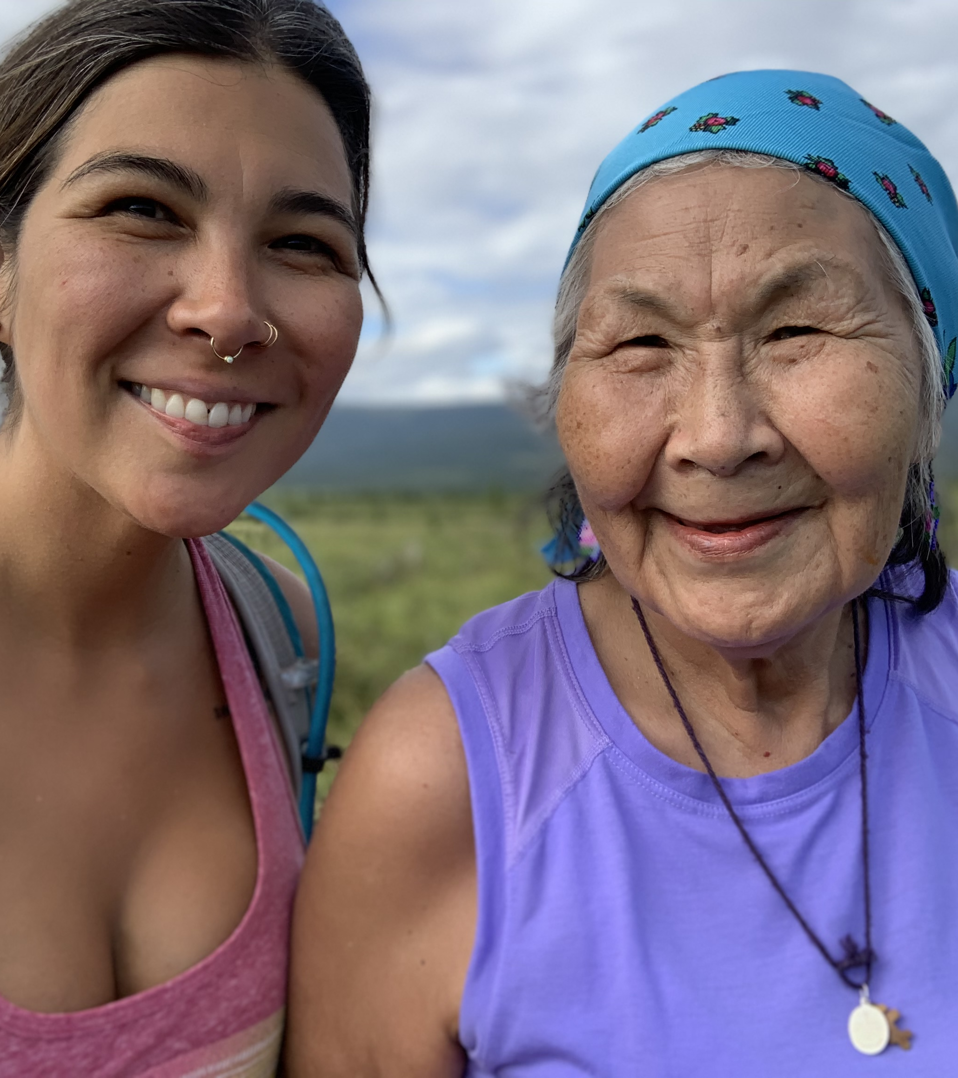
Quyana, thank you
Questionnaire QR code
Notes:
I am honored to share my experience as a Yup’ik woman. Your participation by listening in a Yup’ik way, in an attentive way, is extremely sacred to me. I hope you steal my knowledge; I hope my words find you when you’re face to face with a Yuk who needs your care and understanding. I hope you greet my kin with compassion, restraint, and love – you never know how powerful their grateful mind may be.

