Slide 1
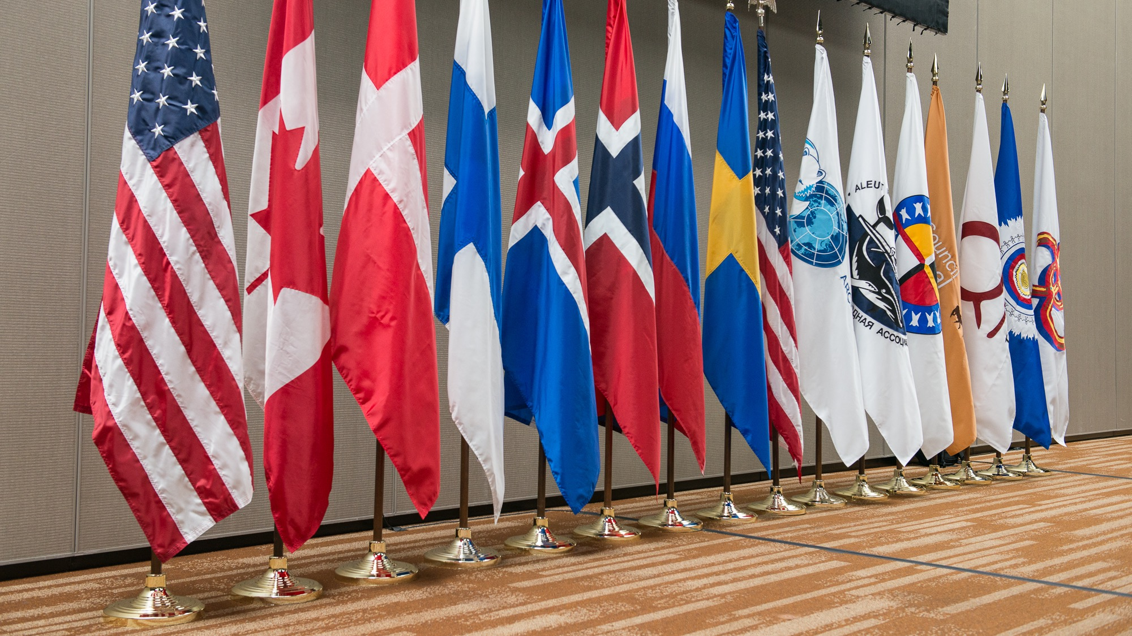


Solid Waste Management in Remote Arctic Communities
Nadine Kochuten
ANTHC GAP Webinar
3/9/22
Photo: Arctic Council Secretariat, Linnea Nordström

Slide 2
Solid Waste Management in Remote Arctic Communities
Assessment created with partners from USA, Finland, AIA, Saami Council
  Will be used to identify future partners to help define smaller pieces of the project to:
Share best practices
Mentor with communities
Events will be held in communities
  Communities not identified yet but likely in Alaska, Russia, Finland, Scandinavia

Slide 3
Main objectives
Developing environmentally sound solid waste and marine debris management in Arctic communities
Building capacity in selected communities in need of solid waste management improvement, as demonstration projects
Encouraging cooperation and information sharing among pilot communities through workshops and community level developmental mentorship activities based on culturally appropriate communications and management templates,
Conducting outreach workshops in Arctic communities outside the pilot communities in need of solid waste management tools,
Developing information material on solid waste and marine debris management for Arctic communities, including a webpage (hosted on an Arctic Council Working Group website) that will serve as an online exchange network for community solid waste management planning.
The website will serve as a “one-stop shop” for access to lessons learned, easy to follow tool kits, best practices, fact sheets, case studies, templates for agreements, and guidance on community standards.

Slide 4
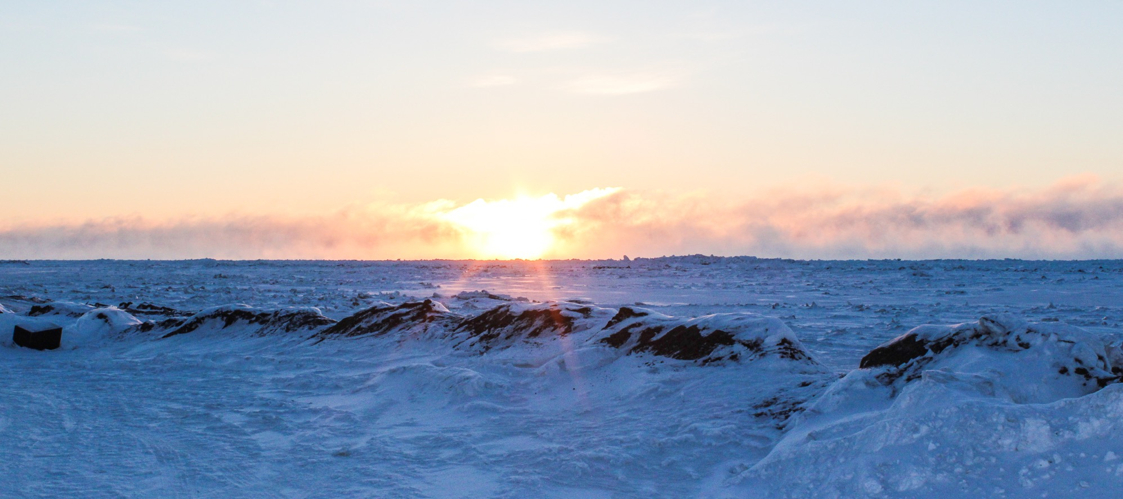
What is the Arctic Council?
The leading intergovernmental forum promoting cooperation, coordination and interaction among the Arctic States, Arctic Indigenous Peoples and other Arctic inhabitants on common Arctic issues, in particular on issues of sustainable development and environmental protection in the Arctic.
Established in 1996 via The Ottawa Declaration
Consensus-based decision-making amongst the eight Arctic states in full consultation and involvement of the Permanent Participants.
Photo: Arctic Council Secretariat, Ksenia Iartceva

Slide 5

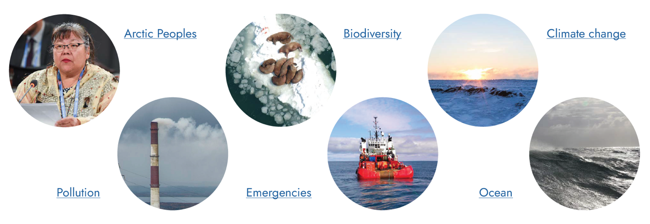
What does the Arctic Council do?
Types of work:
Themes of work:

Slide 6
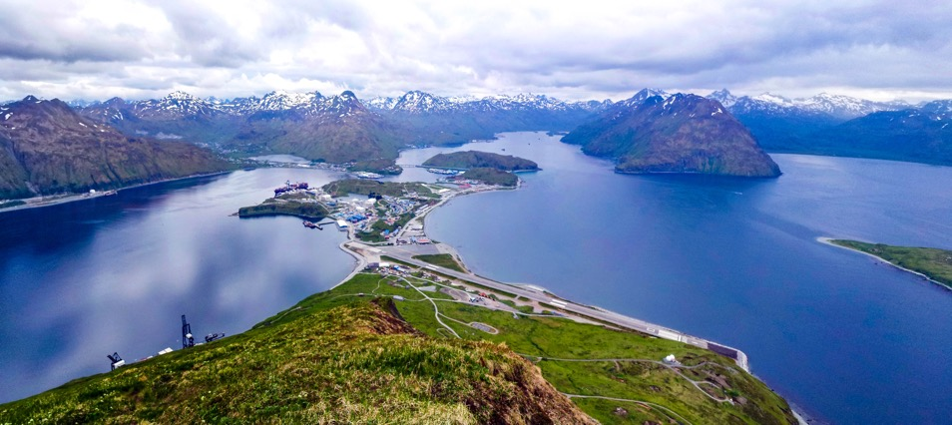
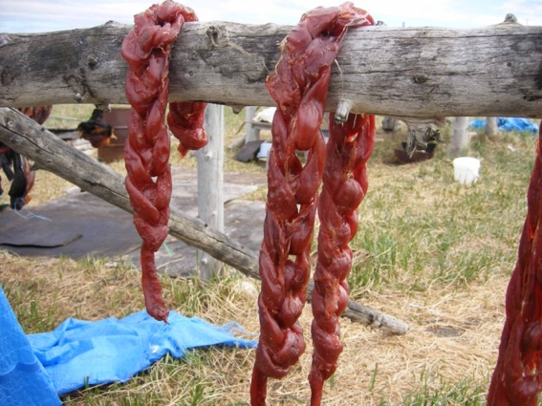
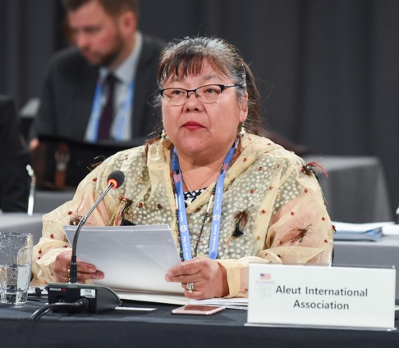
AIA involvement at the Arctic Council
Permanent Participant of the Arctic Council since 1998.
AIA collaborates with Arctic States, Working Groups and other Permanent Participants with regular contributions to Arctic Council work plans, projects and programmes.
AIA has a particular interest in the ocean, and the environmental and social changes occurring in the region.
Photo: Thomas Doyle/Flickr.com
Photo: Western Arctic National Parklands
Photo: Arctic Council Secretariat, Linnea Nordström

Slide 7
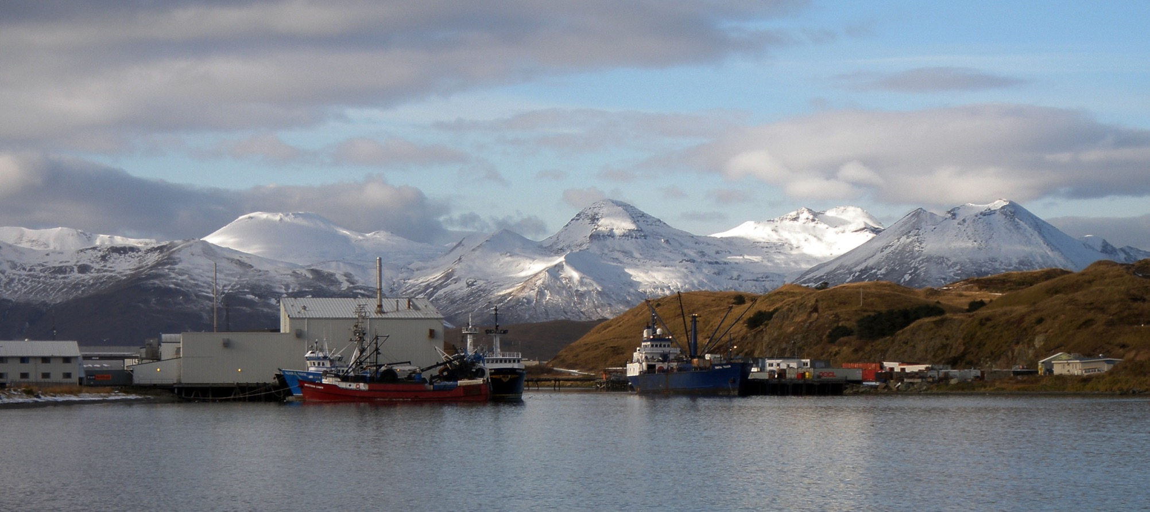
AIA projects at the Arctic Council
Community Observation Network for Adaptation and Security (CONAS)
Solid Waste Management in Small Arctic Communities
Community-based Black Carbon and Public Health Assessment
Circumpolar Local Environmental Observer Network (CLEO)
Photo: Thomas Doyle/Flickr.com

Slide 8
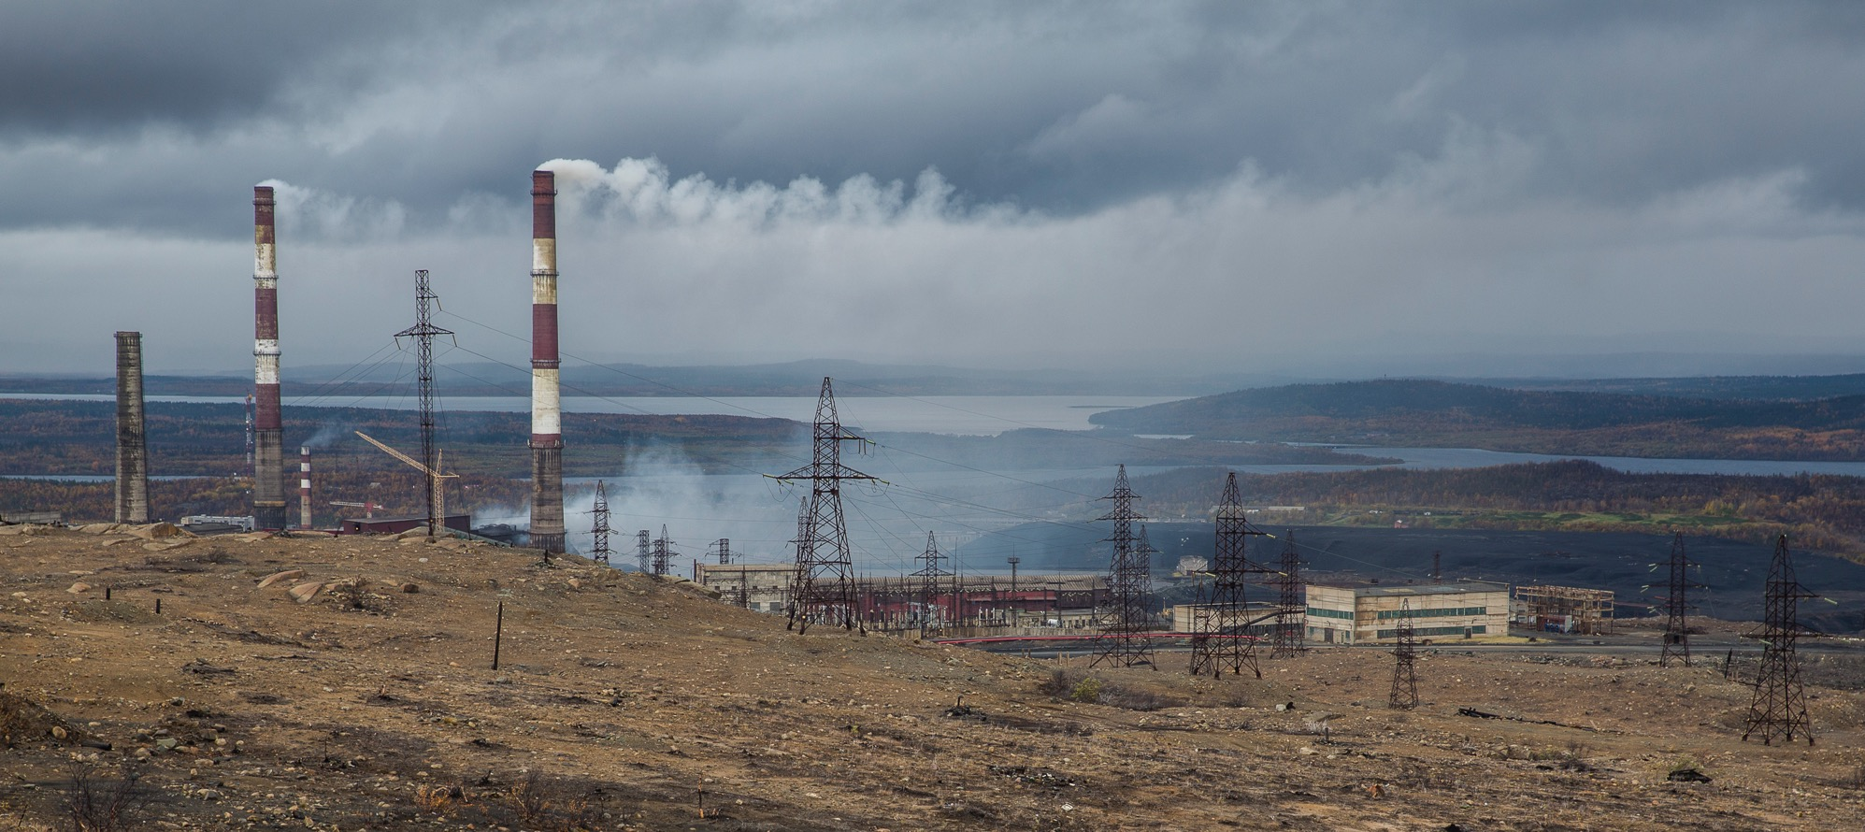

Subsidiary Bodies: Arctic Contaminants Action Program (ACAP)
Carries out demonstration projects to raise awareness and show possibilities to cut pollution and increase clean-up of environmental risks in the Arctic.
Encourages states to strengthen policies and take actions to reduce pollutants and mitigate associated environmental, human health and socio-economic risks.
Photo: Ninara/Flickr.com

Slide 9
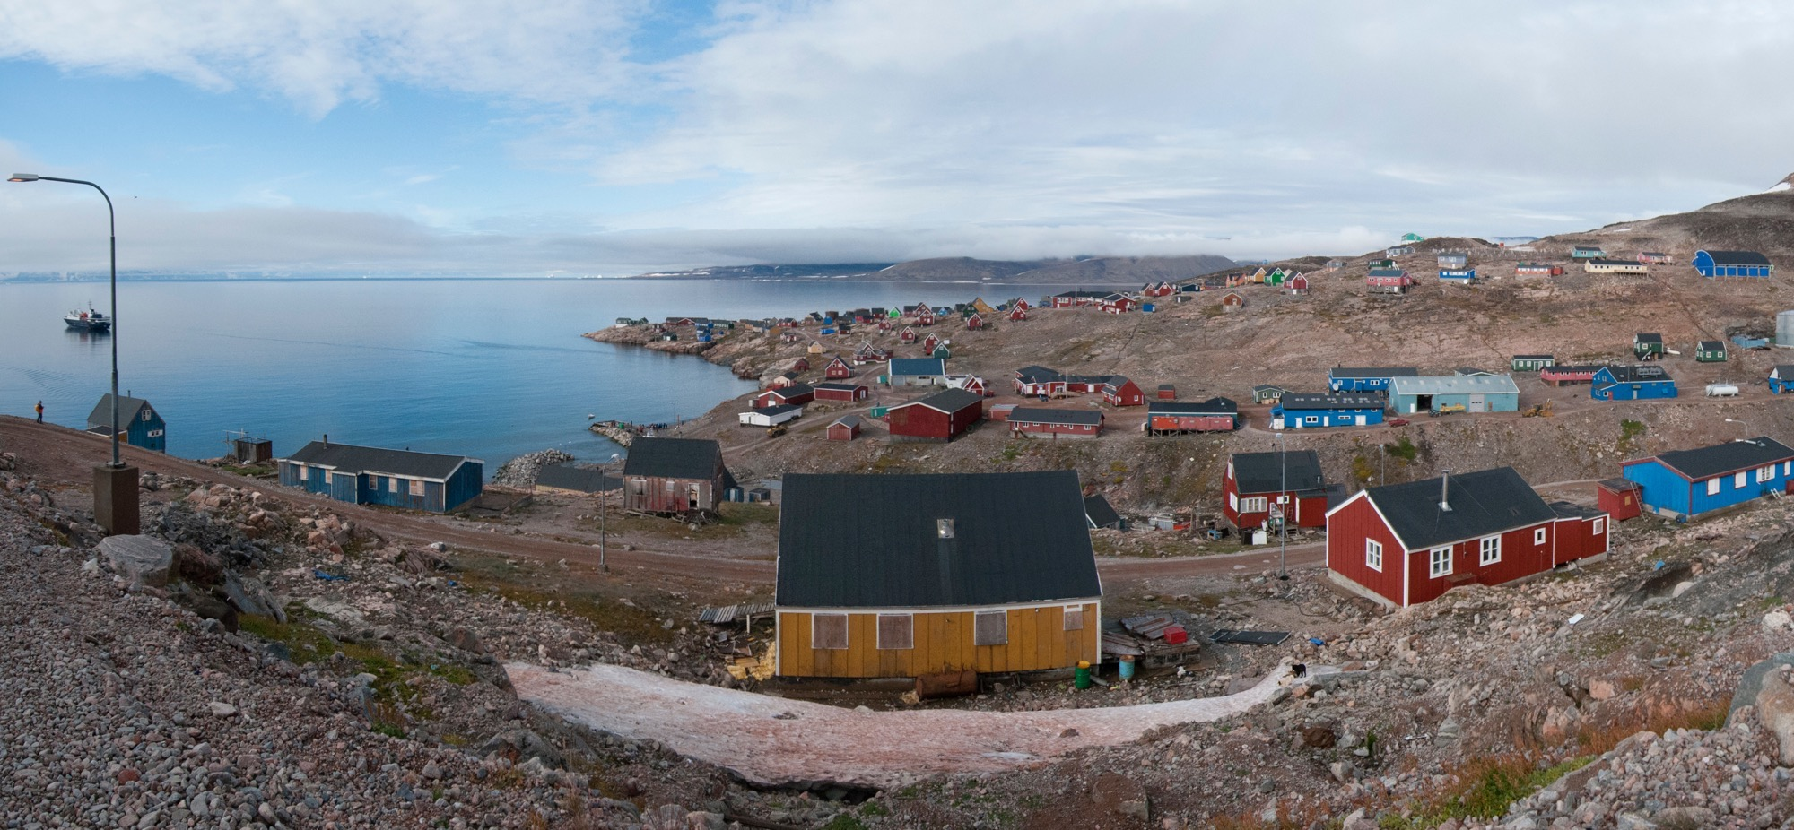

Subsidiary Bodies: Sustainable Development Working Group (SDWG)
Conducts projects to enhance the environment, economies, culture and health of Indigenous peoples and Arctic communities.
Pursues initiatives that provide practical knowledge and contribute to building the capacity of Indigenous peoples and Arctic communities to respond to the challenges and benefits from the opportunities in the Arctic region.
Photo: UNEP GRID Arendal

Slide 10

Thank you! Qaĝaasakung!
520 E 32nd Avenue
Anchorage, AK 99503 USA
Tel.: (+1) 907 332 5388
Website: aleut-international.org
Twitter: @aleut_aia
Instagram: @aleutinternationalassociation
Facebook: @aleutinternational

