Slide 1


Alaska Statewide
Developmental Screening Environmental Scan
Emily Urlacher, Early Childhood Systems Specialist, Division of Public Health
Carmen Wenger, Program Director, Help Me Grow Alaska
Kate Saft, MSW Intern, Help Me Grow Alaska
Notes:
Emily – well hello everyone, my name is Emily Urlacher and I am the early childhood systems specialist for the state of Alaska, division of public health. I’m here today with my colleagues from Help Me Grow Alaska to present the findings of the Alaska statewide developmental screening environmental scan. This scan was done in partnership between DPH and Help Me Grow Alaska. You are in fact the first group to review the long-awaited results, and we’re excited to hear your input today. Before we get started, I’m going to let my colleagues from Help Me Grow introduce themselves. Carmen?....

Slide 2
Presentation Objectives
Attendees will learn about the purpose and proposed outcomes of the statewide Universal Developmental Screening Advisory Committee (UDSAC)
Attendees will learn about the results of the new statewide developmental screening environmental scan.
Attendees will learn how the scan will support and guide the work of the UDSAC over the next few years.
Notes:
Emily – We have three presentation objectives today. First we want to share a little information about the Universal Developmental Screening Advisory Committee, which from now on we will refer to as the UDSAC. Remember this acronym, because it will be mentioned a lot in the next couple slides. Second, we’ll share the results of the scan with you, and third, we’ll explain how these results will support and guide the work of the UDSAC over the next few years.
And one last thing before we move on, we ask that participants please put your questions in the chat box or hold them until the end of the presentation. There’s a good chance that your question may be answered in a subsequent slide, given the skip logic nature of the survey used to conduct the scan. Thank you.

Slide 3
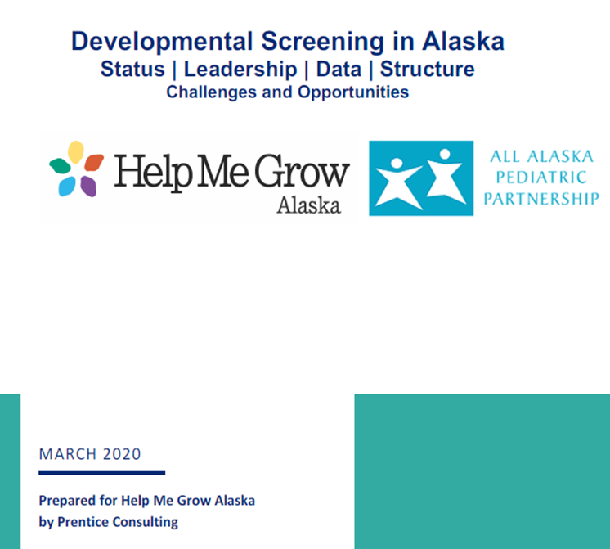


Universal Developmental Screening Advisory Committee (UDSAC)
Developmental Screening in Alaska
Aims of the UDSAC
Streamline efforts to maximize efficiency
Coordinate data sharing
Ensure access to training on developmental screening and screening tools
Provide stakeholder input on the statewide ASQ Online system
Increase family-focused education on developmental screening
Notes:
So, before we share the results of the statewide developmental screening environmental scan, it’s important to set the scene as to how the project came about. As I mentioned, the scan is a project of the UDSAC. The UDSAC builds on the efforts of a Universal Developmental Screening Task Force that was facilitated by the Governor’s Council on Disabilities and Special Education (The Council) . This task force was convened in 2017 to move forward the vision for all children to receive age appropriate and timely developmental screenings in Alaska. The Universal Developmental Screening Task Force partners included staff from the division of public health, section of women’s, children’s and family health (where I work), HMG-AK, early childhood community leadership, physicians, public health nurses, nurse home visitors, the child care program office, behavioral health, the University of Alaska Anchorage, the EI/ILP state office, FASD diagnostic clinics, the All Alaska Pediatric Partnership, Tribal Health, and family representatives.
To keep the momentum of the task force moving forward, HMG-AK conducted a survey of task force members and produced a report focusing on the status, leadership, and structure of developmental screening efforts in the state. The findings in the report showed that an entity other than The Council needed to continue to lead statewide developmental screening efforts, (click) and so I assumed the leadership role of the newly formed UDSAC.
The purpose of the UDSAC is to bring key stakeholders together to ensure that all Alaska children and their caregivers have access to developmental screening. The committee will accomplish this through streamlining efforts to maximize efficiency; coordinating data sharing; ensuring access to training of developmental screening and screening tools; providing stakeholder input on the statewide Ages and Stages Questionnaire (ASQ) online system; and increasing family-focused education on developmental screening.
Members of the UDSAC include parents (who are compensated), multiple State agencies, direct providers from rural and urban communities, and the leadership of community early childhood coalitions. There are four work groups of the UDSAC and this statewide developmental screening scan was a top priority to help inform all of the activities of each group, since we didn’t have statewide data to work iwth since the 2017 scan, which Carmen will talk about in the next slide.
I would like highlight that partners who specifically contributed to the development of this new environmental scan included HMG-AK, Prentice Consulting, Medicaid and CHIP, EI/ILP, DEED, the Alaska Center for Pediatrics, and a maternal child health epidemiologist from the division of public health.

Slide 4
Background
2017 Alaska Developmental Screening Survey
An environmental scan of standardized developmental screenings birth to eight years old was conducted via survey in 2017 by Help Me Grow Alaska with the Governor ’s Council on Disabilities and Special Education Task Force on Developmental Screening. This was the first time statewide, multi-disciplinary data regarding screenings had been collected.
Notes:
Carmen

Slide 5
Notes:
Kate

Slide 6
Notes:
Kate

Slide 7
Notes:
Kate

Slide 8
Notes:
Kate

Slide 9
Notes:
Kate

Slide 10
Notes:
Kate

Slide 11
Notes:
Kate

Slide 12
Notes:
Kate

Slide 13
Notes:
Kate

Slide 14
Notes:
Kate

Slide 15
Notes:
Kate

Slide 16
Notes:
Kate

Slide 17
Notes:
Thanks Kate. Emily – here we asked what format is used for screenings, select all that apply. As you can see, the administration of a developmental screening by paper is still the most common medium, followed by online. It’s important to note that of the 88 respondents for this question, 24 indicated that they use both paper and online. The other category, shown on the far right, captured a small selection of agencies that conduct the screening over the telephone or zoom with a paper copy that the agency fills out, in addition to offering both paper and online access options for families.

Slide 18
Notes:
Emily – here we asked respondents where the screenings are usually conducted. The top three settings reported were clinics, in the home and a school or child care setting. There is one response who noted the other option, and that was to indicate a community location, such as a community child find event. Again, this is a select all that apply option, so most respondents chose more than one option.

Slide 19
Notes:
Emily – here again is another select all that apply question. So most respondents chose more than one option. The question was who is usually present when the screening is conducted? Of course, the majority of respondents indicated the parent or primary caregiver, because most developmental screening tools are made specifically for families to fill out. Many of the provider types, such as Head Start agencies, also require that an early childhood educator fill one out, in addition to the family’s copy. We did have 32.2% of respondents indicate that a clinician may also fill one out, but it was never indicated that ONLY the clinician do this, it was always in conjunction with a parent or guardian participating.

Slide 20
Notes:
Emily – for the next three slides, we followed the continuum of follow-up for children at each type of survey outcome: no-concerns were found, some borderline results were found, and concerns were found. We did this to see what kind of response was given by providers at each stage. Here we have the first type of developmental screening response type, which is that no concerns were found from the screening results. What do providers do when this happens? Well, the majority indicated that they still provide the parent or primary caregiver education on developmentally appropriate activities, and they will still screen at the next interval. There were three responses not shown here that were “other,” that indicated that they would choose one of the question options as a response, based on the caregiver's interest or concern level. Of those who indicated that they would still refer for developmental assessment or evaluation, even with no concern shown in the developmental screening results, the provider type included four tribal health organizations or clinics, one of which was connected to an infant learning program setting, one private practice, and one public school. All of these respondents also chose other options as well, as this was a select all that apply question.

Slide 21
Notes:
Emily – here we are at the next level of the developmental screening results continuum, where we asked respondents, when screening results are borderline, what follow-up occurs? Select all that apply. And we have a nice mix of responses. Our top response was parent/primary caregiver education, followed by targeted developmental monitoring based on individual need, and the third highest response being to conduct a screening at the next interval.

Slide 22
Notes:
Emily – and finally, we asked when screening results show areas of concern, what follow-up occurs? Select all that apply. The majority of the respondents indicated that they would refer for a developmental assessment or evaluation, followed closely by providing the parent/primary caregiver education on developmentally appropriate activities, and the third highest response was that targeted developmental monitoring based on individual need would be conducted.

Slide 23
Notes:
Emily – moving on, question 18 of the survey asked if primary caregivers are given the option to decline the developmental screening. 67.1% said yes, 17.6% of respondents weren’t sure, and 15.3% of the respondents said no. Off those who indicated “no”, 3 were private health care providers and one was a tribal health organization or clinic. The rest of the no respondents were early care and learning settings such as Head Start.

Slide 24
Notes:
Emily – the next question asked if primary caregivers are asked if another developmental screening has been completed previously before completing a new one. This question was important to ask because the UDSAC has heard many anecdotal reports that families are reporting developmental screening fatigue, especially in the fall when they are asked to complete one for an early care and learning program requirement, such as for Head Start enrollment, but also filling one out during the well-child check that they need in order to enroll as well. A big question that we’ve asked ourselves is how we can better facilitate the sharing of developmental screening outcomes between organizations are in situations like this. As you can see here, 63.1% of respondents indicated that they don’t ask if one has been done before, and almost 37% indicated that they ask. Of the respondents that indicated no, the provider type was varied.

Slide 25
Notes:
Emily – here we asked survey respondents if their agency or organization conducts developmental screening if the child already has an identified developmental delay. 64.3% said yes, they still screen, 20.2% said no, and 15.5% indicated that they don’t ask if the child already has an identified developmental delay before conducting the screening. In looking at the provider types indicated by the those who said yes, they still screen, the provider type was again varied, and represented almost all of the provider types or settings that we listed previously.

Slide 26
Notes:
Emily – the next few questions were of specific interest to our state Medicaid partners, because developmental screening is one of the indicators that they have to report on. They have found that the number of those who bill Medicaid for developmental screening wasn’t matching the amount of developmental screenings shown in the statewide ASQ Online system, in that eligible providers may not be billing for screening as much as they would like. There was an ad hoc work group of the UDSAC that talked about this issue and made policy change recommendations, and we are hoping this data will help Medicaid make an informed decision on those proposed changes. So here, you can see that the majority of the respondents said that they do NOT bill for developmental screening. Most of these respondents were not eligible to bill, however 10 of the respondents were tribal health organizations, 3 were community health centers, and 2 were private health care providers.

Slide 27
Notes:
Emily - next we asked respondents who indicated that YES they do bill for developmental screening, what insurance types and billing codes they use. First we’ll look to the far left at Medicaid, and it’s important to note that of the 12 respondents who reported using Medicaid, 8 indicated using the 96110 code, the other 4 didn’t know the code or left the response blank. For respondents who indicated that they bill private insurers, the majority of the respondents knew that the code was 96110, with a few who didn’t know the code. For Tricare, of the 8 respondents who reported billing Tricare, 5 indicated using the 96110 code. And finally, of the two respondents who indicated that they bill Medicare, 0 indicated a code. I’d like to point out that we did ask respondents to include a modifier code, if used, and only ONE respondent indicated that they use the correct modifier of 33.

Slide 28
Notes:
Emily – and here we are at our last presentation slide. Of those respondents who said that they DON’T bill for developmental screening, we asked them what barriers exist that prevent them from billing Medicaid. Over half indicated that they weren’t eligible. 24.1% didn’t give a reason or didn’t answer, 15.5% that they were in a clinical setting but was unsure that they could or how to bill, and 6.9% indicated that they weren’t set up to bill Medicaid.

Slide 29
Questions?
Notes:
And that’s it! I’m sure you all have questions, and we’re happy to answer them.

Slide 30

Contact
Information
Emily Urlacher, emily.urlacher@alaska.gov
Carmen Wenger, carmen@a2p2.com
Kate Saft, kgsaft@alaska.edu

