Slide 1
STATE OF ALASKA PUBLIC HEALTH
Health Systems Collaboration Program The role and value of Self Monitored Blood Pressure in preventing furtherance of chronic diseases.
Ashley Minaei, MPH, CPH
Public Health Specialist II and Program Manager
Section of Chronic Disease Prevention and Health Promotion, DPH, DHSS

Slide 2
Land acknowledgement
I want to acknowledge that our work today is done on traditional Dena’ina land, whose original people are the Dena’ina Athabascan people, one of Alaska’s many distinct and diverse indigenous groups.
Generations of indigenous Native Alaskans created the Alaska that sustains us today.
It is my hope that our public health work supports everyone’s ability to thrive in their traditional homeland.
Dena'inaq ełnen'aq' gheshtnu ch'q'u yeshdu. I live and work on the land of the Dena’ina. (Translation by Sondra Shaginoff-Stuart and Joel Isaak)

Slide 3
Introduction
Ashley Minaei, MPH, CPH
Public Health Specialist II, and Program Manager
Heart Disease and Stroke Prevention Program
Health Systems Collaboration Team
DHSS
CDPHP
DPH
HSC
Heart Disease
Diabetes Prev and Management
Comp Cancer

Slide 4
Chronic Disease is a public health crisis
PreDM 35%
Overweight 69%
Smoking 39%
DM 13%
HTN 46%
Anxiety 19%
1. Centers for Disease Control and Prevention. National Diabetes Statistics Report, 2020: Estimates of Diabetes and Its Burden in the United States. Atlanta, GA: US Department of Health and Human Services; 2020.
2. Whelton PK, Carey RM, Aronow WS, et al. 2017 ACC/AHA/AAPA/ABC/ACPM/AGS/APHA/ASH/ASPC/NMA/PCNA guideline for the prevention, detection, evaluation, and management of high blood pressure in adults: A report of the american
college of cardiology/american heart association task force on clinical practice guidelines. J. Am. Coll. Cardiol. 2017;71(19):2199-2269. doi:10.1016/j.jacc.2017.11.006.
3. National Institute of Mental Health. Mental Health Information - Statistics. https://www.nimh.nih.gov/health/statistics/any-anxiety-disorder.shtml#part_155094. Published November 2017. Accessed February 19, 2019.

Slide 5
The Web of Chronic Disease

Slide 6
The pandemic has had direct and indirect effects
June 2020: Americans gaining 1.5lbs per month¹
● A year later²:
Nearly half (42%) have gained an average of 29 pounds and 10% gained more than 50 pounds
2 in 3 reported sleeping more or less than desired since the pandemic started
Between 2020 and 2022
Nearly 1 in 2 delayed or canceled health care services
Nearly 10 million missed cancer screenings in 2022
1 Lin AL, Vittinghoff E, Olgin JE, Pletcher MJ, Marcus GM. Body Weight Changes During Pandemic-Related Shelter-in-Place in a Longitudinal Cohort Study. JAMA Netw Open. 2021;4(3):e212536. doi:10.1001/jamanetworkopen.2021.2536 2American Psychological Association. (2021, March 11). One year on: Unhealthy weight gains, increased drinking reported by Americans coping with pandemic stress [Press release]. http://www.apa.org/news/press/releases/2021/03/one-year-pandemic-stress; 3 American Association for Cancer Research. AACR Report on the Impact of COVID-19 on Cancer Research and Patient Care. https://www.AACR.org/COVIDReport. Published February 9, 2022. Accessed 2/16/22

Slide 7
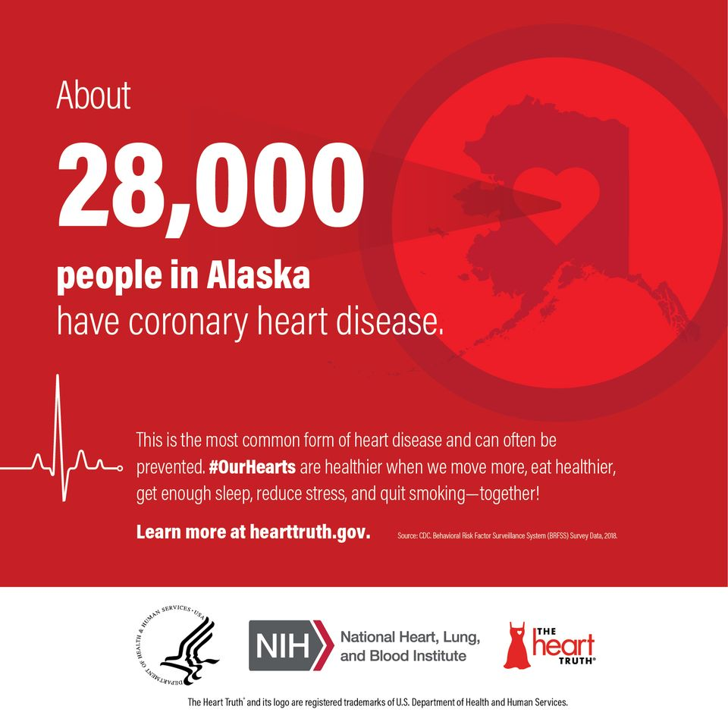
Did You Know?
Coronary heart disease is the most common form of heart disease and is preventable.

Slide 8
Cause of Death by Rank in AK and US
 | Alaska Deaths |  |  | US Deaths
 |  |  | Age-Adjusted | Age Adjusted | Rank
Cause of Death by Rank in Alaska | Number | % | Rate | Rate | Rank
1. Cancer | 974 | 22% | 152.5 | 155.8 | 2
2. Diseases of the Heart | 814 | 18% | 136.3 | 165.5 | 1
3. Unintentional Injuries | 429 | 9% | 61.9 | 47.4 | 3
4. Chronic Lower Respiratory Disease | 236 | 5% | 40.4 | 40.6 | 4
5. Stroke | 193 | 4% | 38.2 | 37.3 | 5
6. Suicide | 186 | 4% | 25.3 | 13.5 | 10
7. Chronic Liver Disease and Cirrhosis | 123 | 3% | 15.9 | 10.7 | 12
8. Diabetes | 122 | 3% | 18.6 | 21.0 | 7
9. Alzheimer’s Disease | 109 | 2% | 25.4 | 30.3 | 6
10. Influenza and Pneumonia | 60 | 1% | 12.4 | 13.5 | 8
Source: Reproduced from State of Alaska, DHSS. Alaska Vital Statistics 2016 Annual Report. Available at http://dhss.alaska.gov/dph/VitalStats/Documents/PDFs/VitalStatistics_AnnualReport_2016.pdf. Accessed 2-17-2020.

Slide 9
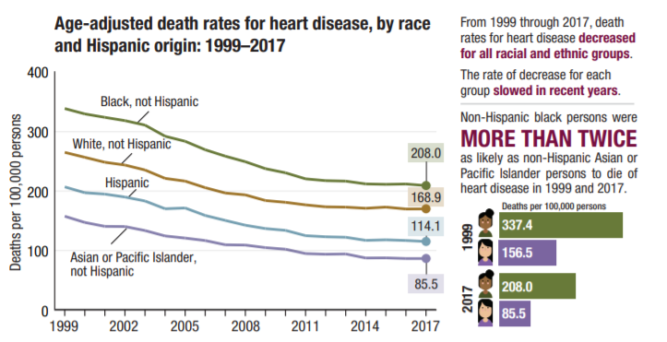
National Data
Notes:
Alaska follows national trends.
CDC publication, April 2019: Health, United States Spotlight Racial and Ethnic Disparities in Heart Disease

Slide 10
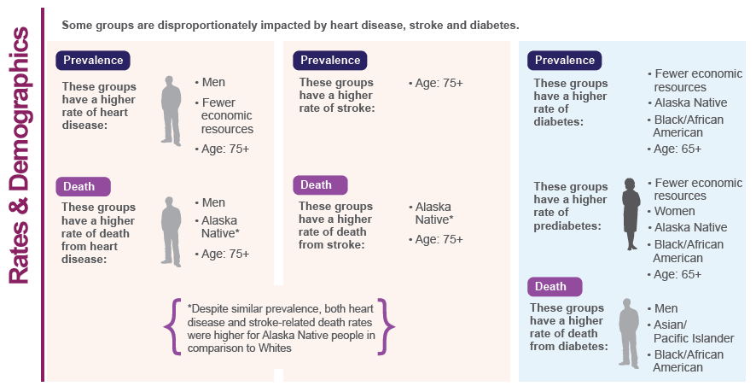
Disease Burden: A Deeper Look
Notes:
Heart Disease, Stroke, and Diabetes burden is not equal.
A coalition must work with and within communities and include community members most impacted by the health issue being addressed.
This requires disaggregating data to understand who bears the most burden.
A first step toward health equity.

Slide 11
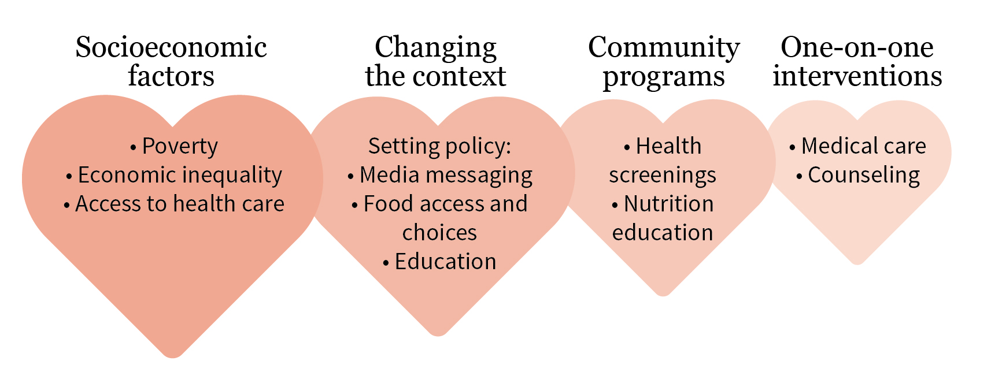
Making an impact
Biggest impact

Slide 12
Risk Factors
Obesity
Lack of physical activity
High Blood Pressure
High Cholesterol
Smoking

Slide 13
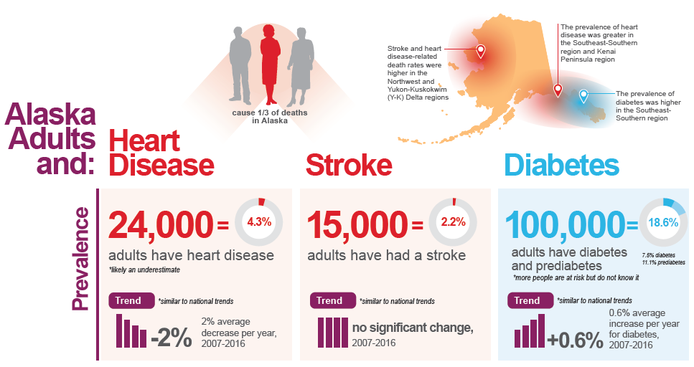
Notes:
In Alaska, Heart Disease is the 2nd leading cause of death, attributed to 1/3 of all deaths in AK.
Heart Disease, Stroke, and Diabetes are experienced differently across regions of our state. NW and YK regions have higher rates of death from stroke and heart disease. While prevalence is higher in the south and southeast for all three.

Slide 14
Alaskans + Underlying Conditions
DHSS Insights Blog: http://dhss.alaska.gov/dph/Epi/id/Pages/COVID-19/blog/default.aspx
Notes:
People with poor cardiovascular health are also at increased risk of severe illness from COVID-19.

Slide 15
Prevalence of Ever Being Diagnosed with Heart Disease Among Adults by Public Health System Regions (2012-2016)
Notes:
Notice the darkest areas are in population centers

Slide 16
Stroke Related Death Rates, by Public Health Systems Region (2007-2016)
Notes:
Notice the lightest areas are in population centers
Shows the significant burden of stroke related deaths caused by undiagnosed disease

Slide 17
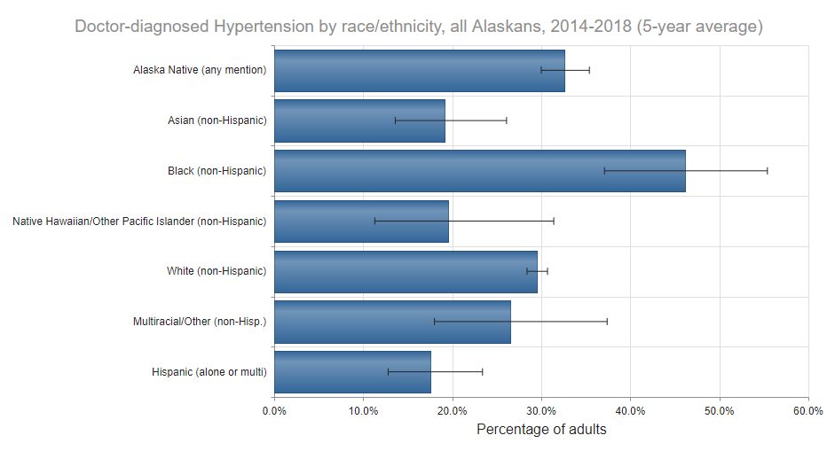
Who has Hypertension?
Notes:
Heart Disease and Stroke Burden is not equal. In Alaska, some groups are disproportionately impacted by heart disease, stroke, and diabetes
Higher rates of heart disease are found among men, people with fewer economic resources, and individuals over 75
Higher rates of death from heart disease occur among men, Alaska Native people, and individuals 75 and over
Higher rates of stroke are found among individuals over 75
Higher rates of death from stroke occur for Alaska Native People and individuals over 75

Slide 18
Managing, preventing or delaying through risk reduction programs

Slide 19
A few State supported programs
National Diabetes Prevention Program (NDPP)
Self Management Resource Center (SMRC)
Self Monitoring Blood Pressure (SMBP)
Diabetes Self Management Education and Support (DSMES)
SoA support is specifically directed towards evidence based, recognized or accredited programs.

Slide 20
What do they have in common
Studies showed that health-coach-led intensive behavioral counseling for lifestyle modification – with a focus on healthy eating, physical activity, and stress management – was more effective than placebo or medication alone at reducing the risk of developing diabetes and other chronic diseases .

Slide 21
Coaching through deep connection
Coach
Participant
Clinical decision support
Data empowered outreach tools
Specialized coaching skills
Standardized curriculum customized to participant needs
Trained in empathy
Skills building
Addressing barriers
Autonomy and intrinsic motivation
Promoting coping
Social support
Behavior Change

Slide 22
What is SMBP
SMBP, or home blood pressure monitoring, is the regular measurement of blood pressure by a patient at home or elsewhere outside the clinic setting using a personal home measurement device.
SMBP may be particularly useful in certain types of patients, including the elderly, people with diabetes or chronic kidney disease, pregnant women, and those with suspected or confirmed white coat hypertension
A Joint Scientific Statement from the American Heart Association (AHA), American Society of Hypertension (ASH), and Preventive Cardiovascular Nurses Association (PCNA) encourages increased regular use of SMBP by clinicians for the majority of patients with known or suspected hypertension as a way to:
increase patients’ engagement
increase ability to self-manage their condition,
enabling the care team to assist in timely achievement
maintenance of control and preventing heart attacks and strokes.

Slide 23
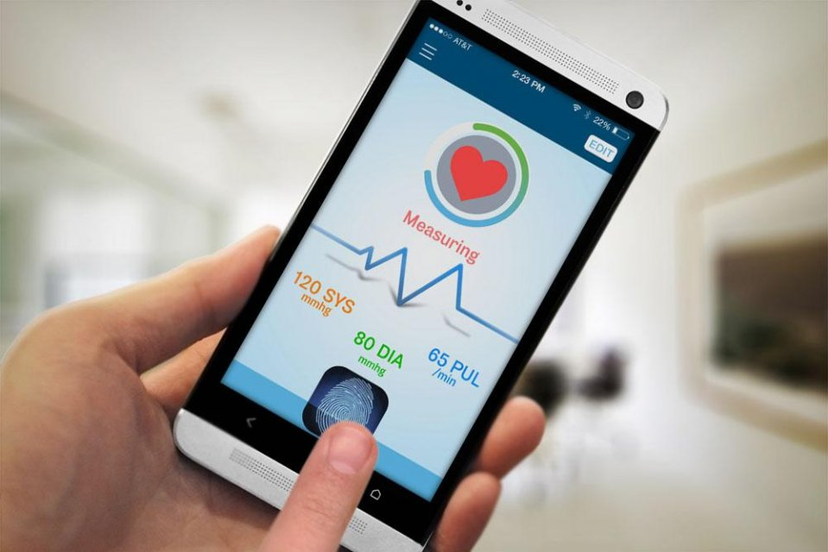
Self-Measured Blood Pressure (SMBP) Monitoring
A priority initiative as outlined by the Surgeon General in October 2020
A patient's regular use of personal blood pressure monitoring devices to assess and record blood pressure across different points in time outside of a clinical, community, or public setting, typically at home.
There are resources free to Alaskans – and we are actively working to expand these resources
In-Person programs in communities around the state
State-wide online/app program
Please let us know if we can provide your office with print materials to support referral

Slide 24
SMBP Programs in Alaska
Program | City
Omada Health (Online/App) | Statewide
AlfaDoc Clinic | Valdez
City of Juneau (for municipal employees) | Juneau
Qawalangin Tribe of Unalaska | Unalaska
Anchorage Neighborhood Health Center | Anchorage
SouthEast Alaska Regional Health Consortium | Sitka
Yukon-Kuskokwim Health Corporation | Aniak
Cordova Community Health Center | Cordova
River Health and Wellness | Soldotna
Homer Medical Center | Homer
Petersburg Medical Center | Petersburg
*More programs coming soon… Please let Ashley know if you’re open to hosting a program!

Slide 25
Digital SMBP with Omada
Will receive a home BP cuff
Must attend online classes, work with health coach and report their home blood pressure on a regular basis.
Does not need a smart phone but will need regular internet access.
Will learn how to take their BP at home.
Program is FREE to anyone in Alaska who qualifies.
To enroll: omadahealth.com/alaska

Slide 27
Alaska Heart and Diabetes Coalition
Vision
Statewide collaboration for a heart healthy Alaska
Mission
Collaborates with stakeholders, healthcare, and community partners to improve cardiovascular health while reducing the overall burden of cardiovascular diseases in their community
Guiding Principles
Patient Self-Advocacy and Empowerment
Collaboration and Partnership
Health Literacy and Education
Prevention
High Value and Quality Healthcare
Optimum Health for Alaskans
We warmly welcome new members!

Slide 28
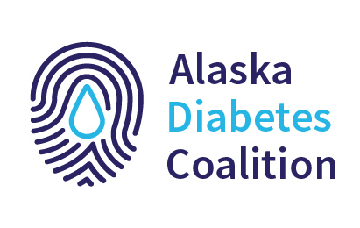
Alaska Heart and Diabetes Joint Coalition
Visit our program website: diabetes.alaska.gov
View the Alaska Diabetes Coalition Strategic Plan, 2020-2025
Become a Member! Click here for membership form.
Email: diabetes@alaska.gov or ashley.minaei@alaska.gov
Visit our coalition website: takeheart.alaska.gov
Follow us: facebook.com/TakeHeartAlaska
Become a Member! Click here for membership form.
Email: heart@alaska.gov or ashley.minaei@alaska.gov
Visit our Section website: dhss.alaska.gov/dph/Chronic

Slide 29
CDC Million Hearts Initiative
Goal: to prevent 1 million heart attacks and strokes by 2022
Notes:
Takeheart.alaska.gov

Slide 30
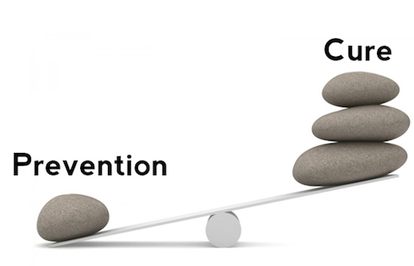
So, what next?
Chronic disease prevention and control activities can help to address health debt
Help Prevent Chronic Disease
To succeed, the gap between risk reduction and clinical services must be bridged

Slide 31
Call to Action
Each contact with the healthcare system is an opportunity.
Creating collaborative referral partnerships with community risk reduction programs
Establish collaborative agreements
Support Evidence Based programs
Refer to digital therapeutics
Train and empower CHWs
Get Creative
Prevention should include primary care, but it does not have to only include primary care
Link with specialty providers
Augment services at your office by hosting enrollment specialists

Slide 32
Thinking outside the box
Same thinking leads to same results.
Covid has created an opportunity for us to begin thinking about healthcare delivery differently.
Collaboration with risk reduction programs will result in improved wellness
Help decrease or delay chronic disease onset.
Don’t have a risk reduction program in your community?
Remember digital options
Consider starting one in your clinic (or maybe hosting one)
Community partners
State of Alaska DHSS is here to support and offer TA

Slide 33
Resources
Implementation Guidance Through the Million Hearts® initiative, CDC has created a series of translation guides on SMBP for public health practitioners and clinicians. The Million Hearts® website also has an SMBP webpage, which has resources, evidence, tools, and information about effective SMBP practices. See these links for more information on implementation:
Self-Measured Blood Pressure Monitoring: Action Steps for Clinicians pdf icon[PDF-946 KB]external icon³
Self-Measured Blood Pressure Monitoring: Action Steps for Public Health Practitioners pdf icon[PDF-1 MB]external icon⁹
Self-Measured Blood Pressure Monitoring by Million Heartsexternal icon¹⁰
2. Resources Several federal agencies and initiatives provide resources related to the use of SMBP, including the following:
Community Preventive Services Task Forceexternal icon¹¹
S. Preventive Services Task Forceexternal icon¹²
Centers for Disease Control and Prevention’s 6|18 Initiative¹³

Slide 34
Ashley Minaei, MPH, CPH
Public Health Specialist II and Program Manager
Section of Chronic Disease Prevention and Health Promotion, DPH, DHSS
Ashley.Minaei@Alaska.gov

