Slide 1
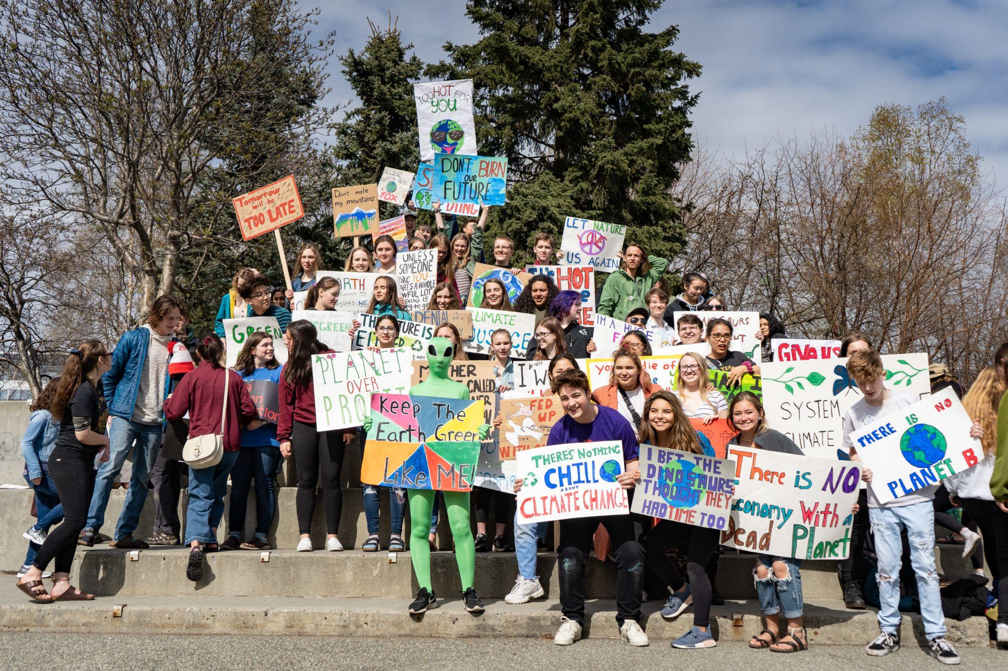
ALASKA YOUTH FOR ENVIRONMENTAL ACTION
Activating, inspiring and training the next generation of Alaskan leaders.
Notes:
Photo: 2019 Climate Strike, Anchorage
Personal Introduction (Name, pronouns, lands, connection to YET)
Intro AYEA, program of AKcenter Education Fund

Slide 2
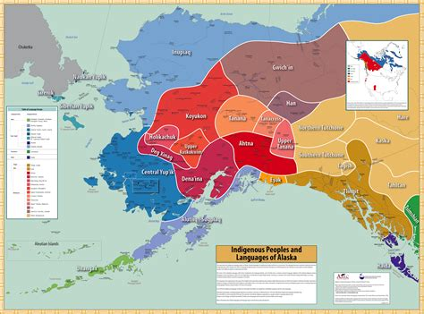
LAND ACKNOWLEDGEMENT
Indigenous Peoples of Alaska never gave up rights or resources to Russia or the United States. We are on stolen lands. Colonialism is still here today. Colonial values spread through all parts of our lives.
Alaska Youth for Environmental Action knows that this legacy needs to be torn down and the true history of Alaska and the United States must be heard. We stand with Indigenous peoples and communities worldwide fighting for clean air, clean water and the right to self-governance.
Notes:
Photo from ANLC

Slide 3
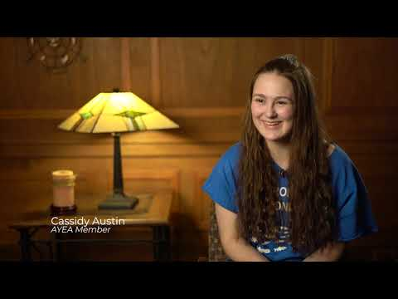
Notes:
Video: 2019 Climate Strike, Statewide

Slide 4
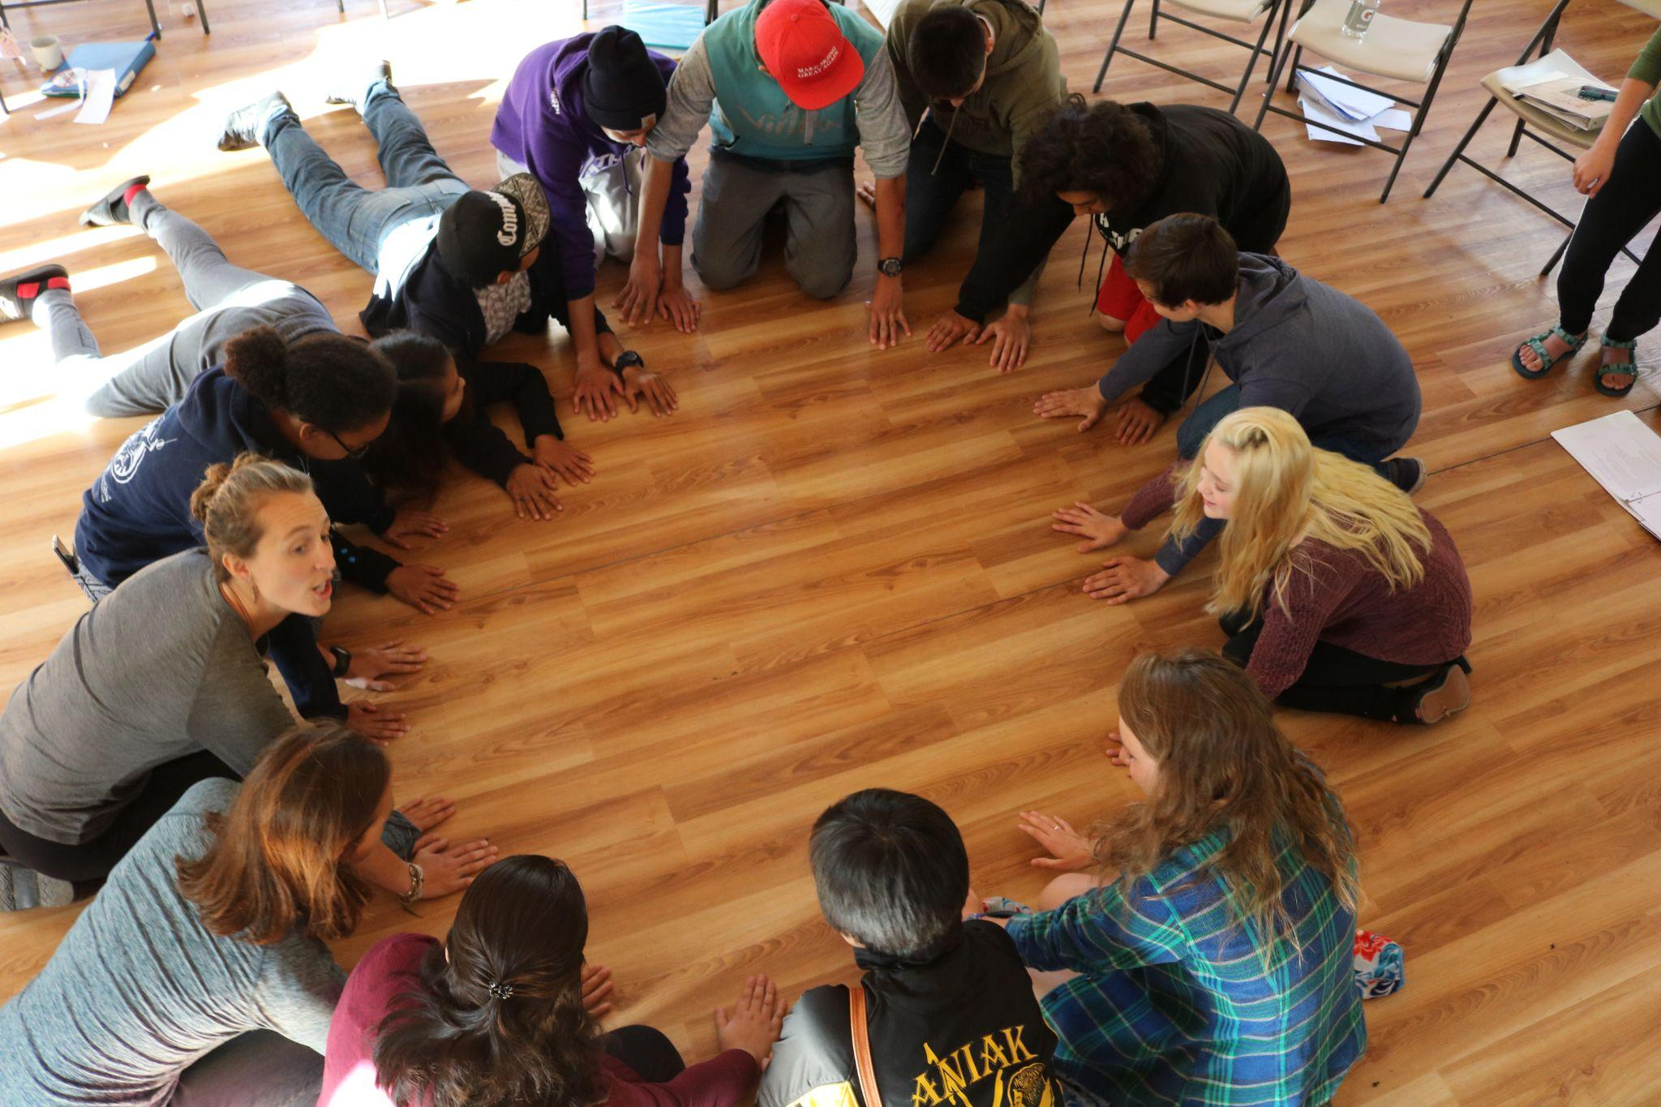
ACTIVITY
Notes:
Photo: YO Summit 2017

Slide 5
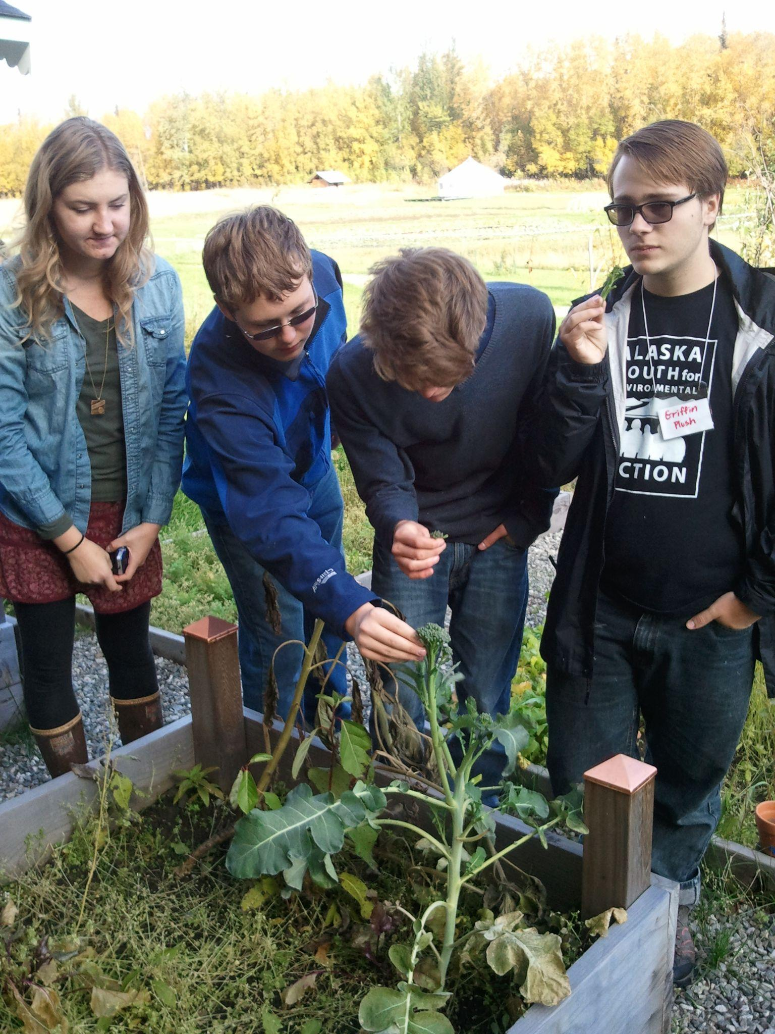
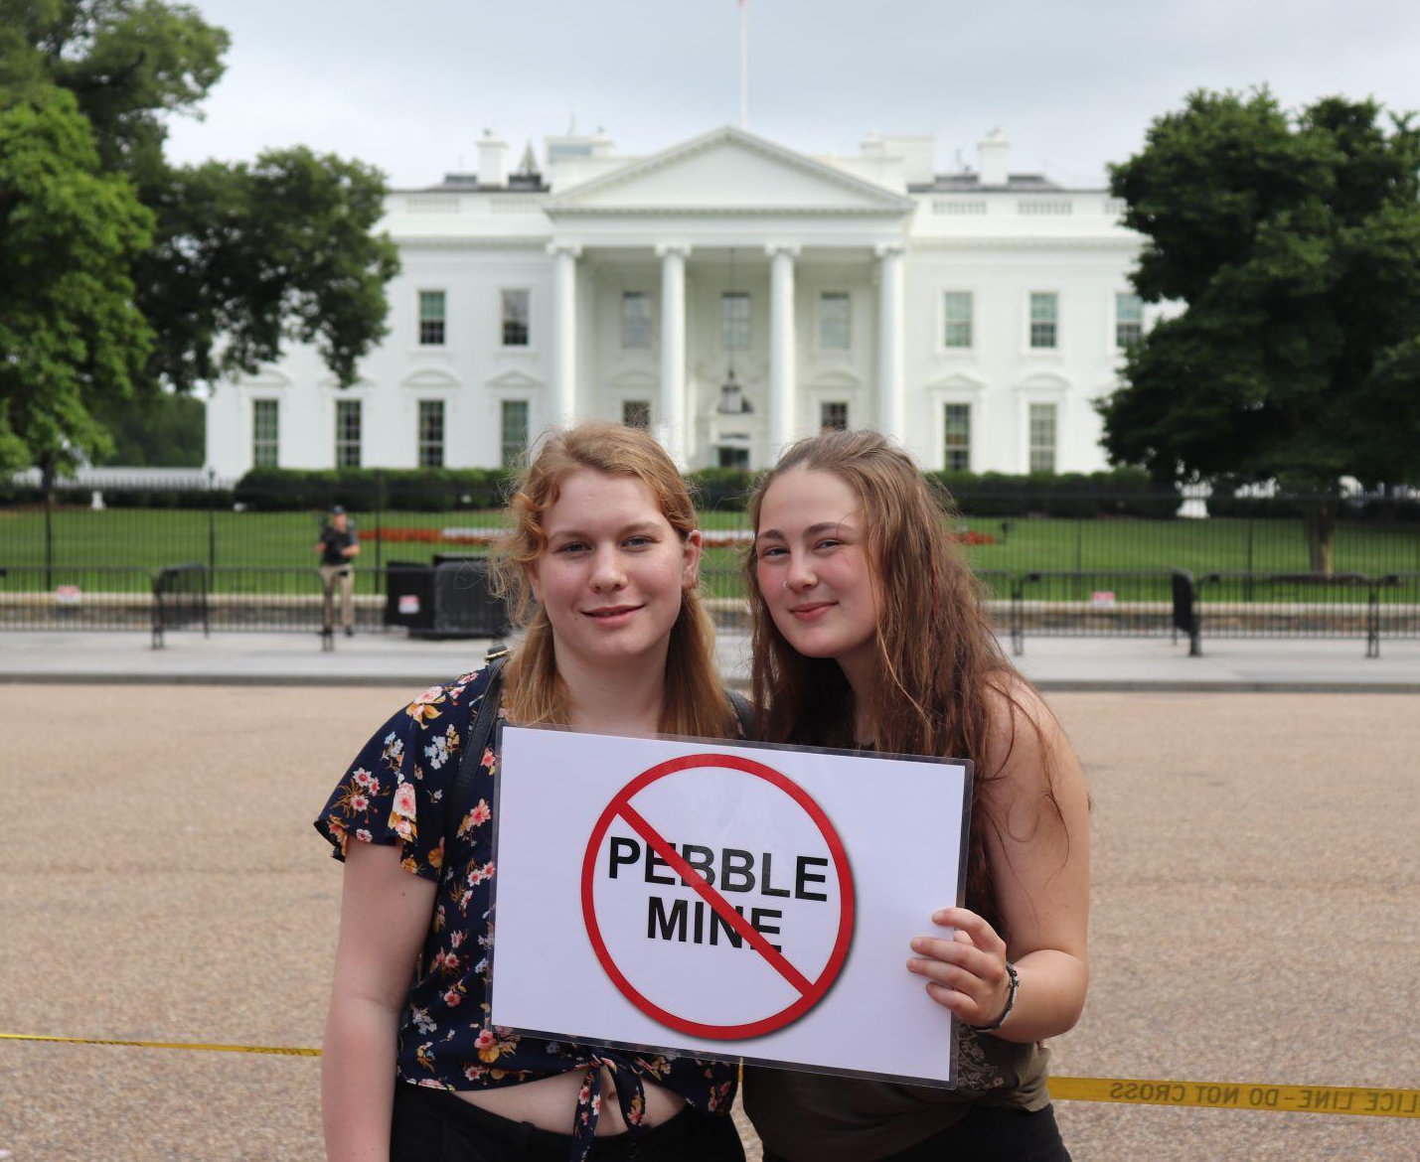
PAST AYEA PROJECTS
Collected over 5,000 petitions against Pebble Mine
Made a local foods cookbook with recipes from across Alaska and kept funding for local food in schools
2006 Letter to Our Leaders to ask Alaskan decision makers to act on climate
Notes:
Photo Left: YO 2014
Photo Right: DC Trip 2018

Slide 6
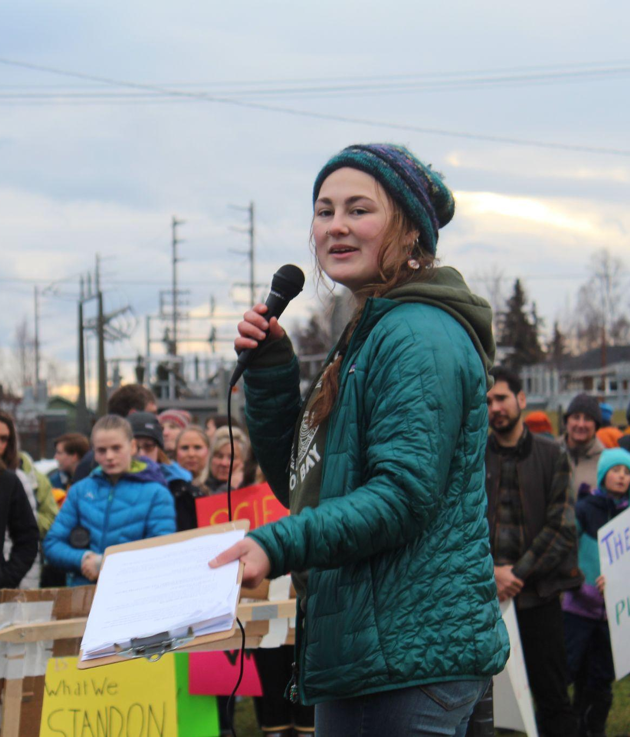
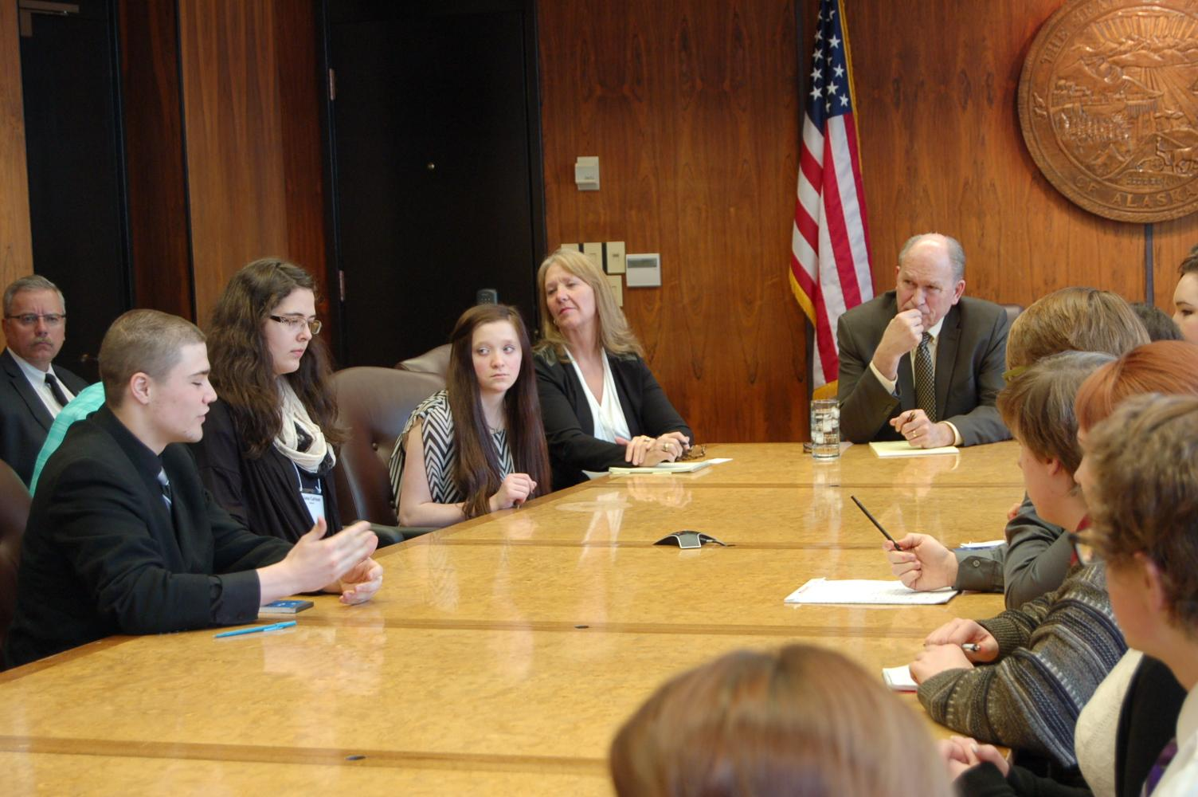
PAST AYEA PROJECTS
In 2014-15 the teens asked Governor Walker to reconvene a Climate Change Task Force
Local recycling, reducing plastic use projects
Climate Strikes engaging hundreds of young Alaskans
Advocated for federal climate action by meeting with Senator Murkowski and other elected leaders
Notes:
Photo Left: 2019 Climate Strike, Anchorage
Photo Right: CCS 2017

Slide 7
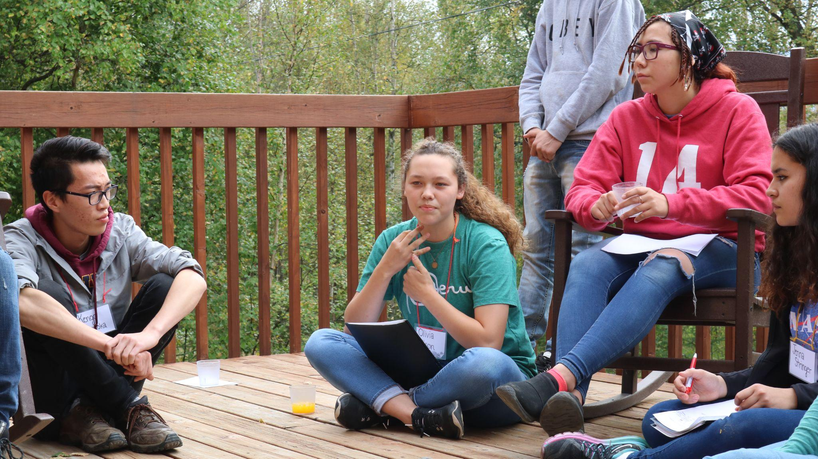
YOUTH ORGANIZER SUMMIT: OCT 14-17
Meet other passionate young Alaskans
Discuss issues in their communities
Learn and practice skills to take action
Plan the AYEA statewide action project
Notes:
Photo: YO 2017

Slide 8
APPLY TODAY!
DEADLINE: SEP 1
AYEA.org
ayea@akcenter.org
@ayea907

Slide 9
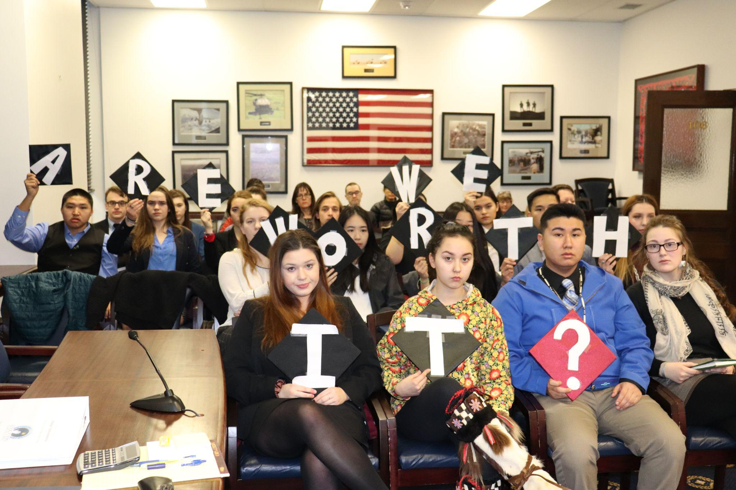
CIVICS & CONSERVATION SUMMIT
Learn the 101’s of our state government
Follow focus bills through the State House and Senate
Meet with your representatives in Juneau!
Notes:
Photo: CCS 2018

