Slide 1
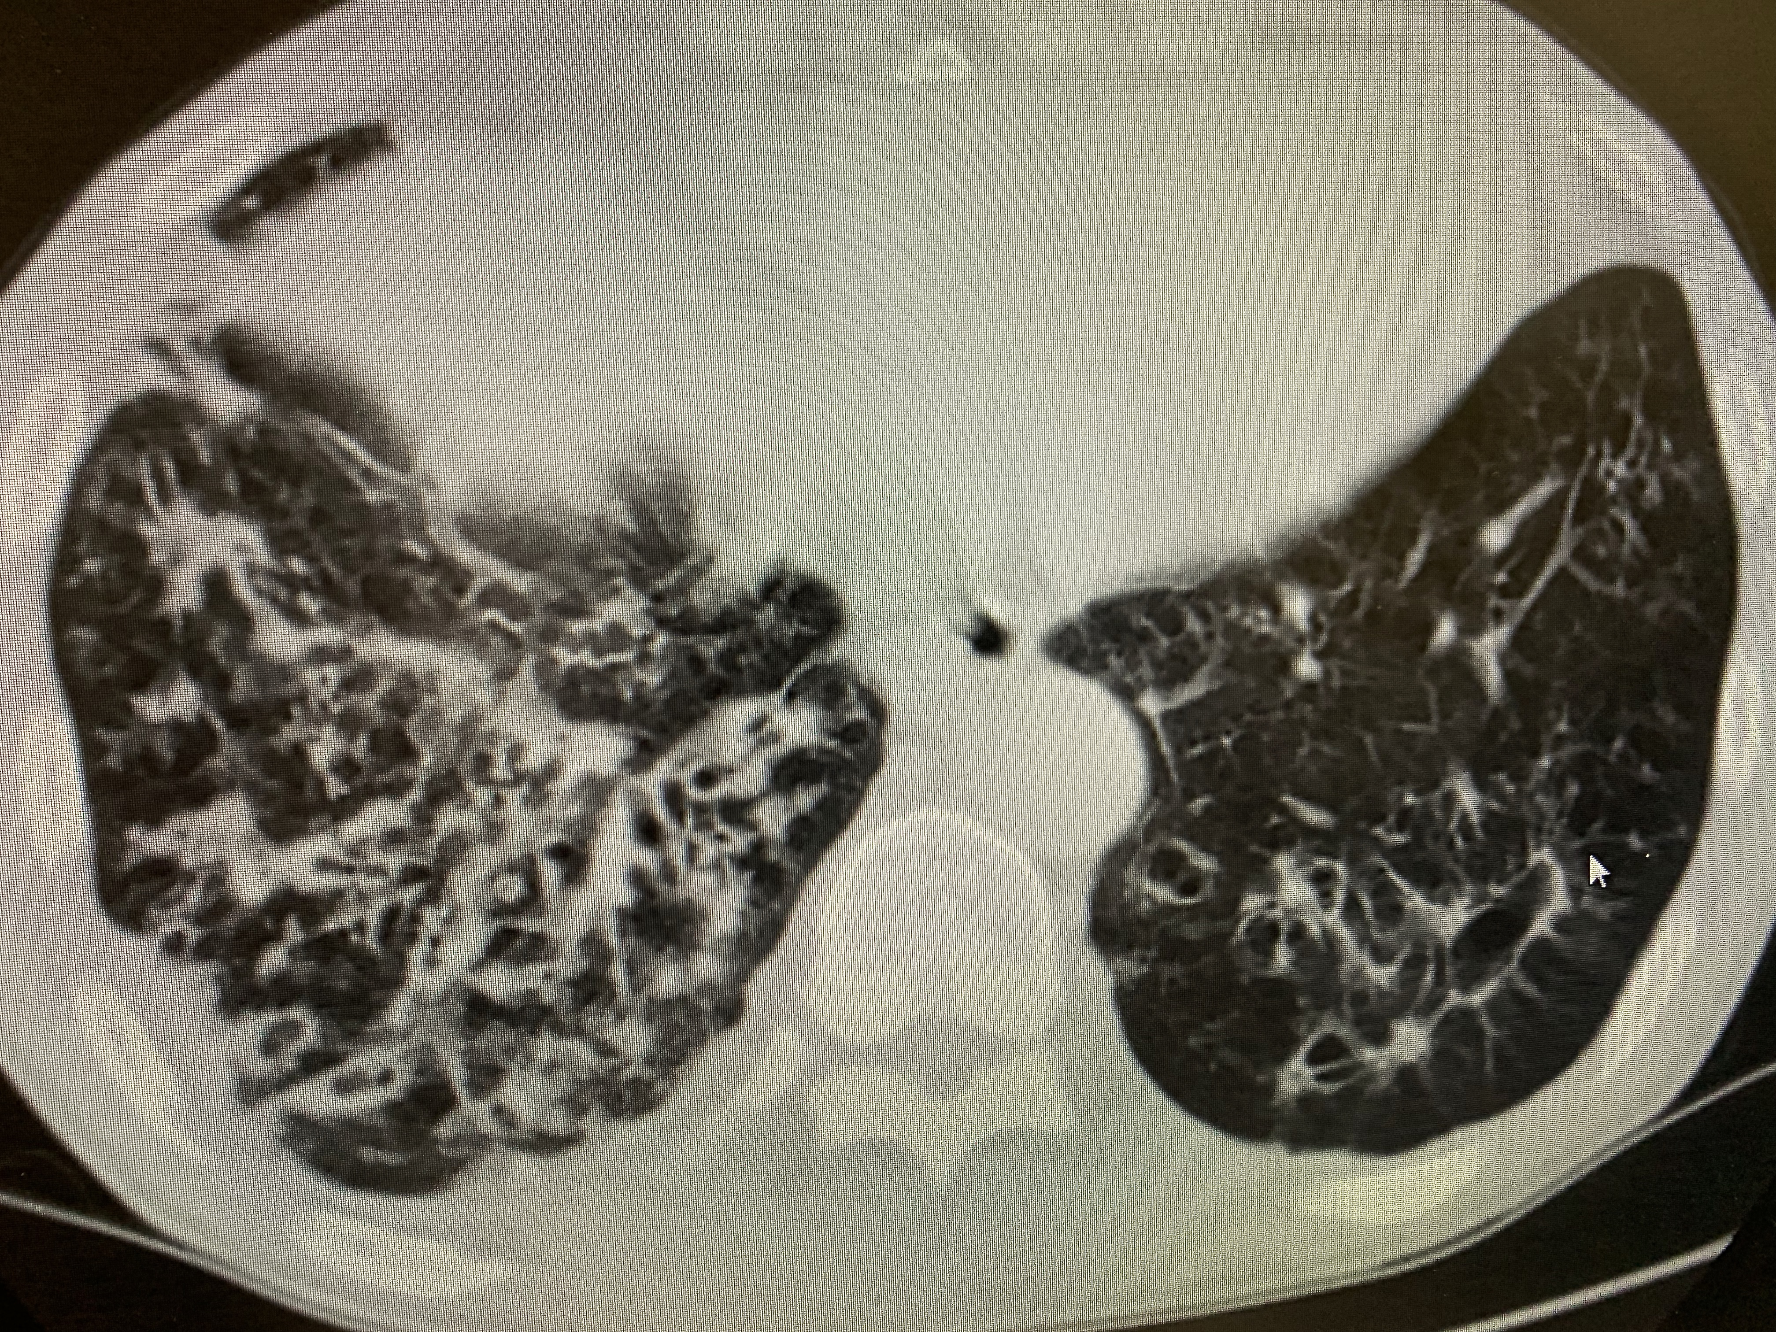
Bronchiectasis
An Under-diagnosed and Under-treated “Orphan Disease” in Alaskan Natives
Notes:
I am going to talk today about bronchiectasis which is a highly prevalent disease in Alaskan Natives that in many instances is under-recognized and under-treated. What makes bronchiectasis an “orphan disease” is that there is little interest or money from pharmaceutical companies, device makers, or government for research into better treatments likely related to absence of financial incentives. absence of financial incentives is related to the fact that bronchiectasis is most prevalent in underdeveloped impoverished third world countries. it is however a very rewarding disease to treat as with relatively simple interventions we can improve patients quality of life, reduce frequency of exacerbations, improve outcomes and reduce spending

Slide 2
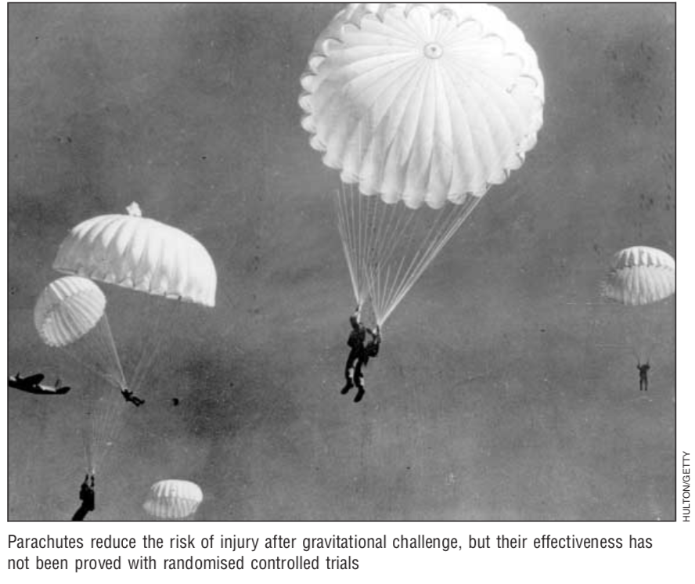
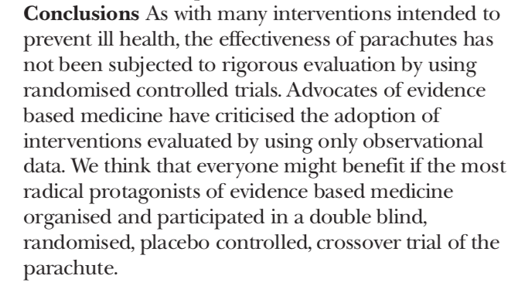
BMJ 2003;327:1459-61
Notes:
Bronchiectasis is a chronic, progressive, and irreversible dilatation of the airway that exhibits geographic variation, contrasting endophenotypes, and involvement in “overlap” states (1–4). Its clinical heterogeneity and etiological complexity are compounded by our incomplete understanding of its pathogenesis. This leads to difficulties with clinical trials and therefore a lack of evidence-based treatments for patients

Slide 3
Some “truths” transcend the need for proof
When your map and the ground disagree the ground is usually right
old bush pilot saying
“the patient will always tell you what is wrong with them”
when the patient with bronchiectasis tells you they are sick, they are usually right

Slide 4
Bronchiectasis
Prevalence of bronchiectasis in Alaskan natives
Definition
Lung microbiome
When to suspect bronchiectasis
Diagnostic criteria
Radiographic patterns
Directed evaluation of the patient with bronchiectasis
Management

Slide 5
Adult Outcomes of Bronchiectasis - YK Delta
Reviewed records of 31 adults age 29-40 with a history of confirmed bronchiectasis as children
4 deceased
15 ongoing symptoms
27/31 had no documentation of bronchiectasis after age 18 (diagnosis “dropped”)
few had regular medical follow up
high incidence of tobacco use (24/31), alcoholism (18/31), mental health disease (9/31), unemployment

Slide 6
Pneumonia hospitalizations by region in Alaska Native infants: 2009 - 2011
Northern and western rural regions – 10-fold higher than U.S.
Anchorage, urban and SE regions – Similar to the U.S.
Foote et al., Alaska Native Research Conference, 2014
Notes:
Similarly one of our former Alaska track residents Eric Foote published a paper in 2014 demonstrating the exceedingly high number of hospitalizations for pneumonia in the YK delta where the rates of bronchiectasis are highest. And in this particular paper the hosp in the YK Delta were 117 compared to a tenth of in the US population

Slide 7
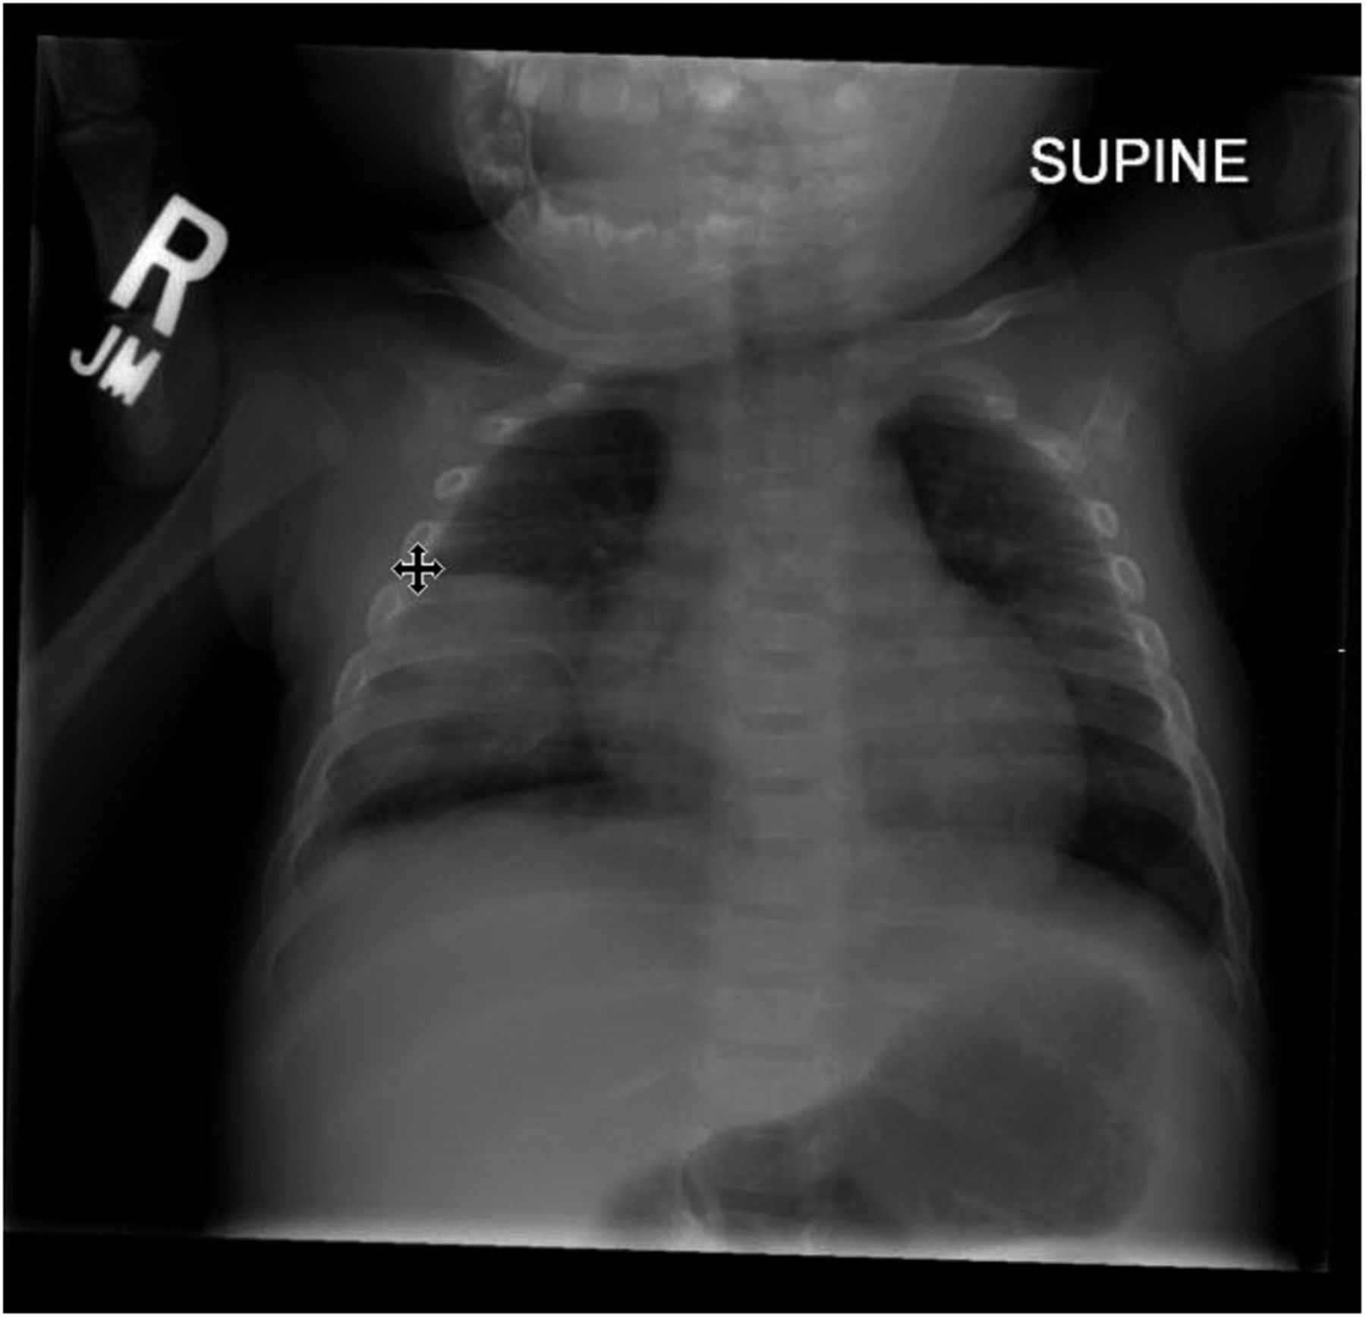
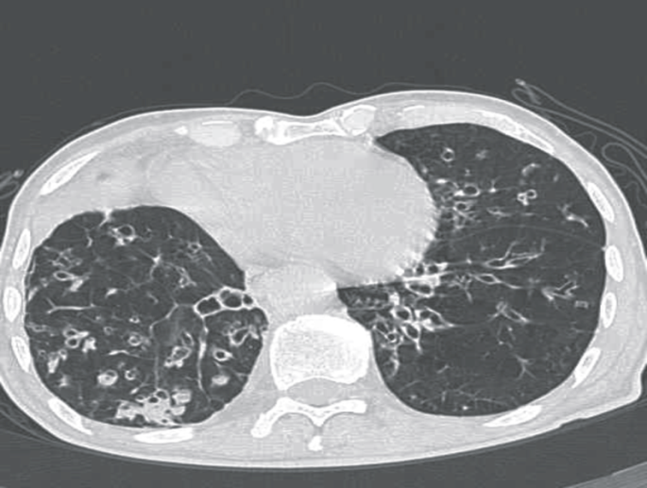
Non-Cystic Fibrosis Bronchiectasis in Indigenous Children
Indigenous children from Alaska, Australia and NZ have high rates of non-CF bronchiectasis
Major Risk Factor: Early/Recurrent pneumonias in childhood
Incidence of bronchiectasis in different populations
Infant pneumonia
Saccular Bronchiectasis
Singleton R, et al. Pediatr Pulmonol 2000; 29:182‑187
Chang AB, Med J Aust.2002;177:200-204
Notes:
It is well known/recognized that children who developed a chronic wet cough following pneumonia and recurrent acute lower resp. tract infections in infancy and early childhood can progress to radiologic diagnosis of bronchiectasis or clinical diagnosis of chronic suppurative lung disease in instances where is an absence of imaging.
In our Alaskan Native population we know that childhood pneumonia and recurrent acute LRIs are strongly associated with bronchiectasis.
Dr Singleton published a paper in 2000 that showed the rates of bronchiectasis of Alaskan and Australian indigenous populations are astronomically high when compared with the rest of the population in those countries.

Slide 8
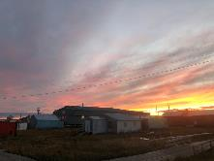
How do Alaska Village study homes compare with other US homes
U.S. data from 2008-2012 Census, American Community Survey
Singleton R, Salkoski AJ et al. Housing characteristics and indoor air quality…Indoor Air 2017
Notes:
THE NEXT COUPLE OF SLIDES really address some environmental risk factors and in my mind really prompted the question why in a developed country or the Global north, the rates of pneumonia without any underlying genetic or anatomical abnormality, a treatable disease are so high – and studies have shown that village houses have some inherent environmental or situational problems that attribute risk.
When compared with the rest of the country – homes in villages are small with high numbers of occupants, heat source is often fuel that produces pollutants and there is a small percentage with running water.

Slide 9
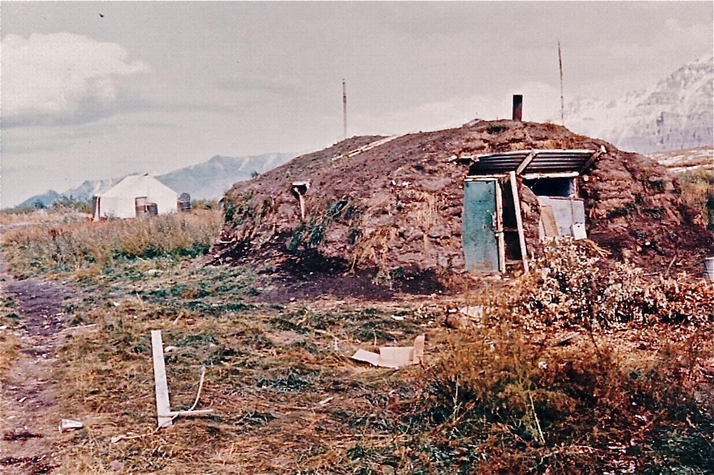
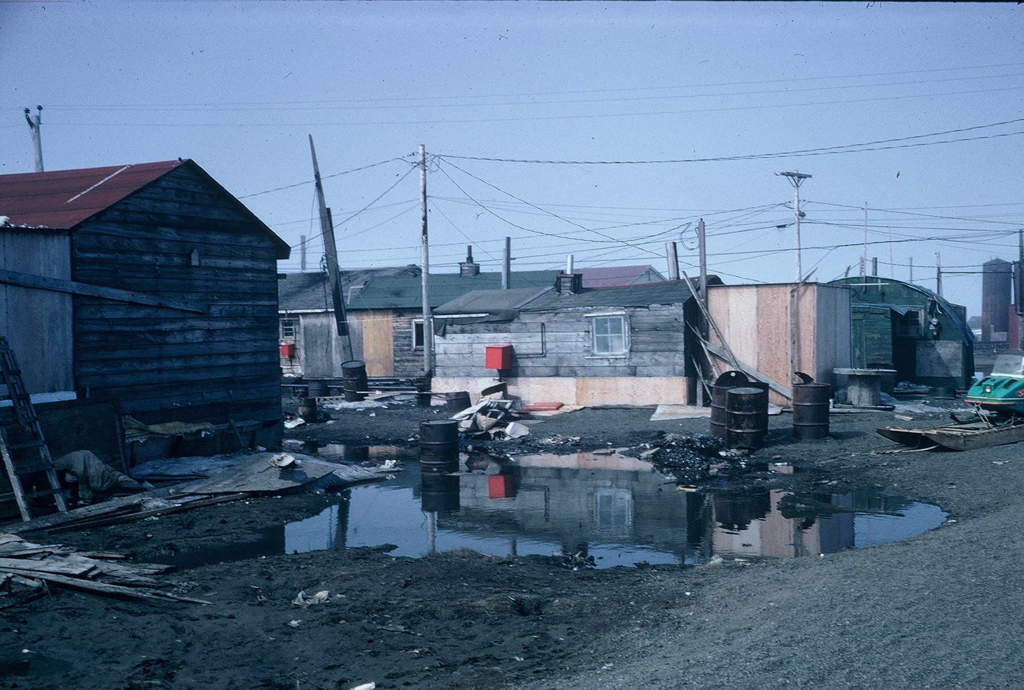
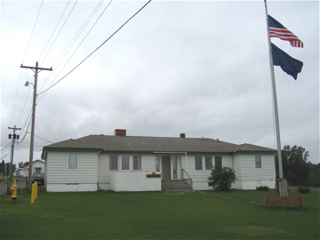
Three Alaskan Homes - 1966
applying the “eye” test, which one is unhealthy?

Slide 10
But I couldn’t always agree with the missionaries either…. they were urging the natives to live in frame houses like white people. This meant heating by stoves, and as driftwood continued scarce as hens teeth, the result was that the wooden shacks were usually cold and drafty, with much pneumonia ensuing. They weren’t half so practical as the old-style native igloos which generations of trial and error had developed for just such conditions, and in which an even day and night temperature could be maintained by stone lamps. The new houses certainly were harder to keep clean, and soon each contained as many Eskimos as ever packed into a single igloo.
–Charles Brower (1863-1945)
Fifty Years Below Zero - A lifetime of adventure in the Far North
Notes:
in a terrific book “fifty years below zero” by charles brower it is interesting that he comments on the health effects of natives moving into framed houses in the early 1900’s…. so i’ll comment more on this later, but in evaluating and treating out native patients with bronchiectasis i think it is important to attempt to understand their living environment and its impact on their risk of disease and its management.

Slide 11
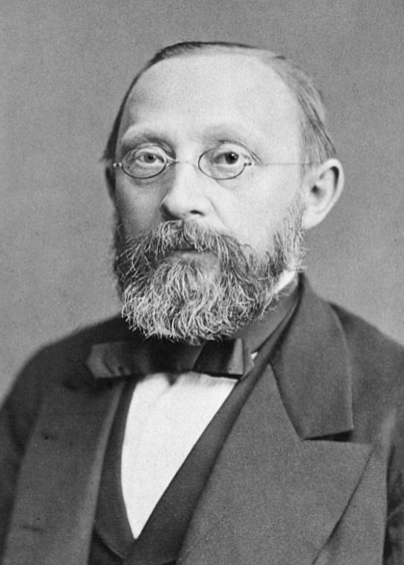
Virchow
1821-1902
“Medicine is a social science and politics is nothing else but medicine on a large scale. Medicine as a social science, as the science of human beings, has the obligation to point out problems and to attempt their theoretical solution… Science for its own sake usually means nothing more than science for the sake of the people who happen to be pursuing it. Knowledge which is unable to support action is not genuine…If Medicine is to fulfill her great task, then she must enter the political and social life… The physicians are the natural attorneys of the poor, and the social problems should largely be solved by them.
Notes:
In his 1848 report on the typhus epidemic he recognized the economic, social and cultural factors that contributed to the typhus epidemic and instead of recommending medical interventions with more doctors or hospitals he emphasized the importance of education, employment, higher wages and social reconstruction

Slide 12
Bronchiectasis
Characterized pathologically by airway inflammation and permanent bronchial dilatation, and clinically by productive cough and recurrent respiratory infections

Slide 13
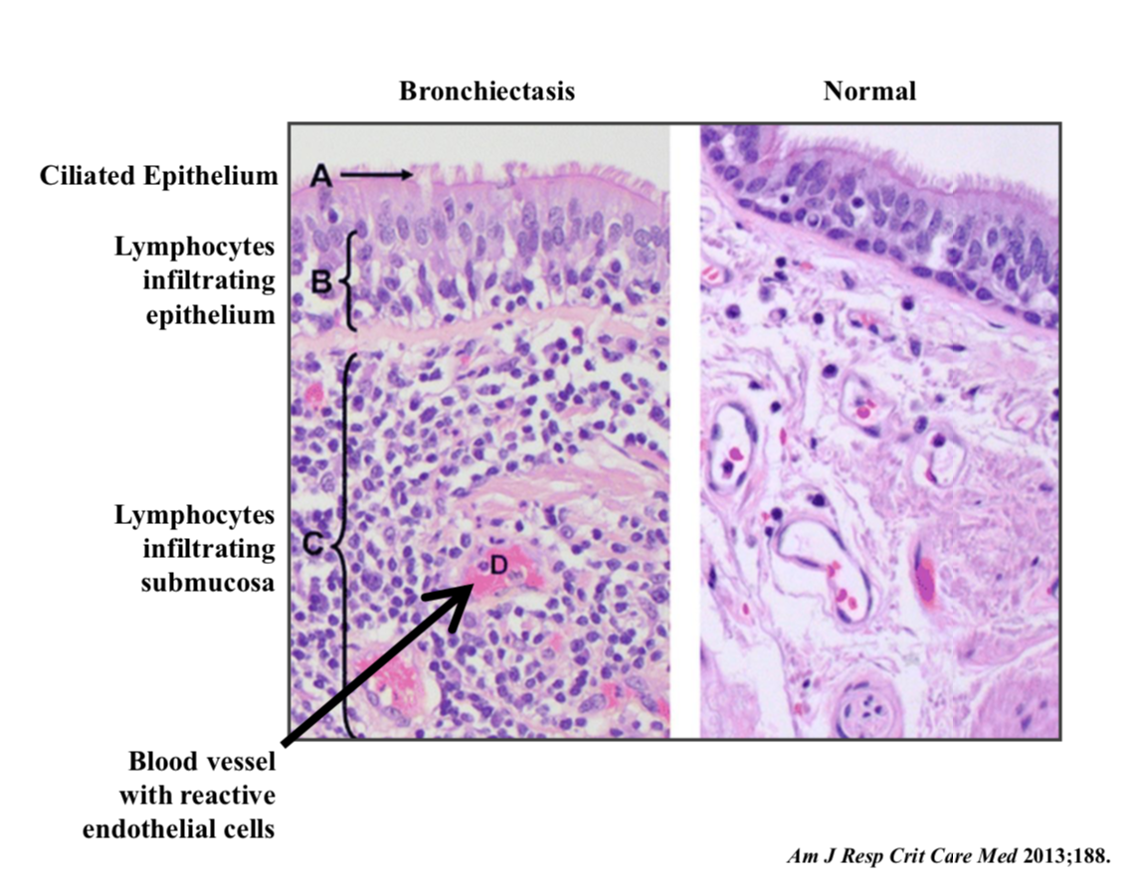

Slide 14
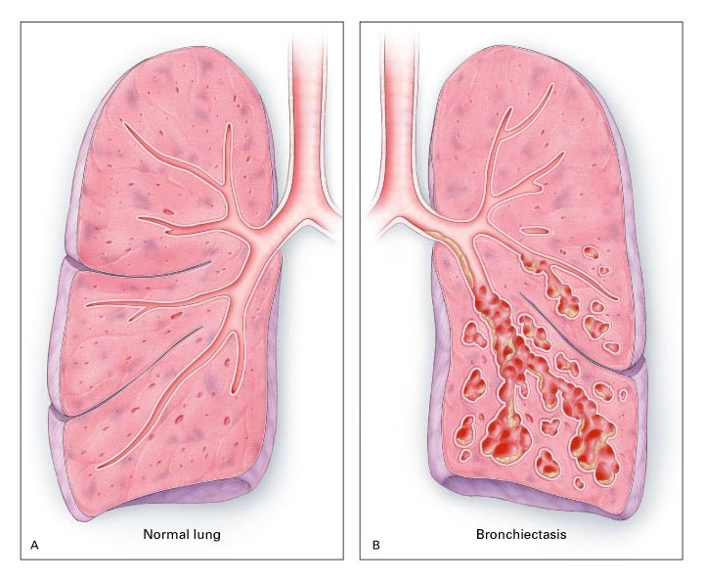
Barker AF. N Engl J Med 2002;346:1383-1393.
Normal Lung and Airways (Panel A) and the Lung of a Patient with Bronchiectasis (Panel B).
Notes:
Figure 2. Normal Lung and Airways (Panel A) and the Lung of a Patient with Bronchiectasis (Panel B). In Panel B, bronchiectasis is primarily in the lower lobe, which is the most common distribution. The saccular dilatations and grape-like clusters with pools of mucus are signs of severe bronchiectasis.

Slide 15
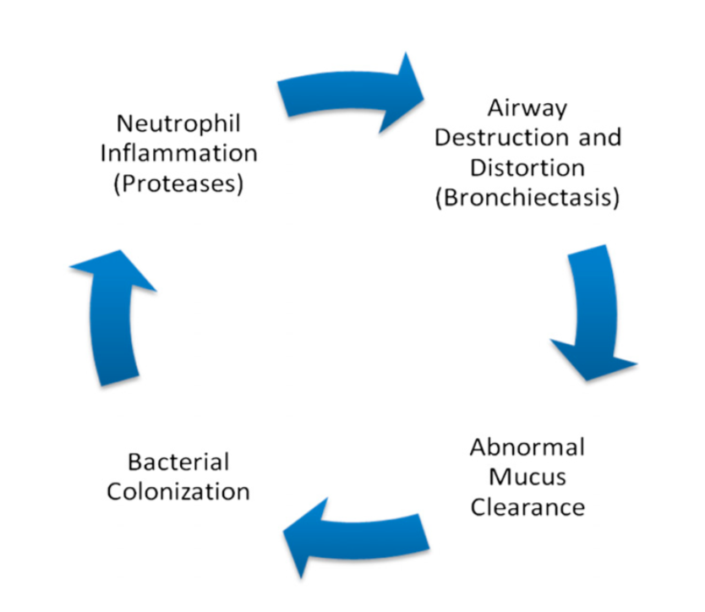
Am J Resp Crit Care Med 2013;188:647-656

Slide 16
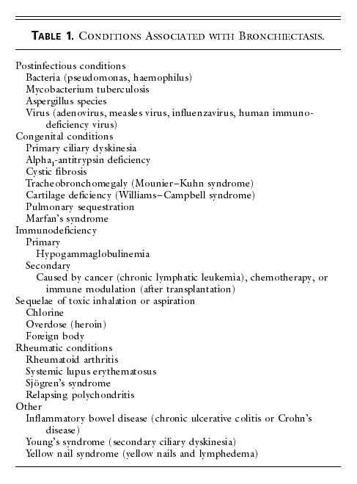
Barker AF. N Engl J Med 2002;346:1383-1393.
Conditions Associated with Bronchiectasis.
Notes:
some authors like to make the point that bronchiectasis is not so much a diagnosis in itself as it is the end result of a heterogeneous group of diseases with a common endpoint of airway injury, architectural distortion, inflammation and infection. these causes include…

Slide 17
Bronchiectasis: “not a disease”
End result of different diseases with a common endpoint
evaluation
Anemia
Rash
Bronchiectasis
Macrocytic Anemia Secondary to vitamin B12 deficiency
Leukocytoclastic Vasculitis
Allergic Bronchopulmonary Aspergillosis
Notes:
Bronchiectasis is not a disease in itself, it is the end result of different diseases with a common endpoint - chronic inflammation of the bronchial wall causing abnormal and irreversible dilatation fo the cartilaginous bronchus, accompanied by the destruction of the muscular and elastic components of the bronchial wall. Just as we should not accept the presence of anemia, or rash without some effort at further evaluation, the finding of bronchiectasis mandates additional evaluation as identifying the underlying cause can have significant implications for management and prognosis.

Slide 18
The Lung Microbiome in Health and Disease
The Lungs Are Not Sterile
Lung Microbiome Is Determined by Three Ecological Factors
microbial immigration into the airways (air/micro-aspiration)
elimination of microbes from airways (mucociliary clearance, cough, host immune defenses)
relative reproduction rates of bacteria as determined by regional growth conditions

Slide 19
Dickson RP. PLoS Pathog. 2015; 11 (7)

Slide 20
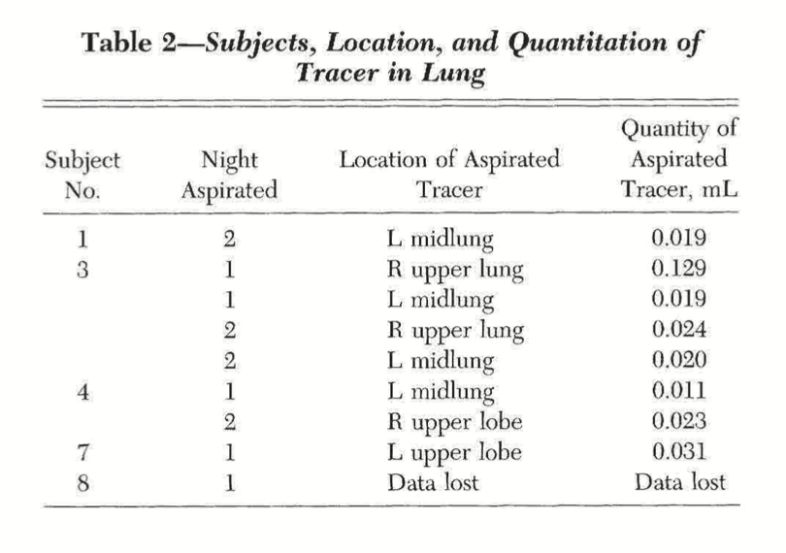
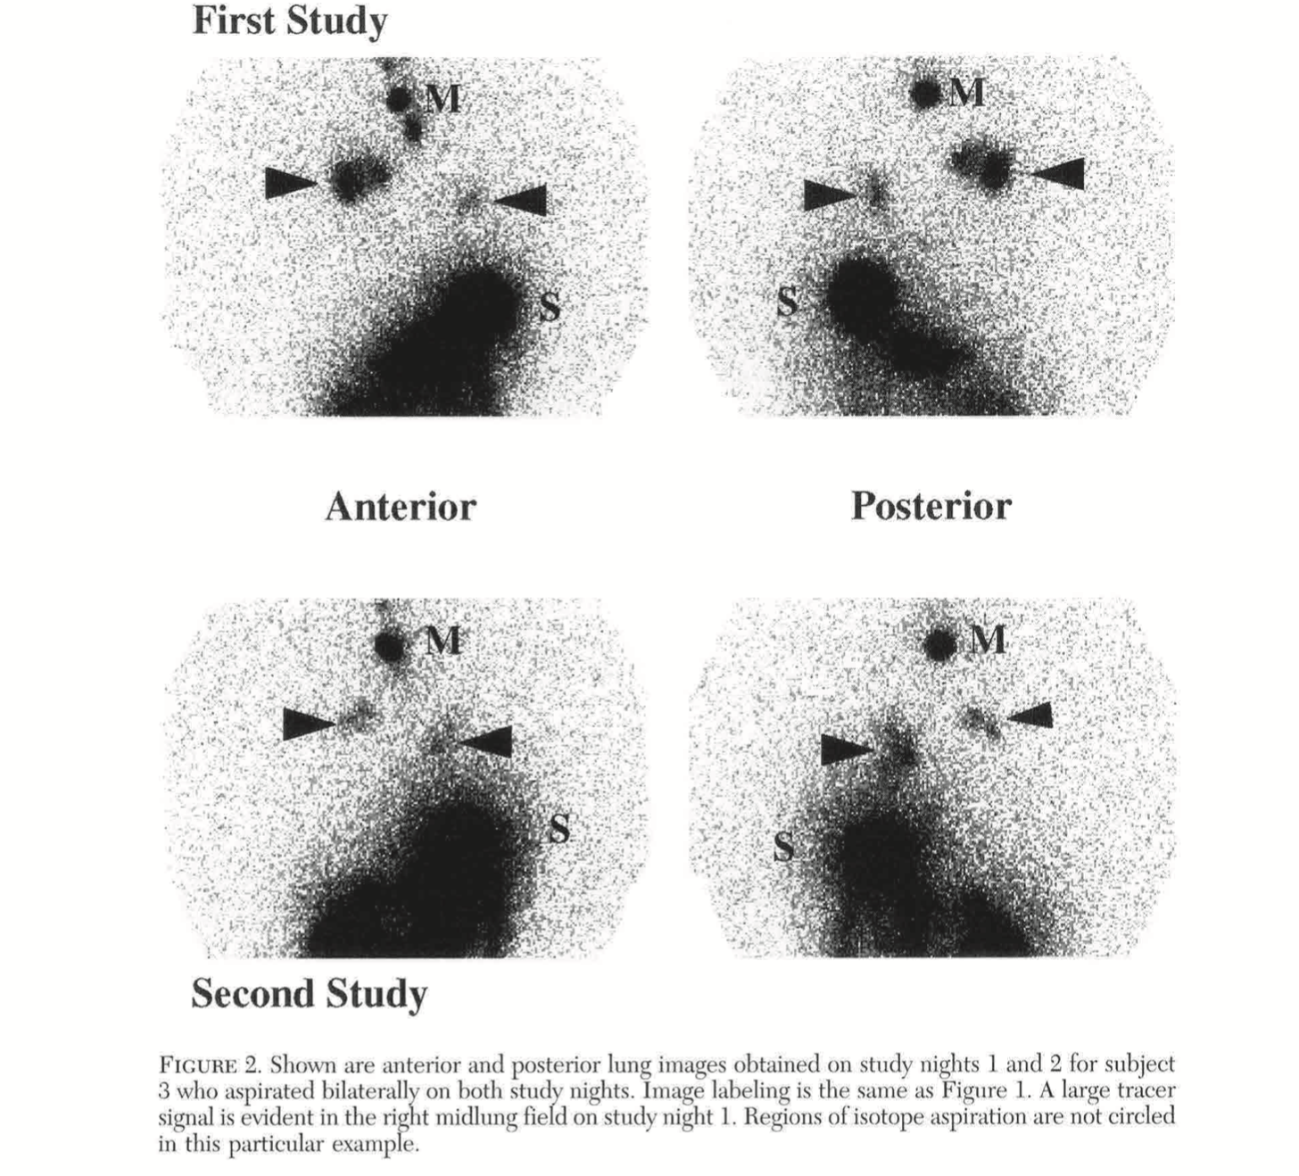
Quantitative Aspiration During Sleep in Normal Subjects
Kevin Gleeson, MD; Douglas F Eggli, MD and Steven L Maxwell DO, FCCP
upper airway secretions: 10⁶ to 10⁸ organisms
.01 to .13 ml aspirated
CHEST 1997;111:1266-72
10⁴ to 10⁵ organisms aspirated
Notes:
Aspiration of upper airway secretions and colonizing microorganisms may be primary event preceding most cases of bacterial pneumonia. In this study ten healthy volunteers, age 22-55 underwent two full night PSG recordings with infusion of Tc99 tracer at 2 ml/hr into nasopharynx through a small catheter. lung scans were performed immediately upon final awakening. 5/10 had tracer evident in pulmonary parenchyma. two subjects aspirated on both nights. quantity aspirated .01 to .129 ml. upper airway secretions contain 10/6 to 10/8 organisms thus minimum quantity aspirated on order of 10 to 4 or 10 to 5

Slide 21
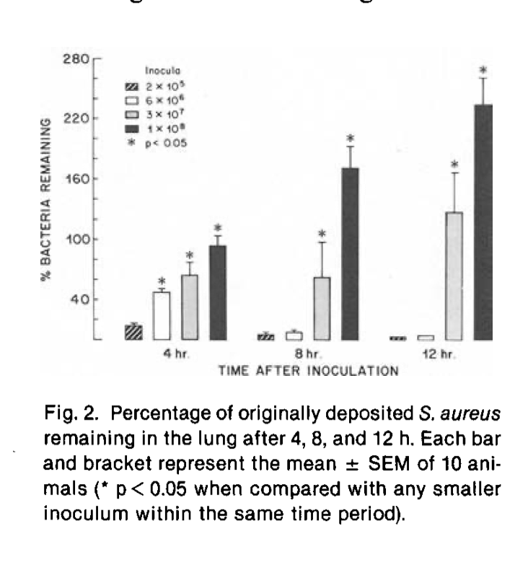
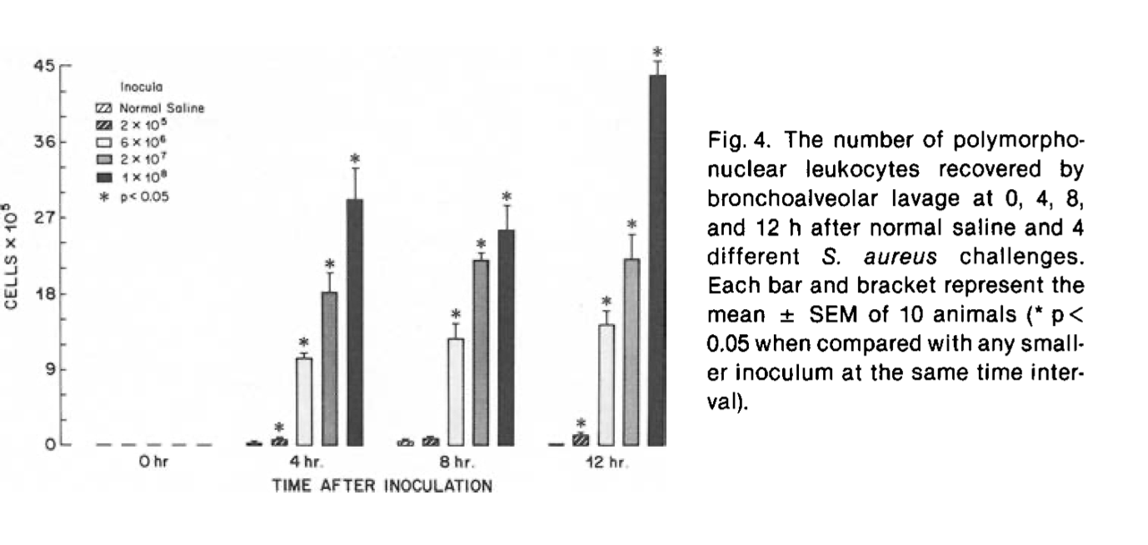
Granulocyte-Alveolar-Macrophage Interaction in the Pulmonary Clearance of Staphylococcus aureus
AM REV RESPIR DIS 1983;127:335-341
Notes:
In this study pulmonary clearance of S. aureus and phagocytic response over a wide range of inoculate size was studied. study showed that small bolus inoculate were rapidly cleared by alveolar macrophages. at larger inoculate PMN’s are necessary for inoculate clearance, which is delayed in time. at even larger inoculate neither AM or PMN’s were sufficient to clear staph from the lung.

Slide 22
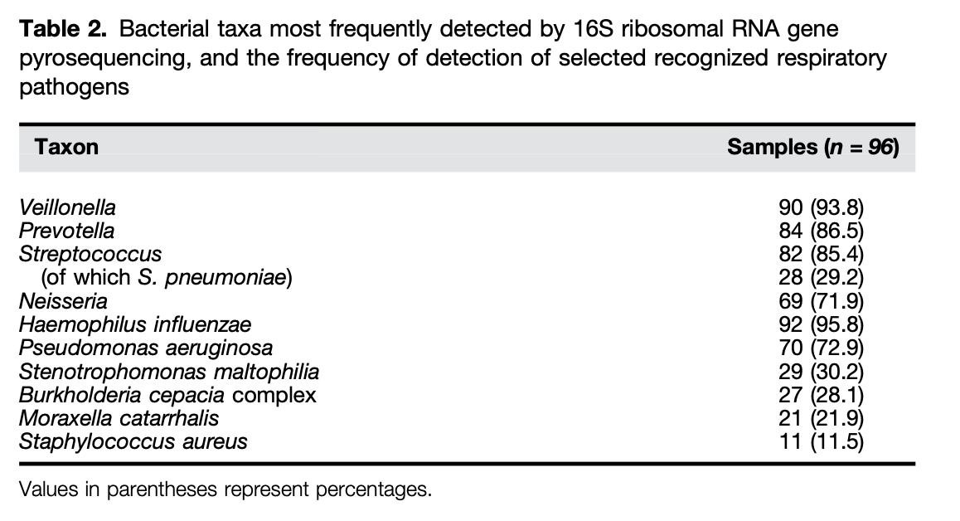
A Novel Microbiota Stratification System Predicts Future Exacerbations in Bronchiectasis
Geraint B. Rogers¹, Nur Masirah M. Zain², Kenneth D. Bruce²*, Lucy D. Burr¹, Alice C. Chen¹, Damian W. Rivett³, Michael A. McGuckin¹, and David J. Serisier^{1,4}*
AnnalsATS Volume 11 Number 4|May 2014
Notes:
In this study from New Zealand bacterial respiratory pathogens from 107 patients with non-CF bronchiectasis were evaluated by culture, quantitative PCR and ribosomal gene sequencing. Microbiological data was correlated with concurrent clinical measures and subsequent outcomes. Microbiota data defined three groups: Pseudomonas dominated, H flu dominated and “other taxa” dominated. Predominance of Pseudomonas, followed by Veillonella species was the best predictor of future exacerbation frequency. 75% of Veillonella and Prevotella isolates were culture negative.

Slide 23
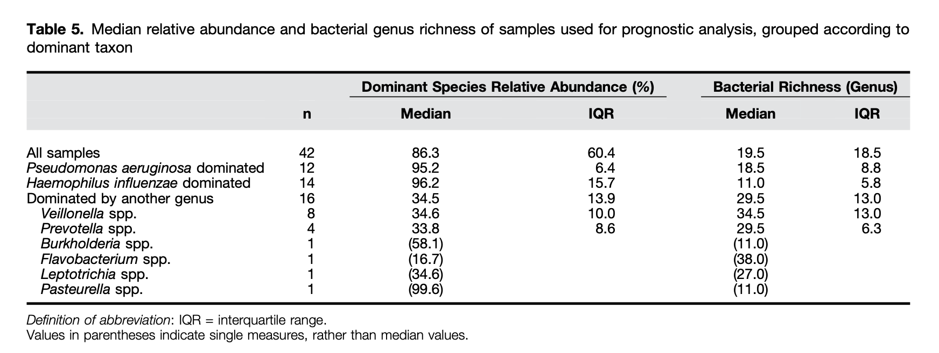
A Novel Microbiota Stratification System Predicts Future Exacerbations in Bronchiectasis
Geraint B. Rogers¹, Nur Masirah M. Zain², Kenneth D. Bruce²*, Lucy D. Burr¹, Alice C. Chen¹, Damian W. Rivett³, Michael A. McGuckin¹, and David J. Serisier^{1,4}*
AnnalsATS Volume 11 Number 4|May 2014

Slide 24
Potential Clinical Importance of Veillonella Species
anaerobic, gram-negative cocci
residents of oral cavity, GI tract, vagina
rarely subjected to anaerobic diagnostic microbiology
susceptible to antibiotics used for rx of anaerobic infections (B-lactam, clindamycin, metronidazole)

Slide 25
Lung Microbiome - preliminary conclusions
the lungs are not sterile
aspiration is an important factor in determining nature of the lung microbiome
aspiration of clinically relevant quantities of bacteria occurs in healthy individuals
oral anaerobes, including species not cultured by routine methods, comprise a significant component of the lung microbiome and may have clinical utility in identifying patients at risk for poor outcomes

Slide 26
“The universe is full of magical things patiently waiting for our wits to grow sharper”
Eden Phillpots (1862-1960)

Slide 27
When Should the Diagnosis of Bronchiectasis be suspected
Persistent productive cough
Daily sputum production
Symptoms for many years
Sputum colonization with Pseudomonas aeruginosa
Recurrent respiratory tract infections
Unexplained hemoptysis

Slide 28
Making the Diagnosis
of Bronchiectasis
Take a careful history - the Patient is always a better source of information than the EMR
childhood illnesses
history of TB
history of pneumonia or sinusitis
signs or symptoms of collagen vascular disease/ILD
Order a non-contrast HRCT chest
If the CT shows bronchiectasis don’t stop there - ask “why”?
If unsure about “why” refer for pulmonary consult

Slide 29
CT Features of Bronchiectasis
Bronchiectasis is defined by bronchial dilatation as suggested by one or more of the following
Broncho-arterial ratio >1 (internal airway lumen vs adjacent pulmonary artery)
Lack of airway tapering
Airway visibility within 1 cm of costal pleural surface or touching mediastinal pleura

Slide 30
Indirect CT findings associated with bronchiectasis
Bronchial wall thickening
Mucus impaction
Mosaic pattern lung attenuation/air trapping on expiratory CT
Notes:
CT can also aid in identifying etiology of bronchiectasis - ABPA, NTM, Alpha one antitrypsin, foreign body

Slide 31
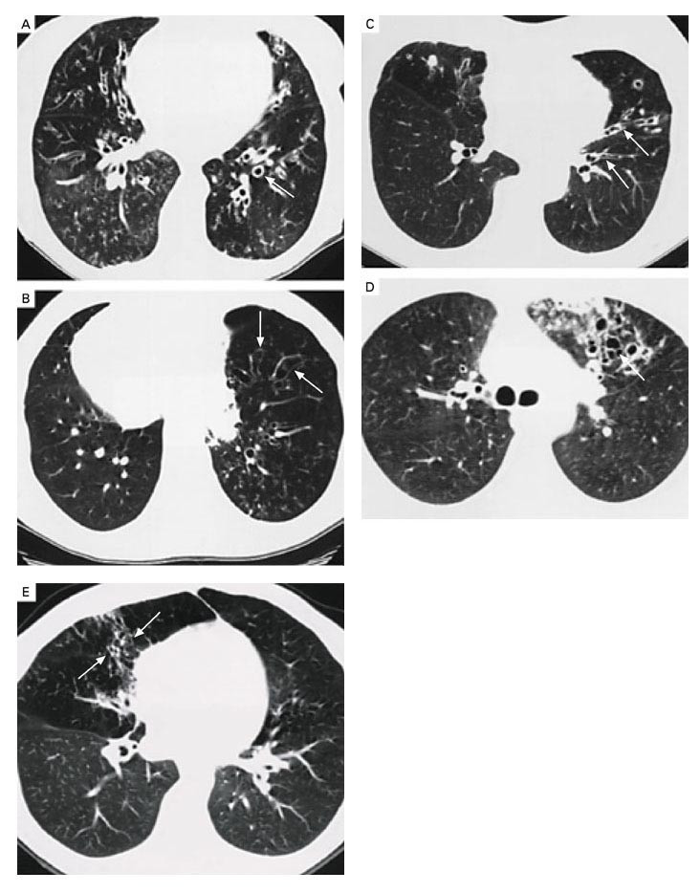
Barker AF. N Engl J Med 2002;346:1383-1393.
High-Resolution Computed Tomographic Images of Lungs with Bronchiectasis.
Notes:
Figure 1. High-Resolution Computed Tomographic Images of Lungs with Bronchiectasis. Panel A shows dilated and thickened airways (arrow); Panel B shows airways that do not taper (arrows) toward the periphery in a patient with Kartagener's syndrome; Panel C shows varicose changes (dilated and beaded airways [arrows]); Panel D shows clustered cysts or saccules (arrow) as well as a peripheral infiltrate; Panel E shows middle-lobe bronchiectasis (arrows) in a patient with Mycobacterium avium complex infection.

Slide 34
Challenges in management of bronchiectasis in Alaskan Natives - co-morbidities and social determinants of health
poor dentition
tobacco addiction
Alcoholism
prompt access to care during exacerbations
crowded living conditions/lack of running water
poverty

Slide 35
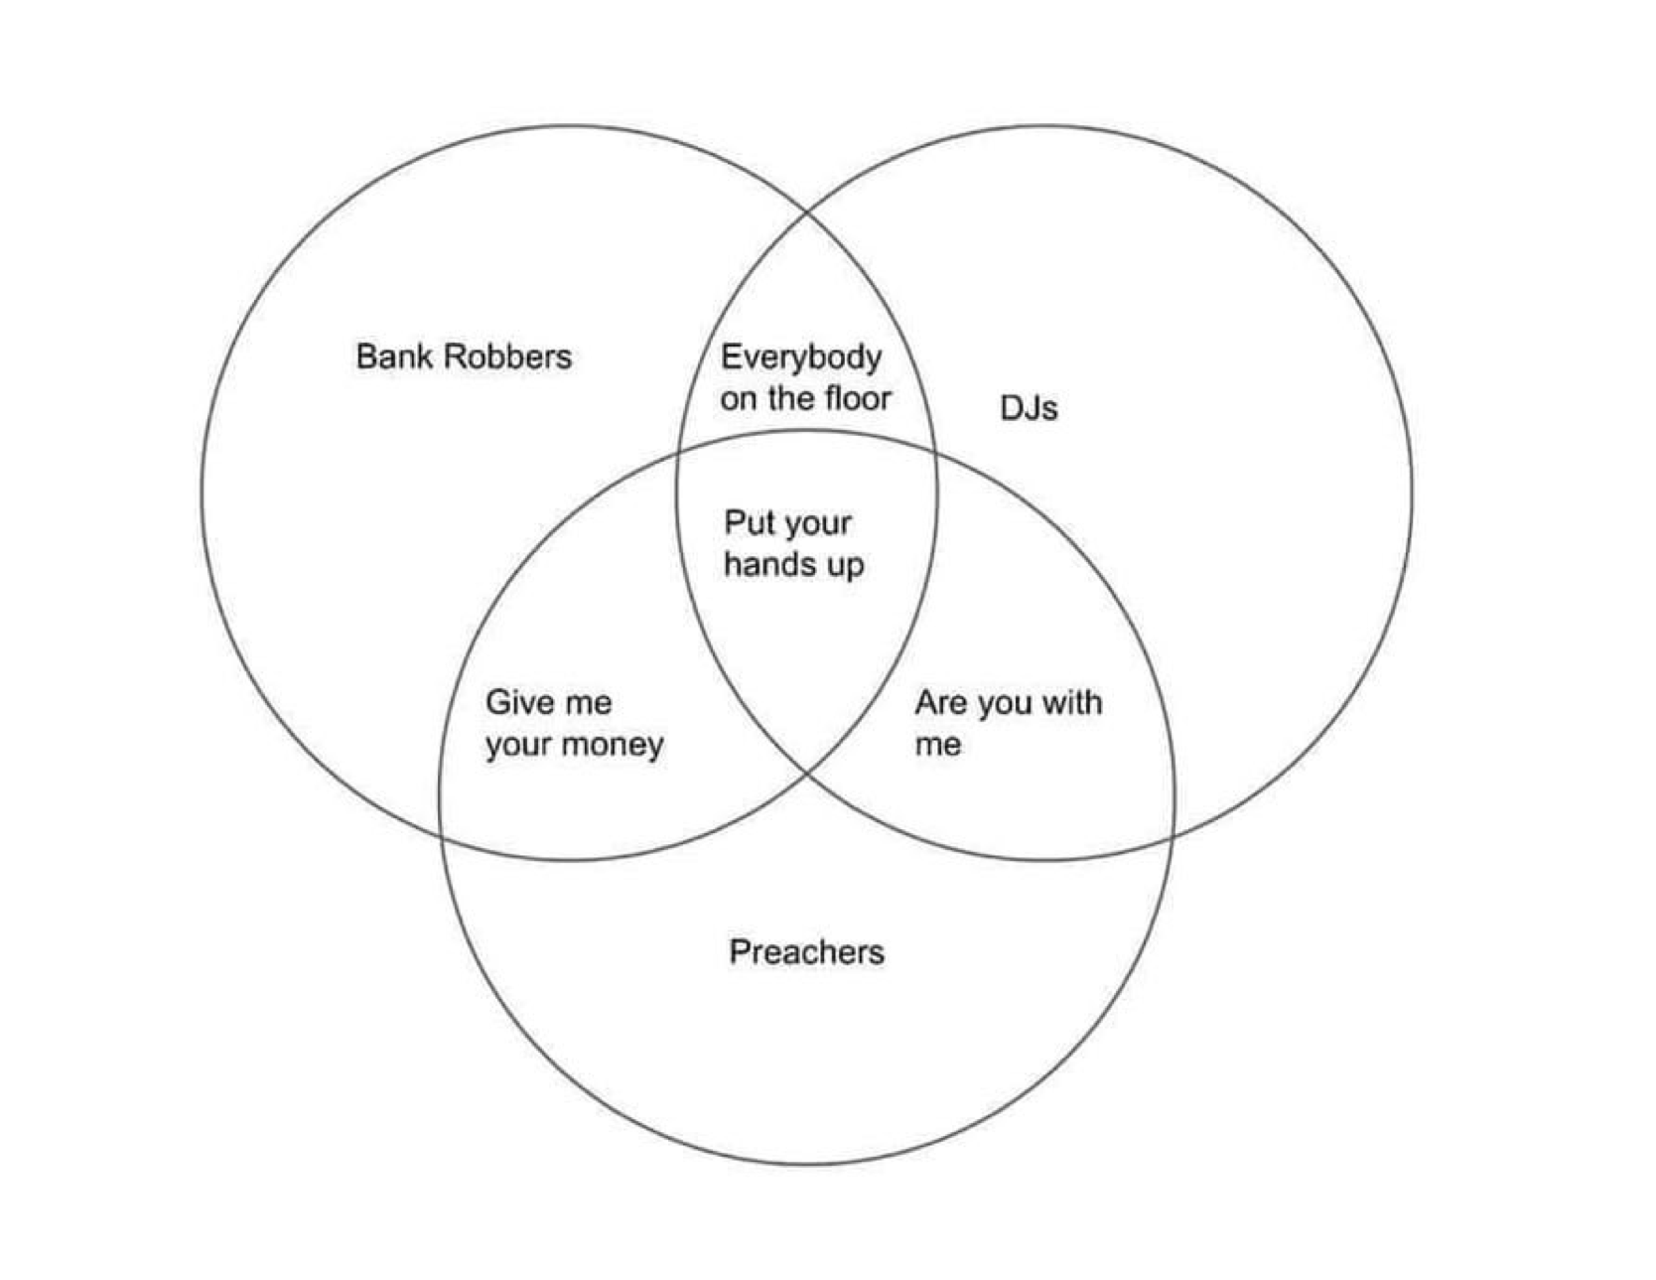
What Do Bank Robbers, DJs and Preachers Have in Common?

Slide 36
COPD -
A Physiologic
Diagnosis
Bronchiectasis -
An Anatomic
Diagnosis
Chronic Cough
Sputum Production
Recurrent exacerbations
airflow obstruction
Exposure Plus
Irreversible Airflow
Obstruction
Airway Dilatation
and Airway Wall
Thickening

Slide 37
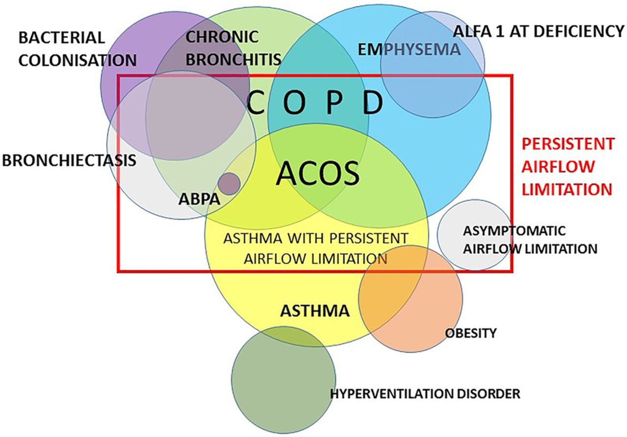
Persistent airflow limitation in view of clinical disease expressions.
Lowie E G W Vanfleteren Thorax 2016;71:781-782
Copyright © BMJ Publishing Group Ltd & British Thoracic Society. All rights reserved.
Notes:
Persistent airflow limitation in view of clinical disease expressions. ABPA, allergic bronchopulmonary aspergillosis; ACOS, asthma COPD overlap syndrome; ALFA 1- AT deficiency, alpha 1-antitrypsin deficiency.

Slide 38
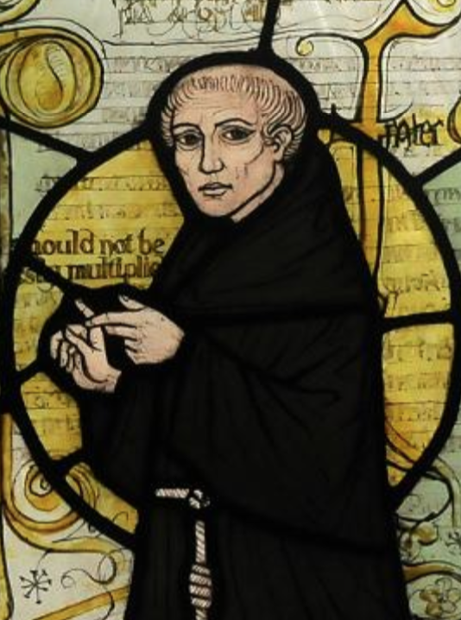
Occam’s Razor vs Hickam’s Dictum
pluralitas non est ponenda sine necessitate
“plurality should not be posited without necessity”
William of Ockham (1285-1347)
“A Man can have as many diseases as he damn well pleases”
John Bamber Hickam (1914-1970)

Slide 39
Case 1
a study in the natural history of under-treated bronchiectasis
70 y.o. from Newtok
25 pack year hx tobacco use
History of binge drinking
Hospitalized 2 weeks in 1985 with pneumonia/resp failure
History of Right Lower Lobe pneumonia/empyema 2014
Poor dentition
2-3 exacerbations of bronchiectasis/yr (purulent sputum/hemoptysis)

Slide 40
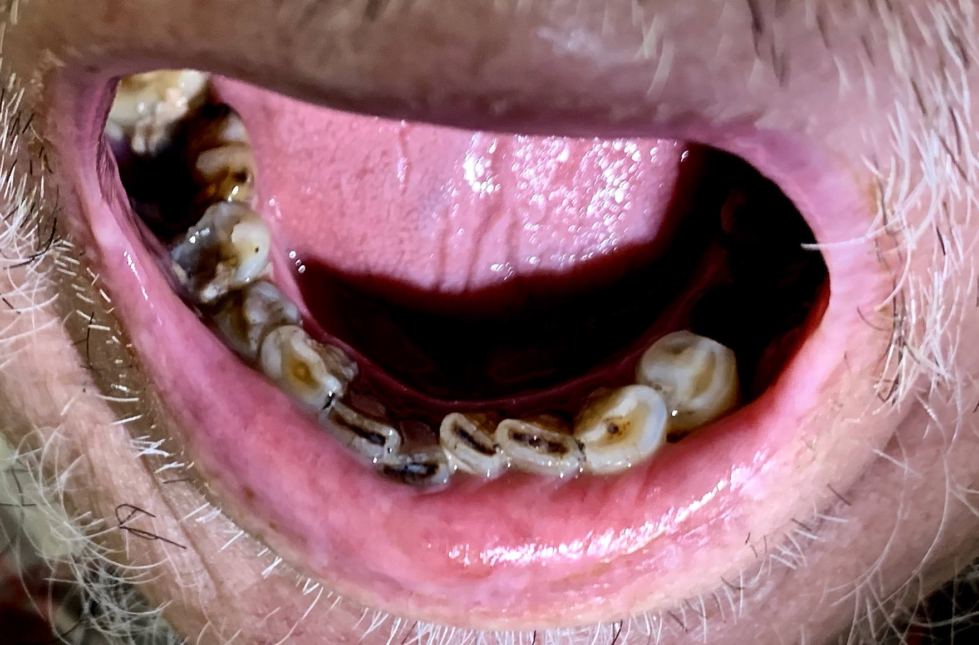
Exam
numerous broken and carious teeth
bilateral rhonchi/basilar crackles
mild clubbing
PFT’s - mild obstruction. severe decrease in DLCO (46%)

Slide 41
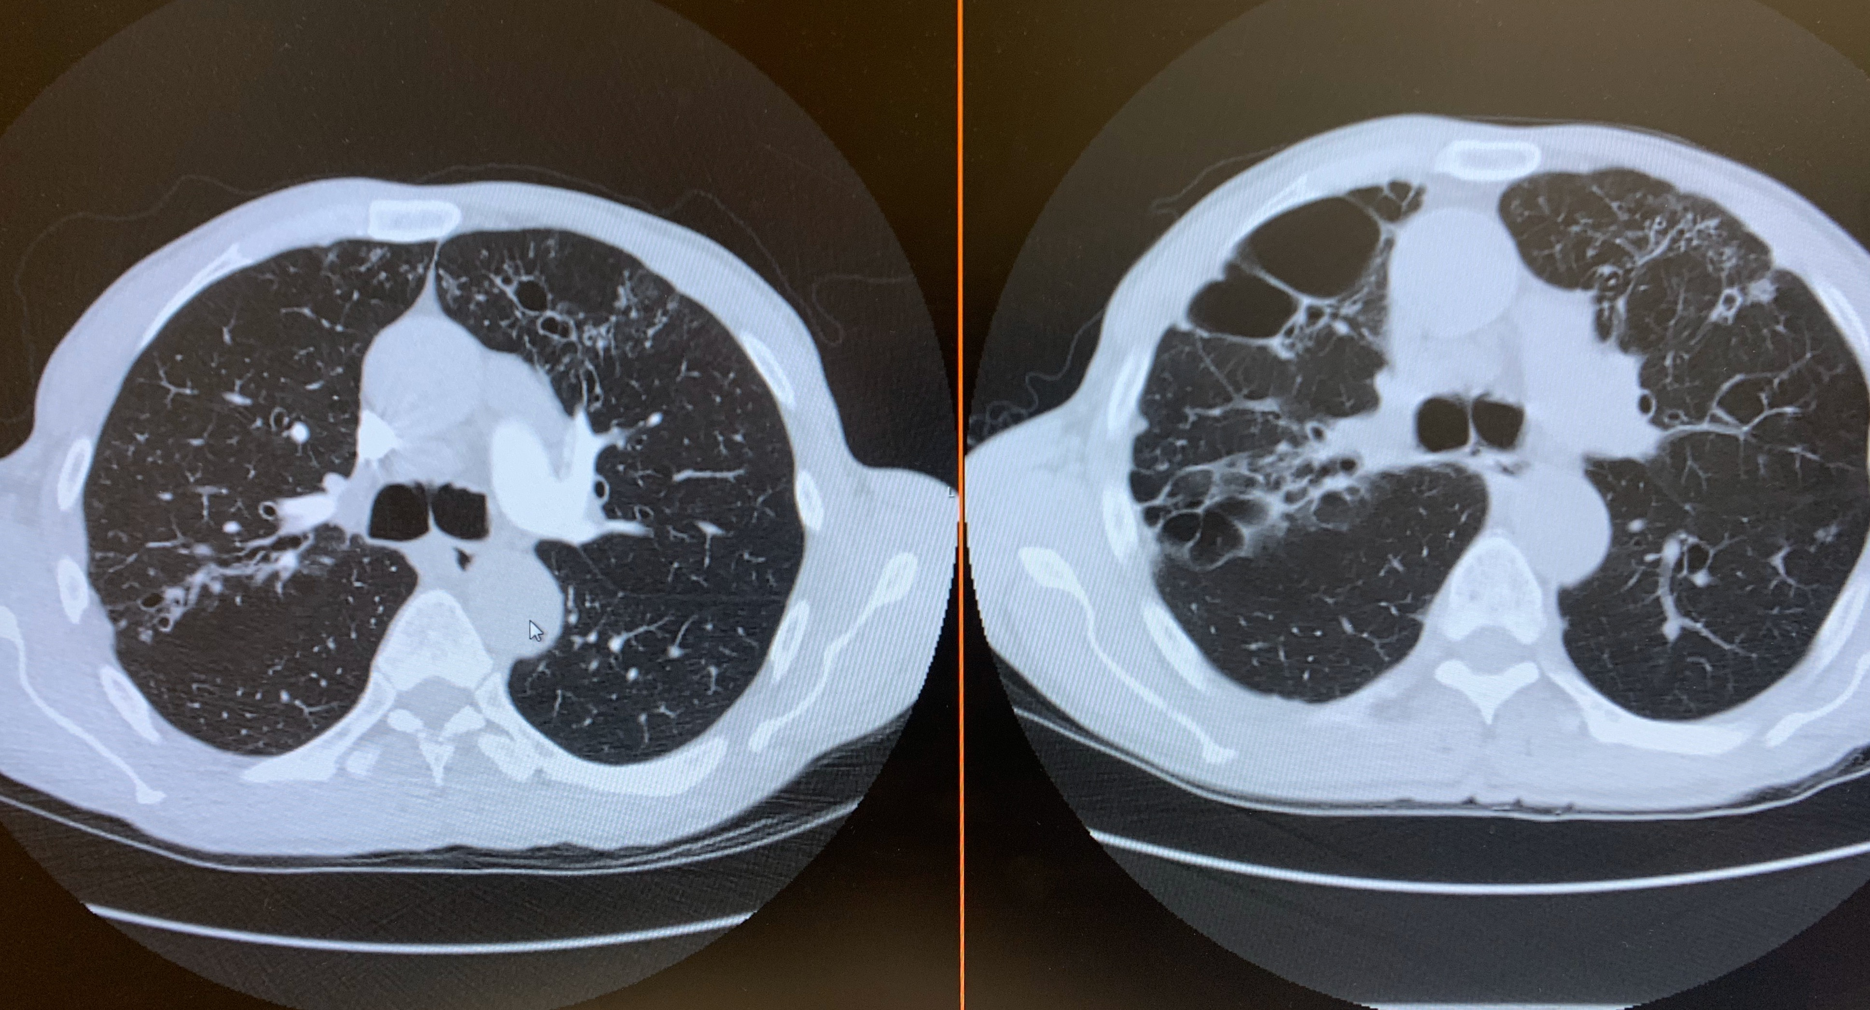
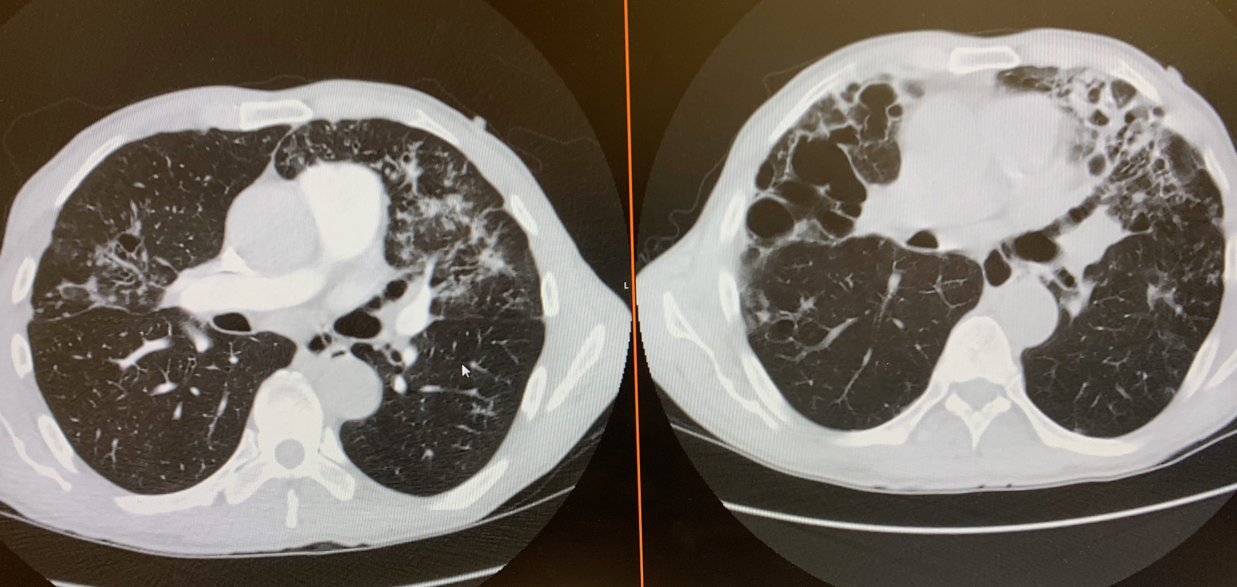
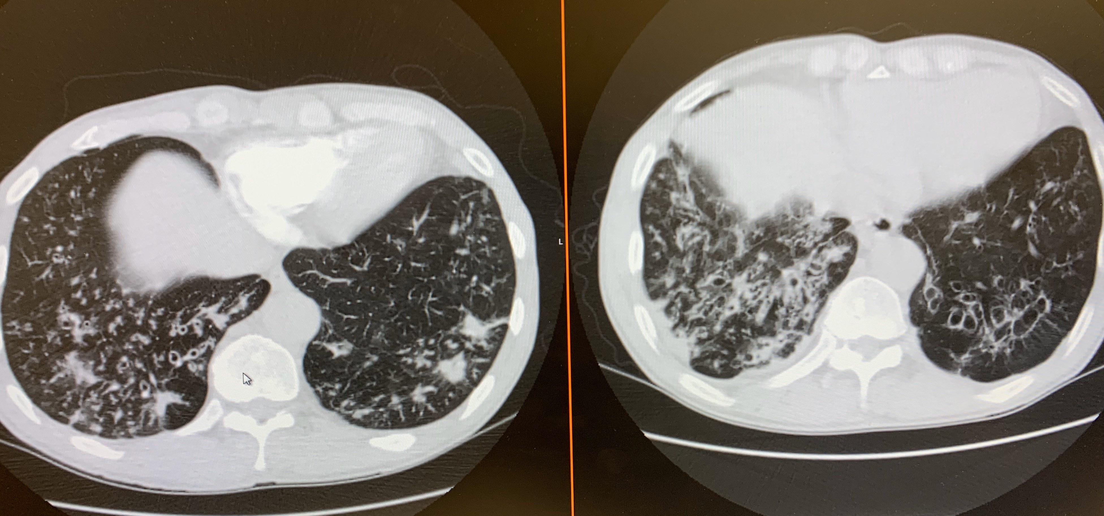
The Natural History
of “under-treated”
bronchiectasis

Slide 42
Bronchiectasis - case 2
66 y.o. generally healthy lady with 9 month hx of cough and recent intermittent hemoptysis
No hx TB
non-smoker
PMH: thyroidectomy
labs: normal

Slide 43
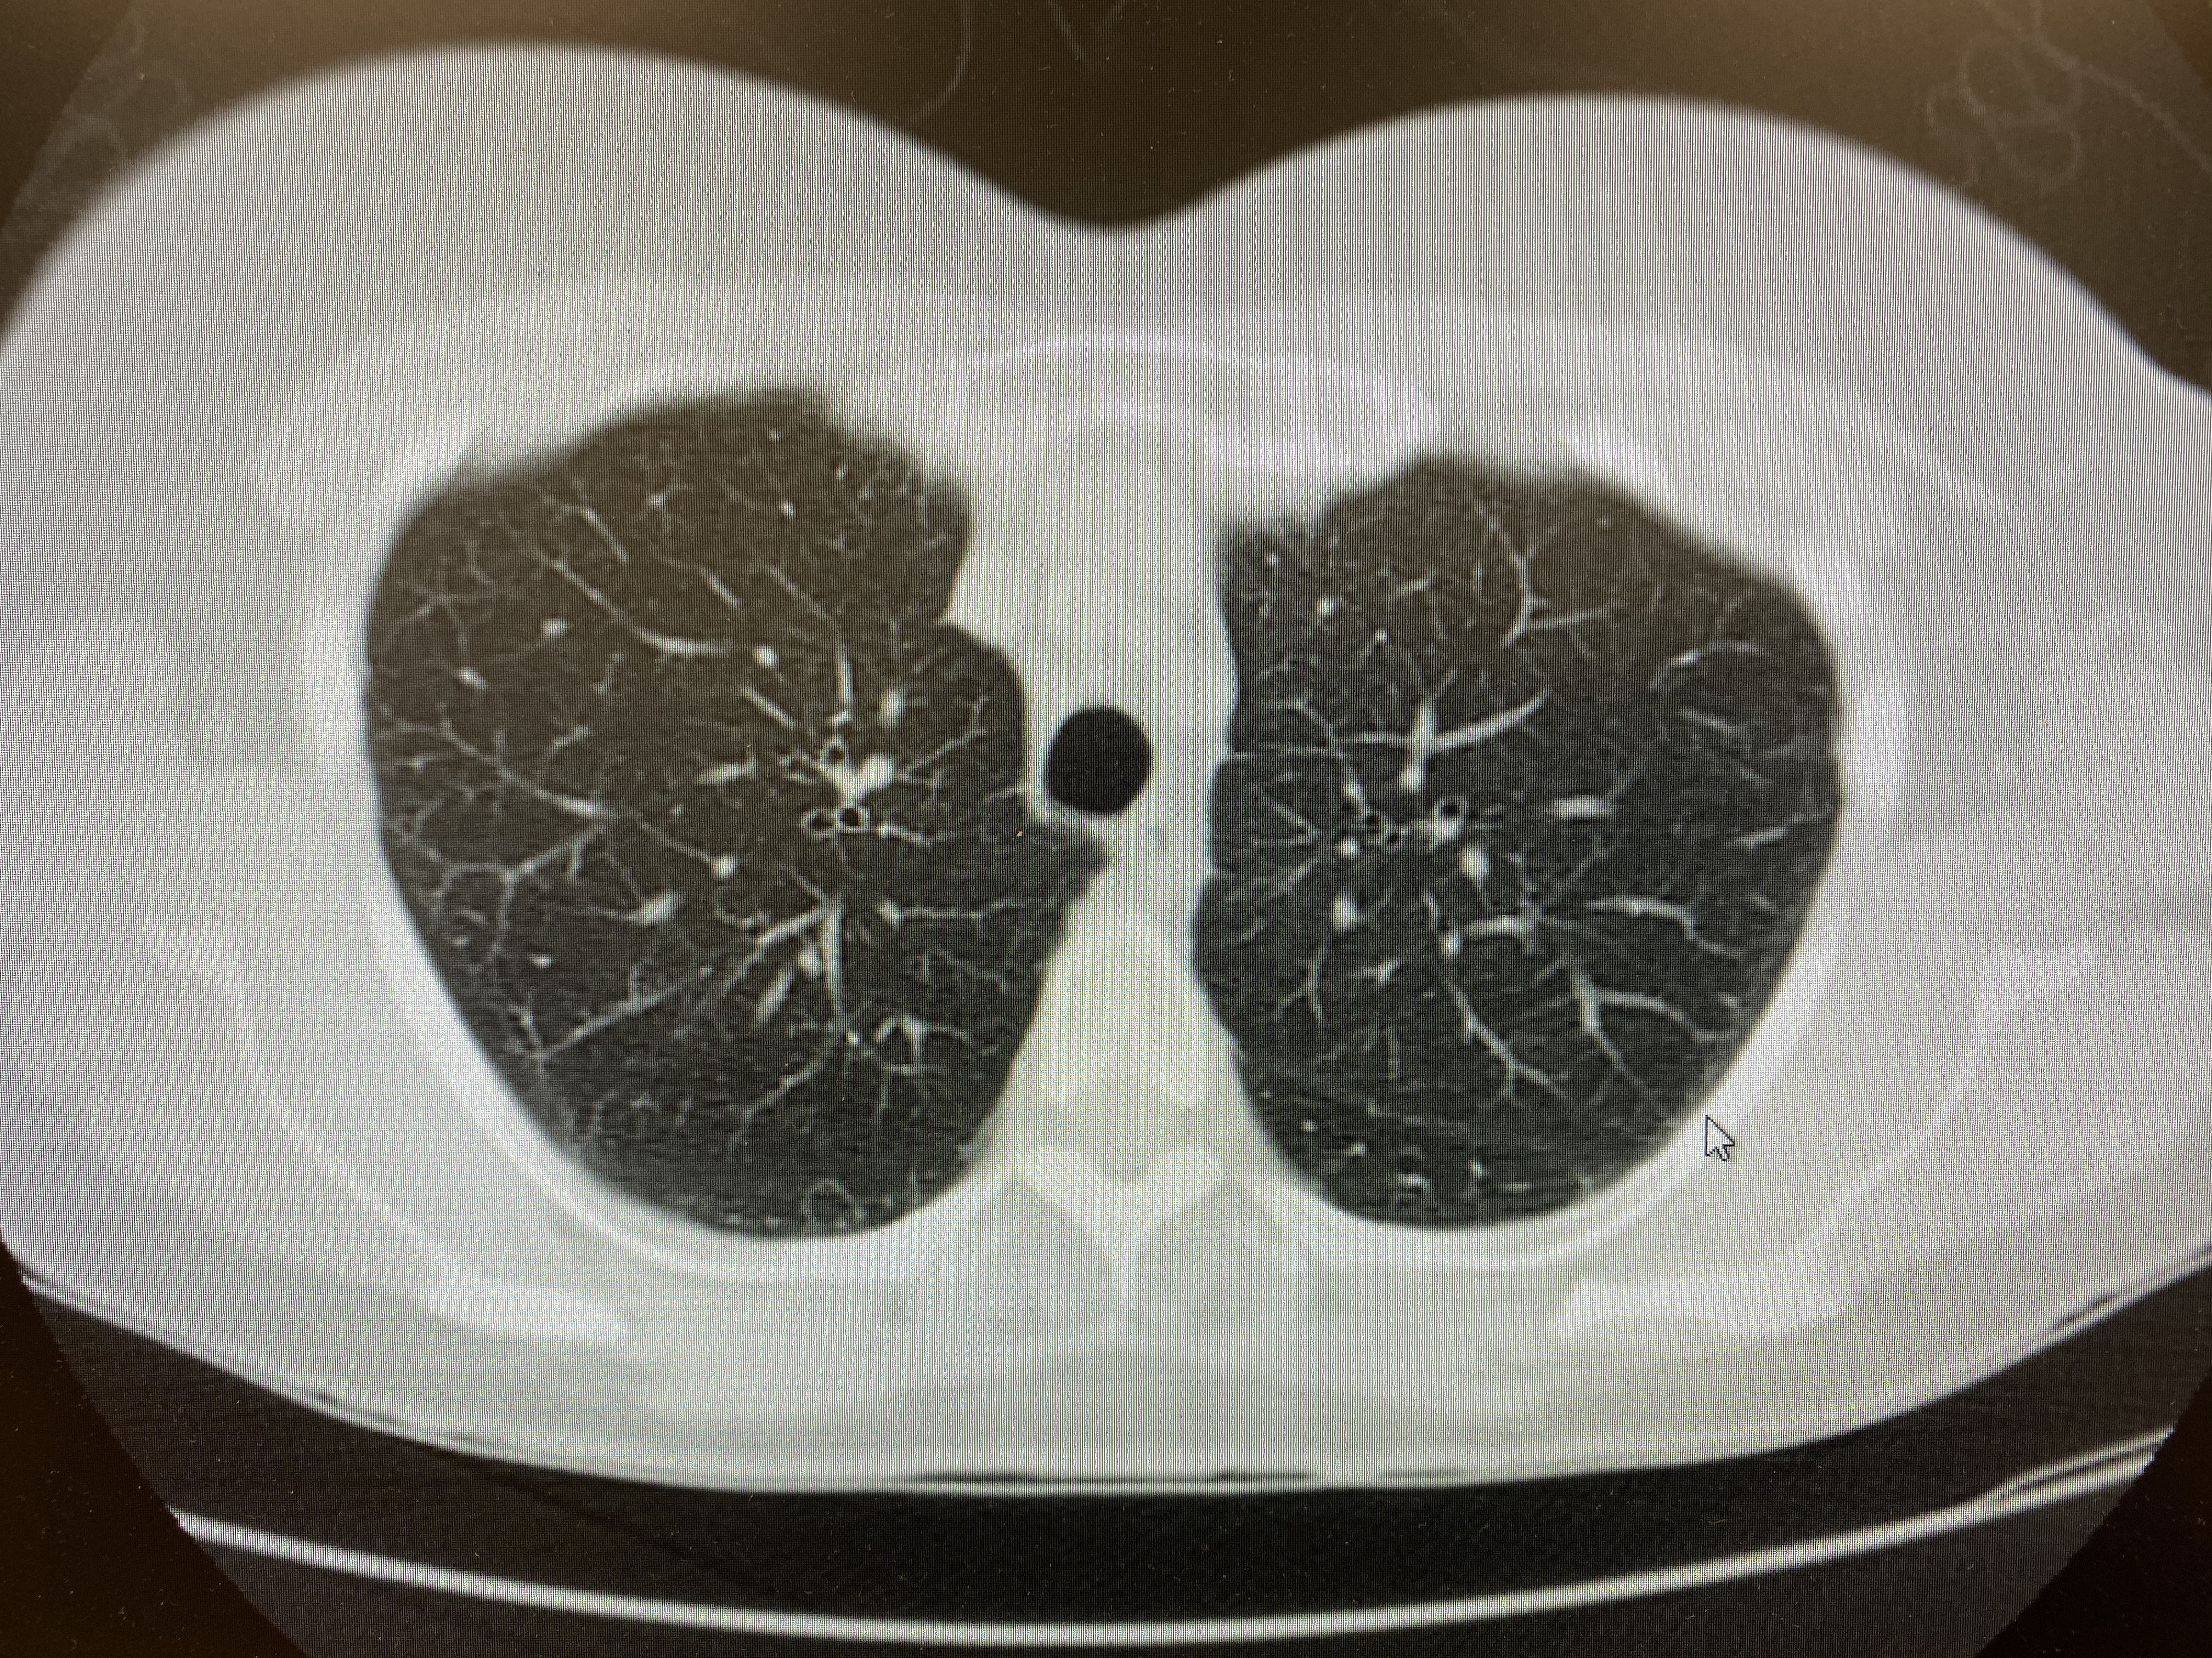
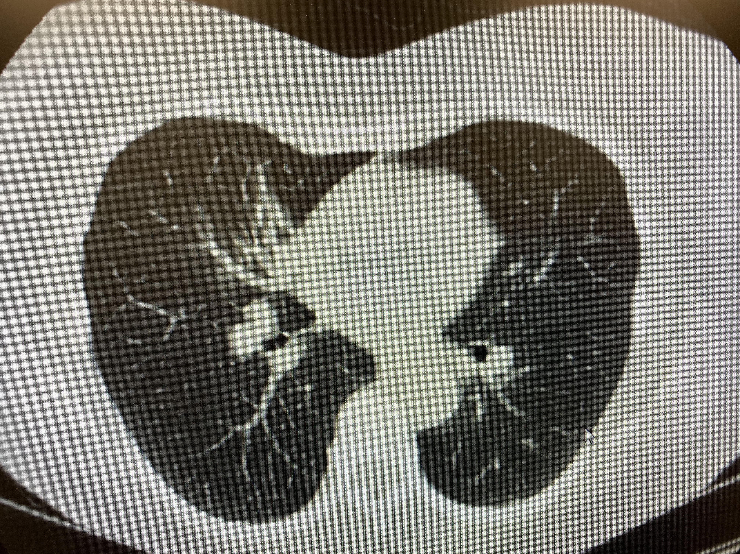
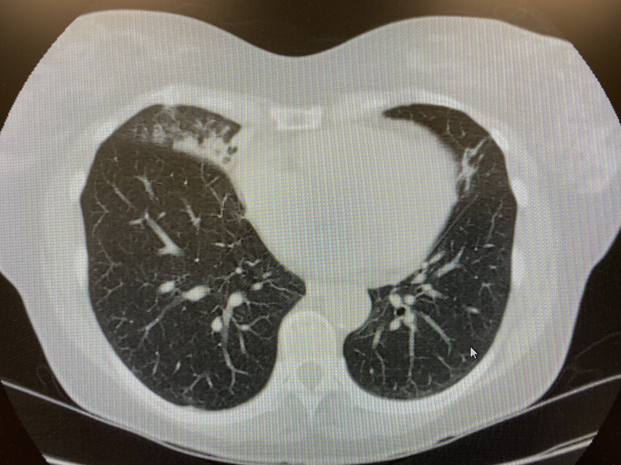
Bronchiectasis - case 2

Slide 44
Bronchiectasis - case 3
progressive dyspnea
55 year old referred by cardiology for evaluation of dyspnea
s/p right pneumonectomy age 11 for bronchiectasis
recurrent pneumonia as child and younger adult
echo: PAP 60-70 mm Hg
non-smoker
PFT’s: moderate airflow obstruction. 12% improvement in FEV1 post bronchodilator

Slide 45
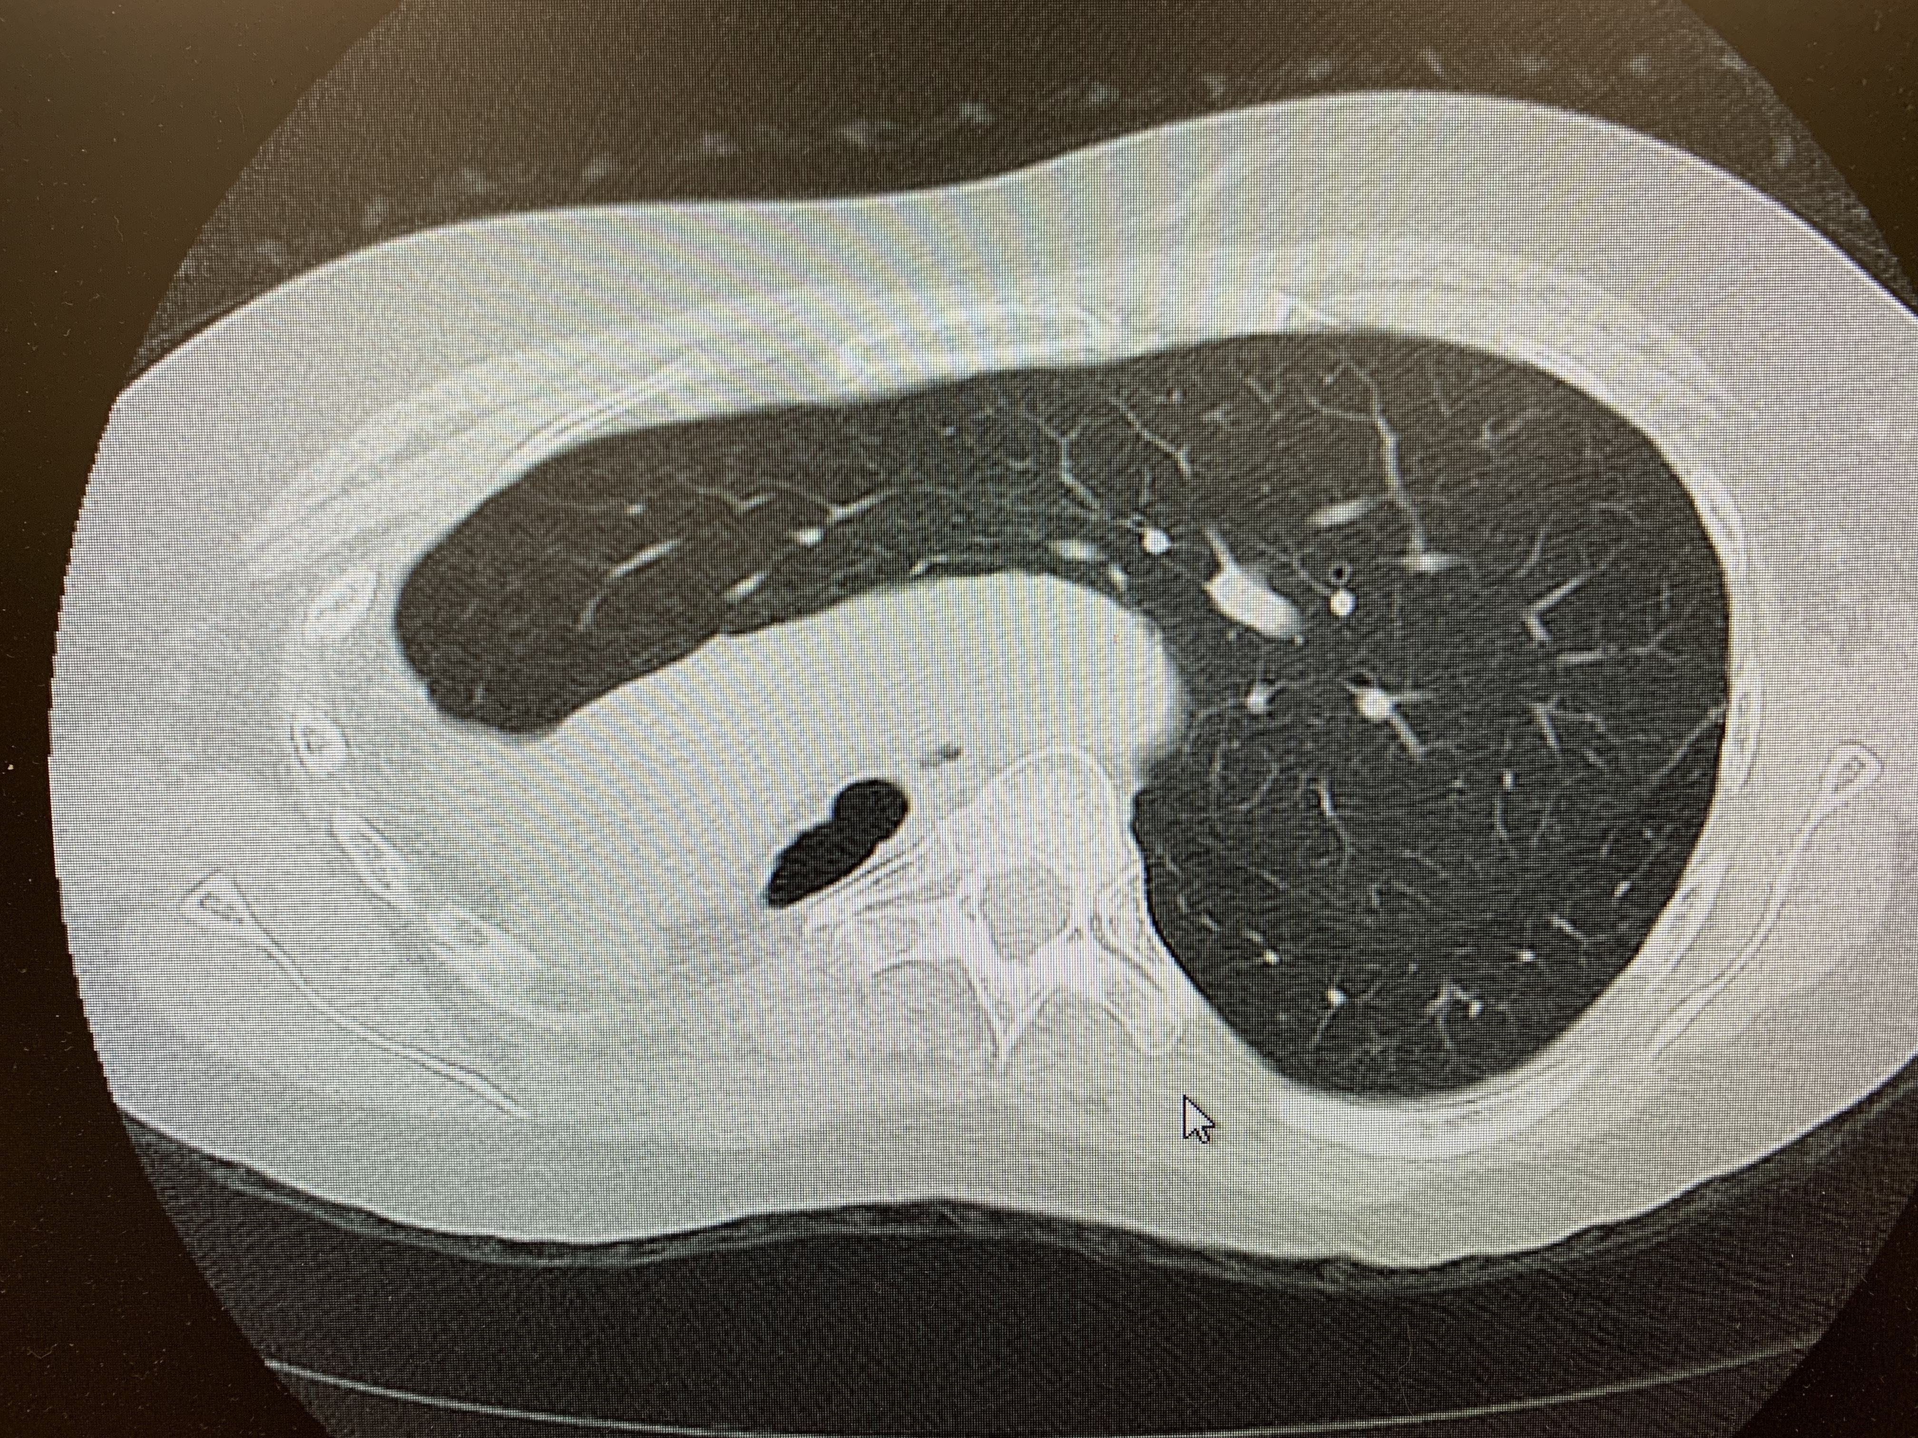
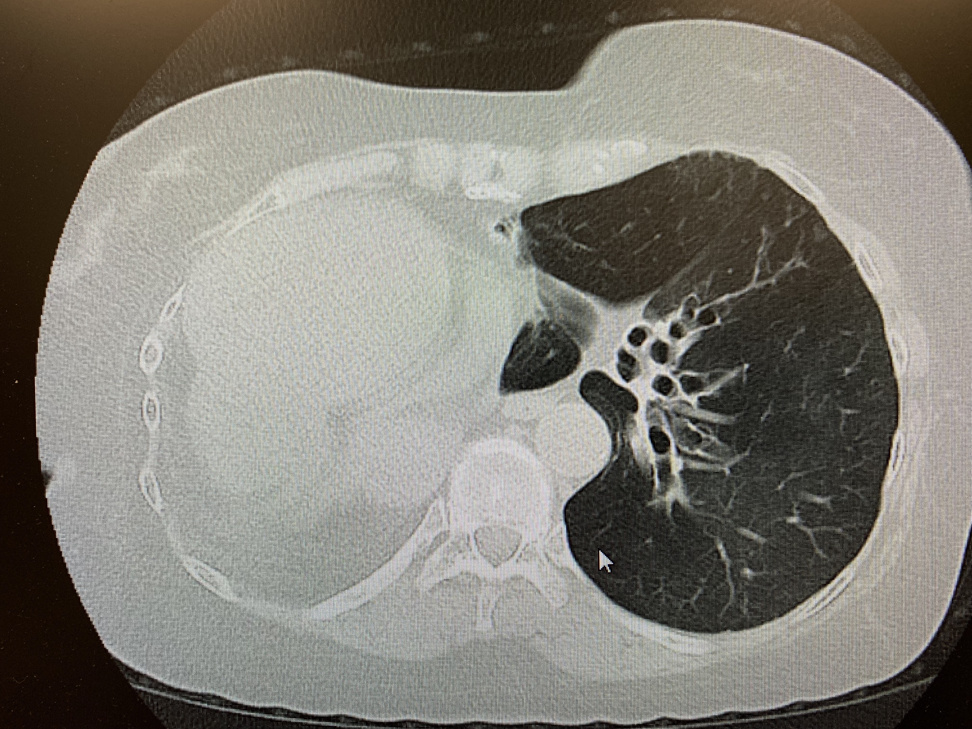
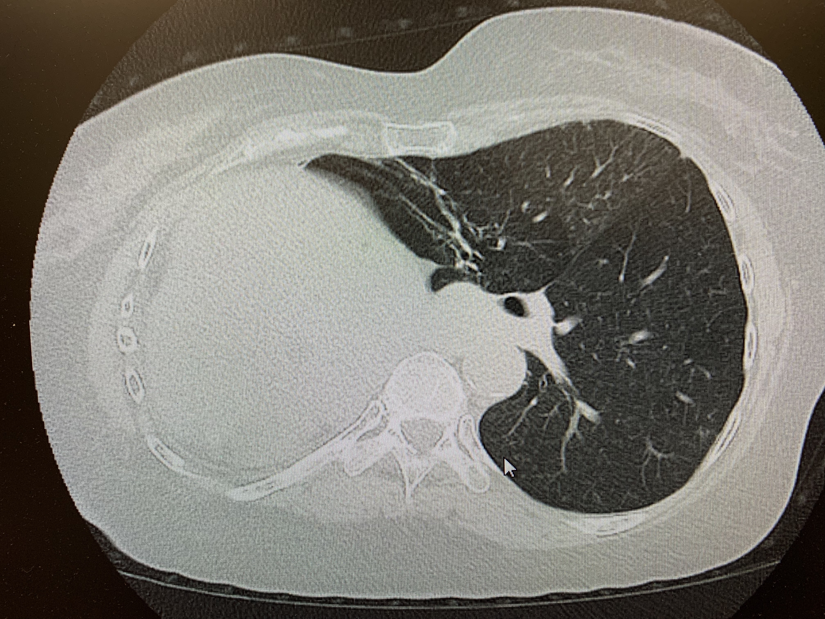

Slide 46
Case 3
causes of dyspnea
restrictive lung disease secondary to pneumonectomy
moderate air-flow obstruction - asthma
secondary pulmonary hypertension
aerobic de-conditioning
bronchitis/bronchiectasis

Slide 48
Investigations for causes of bronchiectasis
History (TB, RA, IBD,COPD, GERD, childhood illnesses)
CBC, IgE, Quantitative Immunoglobulins, Aspergillus precipitins, CF (if early onset, infertility, pancreatitis)
Sputum culture
Sputum for AFB smear and culture

Slide 49
Bronchiectasis: Treatment
Neutrophilic Inflammation
Macrolides
?Steroids
Structural Lung Disease
surgery
Abnormal Mucous Clearance
Airway Clearance
Aerobika
VEST
Bacterial Colonization/Infection
Antibiotics
systemic
inhaled

Slide 50
Macrolides and Inflammatory Lung Disease
Precedent for their use in other airways diseases: CF, Panbronchiolitis, post-transplant OB, COPD
Studies in non-CF bronchiectasis show reduce sputum volume and infectious exacerbations
Reducing exacerbations is a desirable endpoint
improved quality of life
decrease hospitalization and cost

Slide 51
Macrolides & Bronchiectasis
Macrolides have myriad anti-inflammatory and immunomodulatory properties
Inhibit mucus hyper secretion
Reduce IL-8 and neutrophil elastase
Inhibit neutrophil adhesion to epithelial cells
Inhibit biofilm formation

Slide 52
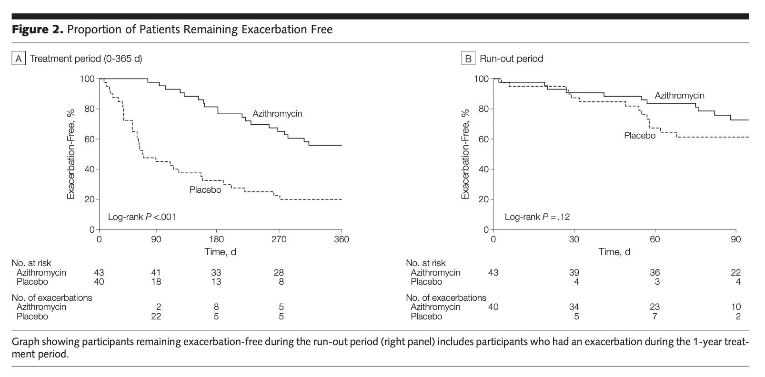
Effect of Azithromycin Maintenance Treatment on Infectious Exacerbations Among Patients With Non-Cystic Fibrosis Bronchiectasis
JAMA. 2013;309(12):1251-1259
Notes:
in placebo group 32/40 (80%) participants had at least one exacerbation during study period. In treatment group, 20/43 (46%) had one exacerbation. QOL scores better in rx group. no difference in adverse

Slide 53
Macrolides and Bronchiectasis
Target Patients
Frequent exacerbations (>2-3 per year)
Avoid in patients with suspected NTM infection; obtain sputum culture for AFB prior to initiating therapy
If patient is on chronic macrolide then periodic audiology exam

Slide 54
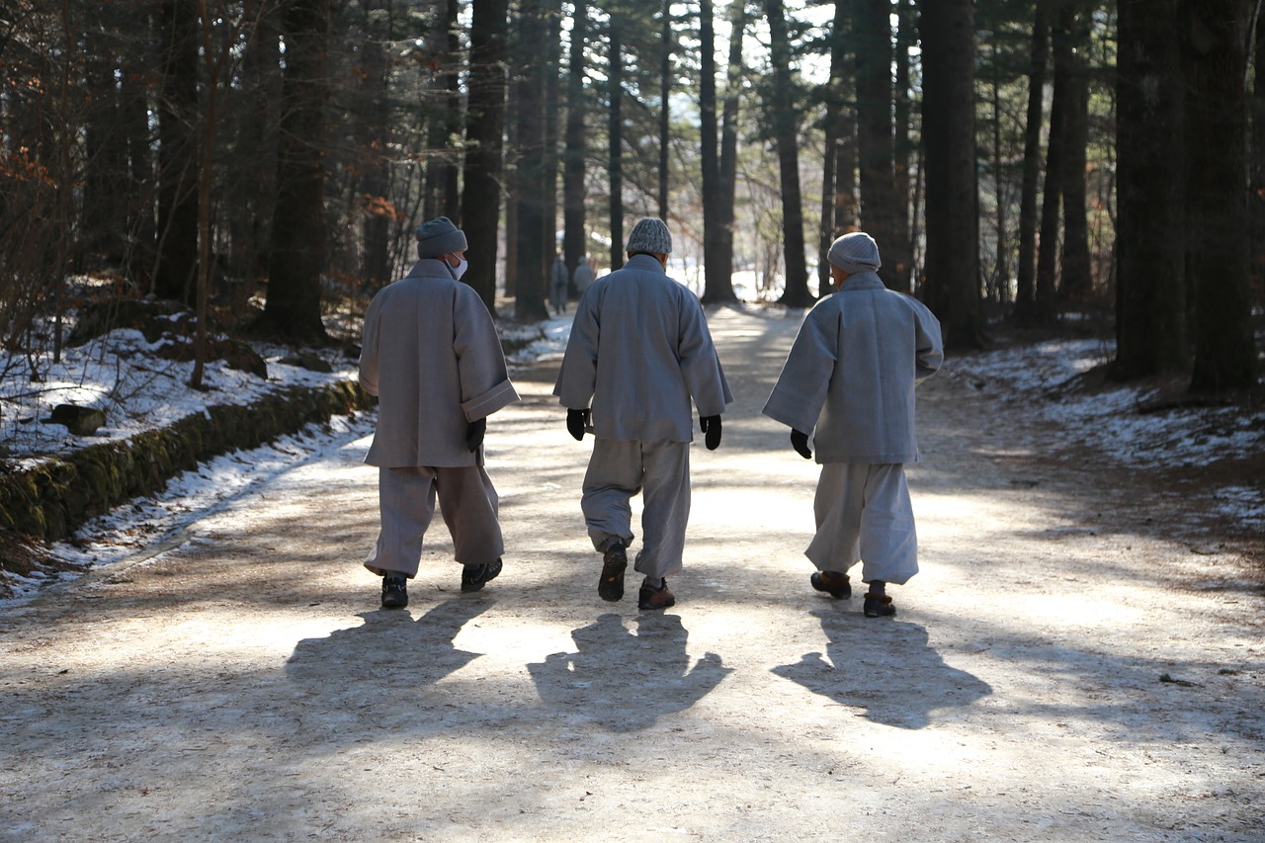
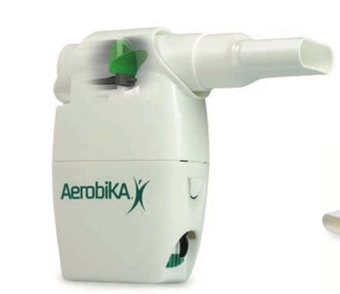
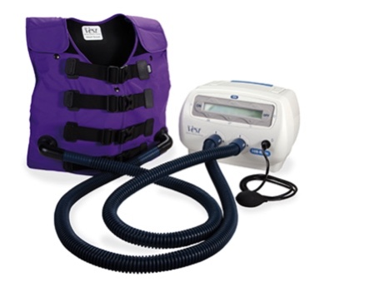
Bronchiectasis Treatment
Chest Physiotherapy
“I never saw an illness i couldn’t walk away from”

Slide 55
Definition of bronchiectasis exacerbation
Cough
Sputum volume and/or consistency
Sputum purulence
Breathlessness and/or exercise tolerance
Fatigue and/or malaise
Hemoptysis
Eur Respir J 2017;49

Slide 56
Bronchiectasis
Anti-inflammatory agents
Inhaled corticosteroids
No data to support routine use
Increased risk of NTM infection
? Increased risk of bronchomalacia

Slide 57
Bronchiectasis
Specific Therapy
Immunoglobulin replacement
Corticosteroids, itraconazole (ABPA)
Rx NTM (azithromycin/rifampin/ethambutol)

Slide 58
Surgery
Refractory or recurrent massive hemoptysis
Localized disease
Adjunct to medical therapy

Slide 59
Bronchiectasis Severity Index
Independent predictors of mortality
Older age
FEV1< 30%
Lower BMI
Prior hospitalization
3 or more exacerbations in previous year
American Journal of Respiratory and Critical Care Medicine Volume 189 Number 5: March 1 2014
Notes:
In the BSI model prior hospitalization was strongest predictor of future hospitalization risk. FEV1<30% predicted, colonization with pseudomonas, increased age, BMI < 18.5 and 3 or more exacerbations per year were all associated with higher mortality

Slide 61
Bronchiectasis: Summary
Bronchiectasis is common in our patient population
Contributes to decreased quality of life, and increased health care utilization and cost
We can improve recognition, transitions of care, and treatment through improved awareness and collaboration between health care providers

Slide 62
The Care of the Patient
The good physician knows his patients through and through and his knowledge is bought dearly. Time, sympathy and understanding must be lavishly dispensed, but the reward is to be found in that personal bond which forms the greatest satisfaction of the practice of medicine. One of the essential qualities of the clinician is interest in humanity, for the secret of the care of the patient is in caring for the patient
Francis W. Peabody, M.D. 1927

Slide 63
Quyana/Thank you
To our patients
Dr. Rosalyn Singleton
Dr. Dawn Sibanda

Slide 64
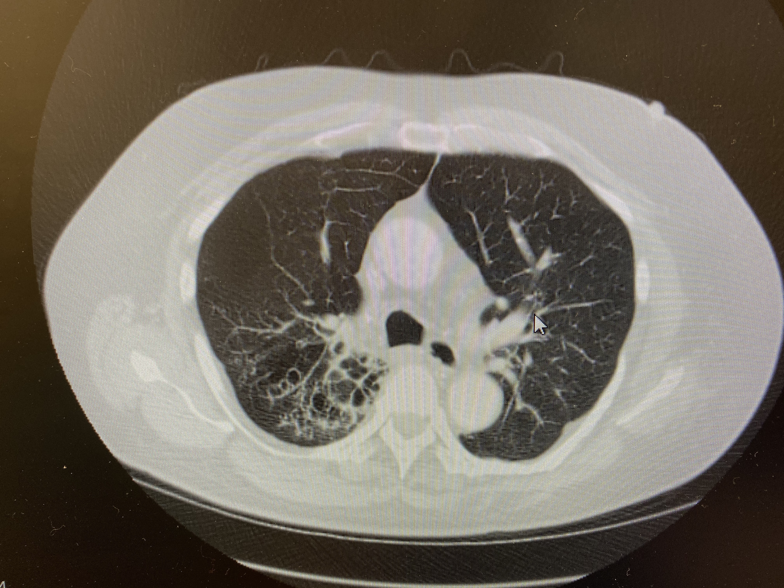
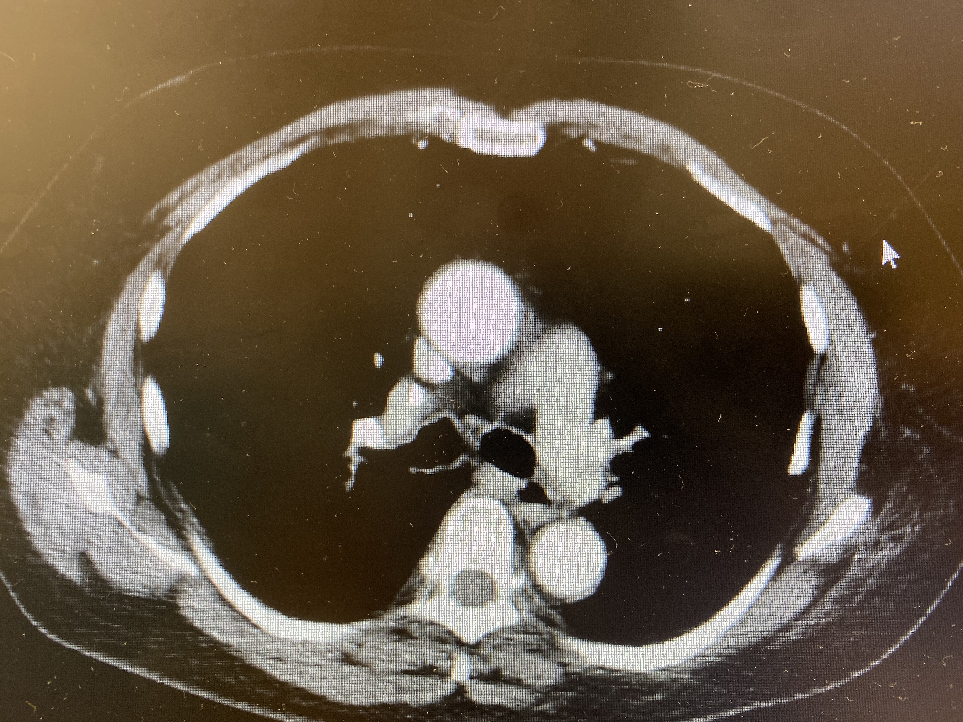
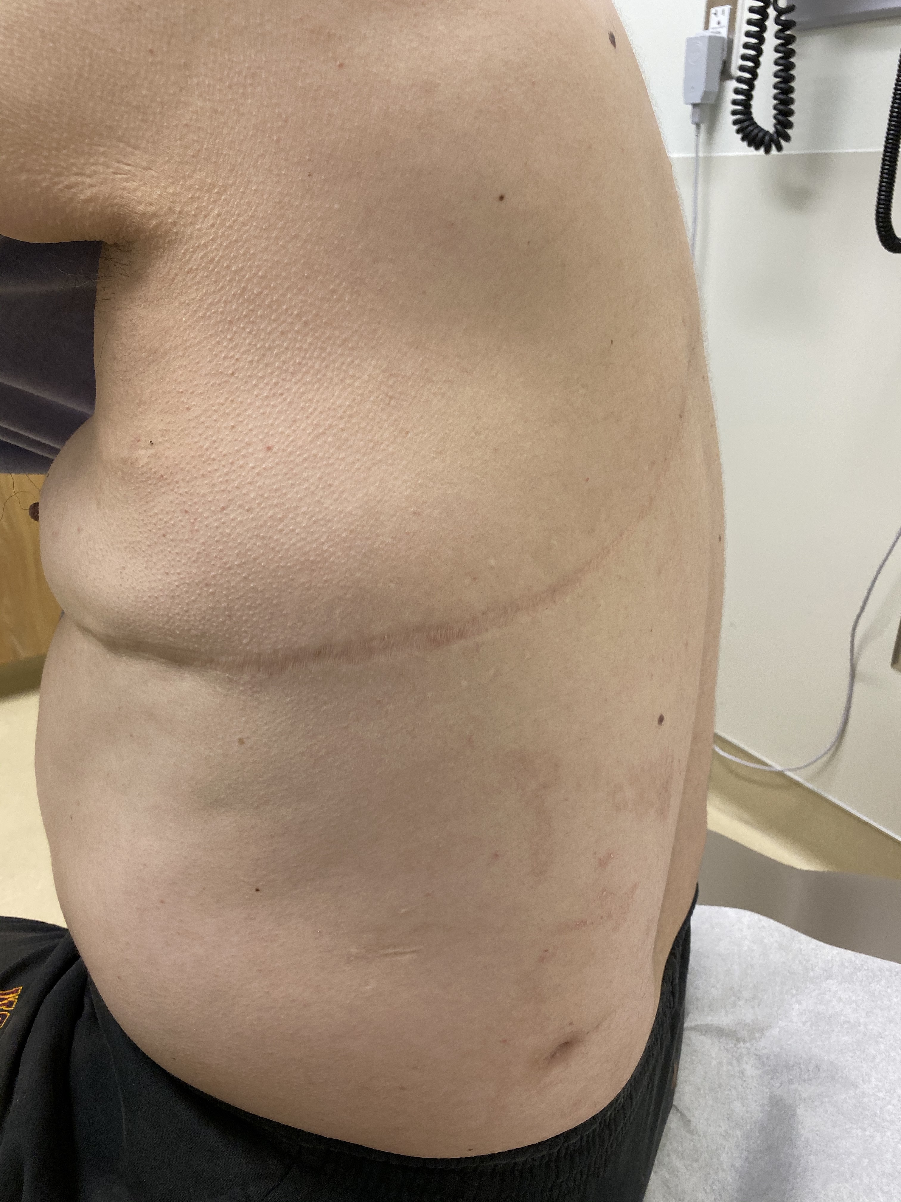
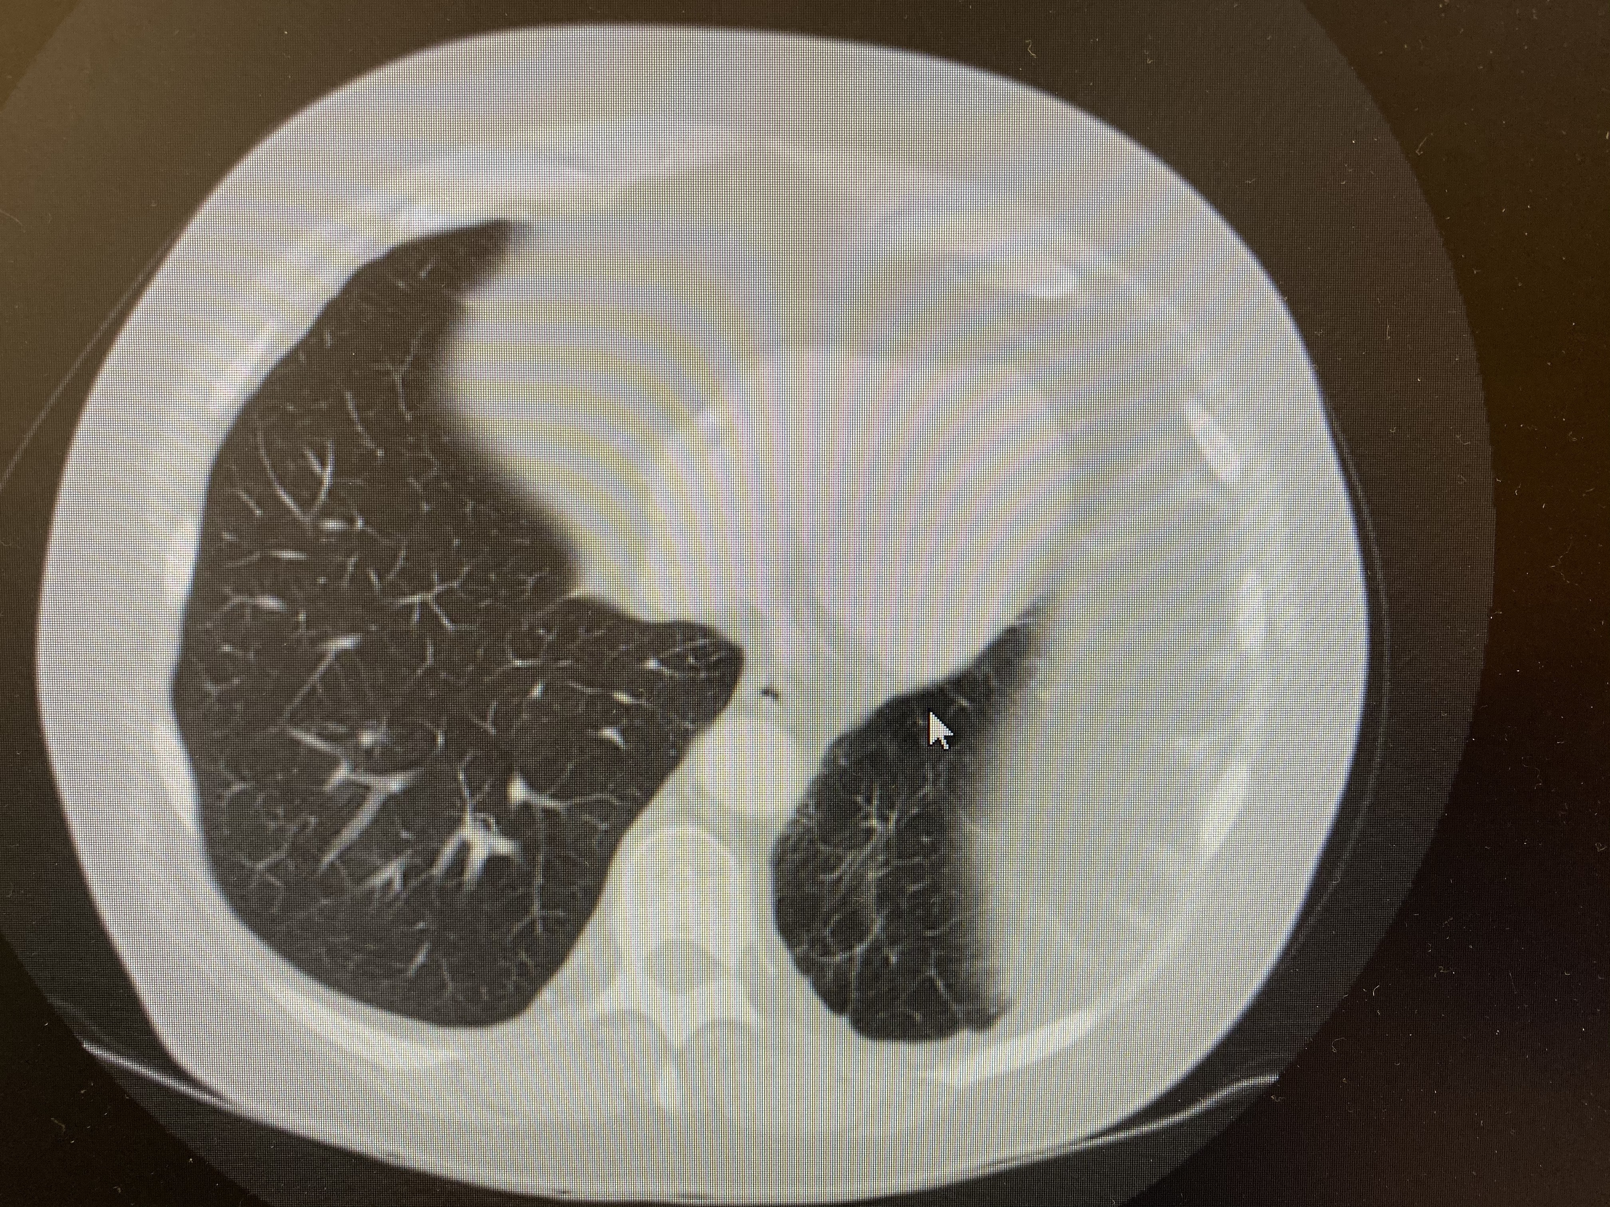
Bonus case
Dr. Hickam was right!

