Slide 1

Updates in Sepsis
Hallie Prescott, MD, MSc
Twitter: @HalliePrescott

Slide 2
Disclosures
I have no financial conflicts of interest.
Current funding:
US Dept of Veterans Affairs IIR 20-313
AHRQ R01 HS026725
Blue Cross / Blue Shield of Michigan
US CDC
Relevant roles:
Physician Lead, HMS-Sepsis (Statewide Sepsis Collaborative Quality Initiative)
Vice Chair, 2021 Surviving Sepsis Campaign Guidelines
This talk does not represent views of US government, Dept of Veterans Affairs, Surviving Sepsis Campaign, or any other organization.

Slide 3
Talk Outline and Objectives
What is sepsis and how is it defined operationally?
How can sepsis be identified quickly?
What’s new in (and since) the 2021 Surviving Sepsis Campaign Guidelines?
What I tell my team

Slide 4
What is sepsis?
“Sepsis is a life-threatening complication of infection that arises when the body’s response to infection injures its own tissues and organs.”
Singer, et al. JAMA, 2016

Slide 5

What is sepsis?
Boundary?
Microbial
Colonization
Septic
Shock
Infection
Sepsis
Body accepts microbe.
Body view microbe as a problem.
Body’s response to microbe causes collateral damage, and the damage continues even after the microbe is eradicated.

Slide 6
How is sepsis defined?
From Greek word sipsi “to make rotten” or sepo “I rot”
Found in poems of Homer (800 BC)
Found in writings of Hippocrates (400 BC)

Slide 7
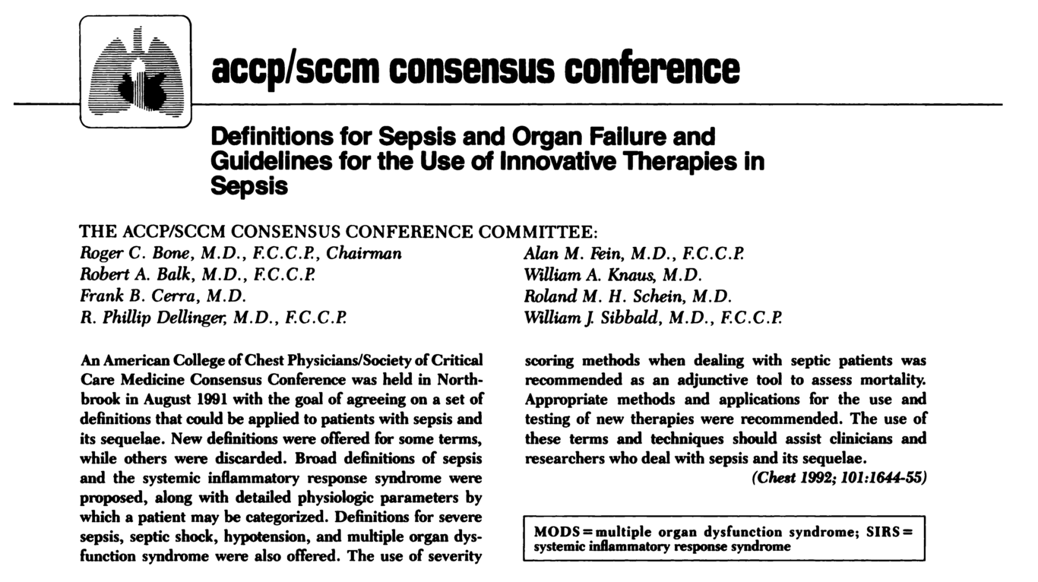

First “modern” definition in 1992 (Sepsis-1)
“Too much inflammation”

Slide 8
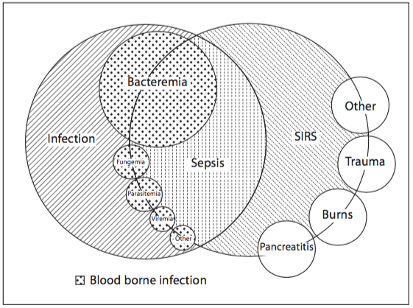
“Systemic Inflammatory Response Syndrome” (SIRS)
A systemic inflammatory response seen following a wide variety of insults:
2 or more:
Temperature <36C or >38C
Heart Rate >90
Respiratory Rate >20
WBC <4 or >12

Slide 9
SIRS
Sepsis
Severe Sepsis
Septic Shock
2+ abnormalities: temperature, heart rate, respirations, white blood cells
SIRS + infection
Sepsis + acute organ dysfunction
(delirium, hypoxia, AKI, etc.)
Severe Sepsis, where acute organ dysfunction includes inadequate organ perfusion.

Slide 10
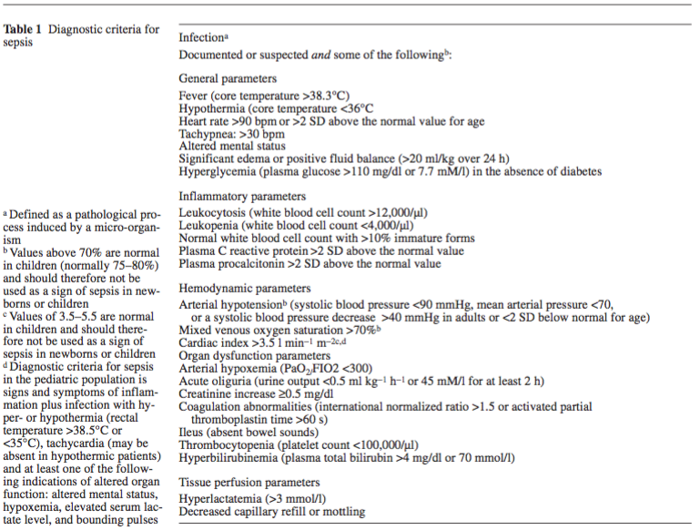
Little changed with Sepsis-2
4 SIRS criteria replaced by a long list of diagnostic criteria
“Too much inflammation”

Slide 11
Larger conceptual changes with Sepsis-3
Sepsis is life-threatening organ dysfunction caused by a dysregulated host response to infection.
SIRS no longer included in the definition because SIRS may simply reflect an appropriate host response. The term “severe sepsis” therefore becomes superfluous.
(Note: “SIRS criteria will continue to aid in the general diagnosis of infection”).
Limitation: No definition for “dysregulated” host response; I prefer “injurious”.

Slide 12
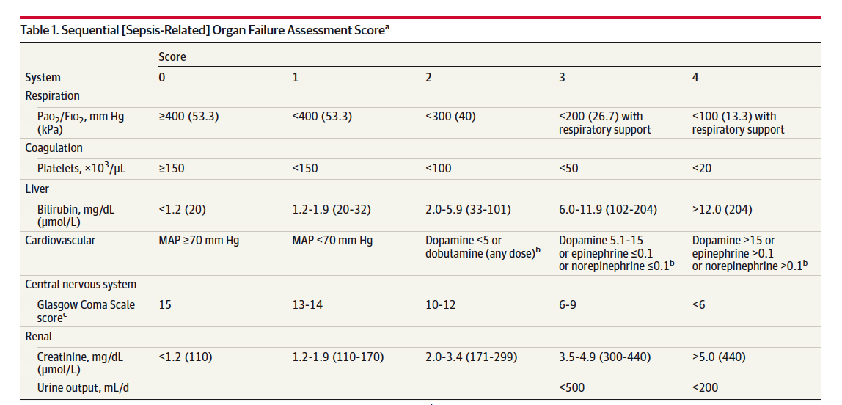
Life-threatening acute organ dysfunction = 2+ new SOFA points

Slide 13
Summary of sepsis definitions over time
 | Sepsis-1 | Sepsis-2 | Sepsis-3
Sepsis | Infection + SIRS | Infection + expanded SIRS criteria | Infection + acute organ dysfunction (suggest 2+ SOFA points)
Severe Sepsis | Sepsis + acute organ dysfunction | Sepsis + acute organ dysfunction
Septic Shock | Sepsis + hypoperfusion | Sepsis + hypoperfusion | Sepsis + hypotension + lactate > 2

Slide 14
Interim Summary
Sepsis is life-threatening acute organ dysfunction due to infection.

Slide 15
Talk Outline and Objectives
What is sepsis and how is it defined operationally?
How can sepsis be identified quickly?
What’s new in and since the 2021 Surviving Sepsis Campaign Guidelines?
What I tell my team

Slide 16
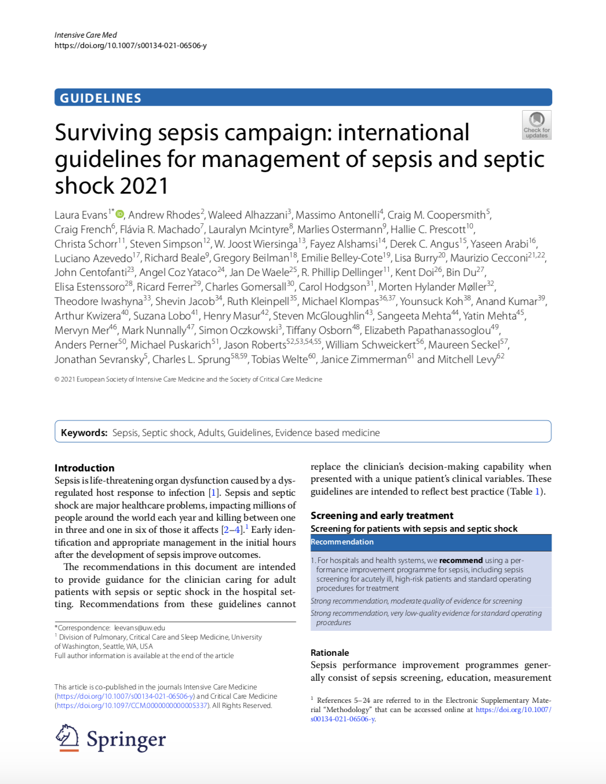
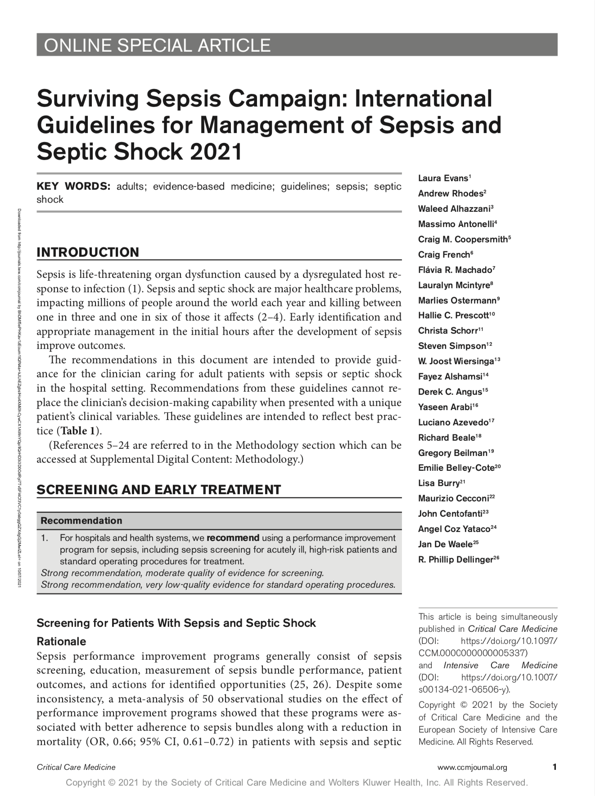
For hospitals and health systems … we recommend sepsis screening for acutely ill, high-risk patients.
No specific screening tool is recommended
We recommend against qSOFA as opposed to SIRS, MEWS, or NEWS as a single screening tool for sepsis.

Slide 17


qSOFA: a tool to rapidly identify infected patients at highest risk for a poor outcome, good for triage not for screening
GCS<15
RR≥22
SBP<100
qSOFA 2-3:
24% of infected patients
70% of poor outcomes

Slide 18
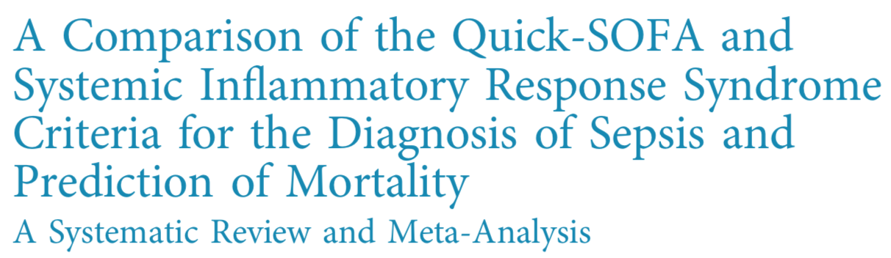
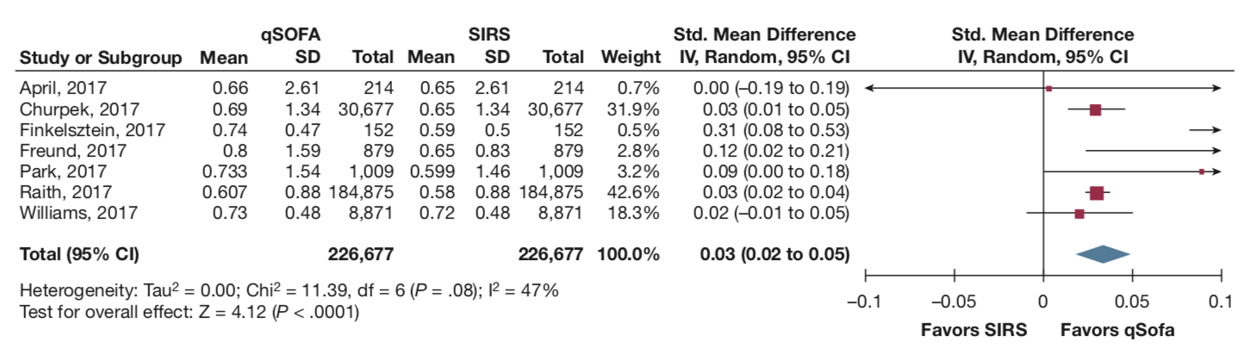
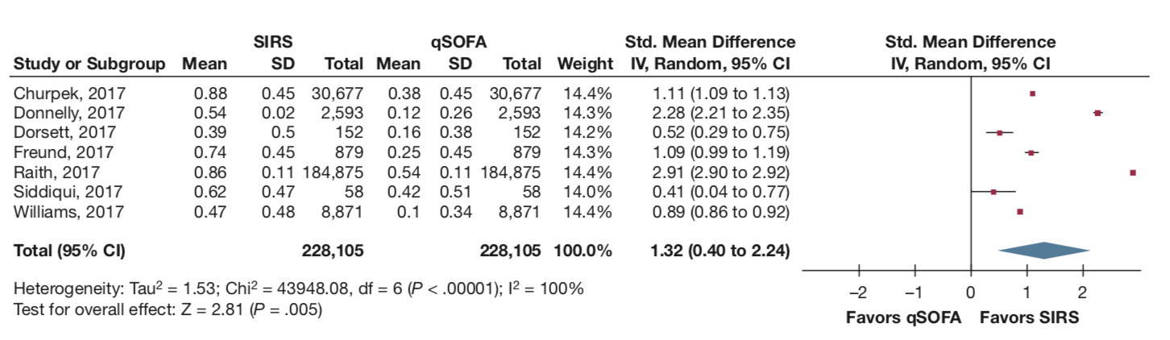
Identifying Sepsis: SIRS > qSOFA
Predicting mortality: qSOFA > SIRS
Mortality
Sepsis

Slide 19
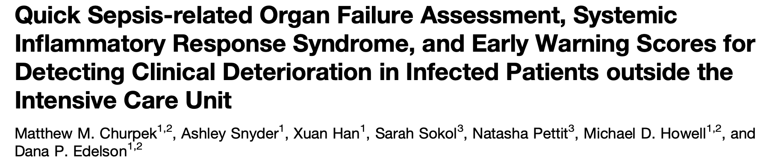
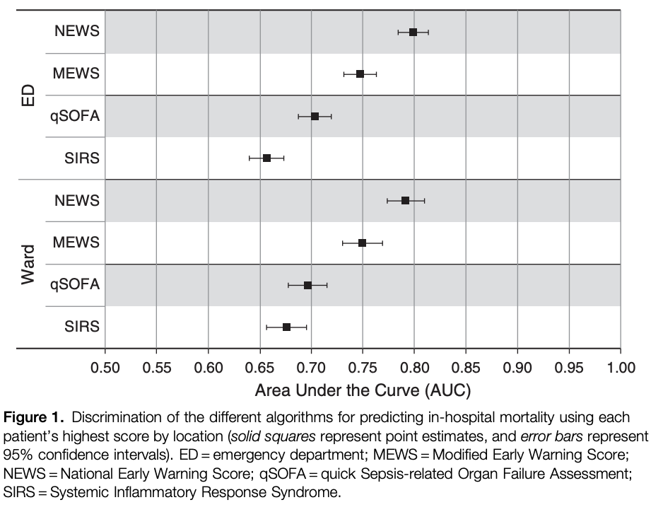
NEWS
RR
SpO₂
Supplemental O₂
Temperature
SBP
HR
AVPU (mental status)

Slide 20
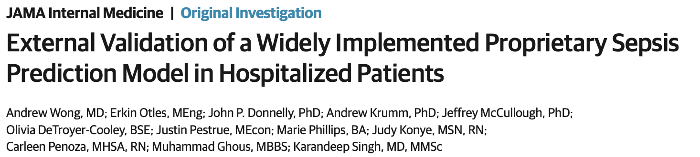
Poor discrimination and calibration for predicting sepsis onset
18% of hospitalized patients have a sepsis alert
67% of sepsis cases did not have an alert prior to sepsis onset

Slide 21
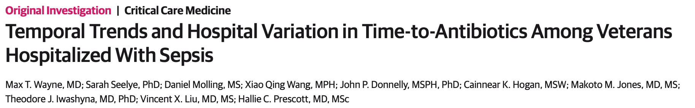
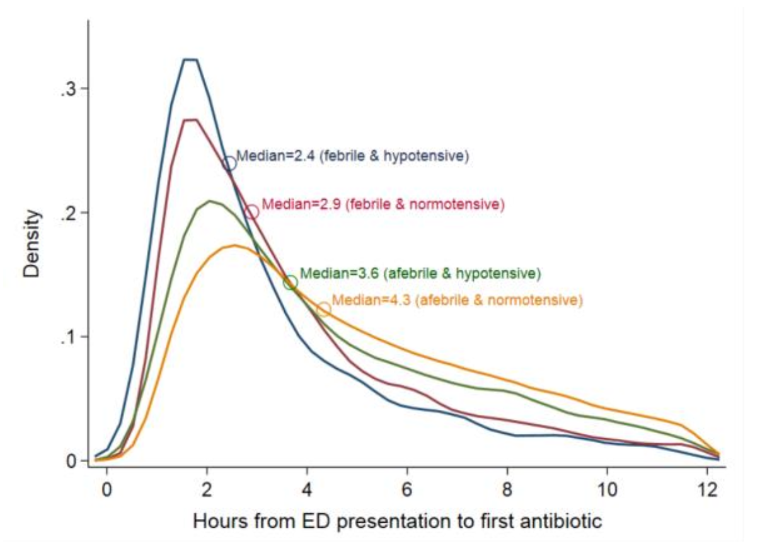
In nationwide VA patients meeting CDC surveillance criteria for sepsis:
Antibiotic timing was faster for febrile & normotensive, as compared to afebrile& hypotensive.

Slide 22
Interim Summary
Infection
Acute Organ Dysfunction
Existing clinical deterioration scores (NEWS) perform well in infected patients.
Sepsis prediction scores do not perform well.
Sepsis should be considered in the context of both infection and unexplained acute organ dysfunction.
Altered mental status, elevated RR, and low BP are strongest predictors of poor outcome.
Is infection-related acute organ dysfunction present?
Could organ dysfunction be due to infection?

Slide 23
Talk Outline and Objectives
What is sepsis and how is it defined operationally?
How can sepsis be identified quickly?
What’s new in and since the 2021 Surviving Sepsis Campaign Guidelines?
  Background on SSC recommendation process / implications
  5 recs: Antimicrobial timing, fluid type, fluid volume, peripheral initiation of vasopressors, steroids in septic shock
What I tell my team

Slide 24
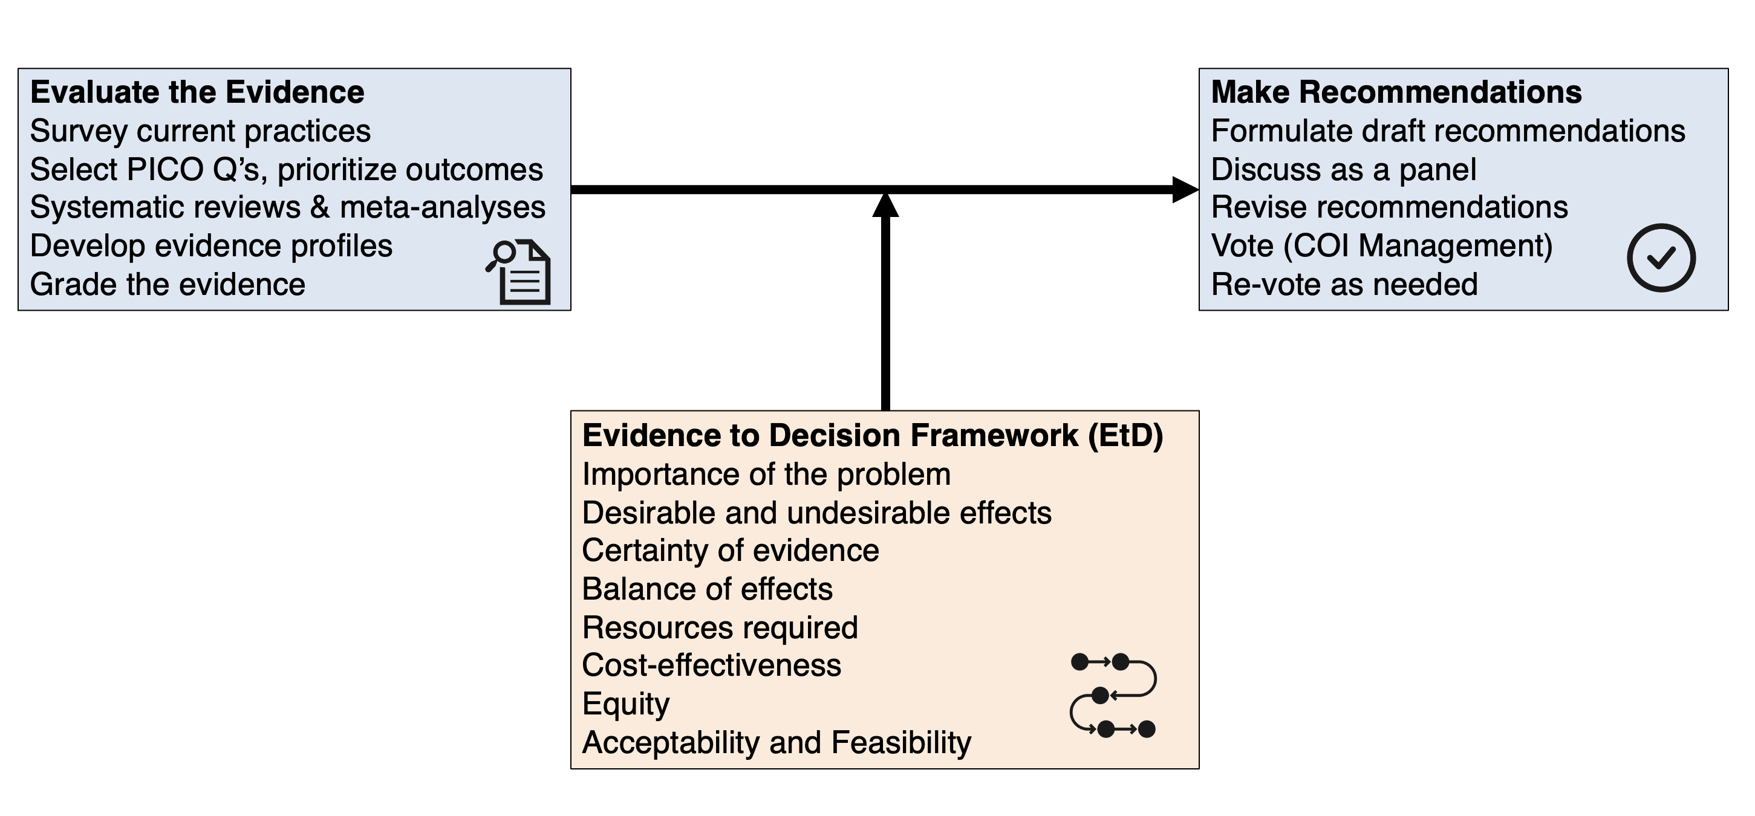

A little background on SSC methods…

Slide 25
A little background on SSC methods…
Strong (BPS or Strong Graded): Should be done always or nearly always (95%).
Weak: Should be the default (66%).
Recommendations are more likely to be weak when:
certainty of evidence is low
close balance between desirable and undesirable effects
variation or uncertainty in patient values and preferences
interventions require considerable resources

Slide 26
Breakdown of 93 statements in 2021 SSC Guidelines
Topic
Type

Slide 27
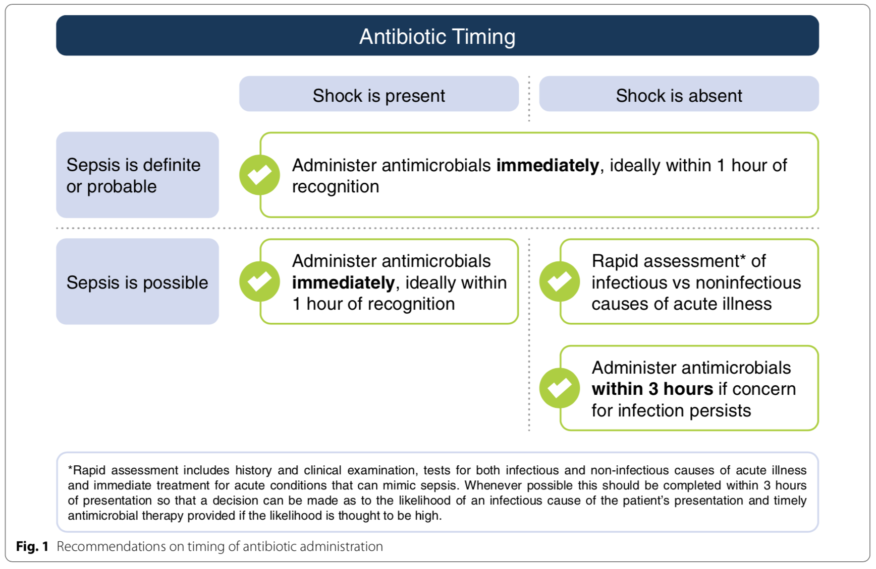
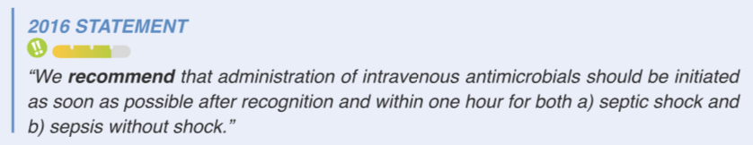
Antimicrobial timing

Slide 28



Background for antimicrobial timing recs
Time-to-antibiotics matters, particularly for patients in shock
Diagnostic uncertainty is common in practice
Seymour, et al. NEJM. 2017
Liu, et al. AJRCCM. 2017
Peltan, et al. Chest. 2019
Klein Louwenberg, et al. Crit Care, 2015.
Rhee, et al. Crit Care, 2016.
Shappell, et al. Crit Care Med, 2021.

Slide 29






Concerns about driving overuse and resistance

Slide 30
Concerns about driving overuse and resistance
“time-to-antibiotic targets risk promoting antibiotic overuse and antibiotic-associated harms”

Slide 31

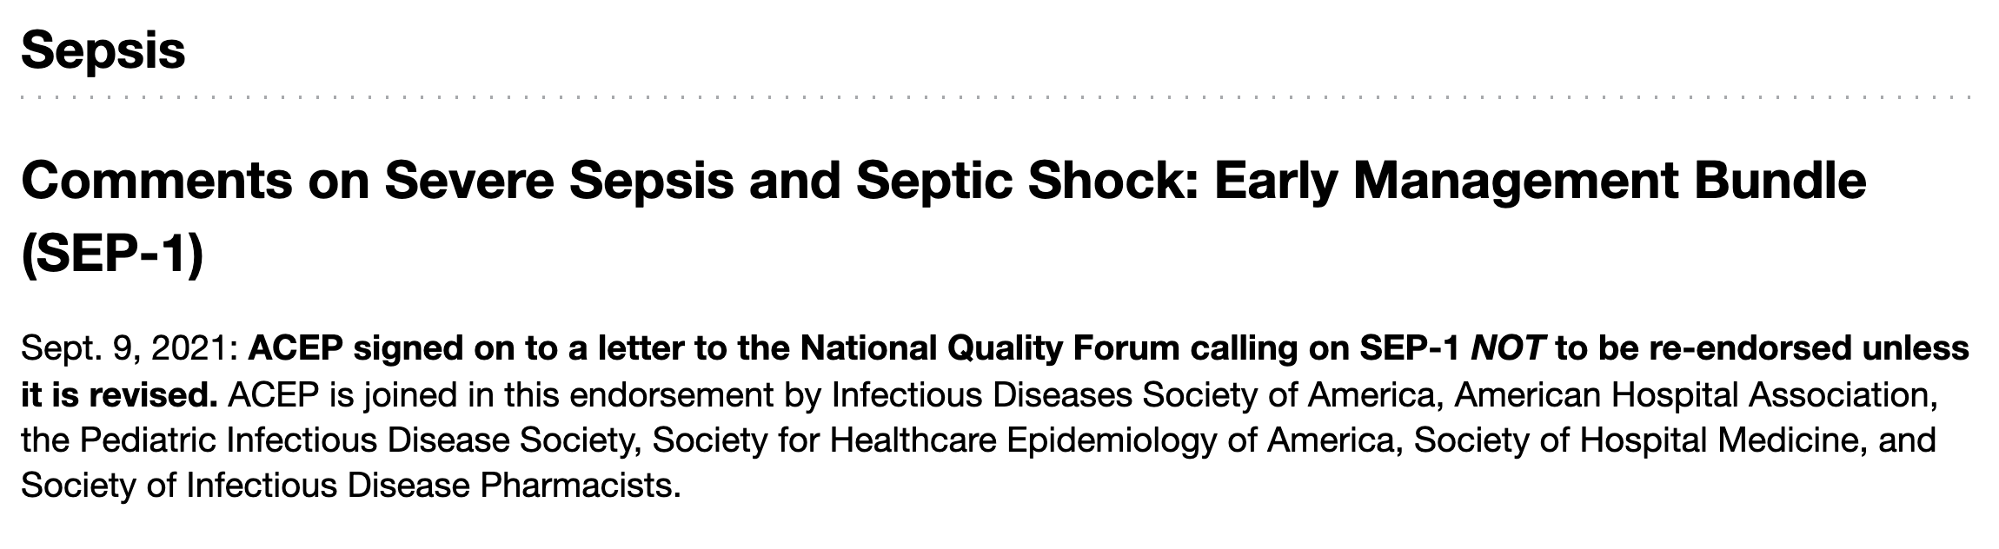

Slide 32

Urgent unanswered question
Is our focus on early antibiotics in sepsis actually driving overuse?

Slide 33
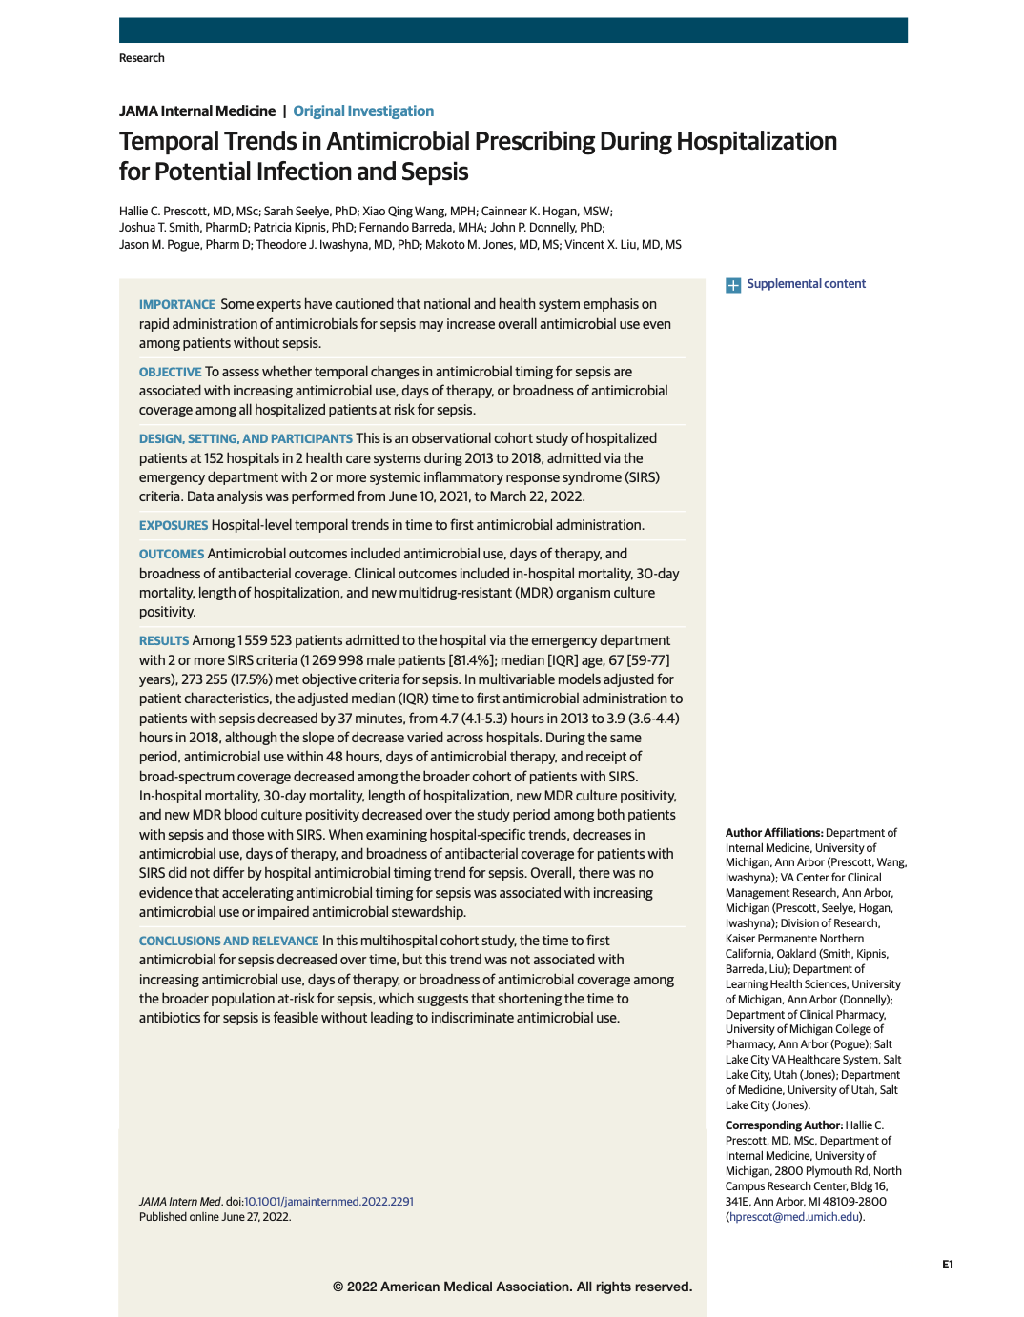
Urgent unanswered question
When hospitals accelerate timing of antibiotics for sepsis, do they prescribe more or broader antibiotics?
Prescott, et al. JAMA Internal Medicine, 2022.

Slide 34
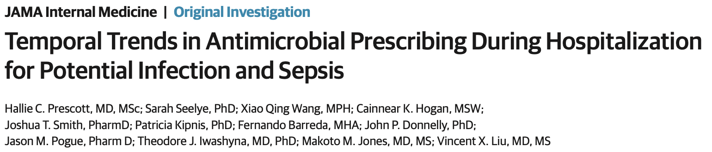
Trends in 152-hospital cohort (2013 to 2018)
Time-to-antimicrobial for sepsis declined (by 37 minutes)
Antibiotics within 48 hours in all SIRS-positive declined (by 0.3%)
Days of therapy in all SIRS-positive declined (by 0.6 days)
Use of broad-spectrum coverage in all SIRS-positive dec. (by 2-4%)
Prescott, et al. JAMA Internal Medicine. 2022.
Notes:
Hospital-specific trends were in antimicrobial timing for sepsis were not associated with rising antimicrobial use or impaired stewardship.

Slide 35
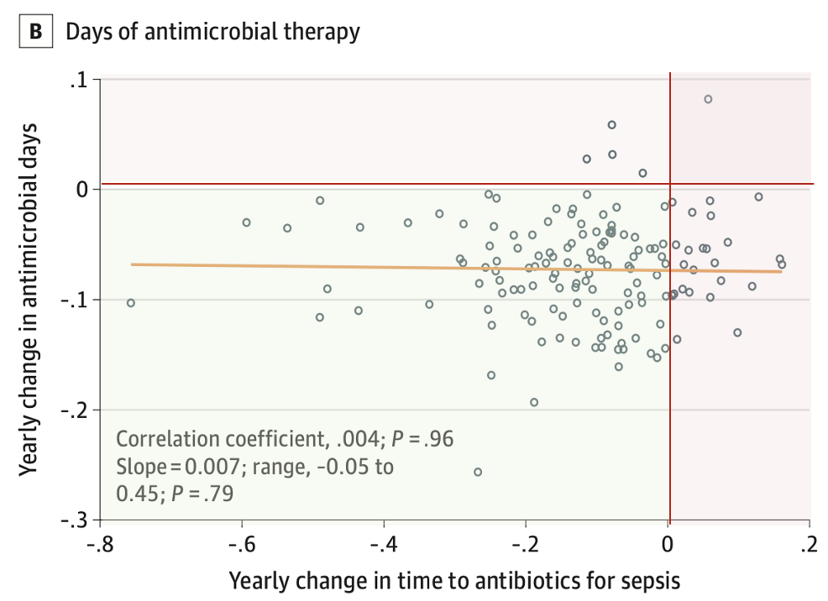
Most hospitals had concurrent improvements
It is feasible to simultaneously shorten time-to-antibiotic for sepsis and improve stewardship.
Faster antibiotics for sepsis did not drive indiscriminate antibiotic use.
Faster antibiotics for sepsis did not impair stewardship.
Prescott, et al. JAMA Internal Medicine. 2022.

Slide 36
Antimicrobial timing

Slide 37
Real-world practice in Michigan
Among patients with non-viral community-onset sepsis who present with hypotension, how many receive antibiotics within 3 hours of presentation?

Slide 38
Fluid type

Slide 39
Fluid type
Evans, et al. Intensive Care Medicine, 2021.
Evans, et al., Critical Care Medicine, 2021.

Slide 40
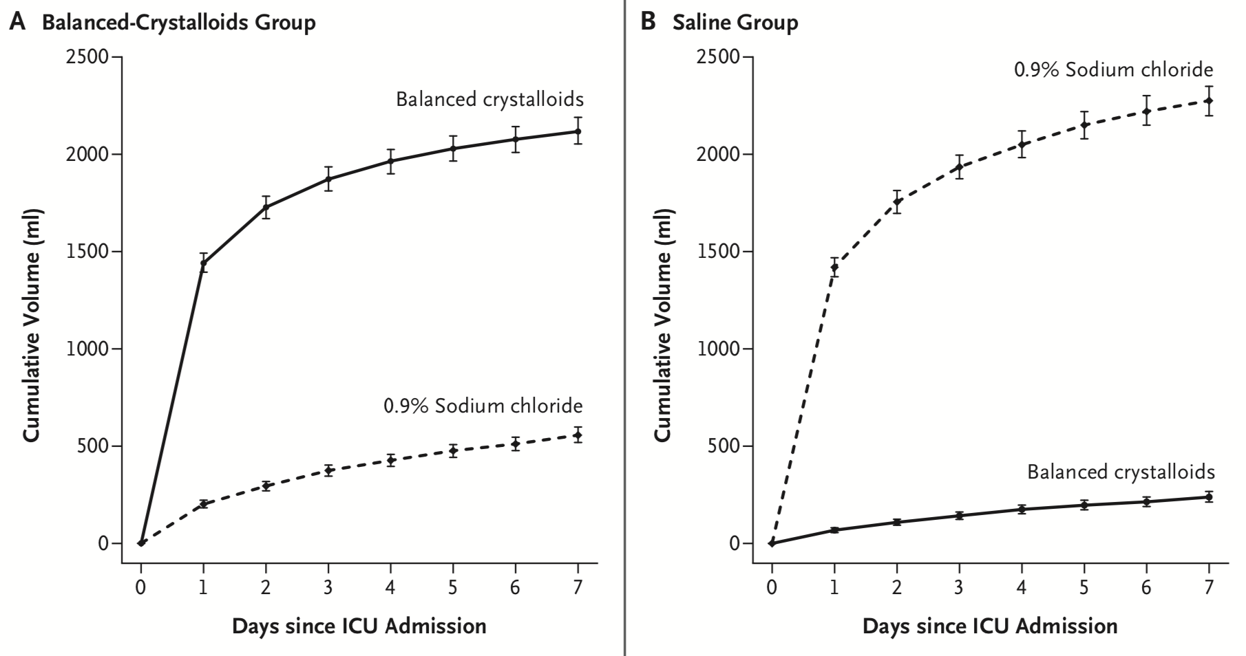
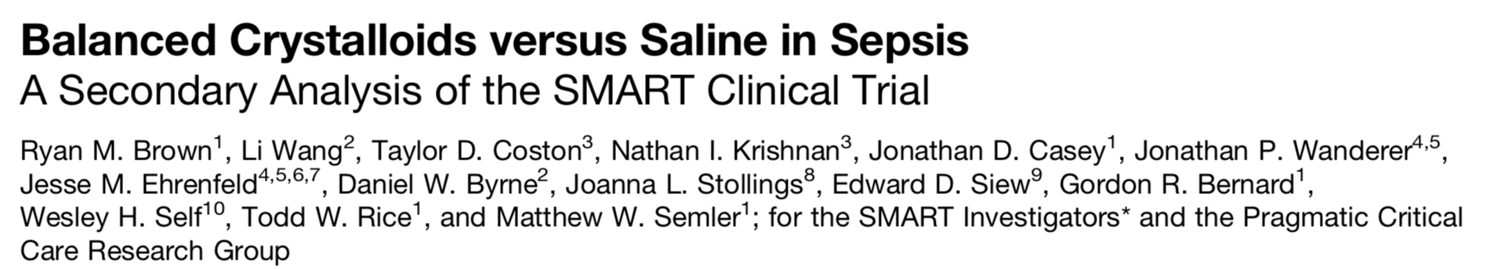
Fluid type
Feasible to give majority balanced fluid
Associated with mortality benefit
26.3% vs 31.2% in-hospital mortality
4.9% absolute risk reduction
aOR 0.74 (0.59, 0.93)
Semler, et al. NEJM, 2018.
Brown, et al. AJRCCM, 2019.

Slide 41
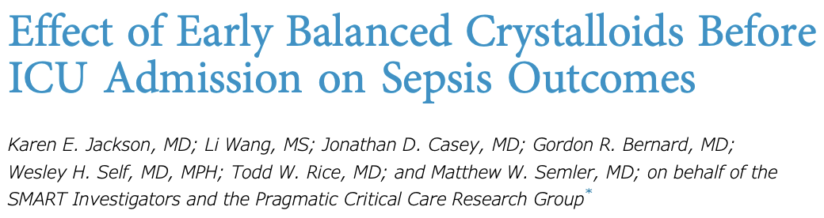
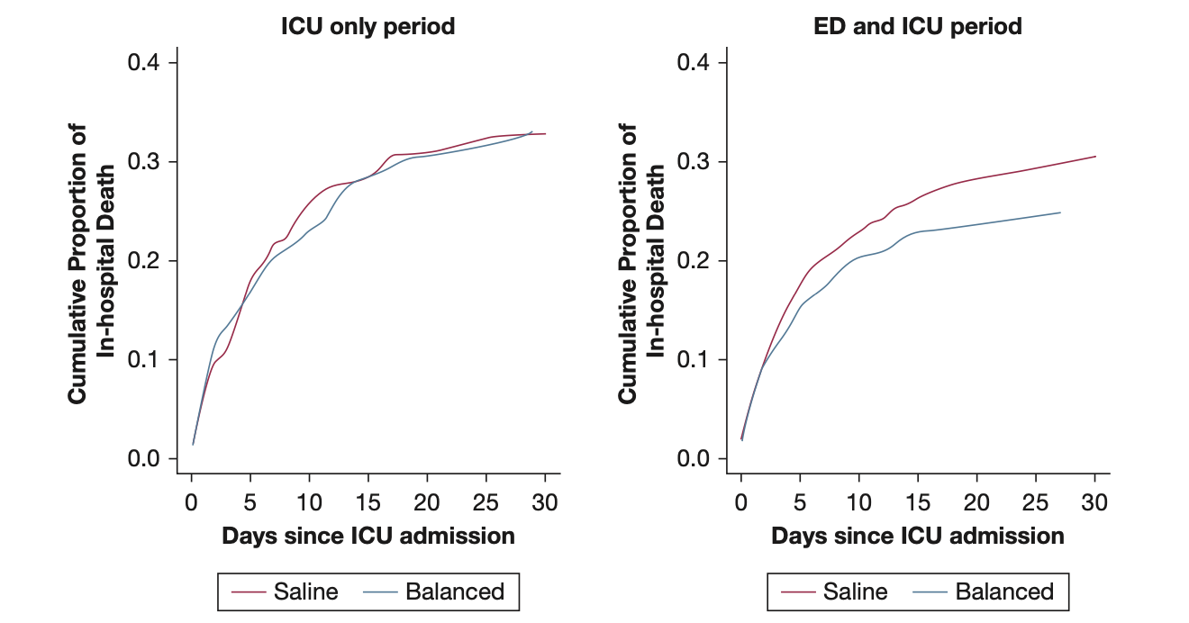
Update 1: Best to start balanced fluid early
Effect of balanced crystalloids vs saline is greatest if started in ED vs ICU
Jackson, et al. CHEST, 2021.

Slide 42
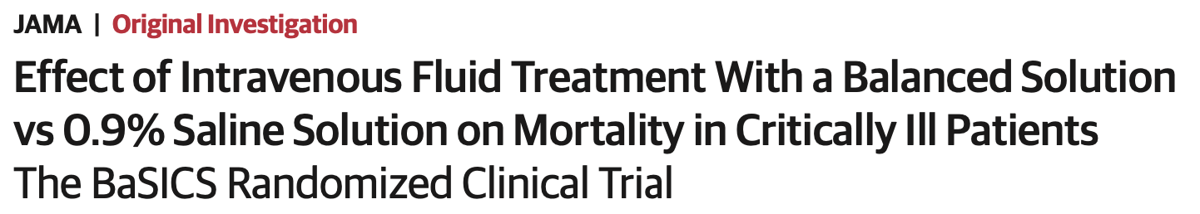

Update 2: More data supporting balanced fluid (BaSICS)
N=10,520 patients in randomized 1:1 to balanced vs 0.9% saline in 75 ICUs in Brazil
Among N=1,987 patients with sepsis:
46.7% vs 49.0% 90d mortality
HR 0.93 (0.82-1.06)
92% probability of mortality benefit of balanced solutions in patients who received only balanced solutions pre-enrollment
(OR, 0.78; CrI, 0.56–1.03)
96% probability of mortality in admissions due to sepsis
(OR, 0.70; 89% CrI, 0.50–0.97)
Zampieri, et al. JAMA, 2021.
Zampieri, et al. AJRCCM, 2022.

Slide 43
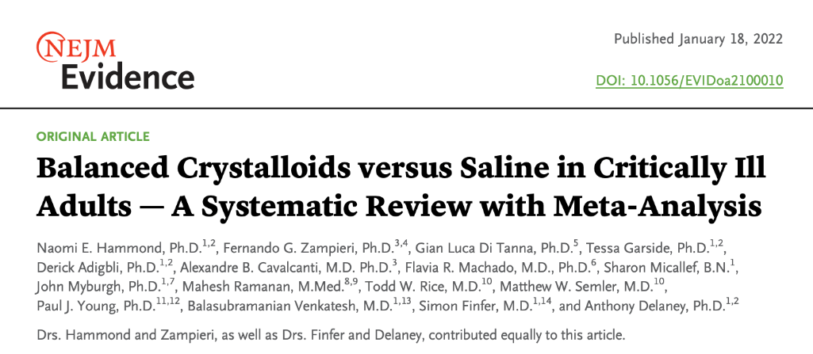
Update 3: Meta-analysis supporting balanced fluid
Balanced crystalloids vs saline:
RR overall: 0.96 (0.91-1.01)
RR in sepsis: 0.93 (0.86-1.01)
There is a 89.5% probability that balanced fluid reduce mortality in all-cause critical illness*.
13 trials of 35,884 patients
6,754 with sepsis
*except in traumatic brain injury where there is evidence of harm with balanced fluids vs 0.9% saline.
Hammond, et al. NEJM Evidence, 2022.

Slide 44
Fluid type: suggest → recommend balanced fluids
Evidence supports benefit of balanced fluids in critically ill patients, particularly with sepsis, and particularly when used throughout resuscitation.
Hospital policies and structures (e.g., order sets, activatable orders, stocking of fluid in ED/ICU) should prioritize balanced fluids.

Slide 45
Real-world practice in Michigan
Among patients with septic shock treated with ≥3L fluid, how many had at ≥80% balanced fluid?

Slide 46
Fluid resuscitation volume

Slide 47
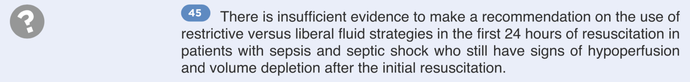
Fluid resuscitation volume
Fluid resuscitation volumes (per ideal body weight)
Height | 5’2” | 5’4” | 5’6” | 5’8” | 5’10” | 6’0” | 6’2” | 6’4”
Male | 1628 ml | 1776 ml | 1914 ml | 2052 ml | 2190 ml | 2328 ml | 24691 ml | 2604 ml
Female | 1500 ml | 1641 ml | 1779 ml | 1917 ml | 2055 ml | 2193 ml | 2331 ml | 2469 ml

Slide 48
Background for initial fluid volume
Earlier guidelines recommended early goal-directed therapy
This recommendation was retired after PROMISE, PROCESS, ARISE.
2016: recommended 30ml/kg
Rationale: majority in PROMISE, PROCESS, ARISE got >30ml/kg
observational studies show benefit of 30 ml/kg even in patients with lactate 2-4 and especially with CHF or CKD
2021: suggest 30 ml/kg
Rationale: no RCT assessing 30ml/kg vs other volume

Slide 49
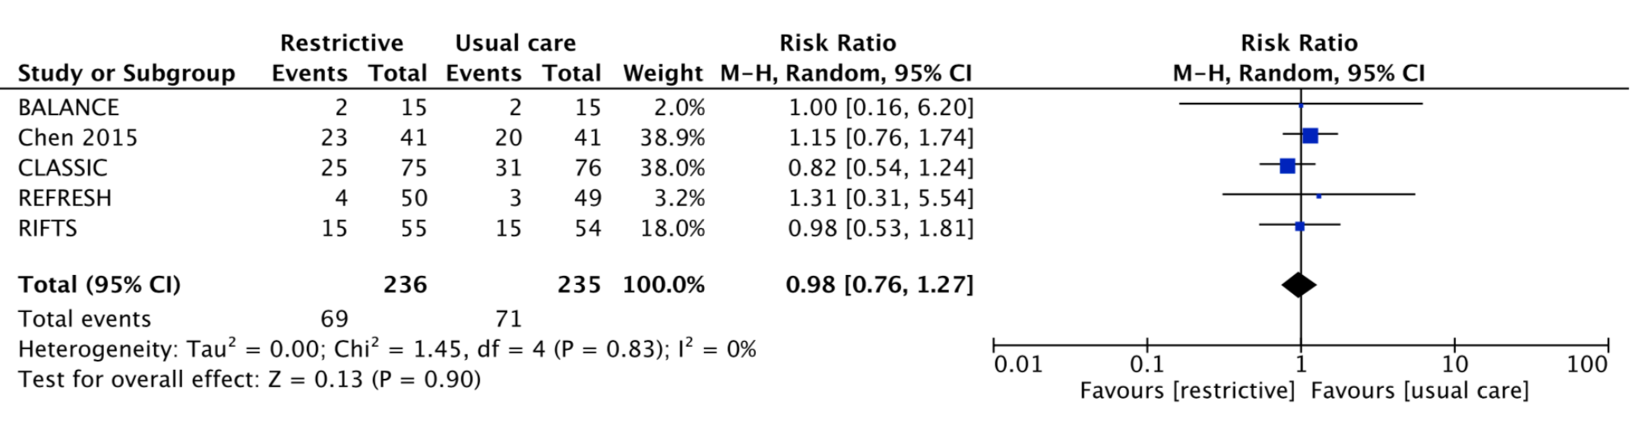
Background for subsequent fluid
5 pilot RCTs: no signal, wide heterogeneity in definitions of conservative vs. liberal fluid approach.
Semler, et al. Journal Intensive Care Med, 2020.
Chen, et al. Chest, 2015.
Hjortrup, et al. Intensive Care Med, 2016.
MacDonald, et al. Intensive Care Med, 2018.
Corl, et al. Crit Care Med. 2019.

Slide 50
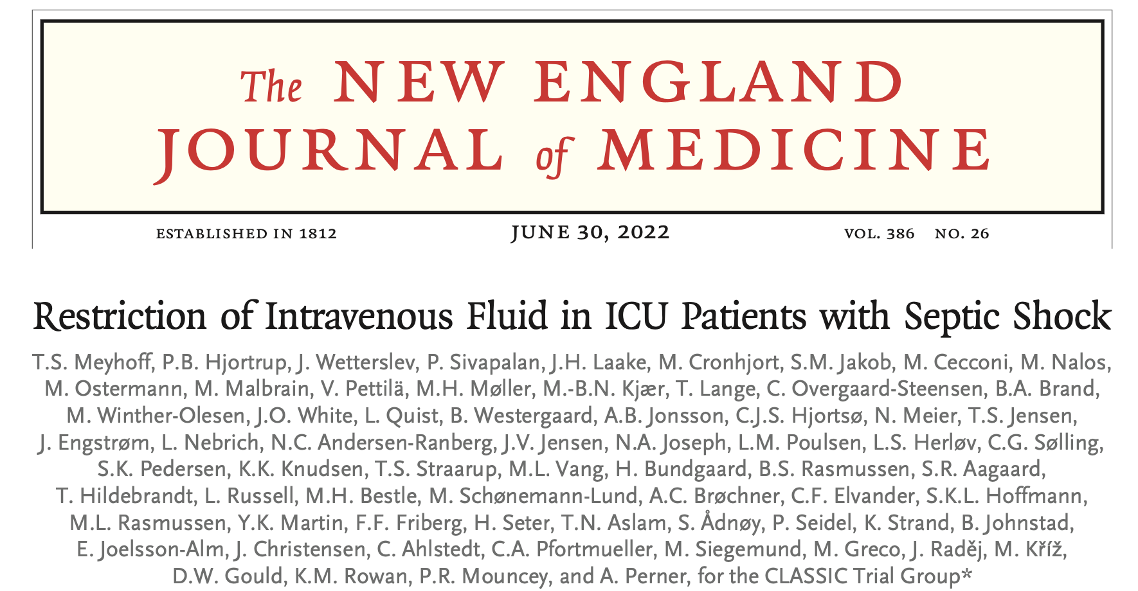

Update: CLASSIC trial
Patients: 1544 patients in ICU with septic shock diagnosed within prior 12 hours and who had received ≥1L fluid
Intervention: Restrictive fluid approach.
250-500ml fluid only if: lactate ≥4 mmol/L; MAP<50 on vasopressor; skin mottling above knee; decreased UOP*
Comparator: Standard fluid approach (usual care)
Meyhoff, et al. NEJM, 2022.

Slide 51
Update: Equivalent restrictive vs liberal (CLASSIC)
Patients: 1544 patients in ICU with septic shock diagnosed within prior 12 hours and who had received ≥1L fluid
Intervention: Restrictive fluid approach.
250-500ml fluid only if: lactate ≥4 mmol/L; MAP<50 on vasopressor; skin mottling above knee; decreased UOP*
Comparator: Standard fluid approach (usual care)
Median fluid volume delivered (post-randomization) | Restrictive N=770 | Standard N=784
Resuscitation | 1,798 mL | 3,811 mL
Total | 10,433 mL | 12,747 mL
Meyhoff, et al. NEJM, 2022.

Slide 52
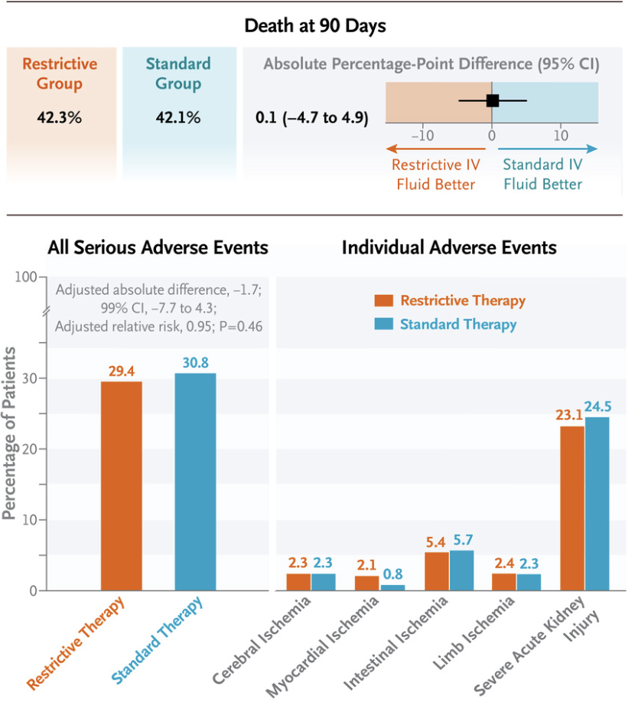
Update: Equivalent restrictive vs liberal (CLASSIC)
Meyhoff, et al. NEJM, 2022.

Slide 53
Fluid resuscitation volume
*unchanged: virtually all patients received 30ml/kg pre-randomization.
*my impression: either approach is acceptable.
Other pending trials (CLOVERS, EVIS) may provide more guidance.

Slide 54
Real-world practice in Michigan
Among patients with septic shock initiated on vasopressors within 3 hours and without contraindications*, how many receive ≥30ml/kg IBW fluid within 6 hours?
*Contraindications for this measure include ESRD, LVEF≤39%, or moderate/severe/critical aortic stenosis.

Slide 55
Vasopressor initiation

Slide 56
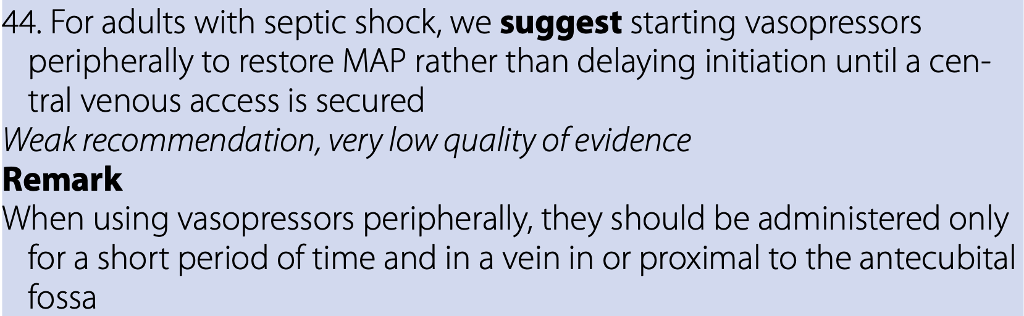
Vasopressor initiation
Evans, et al. Intensive Care Medicine, 2021.
Evans, et al., Critical Care Medicine, 2021.

Slide 57

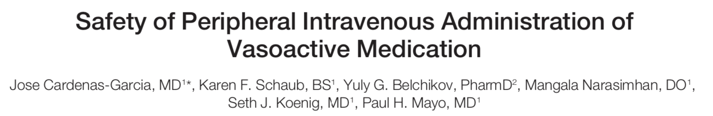

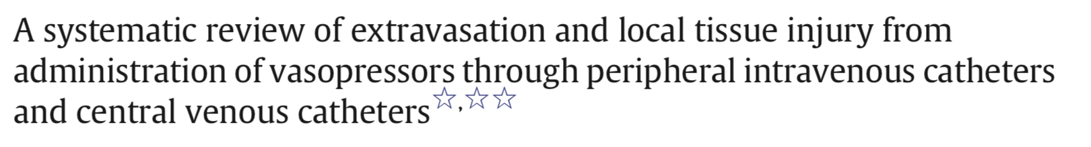
Vasopressor initiation
Rationale: Low complication rate, facilitates faster time to shock resolution, may avoid CVC placement altogether.
Brown, et al. AJRCCM, 2019.
de Cardenas, et al. J Hosp Med, 2015.
Tian, et al. Emergency Medicine Australasia, 2020.
Laubani, et al. Journal of Critical Care, 2015.

Slide 58
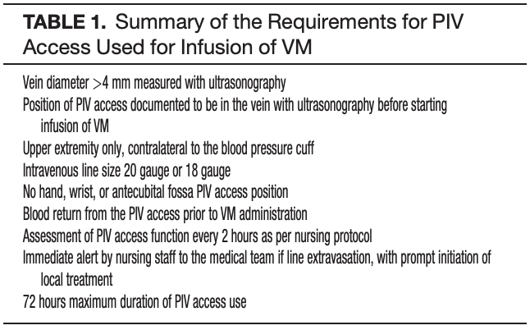
Peripheral vasopressor administration
≤0.2 μg/kg/min NE equivalents
de Cardenas, et al. J Hosp Med, 2015.

Slide 59
Steroids in septic shock

Slide 60
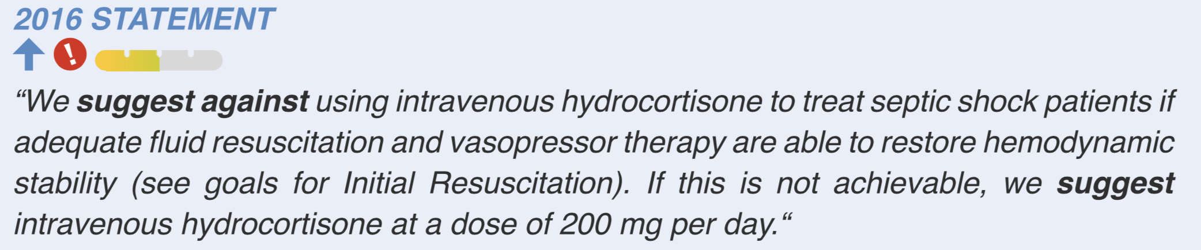
Steroids in septic shock
Evans, et al. Intensive Care Medicine, 2021.
Evans, et al., Critical Care Medicine, 2021.

Slide 61
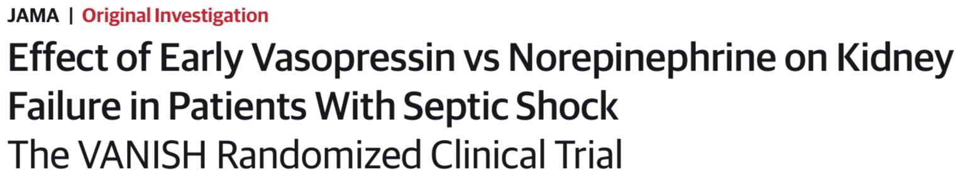

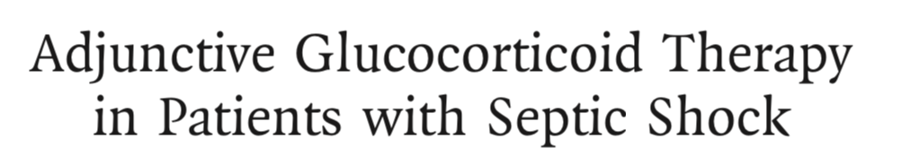
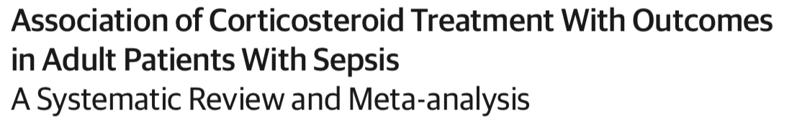
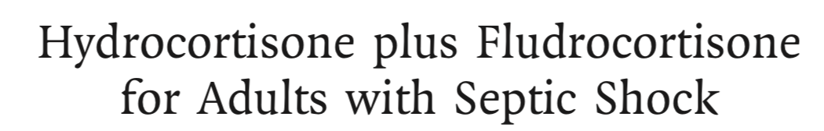
Steroids in septic shock
Gordon, et al. JAMA, 2016.
Vekatesh, et al. NEJM, 2018.
Annanne, et al. NEJM, 2018.
Rygård, et al. Intensive Care Medicine, 2018.
Fang, et al. JAMA Internal Medicine, 2019.

Slide 62
Summary of recommendations
Antimicrobial timing:
Deliver ASAP in sepsis or undifferentiated shock possibly due to sepsis
Do a rapid evaluation of possible sepsis, treatment decision in 3 hours
→ Only 65% of patients with sepsis who arrive hypotensive are treated within 3 hours.
Fluid type:
Use balanced fluid (e.g., Lactated Ringer’s) in all or nearly all patients
→ Only 14% of patients with septic shock are getting balanced fluid resuscitation.
Fluid resuscitation volume:
30ml/kg IBW should be default, a few may need less, some may need more
Further resuscitation beyond 30ml/mg should guided by serial clinical assessment
→ Only 45% of patients initiated on vasopressors for septic shock get 30ml/kg IBW
Peripheral vasopressor administration:
This is accruing evidence of safety, must have a safety/monitoring protocol

Slide 63
Talk Outline and Objectives
What is sepsis and how is it defined operationally?
How can sepsis be identified quickly?
What’s new in (and since) the 2021 Surviving Sepsis Campaign Guidelines?
What I tell my team

Slide 64
What I tell my team
Ask “could this be sepsis?” for s/s of infection or undifferentiated critical illness.
Give antibiotics ASAP for any patient with sepsis or undifferentiated shock.
Do a rapid eval of infectious vs non-infectious causes in patients with possible sepsis
Check lactate in all patients with sepsis.
Give an LR bolus to all patients with sepsis-induced hypoperfusion
(lactate>2, SBP<90, SBP 40+ below baseline)
30ml/kg IBW is a good rule of thumb, but give smaller increments and watch closely in patients with severe/critical aortic stenosis or LVEF<25%.

Slide 65
What I tell my team…
If the patient is hypotensive after antibiotics and 30ml/kg:
consider: are antibiotics appropriate? is source control an issue?
trend clinical trajectory (blood pressure, lactate, cap refill, mentation) and volume assessment to guide further fluid administration
start norepinephrine (okay to initiate via a PIV)

Slide 66
What I tell my team…
If the patient is still on vasopressor and not rapidly improving after 4 hours:
re-consider: are antibiotics appropriate? is source control an issue?
start IV hydrocortisone 50mg q6
place a central line
add vasopressin if norepinephrine is >0.2 mcg/kg/min

Slide 67
What I tell my team…
On daily rounds:
Continually reassess likelihood of infection; stop antimicrobials as soon as infection deemed unlikely.
Stop vasopressin when norepinephrine is ≤0.2 mcg/kg/min
Stop hydrocortisone when off vasopressors (I often do 25 mg x 4 doses, then stop)
Reconcile and titrate meds daily
(make a note of all new starts and ongoing holds with brief rationale, pass along that information at ICU discharge).

Slide 68

Questions

