Slide 1
Posterior Tibial Tendon Dysfunction: The Importance of Standing Foot and Ankle X-rays and Exams
Namory Bagayoko, MD
February 3,2023

Slide 2
Disclosures
I have nothing to Disclose.

Slide 3
Overview
Anatomy of the Posterior Tibial Tendon (PTT)
What is Posterior Tibial Tendon Dysfunction (PTTD)?
Diagnosis of PTTD
The Importance of Standing Foot and Ankle X-rays
The Standing Foot and Ankle Exam
Classification of PTTD
Treatment of PTTD
References

Slide 4
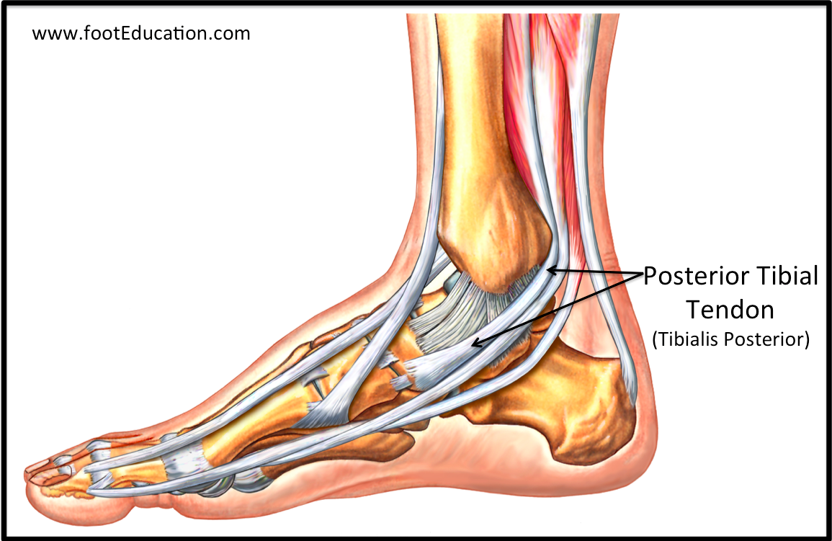
Anatomy of the Posterior Tibial Tendon
Origin: Posterior tibia and fibula and interosseus membrane
Insertion: Navicular tuberosity, cuneiforms, and metatarsal bases
Tibial Nerve
Adducts and inverts the foot and plantarflexes the ankle.

Slide 5
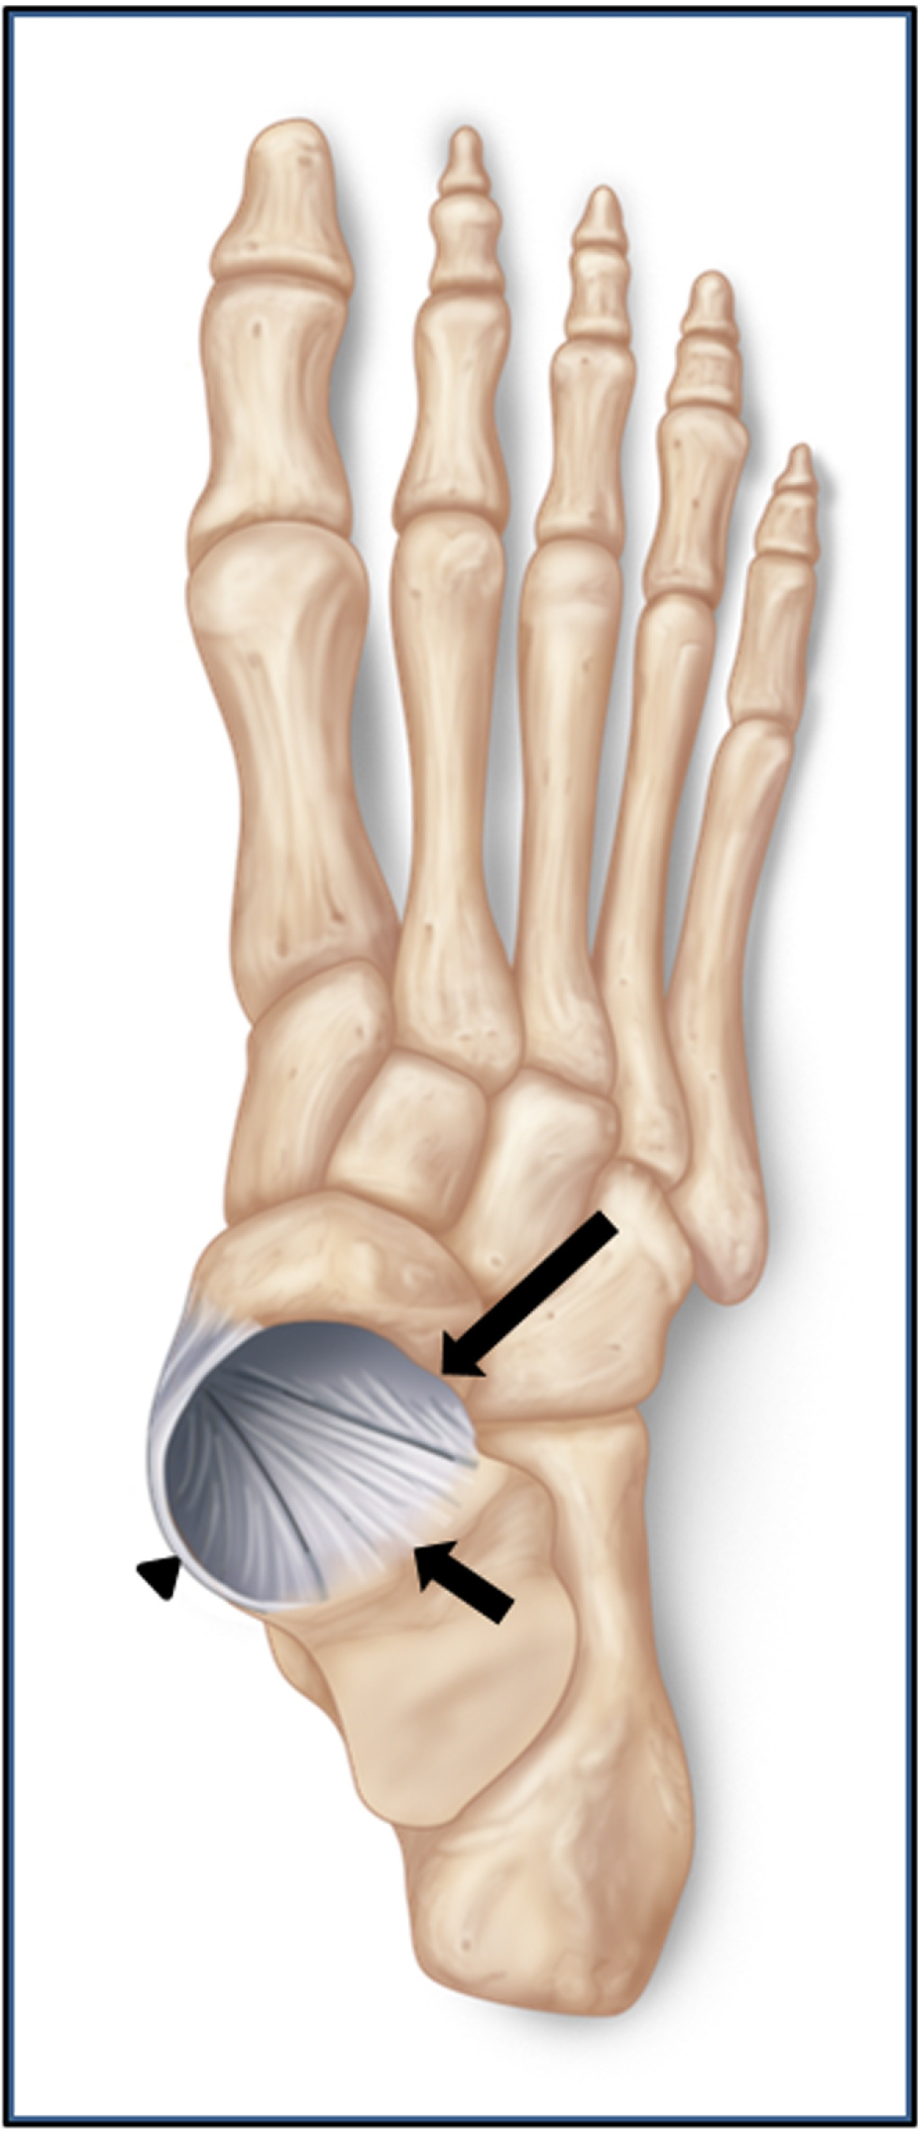
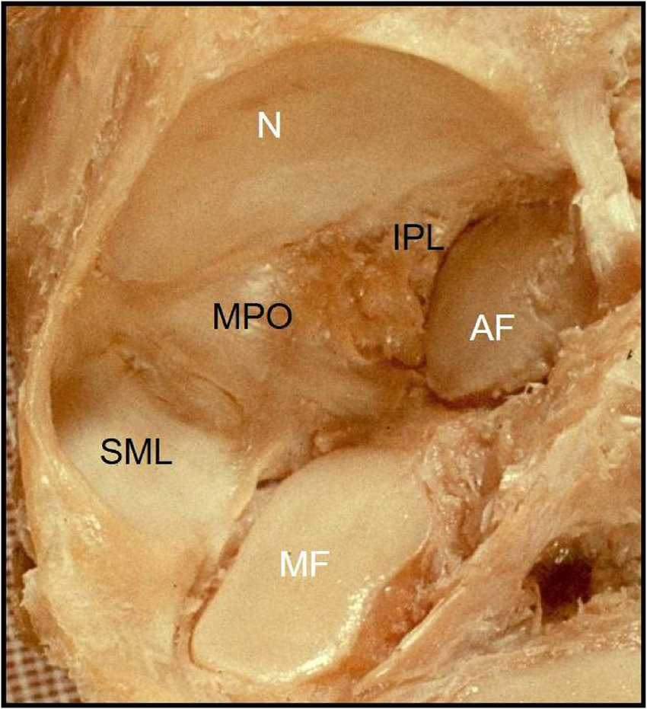
Anatomy of the Posterior Tibial Tendon
PTT– 1° dynamic stabilizer of medial arch
Spring ligament, talonavicular capsule, deltoid ligament are static stabilizers

Slide 6
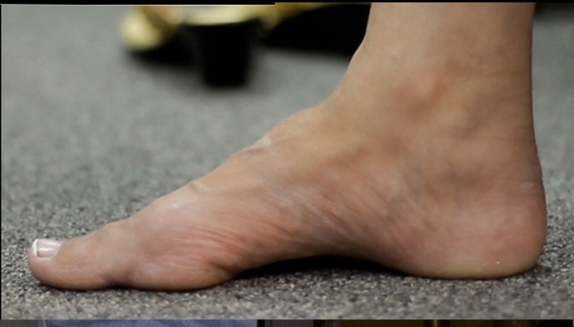
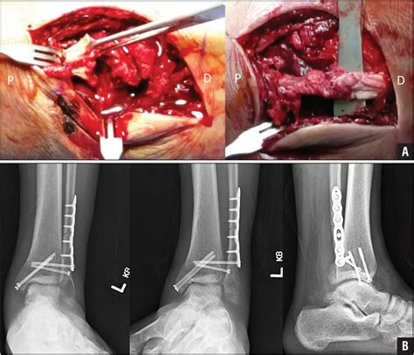
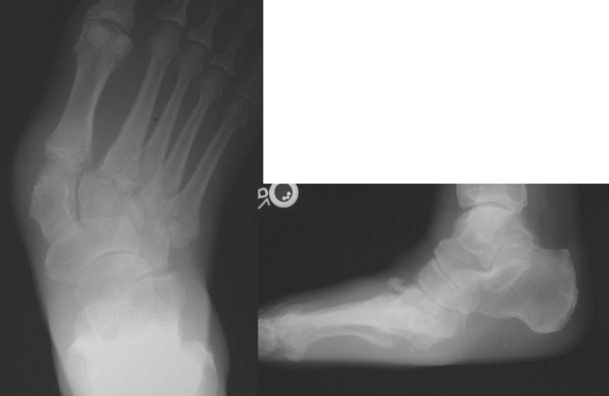
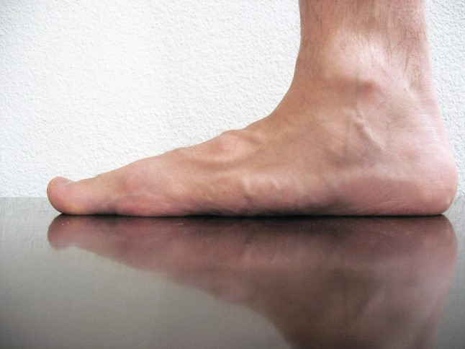
What is Posterior Tibial Tendon Dysfunction?
Most common cause of Adult Acquired Flat Foot Deformity (AAFD)
Other causes of AAFD – trauma, OA, congenital, RA

Slide 7
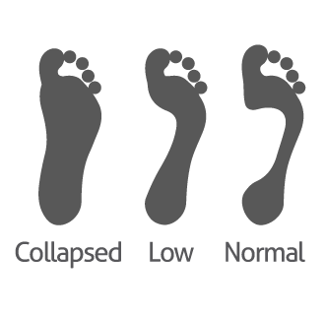
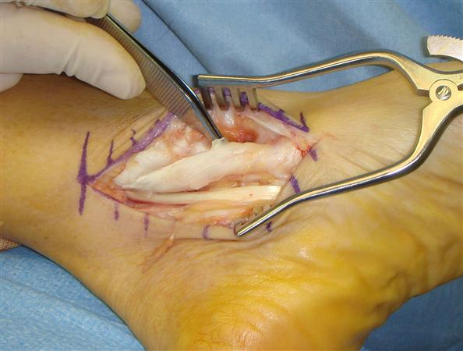
What is Posterior Tibial Tendon Dysfunction?
Slow degeneration and elongation of the PTT from the tip of the medial malleolus to 2 cm distal.
Etiology unknown
Progressive collapse of medial longitudinal arch

Slide 8
Diagnosis of PTTD
PTTD “sees us more than we see it”
Women > Men
More common in 60s
Risk factors
Obesity
Diabetes
Corticosteroid use
Seronegative inflammatory disorders

Slide 9
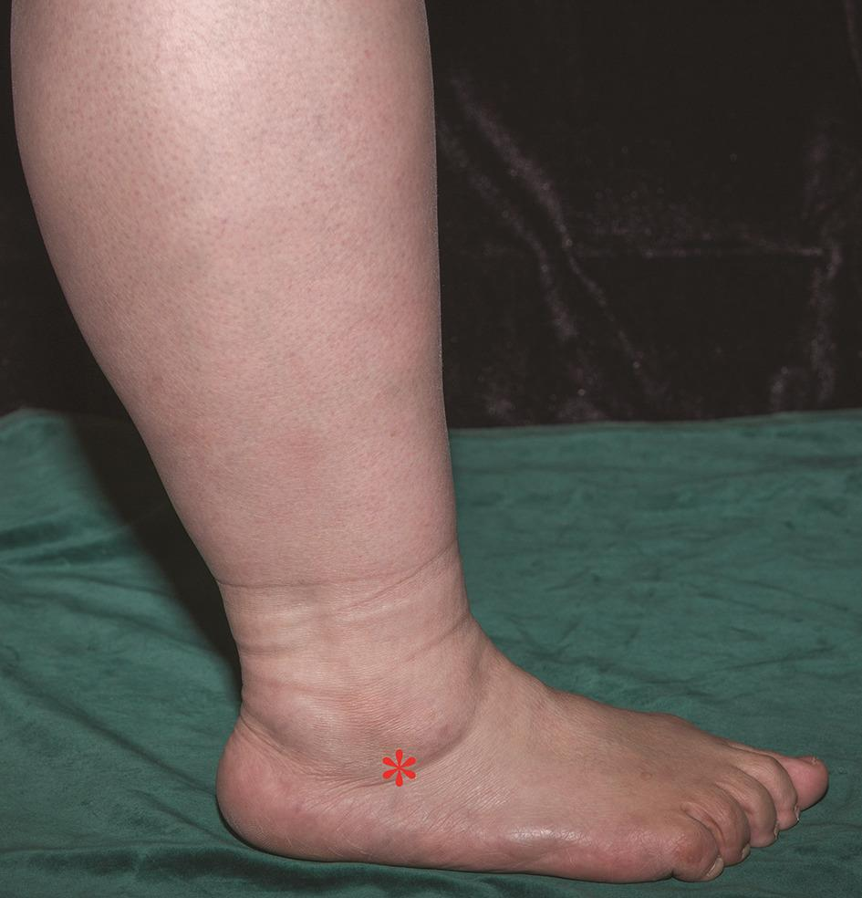
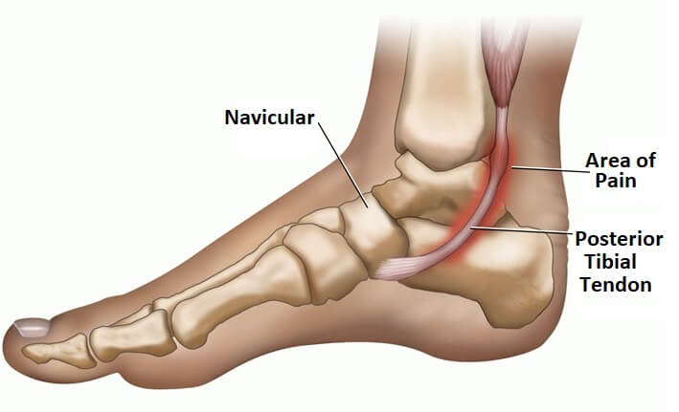
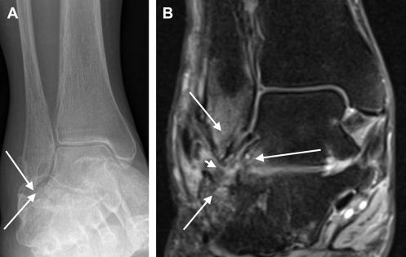
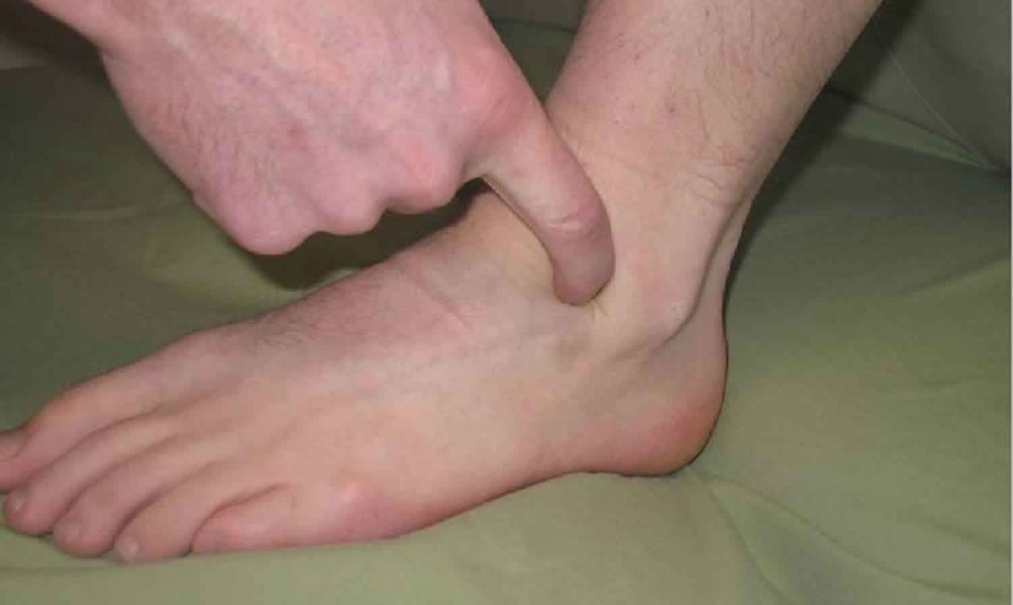
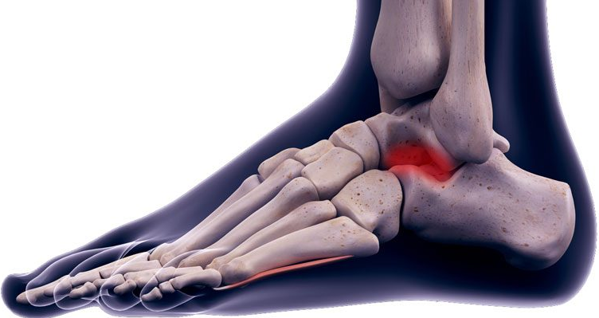
Diagnosis of PTTD
Medial ankle / PTT pain early
Lateral foot and ankle pain late
Sinus Tarsi
Subfibular impingement

Slide 10
Diagnosis of PTTD
Posterior Tibial Tendon
Sinus Tarsi
Subfibular Impingement

Slide 11
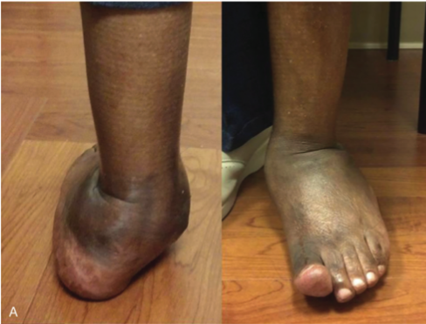
Diagnosis of PTTD
Progressive Collapse
Normal Standing Foot Alignment →
Pes planus, hindfoot valgus, forefoot abduction

Slide 12
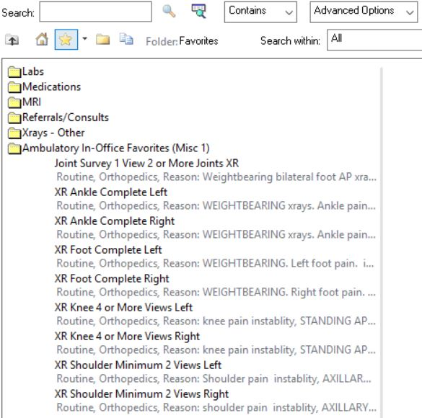
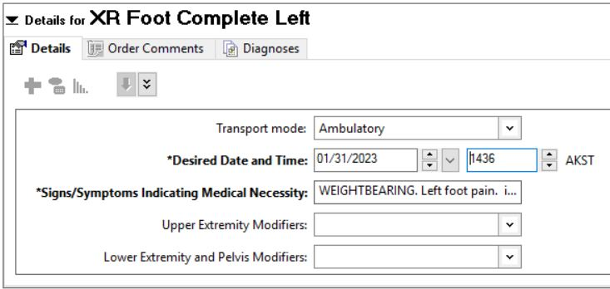
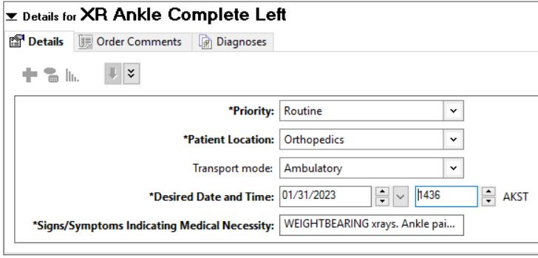
Importance of Standing Foot and Ankle X-rays
Nontraumatic ankle pain patients need:
STANDING foot 3 view x-rays
STANDING ankle 3 view x-rays
Save to Favorites

Slide 13
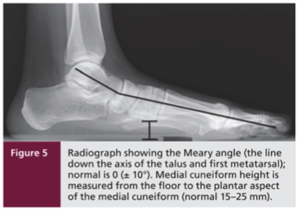
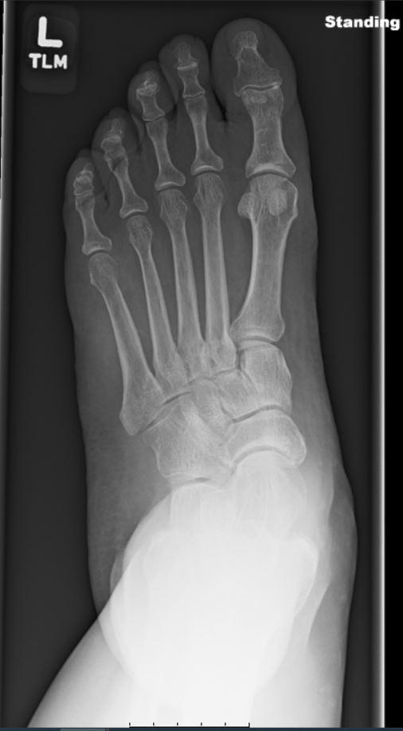
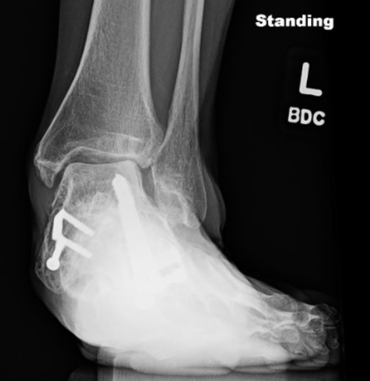
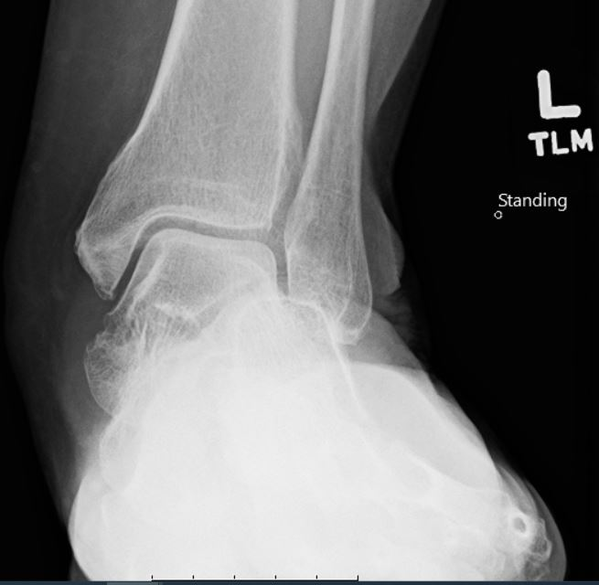
PTTD Findings on Standing Foot and Ankle X-rays
Decreased Meary Angle (Talo-1st metatarsal angle)
Decreased Calcaneal Pitch
Deceased medial cueiform – floor height
Talar head uncoverage / Forefoot ABduction
Talar Tilt

Slide 14
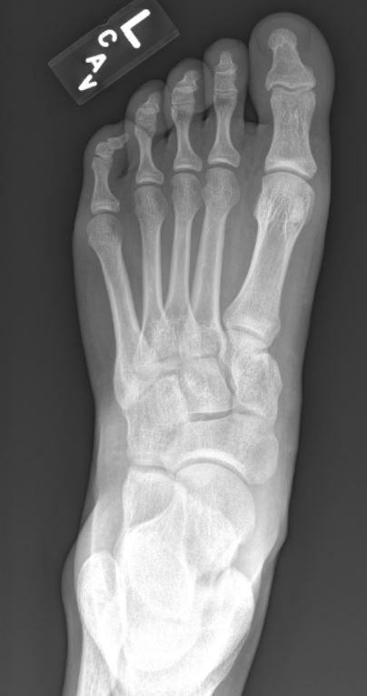
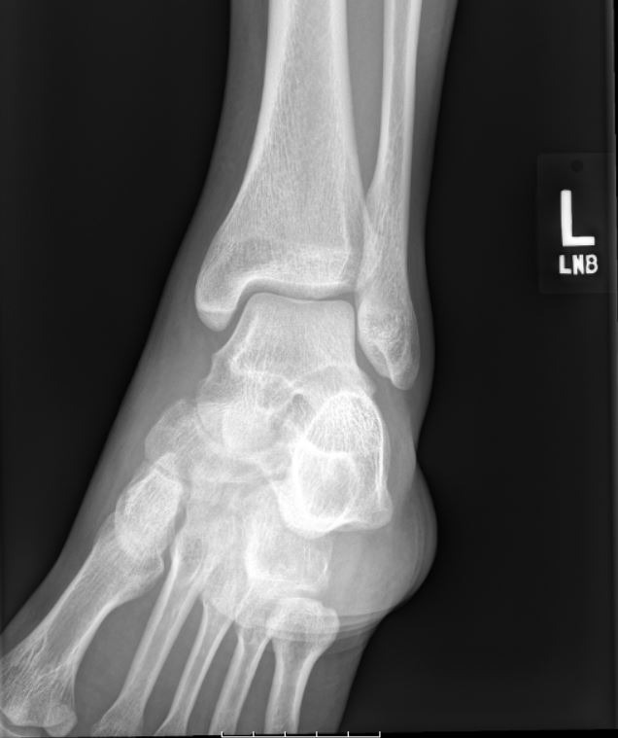
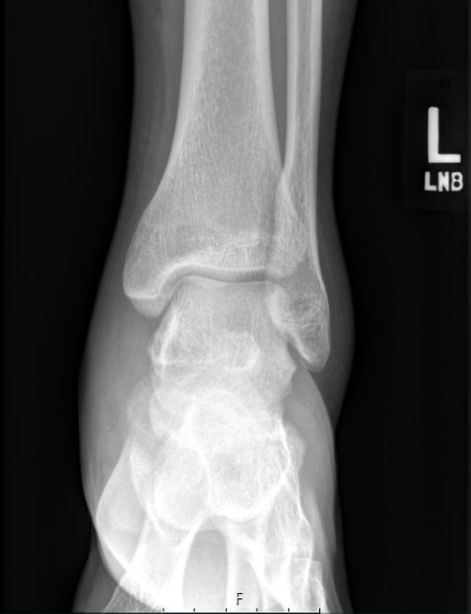
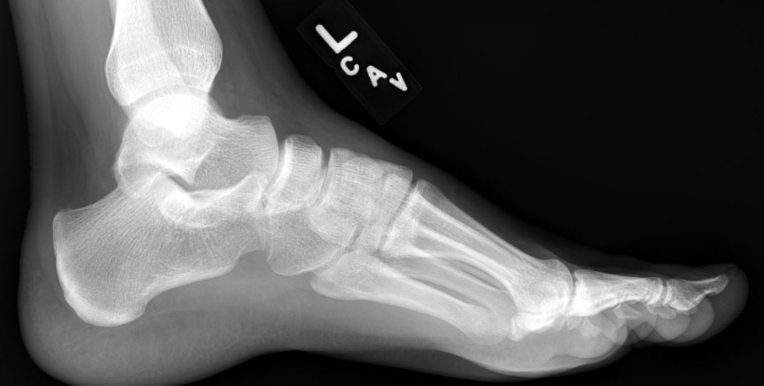
Importance of Standing Foot and Ankle X-rays
65 yo female with left ankle pain x 6 months
NWB ankle and foot xrays with PCP
Radiologist – Normal x-rays
Orthopedic Referral

Slide 15
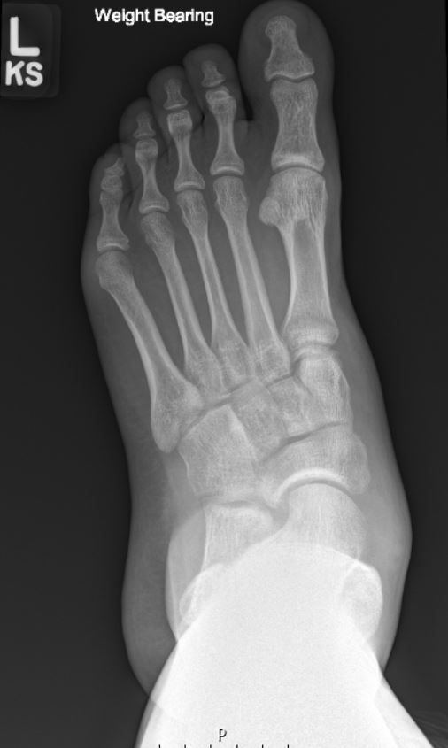
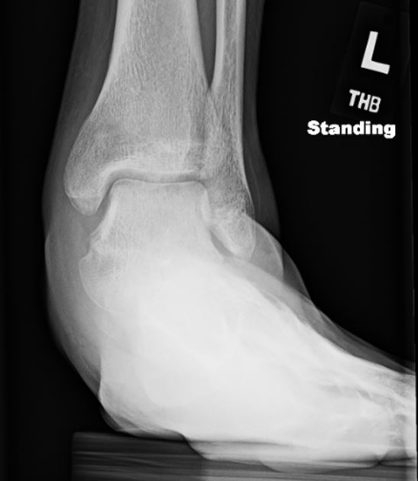
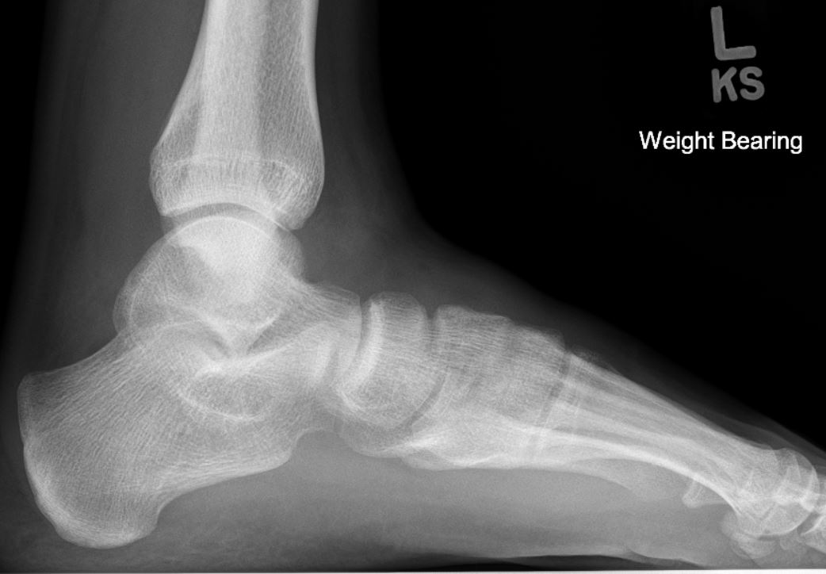
Importance of Standing Foot and Ankle X-rays
Orthopedic eval for “ankle pain” 3 months after referral
Standing ankle and foot x-rays
Radiologist – pes planus

Slide 16
Comparison of Supine and Standing Foot and Ankle X-rays

Slide 17
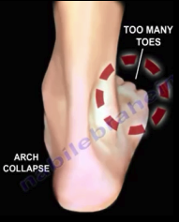
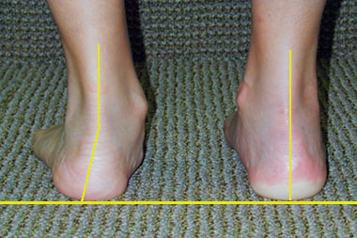
The Standing Foot and Ankle Exam
Standing Posterior Heel Alignment
Hindfoot Valgus
Too Many Toes Sign
Single Limb Heel Raise

Slide 18
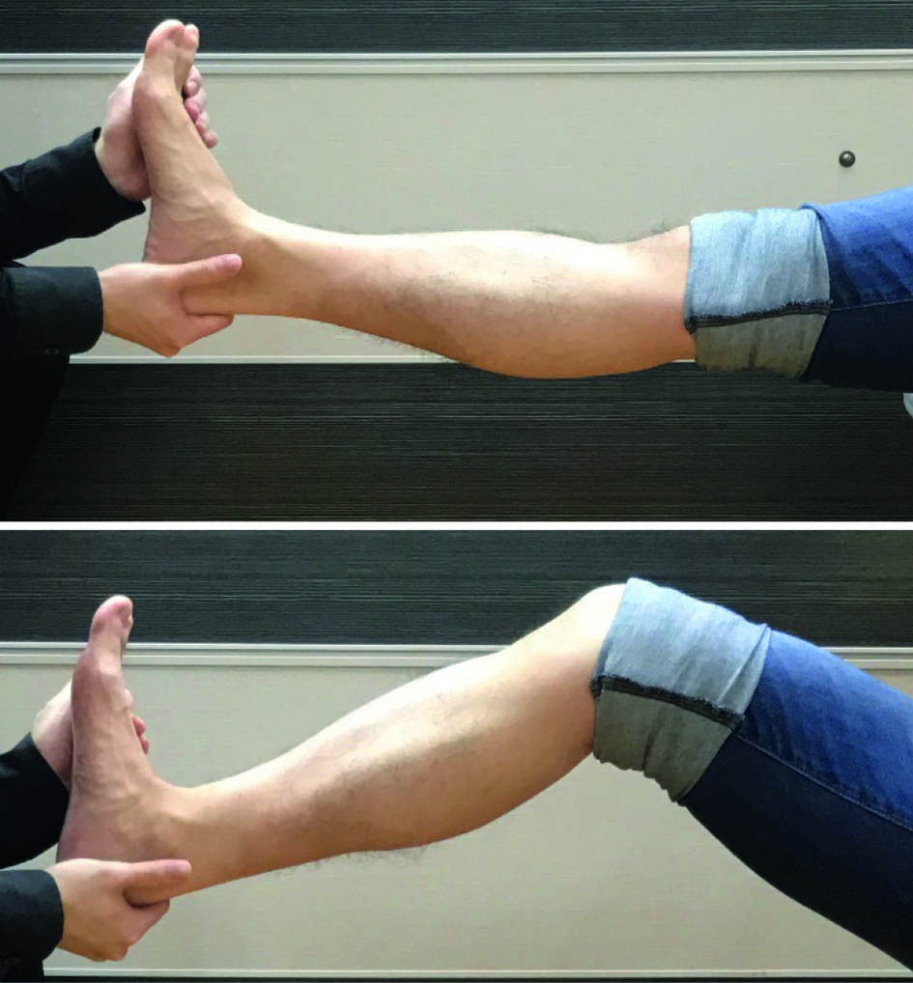
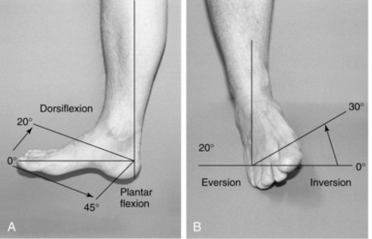
The Sitting Foot and Ankle Exam
Areas of tenderness
Ankle and Hindfoot ROM
Silverskold Test
Strength, Sensation, Pulses
Posterior Tibial Tendon
Sinus Tarsi
Subfibular Impingement

Slide 19
Classification of PTTD
Stage I – No deformity

Slide 20
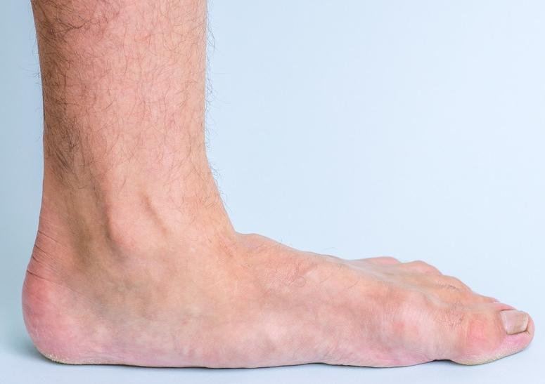
Classification of PTTD
Stage II
Flexible Hindfoot Deformity

Slide 21
Classification of PTTD
Stage III
Rigid Hindfoot Deformity

Slide 22
Classification of PTTD
Stage IV:
Rigid Deformity with Talar Tilt

Slide 23
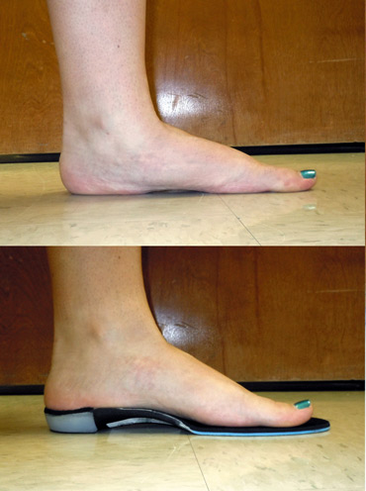
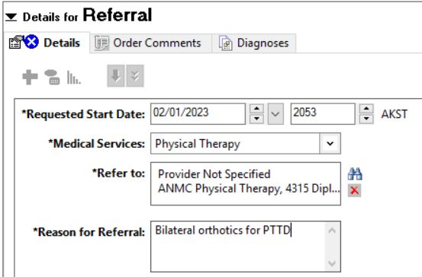
Treatment of Stage I PTTD
NSAIDs
Orthotics – Medial heel lift and longitudinal arch support
ANMC PT Referral
Physical Therapy
Ortho Referral
Stage I – No deformity

Slide 24
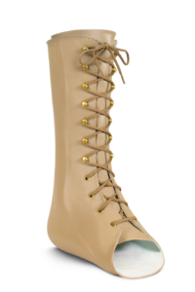
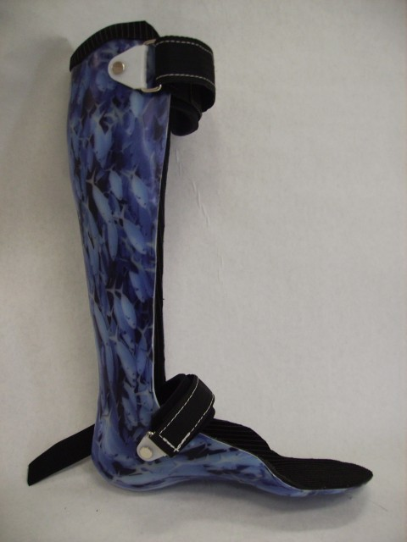
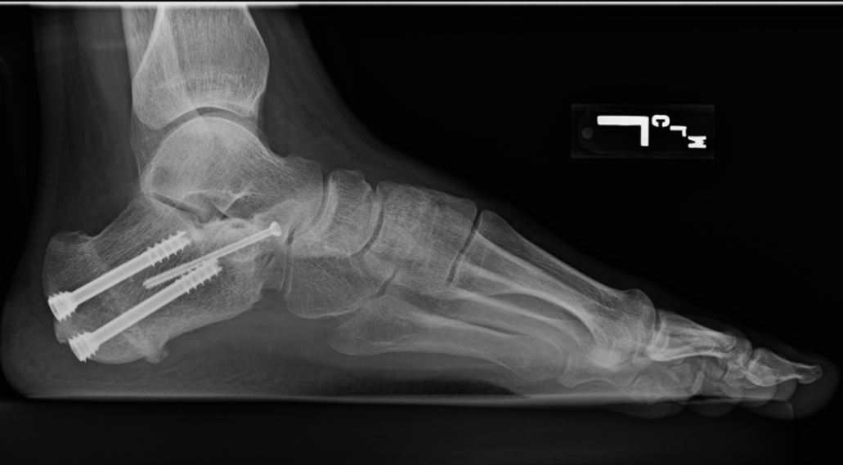
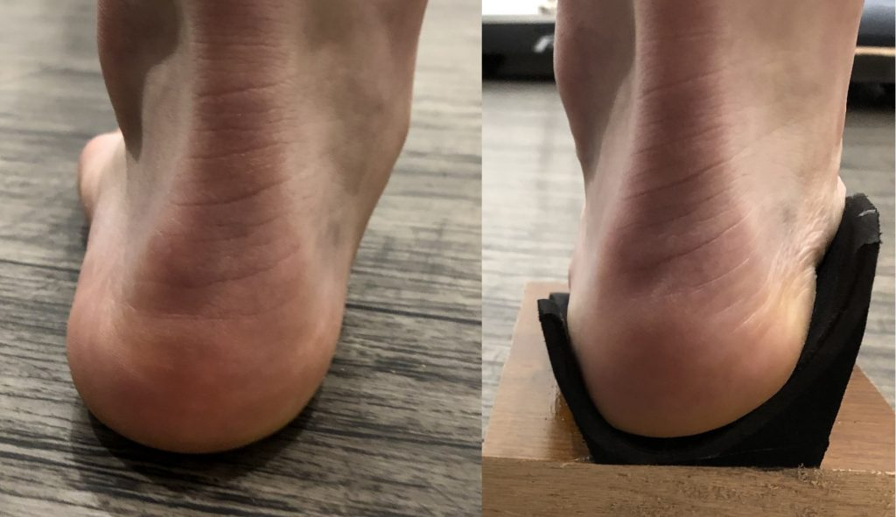
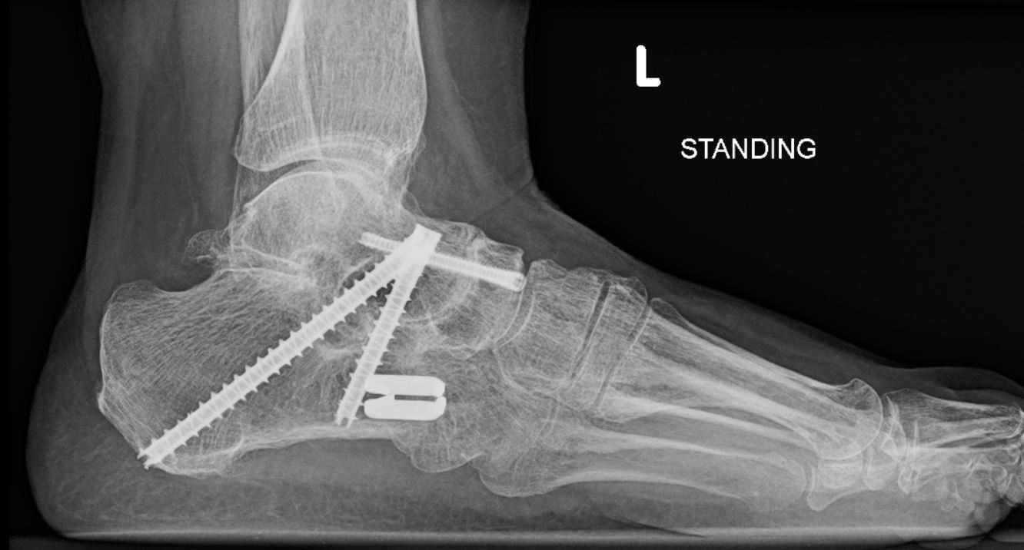
Treatment of Stage II PTTD
Orthotics
AFO
Arizona brace
Flatfoot reconstruction
Young patients
Triple Arthrodesis
Old and obese patients
Stage II
Flexible Hindfoot Deformity

Slide 25
Treatment of Stage III PTTD
AFO / Arizona brace
Poor surgical candidates
Triple Arthrodesis
Stage III
Rigid Hindfoot Deformity

Slide 26
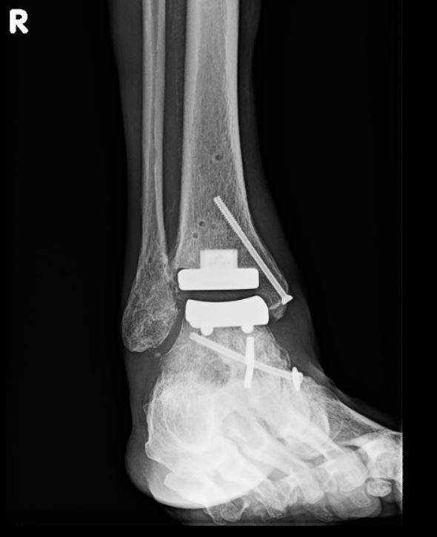
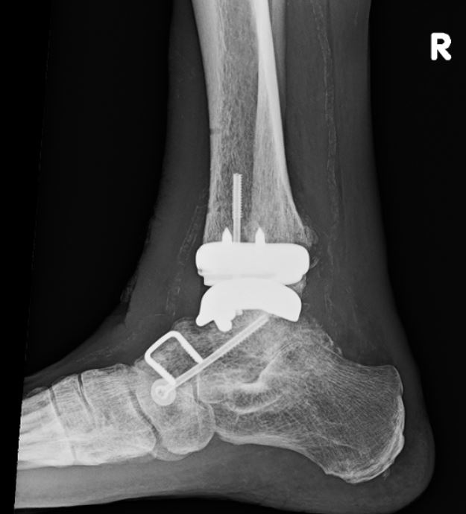
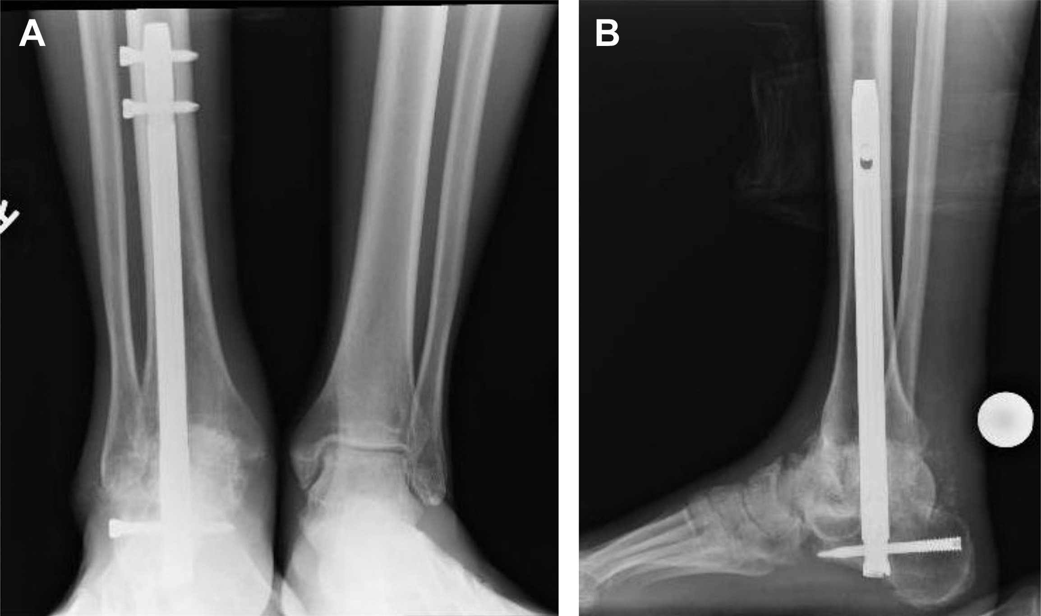
Treatment of Stage IV PTTD
AFO / Arizona brace
Poor surgical candidates
Pantalar fusion
Tibiotalocalcaneal (TTC) fusion
Triple arthrodesis with staged total ankle arthroplasty
Stage IV:
Rigid Deformity with Talar Tilt

Slide 27
Summary
WEIGHTBEARING x-rays and exam for all nontraumatic foot and ankle evaluations
Save x-rays to favorites
Orthotics from ANMC PT for Stage I/II (flexible)
Ortho Referral

Slide 28
Summary
WEIGHTBEARING x-rays and exam for all nontraumatic foot and ankle evaluations
Save x-rays to favorites
Orthotics from ANMC PT for Stage I/II (flexible)
Ortho Referral

Slide 29
References
Ellington, J.K (2014). Adult-Acquired Flatfoot and Posterior Tibial Tendon Dysfunction. In Orthopedic Knowledge Update: Foot and Ankle 5
Haddad S, Myerson M, Pell R, Schon L: Clinical and Radiographic Outcome of Revision Surgery for Failed Triple Arthrodesis. Foot and Ankle International 1997; 18 (8): 489 - 499
Bek N, Simsek IE, Erel S, Yakut Y, Uygur F: Home based general vs center-based selective rehabilitation in patients with posterior tibial tendon dysfunction. Acta Orthop Traumatol Turc 2021; 46 (4):286-292
Bos M, Lusskin R: Acute Disruption of the Posterior Tibial Tendon Associated with Open-Fracture Dislocation of the Ankle. Foot and Ankle International 1997; 18 (12): 823 – 826
https://www.orthobullets.com

