Slide 1

Updates in Management of Sepsis and Septic Shock
Dru Claar, MD
Clinical Assistant Professor & Associate Program Director
Medical Director ICU, VA Ann Arbor Healthcare System
Division of Pulmonary and Critical Care Medicine

Slide 2
Disclosures
No disclosures
Statements expressed are my own and do not represent the views or opinions of the VA or federal government.
Pulmonary and Critical Care Medicine

Slide 3
Overview
Definition, Identification, and Workup
Treatment: Focus on Initial Management
Source Control = Appropriate Antibiotics + Source of Infection Addressed
Fluids and If shock: Vasopressors/Steroids
Assessment of resuscitation
Putting it All Together
Pulmonary and Critical Care Medicine

Slide 4
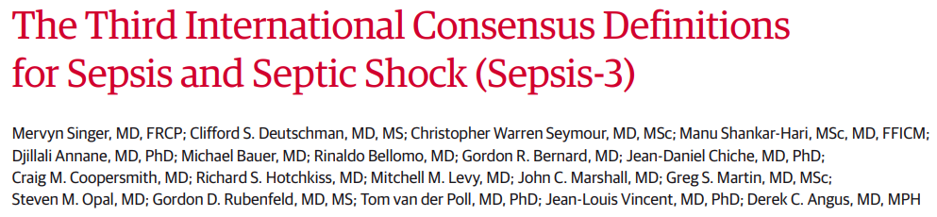
Definition – Sepsis 3.0 (2016)
Sepsis is defined as life-threatening organ dysfunction caused by a dysregulated host response to infection.
Pulmonary and Critical Care Medicine

Slide 5
Clinical Definition – Sepsis 2.0 vs 3.0
Sepsis 2.0
Sepsis 3.0 (2016)
Sepsis
SIRS + Infection
N/A
Severe Sepsis
Sepsis + Organ Dysfunction
Sepsis
Infection + Organ Dysfunction (SOFA change 2)
Septic Shock
Refractory hypotension
Septic Shock
Refractory Hypotension with LA ≥2.0
Pulmonary and Critical Care Medicine

Slide 6
Clinical Definition – Sepsis 2.0 vs 3.0
Sepsis 2.0
SIRS (+ if 2/4)
T: >100.4 F, <96.8 F
RR >20 or PCO2 <32
HR >90
WBC >12K, <4K, >10% Bands
Sepsis 3.0 (2016)
Sepsis
SIRS + Infection
N/A
Severe Sepsis
Sepsis + Organ Dysfunction
Sepsis
Infection + Organ Dysfunction (SOFA change 2)
Septic Shock
Refractory hypotension
Septic Shock
Refractory Hypotension with LA ≥2.0
Pulmonary and Critical Care Medicine

Slide 7
Clinical Definition – Sepsis 2.0 vs 3.0
Sepsis 2.0
Sepsis 3.0 (2016)
Sepsis
SIRS + Infection
N/A
Severe Sepsis
Sepsis + Organ Dysfunction
Sepsis
Infection + Organ Dysfunction (SOFA change 2)
Septic Shock
Refractory hypotension
Septic Shock
Refractory Hypotension with LA ≥2.0
Pulmonary and Critical Care Medicine

Slide 8
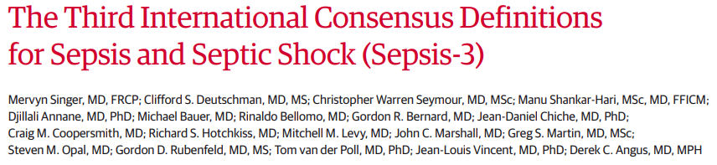
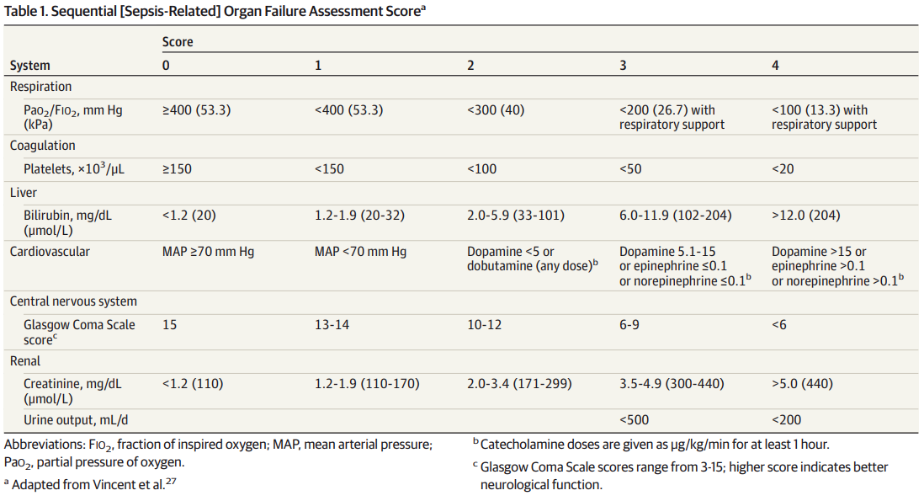
SOFA – Define Organ Dysfunction (Δ SOFA 2)
Pulmonary and Critical Care Medicine

Slide 9
Clinical Definition – Sepsis 2.0 vs 3.0
Sepsis 2.0
Sepsis 3.0 (2016)
Sepsis
SIRS + Infection
N/A
Severe Sepsis
Sepsis + Organ Dysfunction
Sepsis
Infection + Organ Dysfunction (SOFA change 2)
Septic Shock
Refractory hypotension
Septic Shock
Refractory Hypotension with LA ≥2.0
Pulmonary and Critical Care Medicine

Slide 10
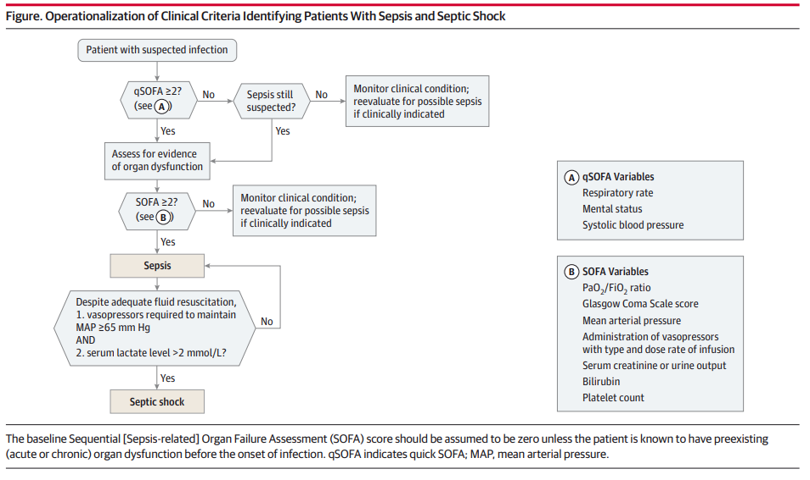
Identification of Sepsis
Sepsis 2 vs 3 Side by Side include mortality
Pulmonary and Critical Care Medicine

Slide 11
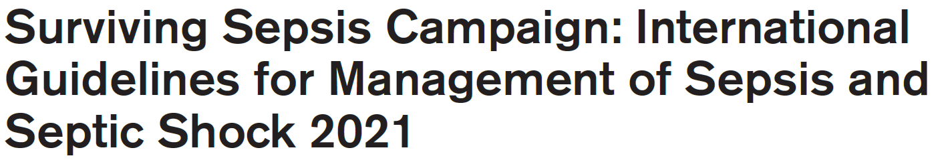
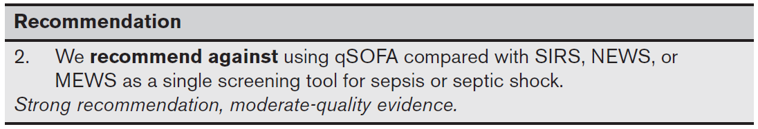
Identification of Sepsis
qSOFA specific (identifies high risk pts) but not sensitive enough compared with other scoring scales
Pulmonary and Critical Care Medicine
Notes:
Only used qSOFA you would identify patients at higher risk of mortality but would miss a number of cases.

Slide 12
Identification of Sepsis – ***Take Home Point***
No individual screening tool is perfect
qSOFA – specific but not sensitive
SIRS – not perfectly sensitive and less specific
Need to maintain a high index of suspicion and reevaluate
Pulmonary and Critical Care Medicine
Notes:
Only used qSOFA you would identify patients at higher risk of mortality but would miss a number of cases.

Slide 13
Workup
Essential Workup Components (Besides clinical evaluation)
CBC, Basic Metabolic Panel, Hepatic Function Panel, PT/PTT/INR, Blood Cultures, UA/Urine Culture, Lactate, Chest XR
Goal:
Initial screen for organ dysfunction/disease severity, source of infection, and needs for ongoing management
Other Considerations:
Blood Gas (Venous Ok), Lipase, Procalcitonin, Point-of-Care Ultrasound
Pulmonary and Critical Care Medicine
Notes:
Discuss that key point is rapid triage to understand if capabilities exist – LFT abnormalities →ERCP, perc neph chest tube etc

Slide 14
Workup – Key Considerations
Suspected Source revealed by Initial Workup:
Is there a source that may not be able to be treated with antibiotics alone (eg Pleural effusion, Biliary obstruction, etc)? Do I need to transfer the patient for this?
Do I need further imaging to clarify (CT or US)?
No Clear Source:
Do I have the right diagnosis?
Do I need further labs/imaging to clarify (CT or US)?
Pulmonary and Critical Care Medicine
Notes:
Discuss that key point is rapid triage to understand if capabilities exist – LFT abnormalities →ERCP, perc neph chest tube etc

Slide 15
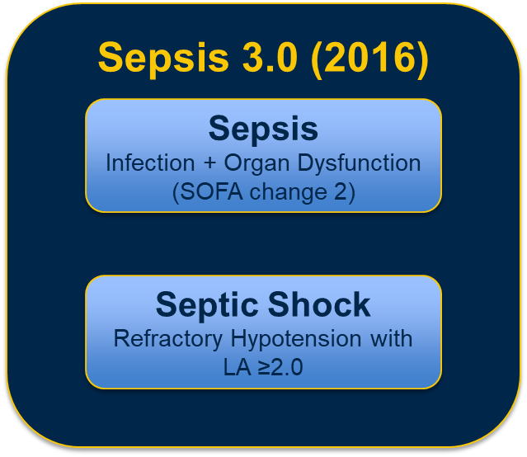
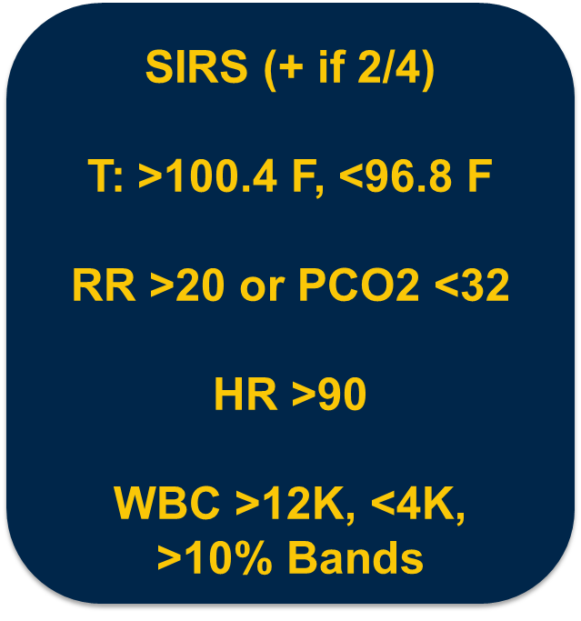
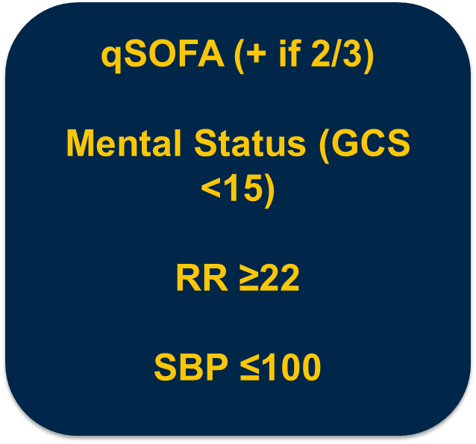
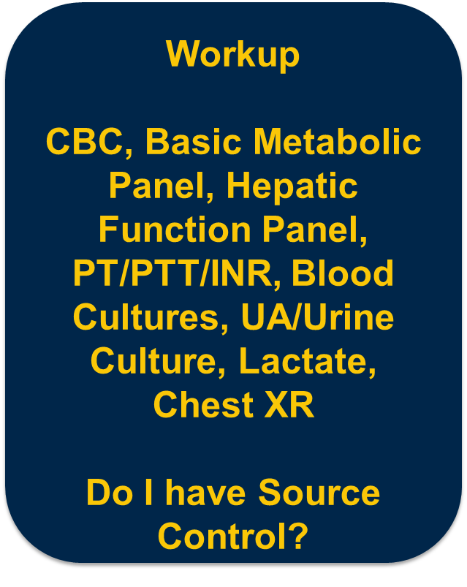
Putting it Together
Definition
Screening
Screening
Pulmonary and Critical Care Medicine

Slide 16
Treatment – Focus on Initial Management
Source Control = Appropriate Antibiotics + Source of Infection Addressed
Fluids and If shock: Vasopressors/Steroids
Assessment of resuscitation
Pulmonary and Critical Care Medicine

Slide 17
Treatment – Focus on Initial Management
Source Control = Appropriate Antibiotics + Source of Infection Addressed
Fluids and If shock: Vasopressors/Adjuncts
Assessment of resuscitation
Pulmonary and Critical Care Medicine

Slide 18
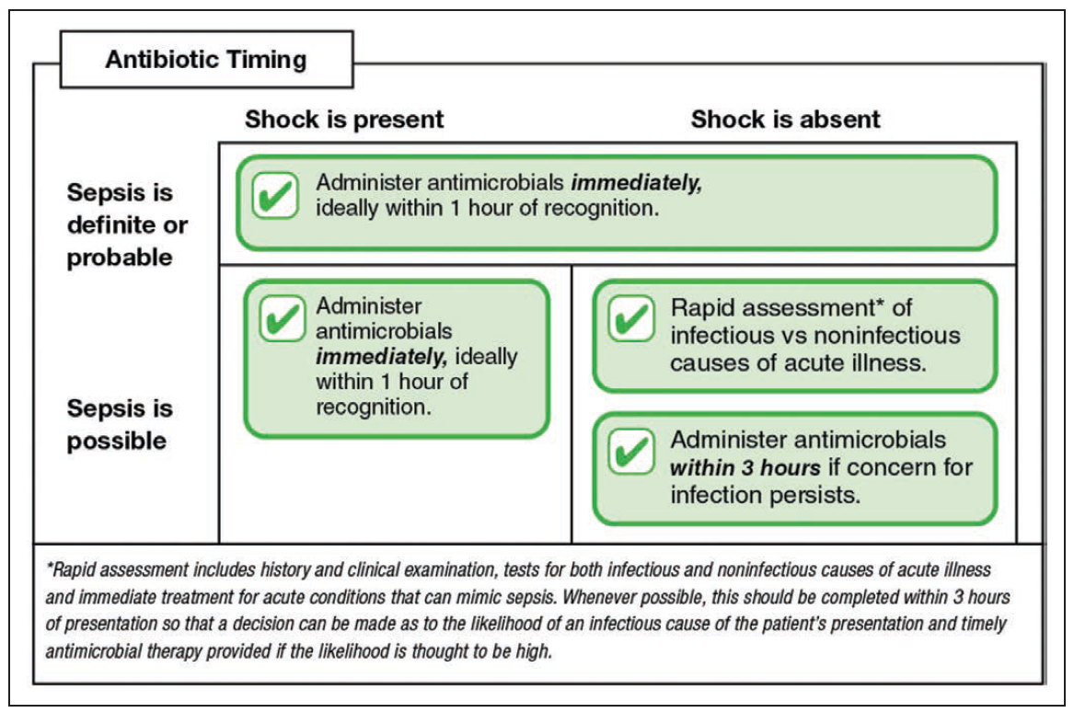
Antibiotic Considerations
Timing
Pulmonary and Critical Care Medicine
Notes:
Emphasize stronger data with shock here and that important stratification, discuss paper with evidence that clinicians react more strongly to fevers than to low blood pressure but harm signal much more from shock, don’t consider anything else if someone has shock the mostly likely type of shock is septic shock

Slide 19
Antibiotic Considerations
Types
Broad Spectrum Antibiotic Coverage
Generally MRSA coverage (eg Vancomycin)
AND
B-Lactam with Gram Negative Activity (piperacillin-tazobactam, cefepime, etc)
Targeted Antibiotics
CAP Coverage (eg Ceftriaxone/Azithromycin)
Pulmonary and Critical Care Medicine

Slide 20
Antibiotic Considerations
Timing and Type
Does that mean we just give everyone broad spectrum antibiotics?
In shock, the answer is probably yes. Stakes are too high to miss.
In sepsis alone, this will likely lead to overuse of antibiotics.
Pulmonary and Critical Care Medicine

Slide 21
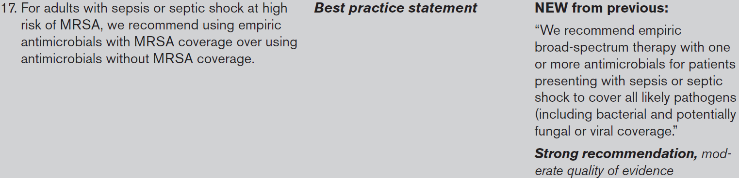
Antibiotic Considerations
Timing and Type
Decision to include MRSA Coverage for empiric treatment:
Likelihood of MRSA infection
Harm of withholding treatment for MRSA if the patient has MRSA
Harm of treating for MRSA in a patient without MRSA
Pulmonary and Critical Care Medicine

Slide 22
Antibiotic Considerations
Timing and Type
How do you figure this out?
Know your local antibiogram
Look at prior culture data for the patient
Other – prior hospitalizations/exposure to healthcare, immunocompromised, clues in patient presentation, etc
Pulmonary and Critical Care Medicine

Slide 23

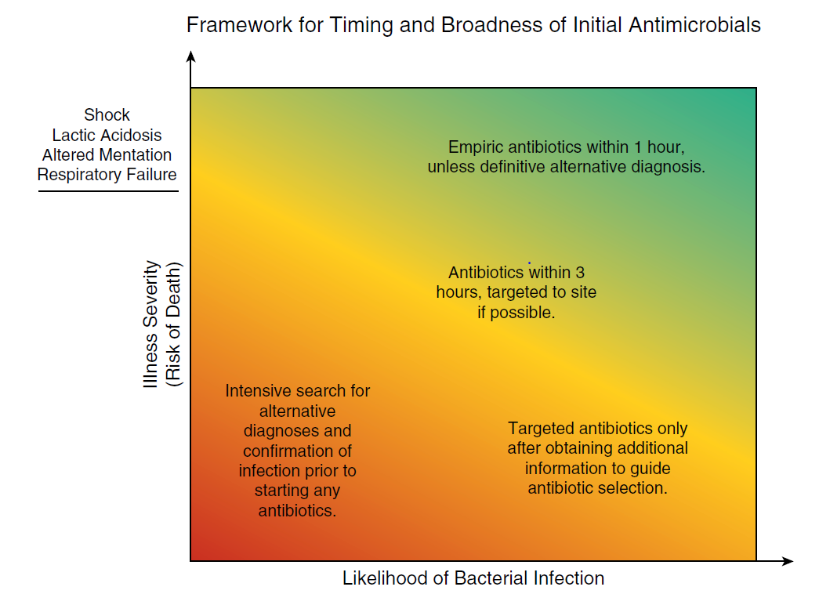
Antibiotic Considerations
Pulmonary and Critical Care Medicine

Slide 24
Antibiotic Considerations
Example:
Heme-Onc Patient with Septic Shock
Acute peritonitis with shock
Treatment:
Antibiotics Now, Covering everything
Patient is too sick to miss
Pulmonary and Critical Care Medicine

Slide 25
Antibiotic Considerations
Example:
Heart Failure or STEMI with Cardiogenic Shock
Treatment:
No antibiotics
Pulmonary and Critical Care Medicine

Slide 26
Antibiotic Considerations
Example:
Chronic Osteomyelitis
Treatment:
No antibiotics initially
Get cultures/bone biopsy to identify organism
Targeted antibiotics once organism known
Pulmonary and Critical Care Medicine

Slide 27
Antibiotic Considerations
Example:
Confused elderly person with BP 60/40, LA 5
Treatment:
Antibiotics now, Covering Everything (too sick to miss)
Reassess and deescalate if not infected over next 48hrs
Pulmonary and Critical Care Medicine

Slide 28
Antibiotic Considerations
Example:
Confused elderly person with BP 90/60, LA 1.8, WBC 13, HR 110.
Treatment:
Rapid workup as to possible source
Antibiotics in 3 hrs (targeted if possible)
Reassess and deescalate if not infected over next 48hrs
Pulmonary and Critical Care Medicine

Slide 29
Summary - Antibiotics
Urgency and spectrum of antibiotics should be determined by likelihood of sepsis and disease severity
Clear dividing line is the presence of SHOCK
Pulmonary and Critical Care Medicine
Notes:
Emphasize stronger data with shock here and that important stratification, discuss paper with evidence that clinicians react more strongly to fevers than to low blood pressure but harm signal much more from shock, don’t consider anything else if someone has shock the mostly likely type of shock is septic shock

Slide 30
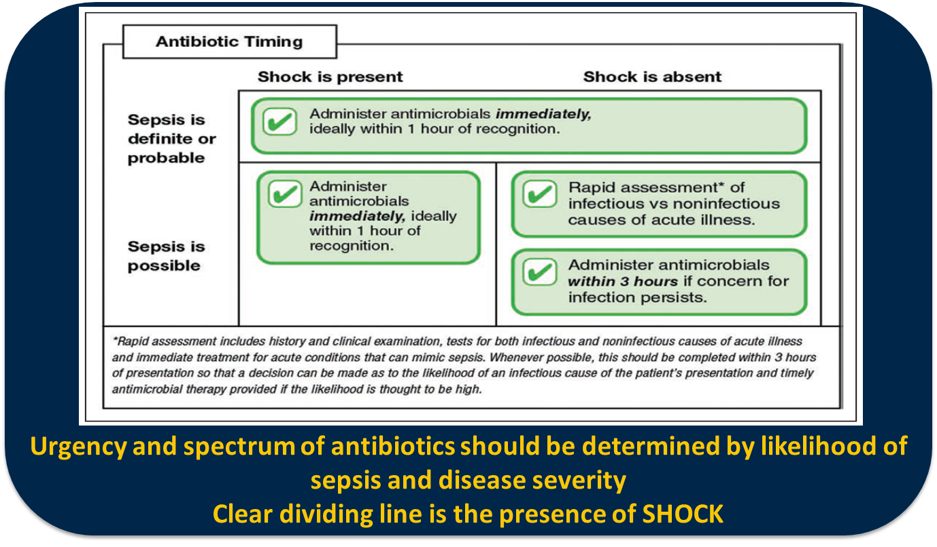
Putting it all Together
Definition
Screening
Screening
Antibiotics
Vasopressors
Monitoring
Pulmonary and Critical Care Medicine

Slide 31
Treatment – Focus on Initial Management
Source Control = Appropriate Antibiotics + Source of Infection Addressed
Fluids and If shock: Vasopressors/Steroids
Assessment of resuscitation
Pulmonary and Critical Care Medicine

Slide 32
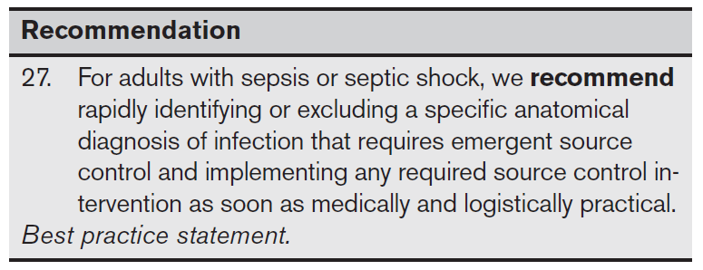
Treatment – Focus on Initial Management
Source Control = Appropriate Antibiotics + Source of Infection Addressed
Pulmonary and Critical Care Medicine

Slide 33
Treatment – Focus on Initial Management
Source Control = Appropriate Antibiotics + Source of Infection Addressed
Fluids and If shock: Vasopressors/Steroids
Assessment of resuscitation
Pulmonary and Critical Care Medicine

Slide 34
Treatment – Focus on Initial Management
Source Control = Appropriate Antibiotics + Source of Infection Addressed
Fluids and If shock: Vasopressors/Steroids
Assessment of resuscitation
Pulmonary and Critical Care Medicine

Slide 35
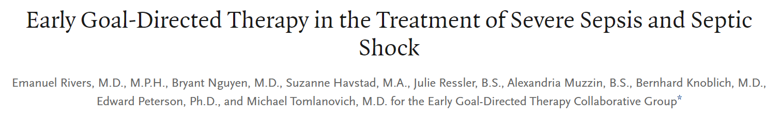
Fluids/Vasopressors – Many Questions?
How much fluid? What kind of fluid? When to give fluid?
When should I use vasopressors? What vasopressor? Do I have to administer them through a central line?
Challenging because the era of having the “Sepsis Cookbook” is gone…
Pulmonary and Critical Care Medicine

Slide 36
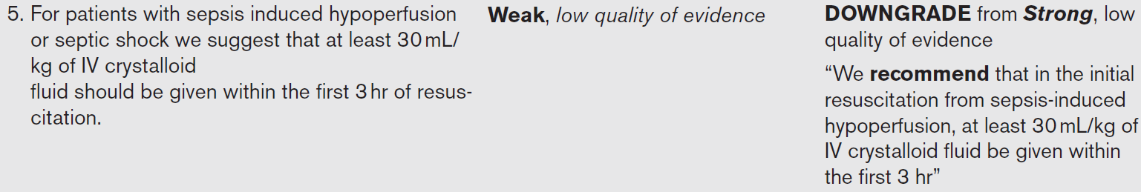
Fluids/Vasopressors – Many Questions?
Not a lot of guidance
Pulmonary and Critical Care Medicine

Slide 37
Fluids/Vasopressors – Many Questions?
Changes over time
BASICS
SMART
SALT-ED
NEJM/JAMA
2018-2021
PROCESS
PROMISE
ARISE
NEJM 2014-2015
CLOVERS
CLASSIC
NEJM 2022-2023
Rivers EGDT
NEJM 2001
Protocolized
Care
No difference between EGDT and Usual Care
Mixed results but favor balanced crystalloid (eg LR) based on mortality and renal failure endpoints
No difference between liberal (fluid first) and restrictive fluid (early pressors) strategy
5L fluid resuscitation in first 6hrs
3.5 to 5.5L fluid resuscitation from presentation to 6hrs
Pulmonary and Critical Care Medicine

Slide 38
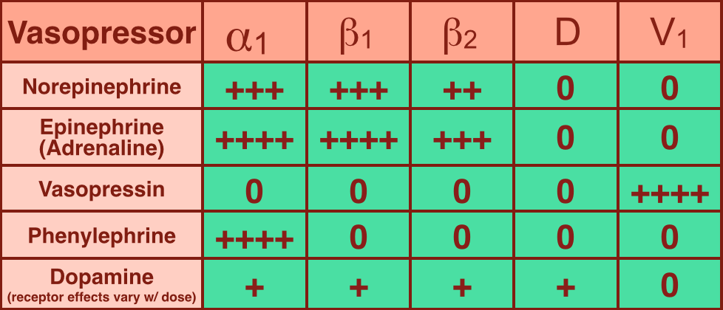
Vasopressors
Pulmonary and Critical Care Medicine

Slide 39
Vasopressors
Just use norepinephrine!
Pulmonary and Critical Care Medicine

Slide 40
Fluids and If shock: Vasopressors/Steroids
Take Home Points
Current standard of care based on large trials is ~3-4L of fluid through the first 6hrs of resuscitation
Caveat is those that may be harmed by fluid or are clearly under-resuscitated
Evidence currently favors balanced crystalloids like lactated ringers for resuscitation
Vasopressors are increasingly being used early and side-by-side with fluids to stabilize patients
First line vasopressor is norepinephrine
Pulmonary and Critical Care Medicine

Slide 41
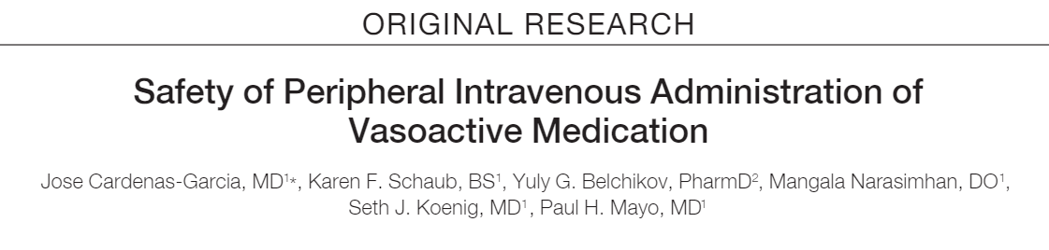
Early Vasopressors Sounds Great:
What about a Central Line?
Vasopressors can be safely given through a peripheral IV, but long-term use should prompt stable central access placement.
Proof-of-Concept in 734 patients
Extravasation rare (~2%)
No tissue injury with treatment (phentolamine/nitro paste)
Pulmonary and Critical Care Medicine

Slide 42
Considerations for Peripheral Vasopressors
Administer through a superficial vessel in the upper extremity proximal to the wrist and distal to the antecubital fossa
Should be checked q1-2hrs by nursing for extravasation
Maintain 2 IVs at all times since they fall out
If Extravasation:
Phentolamine: Inject 5-10mg (diluted in 10mL of 0.9% sodium chloride). Inject subcutaneously in 2 mL increments into and around the extravasation site at the leading edge in a clockwise manner. Use a new 25-gauge needle for each injection. Administer as soon as possible, but within 12 hours of extravasation.
Pulmonary and Critical Care Medicine

Slide 43
Steroids – Brief Version
Two recent large trials of steroids in septic shock
ADRENAL NEJM 2018
APROCCHSS NEJM 2018
Used 200mg hydrocortisone either continuous or intermittent over 24hrs +/- fludrocortisone
Mixed signal for mortality but other benefits include faster resolution of shock and respiratory failure
Importantly no signal for harm
Increased use in persistent or refractory shock
Pulmonary and Critical Care Medicine

Slide 44
Putting things together
Unstable Pt w/
Septic Shock
Fluids
Vasopressors
Start: 2L balanced Crystalloid
Concurrent Peripheral Norepinephrine administration
Target: Total 3-4L balanced crystalloid resuscitation unless contraindicated
2nd Line Vasopressor – Vasopressin
Stress dose Steroids if refractory
More Stable Patient
Pulmonary and Critical Care Medicine

Slide 45
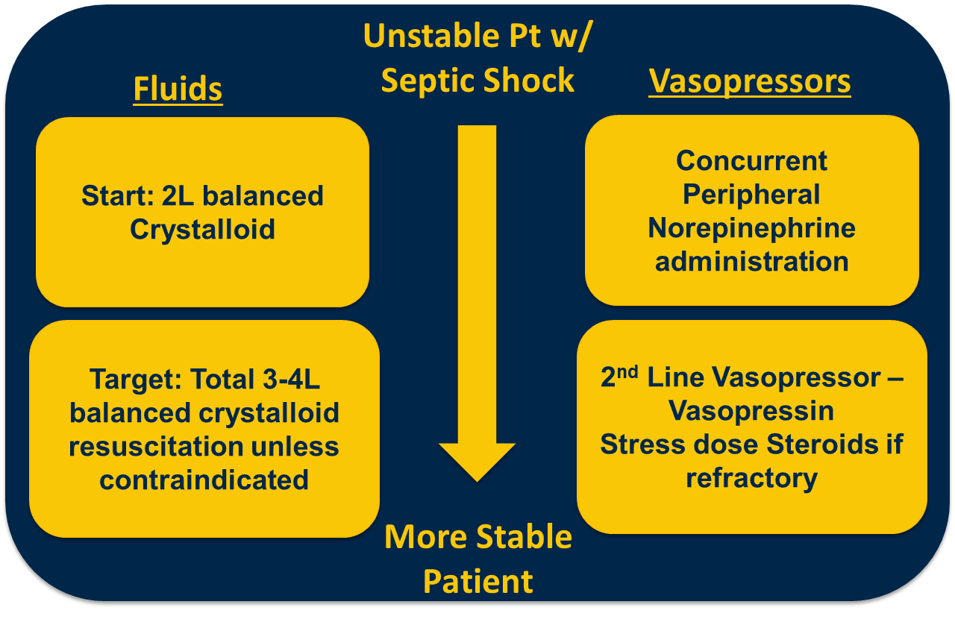
Putting it Together
Definition
Screening
Screening
Antibiotics
Vasopressors
Monitoring
Pulmonary and Critical Care Medicine

Slide 46
Monitoring Resuscitation and Reviewing Progress
Parameters to Monitor
Hemodynamics – HR, MAP (target ≥65)
Exam – Capillary Refill
Labs – Lactate, Creatinine
Urine Output (goal ≥0.5cc/kg/hr)
Ultrasound
Can’t chase a single parameter in isolation
If things are not improving, consider the following:
Is my antibiotic coverage sufficient?
Is there an addressable source that I am missing?
Pulmonary and Critical Care Medicine

Slide 47
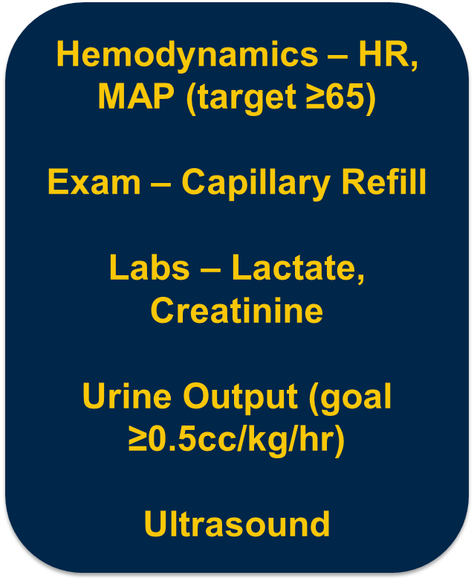
Putting it all Together
Definition
Screening
Diagnostics
Antibiotics
Vasopressors
Monitoring
Pulmonary and Critical Care Medicine

Slide 48
Thank you!
Questions?
  Email: dclaar@med.umich.edu
Pulmonary and Critical Care Medicine

