Slide 1
The Chickasaw Nation’s Empowered Living Clinic
Dr. Stephanie Schofield MD, FAAP, DABOM
LCDR Kayla Dewitt, PT, DPT, TPS, CFPS
March 10, 2023

Slide 2
Disclosures
In the past 12 months, Stephanie Schofield and Kayla Dewitt have no relevant financial relationships with the manufacturer(s) of commercial services discussed in this CME activity.
We do not intend to discuss and unapproved/investigative use of a commercial product/device in our presentation.

Slide 3
Learning Objectives
Recognize how best practices for pediatric obesity management can be applied in an Indian Health Service setting.
Identify strengths of a team-based approach to pediatric obesity management.
Be informed on how to integrate these principles of care into their daily practice.

Slide 4
Background Information
Pediatric obesity statistics
Our population statistics
Trends in obesity and severe obesity… (Hales et al 2018)
Longitudinal trends in body mass index…(Lange et all 2021)
Notes:
Hales CM, Fryar CD, Carroll MD, et al. Trends in obesity and severe obesity prevalence in US youth and adults by sex and age, 2007-2008 to 2015-2016. JAMA. 2018;319:1723-1725.
Lange S. J. Kompaniyets L. Freedman D. S. Kraus E. M. Porter R. Blanck H. M. Goodman A. B. & DNP3. (2021). Longitudinal trends in body mass index before and during the covid-19 pandemic among persons aged 2-19 years - united states 2018-2020. Mmwr. Morbidity and Mortality Weekly Report 1278–1283. https://doi.org/10.15585/mmwr.mm7037a3

Slide 5
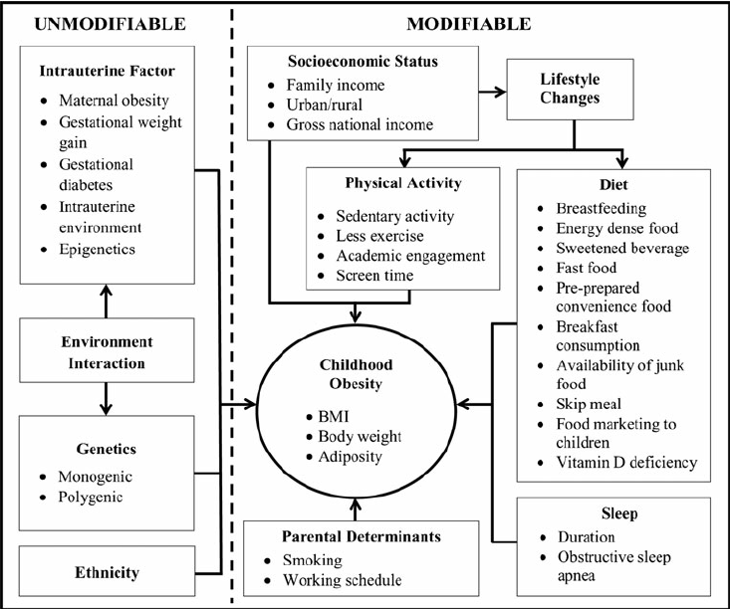
Social determinants of health factors
Multifactorial Influences of Childhood Obesity (Ang et al 2012)
Notes:
Ang, Yeow & Wee, Bee Suan & Poh, Bee & Ismail, Mohd. (2012). Multifactorial Influences of Childhood Obesity. Current Obesity Reports. 2. 10.1007/s13679-012-0042-7.

Slide 6
History of Empowered Living
2015
Empowered Living established
2022
Full time Empowered Living Team established
Ardmore Health Clinic and Chickasaw Nation Medical Center
½ day per week
Ardmore Health Clinic
Expanded day/times
Notes:
Barlow, S. E., & Expert Committee. (December 01, 2007). Expert committee recommendations regarding the prevention, assessment, and treatment of child and adolescent overweight and obesity: summary report. Pediatrics.

Slide 7
Pediatric Obesity Management
Collaboration from multiple departments
Guidance from experts in the field
Facilitation trainings and collaboration
Journal Clubs
Pediatric Integration Plan
Chart Reviews

Slide 8
Pediatric Obesity Management
Staged approach and consult system
Expert committee recommendations regarding..(Barlow et al 2007)
Notes:
Barlow, S. E., & Expert Committee. (December 01, 2007). Expert committee recommendations regarding the prevention, assessment, and treatment of child and adolescent overweight and obesity: summary report. Pediatrics.

Slide 9
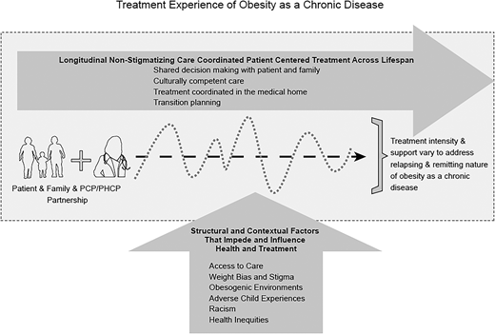
Current Guidelines
Treatment experience of obesity as a chronic disease (this figure illustrates how longitudinal care is important to help address this chronicity and to address and buffer the social and contextual factors that influence a person’s health).
Clinical Practice Guidelines for the Evaluation and Treatment of Children and Adolescents With Obesity (Hampl et al 2023)
)
Notes:
https://publications.aap.org/pediatrics/article/doi/10.1542/peds.2022-060640/190443/Clinical-Practice-Guideline-for-the-Evaluation-and?autologincheck=redirected

Slide 10
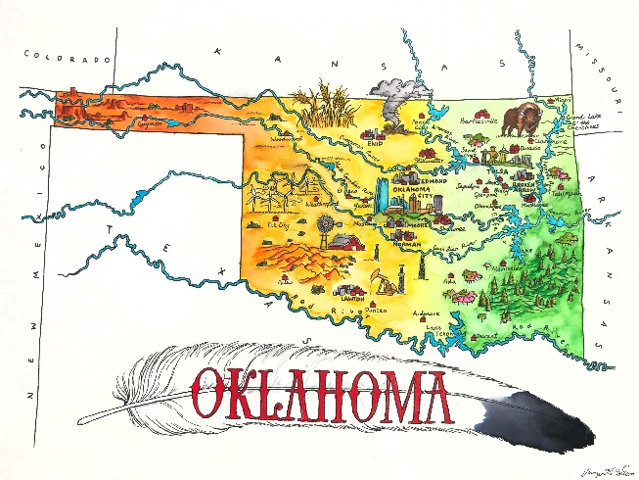
Pediatric Obesity Management
Adapting to our practice setting
Incorporating telehealth visits to improve access
Expansion of services
This Photo by Unknown Author is licensed under CC BY-NC
This Photo by Unknown Author is licensed under CC BY-NC

Slide 11
Health Equity Considerations
Variety of cultures and socioeconomic backgrounds
Look at the patient, family, and environment as a whole
Resources
Tribal
State
Federal

Slide 12
Team Based Approach
Patient visits involve a high level of collaboration before, during, and after the visit.
Leads to a higher level of care.
Leads to addressing concerns from multiple angles.
Helps our team to reinforce patient goals that may be outside our areas of expertise.

Slide 13
Weight Bias and Stigma
What to focus on
Health and growth
Overall wellness
Terms and words that children/families prefer to use
Clear communication and clarification
An optimistic, strength-based approach
Acknowledgement that both height and weight are the result of the interaction of genetics/heredity and the environment
Body diversity

Slide 14
Weight Bias and Stigma
What to avoid
Unclear language
Blaming language or focusing on what the child can’t do or should stop doing
Labeling children according to body type terminology
Using growth charts to shock or shame
Solely focusing upon weight, size, or BMI
Comparing children with norms where little normative data exits

Slide 15
Comprehensive Obesity Treatment
What to avoid
Unclear language
Blaming language or focusing on what the child can’t do or should stop doing
Labeling children according to body type terminology
Using growth charts to shock or shame
Solely focusing upon weight, size, or BMI
Comparing children with norms where little normative data exits
Notes:
SS: As a part of the new clinical practice guidelines, there was a big focus on reducing stigma and treating obesity as a chronic disease along side other health concerns and comorbidities.
I am clear with my families that I am most concened about their child’s health and not what the scale says. Just the other day, I was able to clarify this with a family and a child who was shaming himself by name calling and had been bullied at school due to his weight. He agreed that he would never make fun of a child for having asthma so why would he make fun of himself for having obesity. We were then able to focus on goal setting for changes that he was able to make to improve his health and reduce risk of diabetes – his parent’s main concern.

Slide 16
Integrate Into Daily Practice
Motivational interviewing
This Photo by Unknown Author is licensed under CC BY

Slide 17
Integrate Into Daily Practice
Goal setting
This Photo by Unknown Author is licensed under CC BY-SA

Slide 18
Integrate Into Daily Practice
Ask 7 questions
What does the patient want to do?
What small steps could help them accomplish their goal?
What could make it easier?
What might make it harder?
When will you do this?
How will they keep track of what they do?
When will they review how it’s going?

Slide 19
Integrate Into Daily Practice
Collaborate with your patient’s team
Quick email
Phone call
Tag in a note in your electronic medical record to ensure that they stay up to date on patient’s care
Notes:
SS: We encourage other clinicians to use collaboration in their practice setting even if they are not a part of a multidisciplinary team.

Slide 20
Case Example

Slide 21
Patient
6-year-old female patient
Initial family concerns
Activity level
Is she just “big boned”?
Why is she not active?
Worry about changing family diet
Strengths
Equipment for activities
“Social Butterfly”
Change is important to family

Slide 22
Further History
Nutrition
Not a picky eater
Described as “always hungry”
Activity
Easily fatigued when running
Good at bike riding.
Sleep and Screen time
Gets 1-2 hours screen time daily
Gets 11 hours of sleep at night
Reports snoring

Slide 23
Medical and Surgical History
Risk factors
Maternal obesity
Early antibiotics
C-section
Protective factors
Breastfeeding
ADHD
Stimulant medication

Slide 24
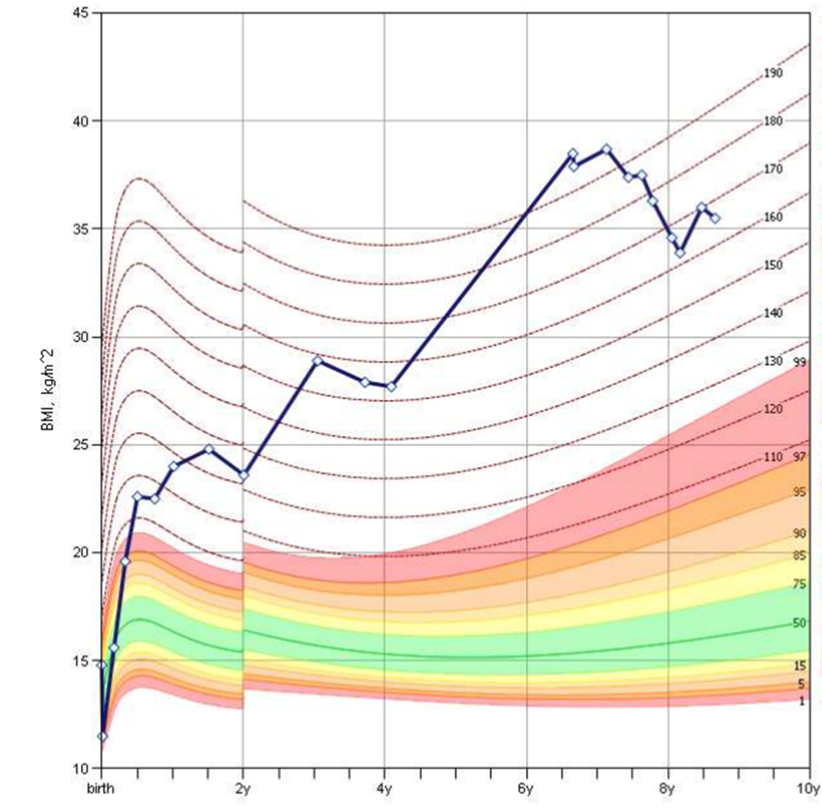
Growth Chart

Slide 25
Family and Social History
Family History: Obesity, history of bariatric surgery, gallbladder disease, mental health concerns, and type 2 diabetes.
Social History:
Lives with parents and older brother
Attends public school
Culture
First American
Chickasaw and Apache

Slide 26
ROS
General
Denies fevers or recent illness
ENT
Reports snoring
Resp
Short of breath with activity
Skin
Positive for darkening of skin around neck and underarms
MSK
Will complain of pain with activity – unsure if pain or “boredom”
Sleep
Snoring, denies pauses in breathing
Neuro, Pysch, GU, GI, CV, and Endo systems negative.

Slide 27
Vital Signs and Physical Exam
Weight - 62.46 kg (137.57 lbs)
Height - 128.27 cm (50.5 in)
BMI - 37.96, 197% of the 95th percentile
BP 115/51
Stage 1 HTN for age, sex, and height
Exam findings
Acanthosis noted on neck
Sexual Maturity Rating - I
No hepatomegaly palpable
Difficult exam due to habitus
Lungs clear, normal S1, S2 no murmur
Full ROM of major joints

Slide 28
Laboratory Results
Labs
Glucose | 98
A1C | 5.1
ALT | 33
TC | 132
TG | 85
LDL | 89
HDL | 39
Visit | Initial
Genetic Testing through uncovering rare obesity program - indeterminate

Slide 29
Management
Obesity, Elevated blood pressure, Insulin resistance, Hypertriglyceridemia, Hypoalphalipoproteinemia, Exercise
Motivational Interviewing
SMART Goal Setting Techniques
Initial Goals based on family response to education
Eat the colors of the rainbow over the next two weeks
Trial a 10-minute kids exercise video as a family
Strengths Identified
Strong family support
Follow up in 2 weeks, then every 4-6 weeks
During follow ups, early adrenarche found

Slide 30
Progress
Goals
Using reminder signs to work on a routine (picture schedule)
30 minutes of moderate physical activity 5 times a week
Continue to focus on eating colors of the rainbow, trying a new fruit or vegetable every 1-2 weeks
Ride bike 3 times per week for at least 10 minutes
Stretches and dance work outs (online) 3 x per week

Slide 31
Progress in Labs
Labs
Glucose | 98 | 91 | 93 | 91 | 92
A1C | 5.1 | 5.1 | 5.3 | 5.2 | 5.1
ALT | 33 | 34 | 30 | 19 | 21
TC | 132 | 144 | 138 | 149 | 141
TG | 85 | 94 | 107 | 65 | 79
LDL | 89 | 93 | 81 | 91 | 82
HDL | 39 | 46 | 46 | 53 | 50
Visit | Initial | 6 months | 12 months | 18 months | 24 months

Slide 32
Abnormal Labs at Baseline Visit

Slide 33
Patients with Stable or Improved Labs
Over 6 Months

Slide 34
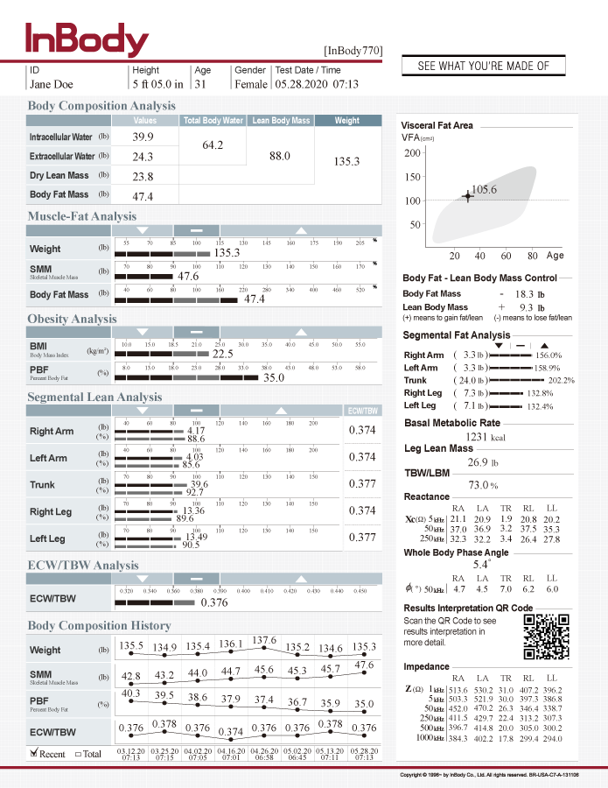
Progress in InBody
Notes:
770 Result Sheet Interpretation - InBody USA

Slide 35
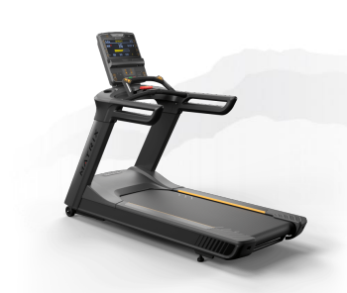
Progress in Treadmill Test

Slide 36
Growth Chart
Notes:
Since starting our clinic our patient’s BMI percentile has gone from 197% of the 95th percentile to 156% of the 95th percentile over about 27 months.

Slide 37
Areas for continued improvement
Blood pressure remains in stage I-II HTN zone for age and height
For Children Aged 1-<13 y | For Children Aged ≥13 y
Normal BP: <90th percentile | Normal BP: <120/<80 mm Hg
Elevated BP: ≥90th percentile to <95th percentile or 120/80 mm Hg to <95th percentile (whichever is lower) | Elevated BP: 120/<80 to 129/<80 mm Hg
Stage 1 HTN: ≥95th percentile to <95th percentile + 12 mmHg, or 130/80 to 139/89 mm Hg (whichever is lower) | Stage 1 HTN: 130/80 to 139/89 mm Hg
Stage 2 HTN: ≥95th percentile + 12 mm Hg, or ≥140/90 mm Hg (whichever is lower) | Stage 2 HTN: ≥140/90 mm Hg
https://publications.aap.org/pediatrics/article/140/3/e20171904/38358/Clinical-Practice-Guideline-for-Screening-and?autologincheck=redirected

Slide 38
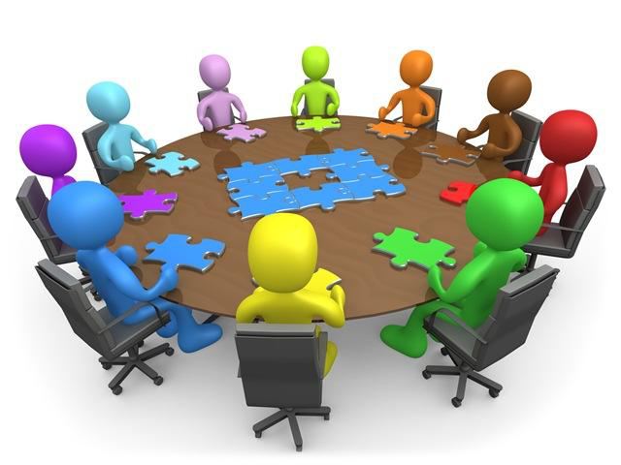
Empowered.Living@chickasaw.net
This Photo by Unknown Author is licensed under CC BY-SA

Slide 39
Improvements in BMI and BMI Percentile
Percent
n=49

Slide 40
BMI at Baseline and 6 Months
n = 23
Notes:
REMOVE SLIDE

