Slide 1
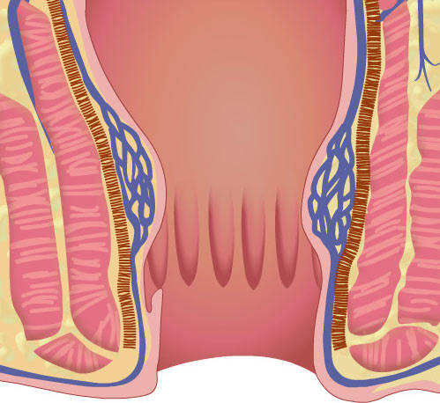
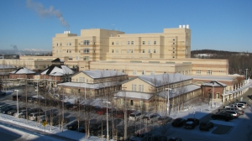
Anorectal Disease Management
Sheridan Morgan MD
General & Colorectal Surgery
Alaska Native Medical Center

Slide 2
Disclosures
No Relevant Disclosures

Slide 3
Rectum
Distal 12-15 cm of the Large Bowel
Colon becomes rectum at level of the sacral promontory, where tinea splay forming continuous outer muscular layer
Anterior to Rectum: Women - uterus, cervix, posterior wall of vaginal
Men - bladder, prostate
Proceeds posteriorly along curvature of sacrum & coccyx to anal canal
Upper 1/3rd – anterior / lateral surfaces - intraperitoneal
Middle 1/3rd – anterior surface - intraperitoneal
Lower 1/3rd – entirely extraperitoneal
Mesorectum - areolar tissue surrounding rectum: nerves, lymphatics, nourishing vessels
Well Vascularized: Inferior Mesenteric Artery (IMA) → Superior Rectal Artery
Internal Iliac → Middle Rectal Artery
Internal Pudendal Artery → Inferior Rectal Artery

Slide 4
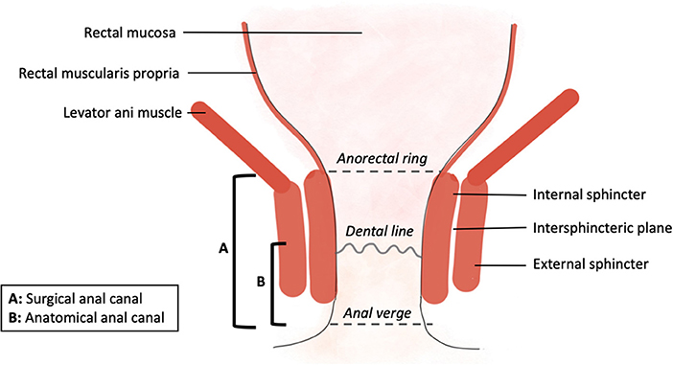
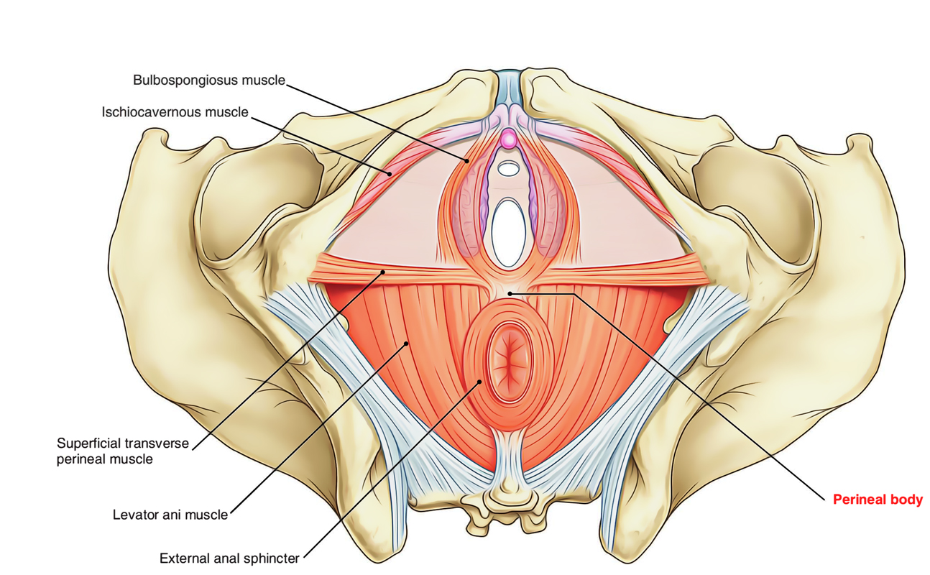
Anus / Anal Canal
Anal Canal: begins at level of pelvic floor (anorectal ring), extends to the anal verge
Anal Canal 2-4cm in length, men > women
Internal sphincter muscle, continuation of circular muscle of rectum
External sphincter muscle, continuation of pelvic floor musculature
Both muscles encircle the anal canal and contribute to continence
Internal sphincter - automimic innervation
External Sphincter - somatic innervation
Dentate line - marks transition between columnar epithelium of the rectum & squamous epithelium of the anus
Anal crypts at the level of the dentate line lubricate anal canal
Perineal Body: tendinous insertion of external sphincter muscles & pelvic floor musculature

Slide 5
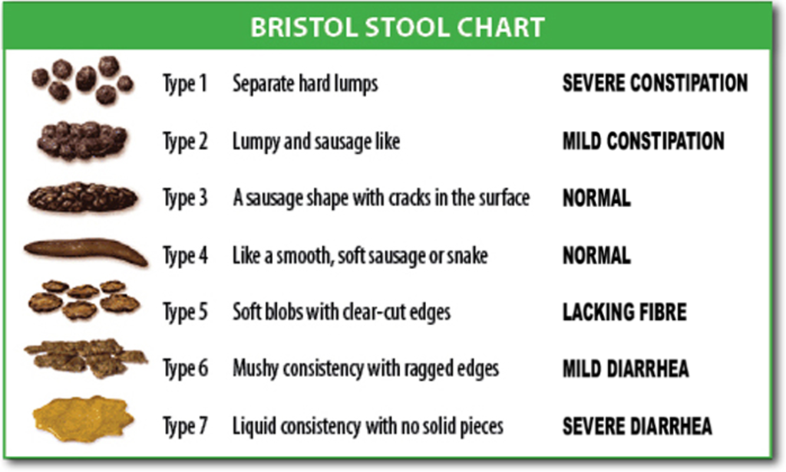
Anorectal Clinical History
Perianal symptoms: Lumps/Bumps, Rash, Pain, Drainage, Fullness
Rectal symptoms: Rectal bulging, Rectal pain, Prolapsing tissue, Rectal bleeding
Rectal Bleeding: -Blood on toilet paper w/ whipping - anal bleeding
-Bright red blood per rectum - lower GI bleed
-Dark stool / tarry stool - melena, upper GI bleed
Stool changes: consistency of stool, frequency of bowel movements, color
Systemic symptoms: fevers, chills, light headedness, dizziness, stress, rashes
Medication changes: stool softeners, laxatives, opioids, calcium etc…
Dietary changes, family history, other systemic diseases etc.

Slide 6
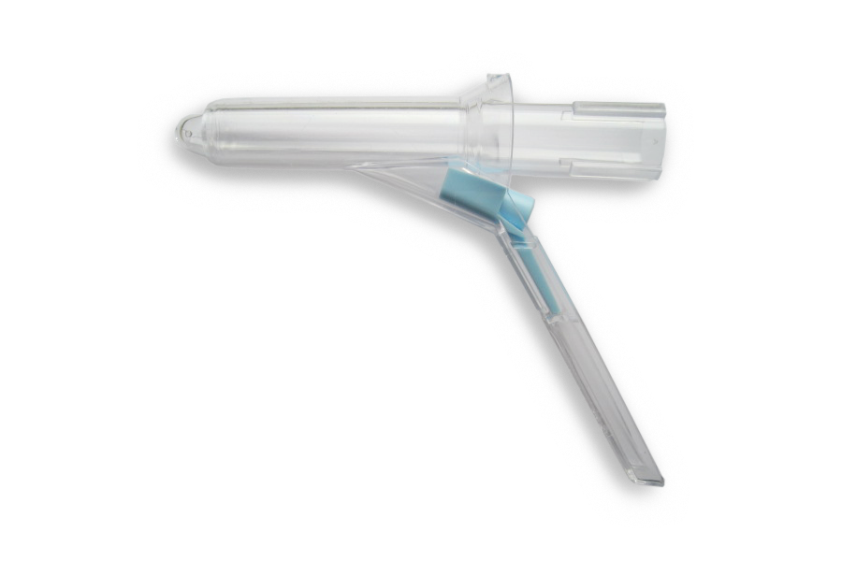
Anorectal Examination
Positioning: Left Lateral vs Prone vs Lithotomy
Inspection: examine the entirety of the perianal tissue, skin of buttocks and perineum, consider GU exam depending on symptoms
-look for: rash, erythema, fluctuance, fullness, skin tags, etc.
Digital Rectal Exam: insert lubricated finger, palpate circumferentially
-feel for: anal tone, fullness, masses, defects of anal musculature & anal mucosa
Anoscope: allows for inspection of the mucosa of the anal canal and distal rectum
-very useful for examination of internal hemorrhoids
-Disposable plastic lighted anoscopes are readily available and cheap
For Rectal Bulging complaints: Perform examination with patient straining on commode

Slide 7
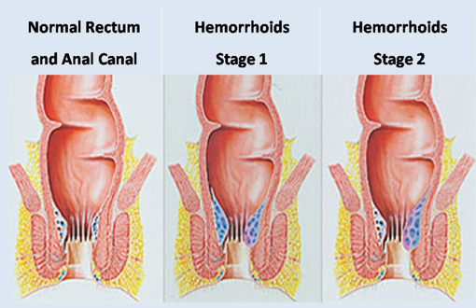
Hemorrhoids
Submucosal tissue of the anal canal containing arterial-venous plexus
Cushion the anal canal to aid in continence
Straining, constipation and hard stools → engorge hemorrhoids → symptoms
Three Pillars: Left Lateral, Right Anterior and Right Posterior
External Hemorrhoids: distal to the dentate line, covered by anoderm, sensate
-engorgement → itching, discomfort and pain
Internal Hemorrhoids: proximal to dentate line, insensate
-engorgement → swelling, bleeding, bulging & prolapsing of tissue
Enlarged Internal Hemorrhoids:
1st Degree - prolapse on straining
2nd Degree - prolapse spontaneously, reduce spontaneously
3rd Degree – prolapse & require manual reduction
4th Degree - cannot be reduced

Slide 8
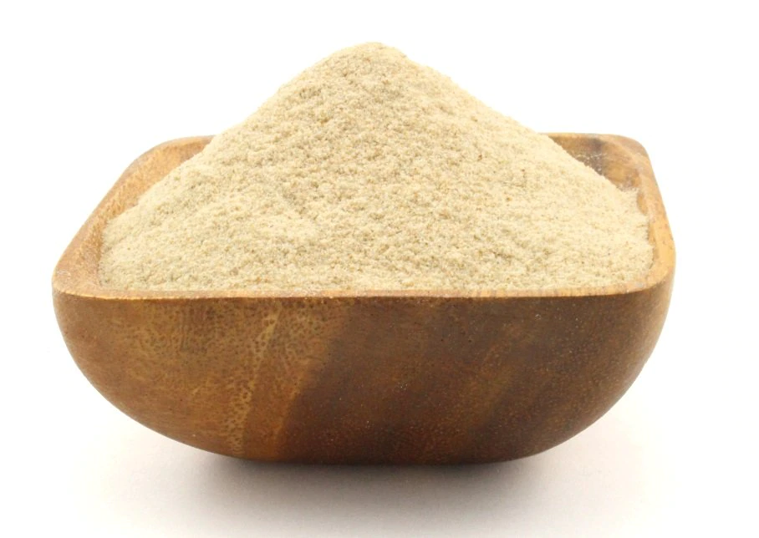
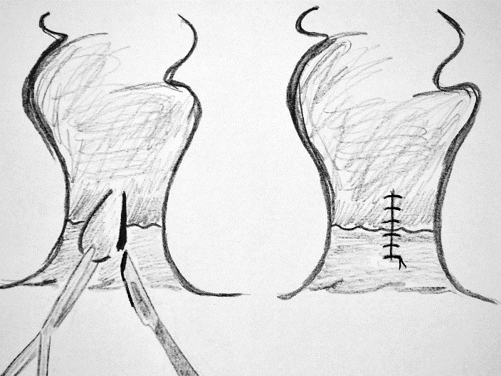
Symptomatic External Hemorrhoids
History: Perianal fullness, Perianal pain, Blood with whipping, recent changes in bowel habits
PE: -Enlarged vascular tissue around anus in 1-3 columns
-May become engorged with staining
-May or may not be accompanied by enlarged internal hemorrhoids
TX: Dependent on severity of symptoms
Conservative treatment: -increased fluid intake -increased exercise -increase dietary fiber -daily sitz baths
-therapeutic psyllium husk, 25g/day females, 38g/day males
-constipated - TX stool softeners / laxatives -diarrhea - TX antidiarrheal
Acute symptoms: Preparation H, Lidocaine, Steroid creams etc. - may help relieve symptoms, will not shrink hemorrhoids
Longstanding or severely symptomatic external hemorrhoids: surgical excision

Slide 9
Thrombosed External Hemorrhoid
History: -Perianal fullness / pain with an acute perianal lump
-No fevers and chills
PE: -Enlarged vascular tissue around anus with dark nodule at site of symptoms
TX: -Depends on symptom severity, and timing of presentation
-Conservative management vs excision for symptom management
Conservative treatment: -increased fluid intake –non-narcotic pain control
-increase dietary fiber, stool softeners -daily sitz baths
-Preparation H, Lidocaine, Steroid creams etc.
-Symptoms should resolve in 2-4 weeks
Severe symptoms: Excision vs clot drainage at bedside with local anesthetic

Slide 10
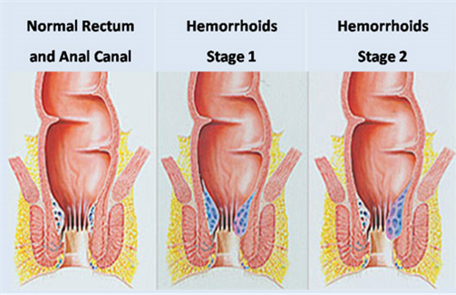
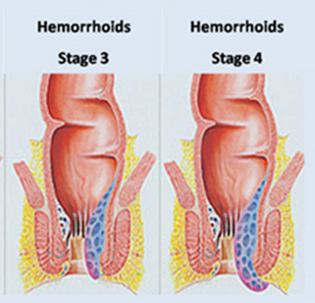
Symptomatic Internal Hemorrhoids
History: Rectal bleeding, blood with whipping, anal fullness, recent changes in bowel habits
PE: may have associated external hemorrhoids, internal hemorrhoids not usually visible on external inspection
likely not palpable on DRE, best examined with anoscope or with patient straining on commode
Grading of Internal : 1st Degree - prolapse on straining
2nd Degree - prolapse spontaneously, reduce spontaneously
3rd Degree - require manual reduction
4th Degree - cannot be reduced
TX: Dependent on severity of symptoms
Conservative treatment: -increased fluid intake -increased exercise -increase dietary fiber -daily sitz baths
-therapeutic psyllium husk, 25g/day females, 38g/day males
-constipated - TX stool softeners / laxatives -diarrhea - TX antidiarrheal
Grade 1,2 & 3 w/o external component: rubber band ligation vs. sclerotherapy
Grade 3&4 or symptomatic internal & external hemorrhoids: surgical excision

Slide 11
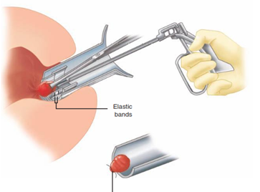
Rubber Band Ligation, Sclerotherapy
Rubber Band Ligation: for patients w/ internal hemorrhoids who failed conservative TX
-band placed around superior aspect of hemorrhoid tissue above dentate line
- Tissue sloughs → fibrosis occurs at site → fixation of tissue to prevent prolapse
-80% of patients have relief of symptoms, generally well tolerated
-Contraindicated in pts w/ cirrhosis & pts requiring anticoagulation
Severe perianal sepsis - rare complication - pain, fever, inability to void
Sclerotherapy: -another bedside procedure for internal hemorrhoids
-injection of sclerosing agent (phenol) into submucosa of hemorrhoid
-usually performed in clinic w/ anoscope
-causes fibrosis of surrounding tissue → shrinkage of hemorrhoids

Slide 12
Hemorrhoids, Operative Treatment
Indications for Surgery: -failure of conservative management or office procedures
-combined internal & external hemorrhoids -Large grade 3 or 4 hemorrhoids
-Acutely thrombosed or necrotic hemorrhoids
Surgical hemorrhoidectomy: superior for achieving complete remission of symptoms
Complications: severe pain, incontinence, anal stenosis & anal sepsis
Technique:
-Prone Jack-knife position, buttocks taped apart
-elliptical incision from anoderm up to dentate line, to include entire enlarged hemorrhoid
-remove hemorrhoid up to IAS w/ bovie, knife or scissors taking care not to damage IAS
-1,2 or 3 columns may be excised at once, normal anoderm left between sites to avoid stenosis
-Wound may be left open or closed w/ absorbable suture

Slide 13
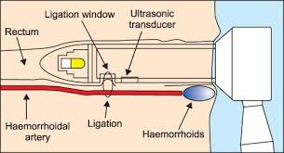
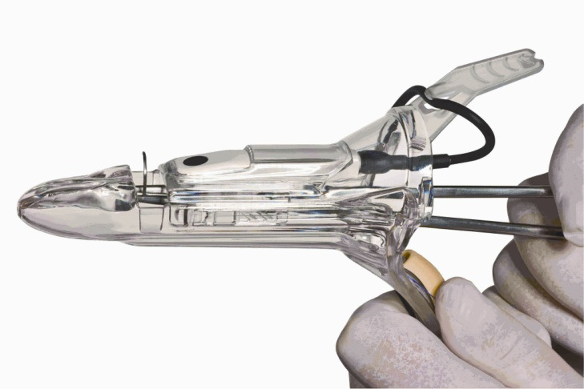
Hemorrhoids, doppler-guided transanal devascularization
Suture ligation of each hemorrhoidal column under doppler guidance
Technique:
-Specific anoscope w/ doppler probe used to identify feeding vessel just above column
-Through anoscope, ligate feeding vessel just above top of column
-Doppler used to confirm disappearance of signal
-Remainder of column is over sewn w/ suture
Advantage: Less post-op pain,
Disadvantages: Higher risk of recurrence compared to excision
Used for internal hemorrhoids only

Slide 14
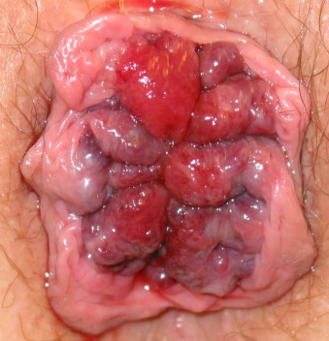
Incarcerated Hemorrhoids
Prolapsed fourth-degree hemorrhoids can become incarcerated
Severe pain, Urinary Retention
TX: pain medication → reduction → elective surgery
Urgent hemorrhoidectomy

Slide 15
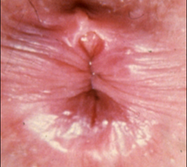
Anal Fissure
Tear in mucosa of anal canal distal to dentate line
Classified as acute vs chronic / primary vs. secondary
Acute < 6 weeks, Chronic > 6 weeks
Primary - almost always in posterior or anterior location
Causes: trauma to anal canal, hard stool, diarrhea, childbirth, hypertonicity w/ high resting pressure
Secondary - associated w/ Crohn’s, HIV, tuberculosis, syphilis or malignancy. May occur in lateral position.
Presentation: pain w/ defecation, tearing sensation persists after bowel movement, bright red blood separated from stool on toilet paper, constipation from fear of pain
Dx: Made on physical exam, spreading buttocks, oval shaped or longitudinal tear in anal mucosa associated w/ sentinel pile (a skin tag at distal end of fissure), Avoid anoscope (pain)

Slide 16
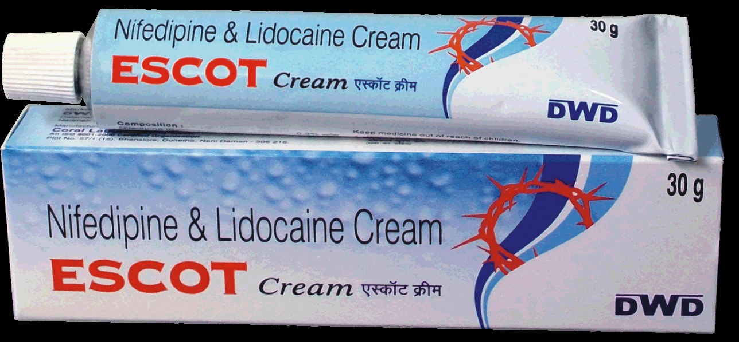
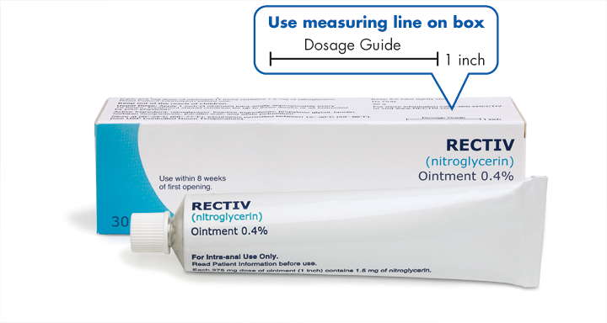
Anal Fissure, Medical Treatment
Most Fissures will heal by medical management within 6 weeks
Warm Sitz bath 2-3 times per day, symptomatic relief
Medial therapy is directed at decreasing resting pressure
Nitric oxide: potent neurotransmitter induces relaxation of IAS
-BID application of 0.2% nitroglycerine for 6 weeks
-induces healing in 85% of pts
-causes nitrate induced headache in some patients
calcium channel blockers used locally can cause IAS relaxation
-Diltiazem 2% or Nifedapine 0.2% ointment application BID for 6 weeks
-no headache, similar healing rates to Nitric oxide, preferred
-can only be obtained at compounding pharmacy (Bernies Pharmacy Anchorage)

Slide 17
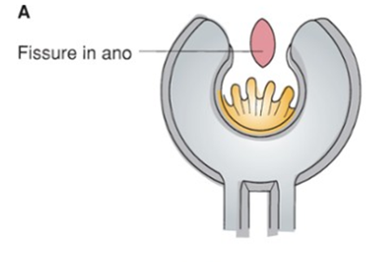
Anal Fissure, Surgical Treatment
Indicated after 6 weeks of failed medical therapy
Botulinum toxin: endopeptidase, blocks acetylcholine release at neuromuscular junction
-Botox injected into IAS complex → relaxation of IAS (2-4months) → healing of fissure
-option for pts who are not surgical candidates or to avoid fecal incontinence
-50-70% rate of healing fissure
Lateral Internal Anal Sphincterotomy: healing rate of 90-100%
-Not for pts w/ Crohn’s
-can cause fecal incontinence, 10% risk

Slide 18
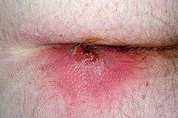
Anorectal Abscess
Most result from infection of anal glands that empty into anal crypts
Infections start in intersphincteric space → seed other areas
Other causes: IBD, trauma, infection (TB, actinomycosis), malignancy
Form in four spaces: perianal, ischiorectal, intersphincteric, supralevator
Frequency: Perianal > ischiorectal > intersphincteric > supralevator
Presentation: Pain, swelling, erythema
perianal / ischiorectal – pain, swelling, erythema
Intersphincteric – pain & swelling only
Supralevator – fever only

Slide 19
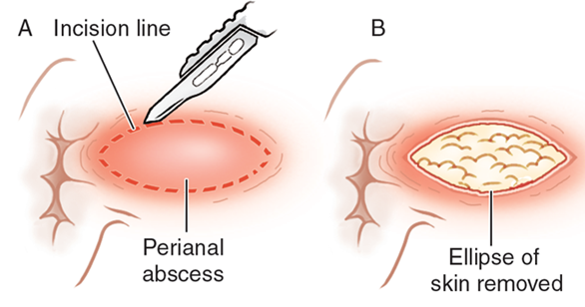
Treatment of Superficial Anorectal Abscess
Incision & Drainage +/- antibiotics for associated cellulitis
Antibiotics alone → progression to more complex abscess
Perianal or Superficial Ischiorectal: can be drained in clinic with local anesthesia
-prep / drain over area
-perform field block with local anesthetic
-cruciate incision or elliptical incision over fluctuance closest to anus
-minimal instrumentation of abscess cavity to avoid nerve injury
-packing needed only for hemostasis
-post-op: -antibiotics if associated cellulitis or if immunocompromised
-BID sitz baths for comfort and to encourage drainage
-follow-up to check for healing and rule out fistula

Slide 20
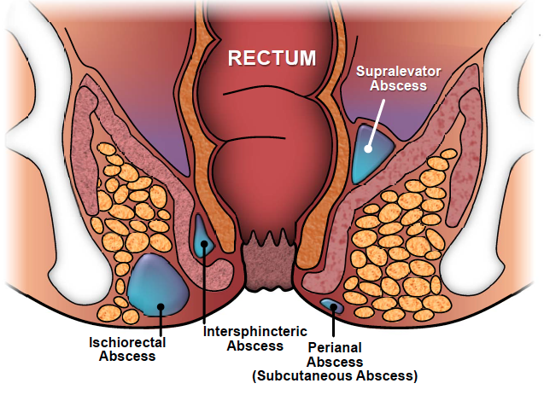
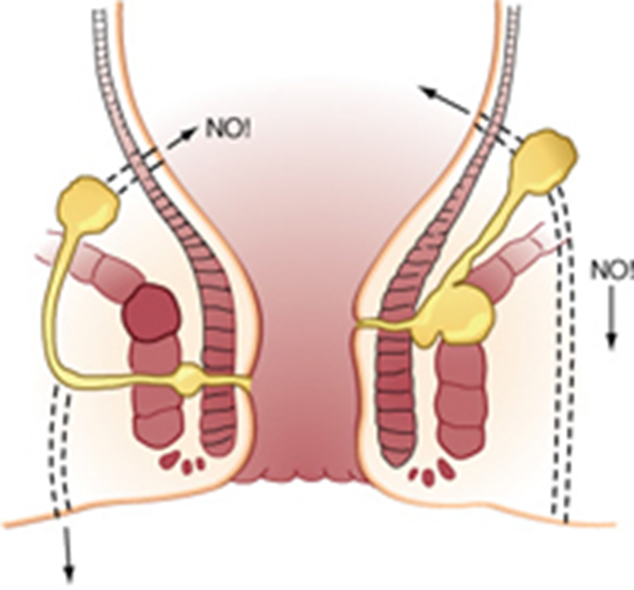
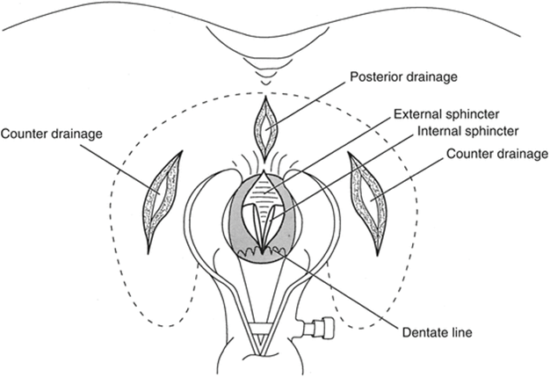
Treatment of Complex Anorectal Abscess
Deeper / Complex Abscess: → Surgical Drainage
Includes: Intersphincteric, Supralevator, Complex ischiorectal abscesses, Horse Abscesses
-May be hard to diagnose
-Consider CT pelvis w/ IV contrast for diagnosis
Intersphincteric Abscess - identified by palpating fullness in anal canal
- drained by dividing internal sphincter along length of abscess surgically
Supralevator Abscess - identified by palpation of induration / fullness above anorectal ring
- best diagnosed by CT or MRI or Pelvis
- May require transrectal drainage or transabdominal surgical drainage
Horseshoe Abscess – Infection in deep postanal space → spreads to ischiorectal spaces
-diagnoses by imaging or identifying induration of deep postanal space & ischiorectal space
-treatment involves external drainage of deep post-anal space and involved ischiorectal space

Slide 21
Anal Fistula
Abnormal communication between anorectal canal & perianal skin
- Occur in 25-35% op patients after perianal abscess -Can also be associated with Crohn’s disease, Hidradenitis or other systemic disease
Presentation: perianal drainage, intermittent perianal swelling, pain w/ defecation,
Physical Exam: -external opening in perianal skin w/ granulation tissue
-sometimes palpate tract under skin
-Sometimes can identify internal opening on DRE or anoscopy
Dx: Rectal exam under anesthesia and / or MRI pelvis
-colonoscopy / flexible sigmoidoscopy - may be useful to R/O IBD or other underlying GI pathology
Classified by relation of fistula tract to sphincter complex:
Subcutaneous- tract passes through skin around anus
Intersphincteric- tract passes between internal / external anal sphincter muscles
Transsphincteric- tract passes through internal / external sphincter muscles
-“low” less than 1/3rd if sphincter complex distal to tract
-”high” greater than 1/3rd of sphincter complex distal to tract
suprasphincteric / extrasphincteric - tract passes above sphincter complex

Slide 22
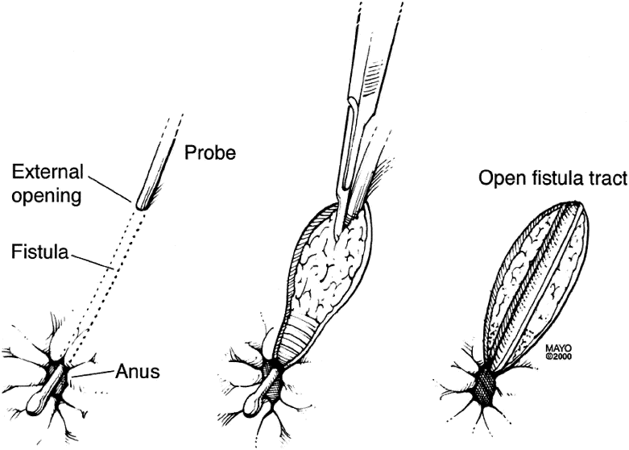
Anal Fistula, Management
Anal fistulas rarely spontaneously resolve and generally require surgical treatment
Specific treatment is dictated by: -underlying cause of fistula
-extent of anal sphincter complex distal to fistula tract
Division of anal sphincter muscle, often required for treatment → impaired continence
High risk for impaired continence: elderly, history of episiotomy, anterior fistula, chronically loose stool ( Colitis, Crohn’s)
General goals for treatment of Anal Fistulas: 1- treat acute perianal infection / inflammation
2- preserve anal continence
3- resolve fistula
Simple Fistulas: Submucosal, intersphincteric, low transsphincteric- low risk of incontinence
-usually safely treated by performing division of fistula tract - “fistulotomy”
Complex Fistulas: High fistulas involving significant sphincter muscle: require complex surgical management
-often handled in staged fashion, -placement of drain “seton” to allow resolution of acute sepsis
-definitive surgical intervention

Slide 23
Fistula Management, Complex Fistulas
LIFT (ligation of intersphincteric fistula tract): -Avoids division of anal sphincter muscles
-Involves identifying fistula tract inside intersphincteric space and dividing tract
-60-70% success rate
-failure may result in less complex intersphincteric fistula

Slide 24
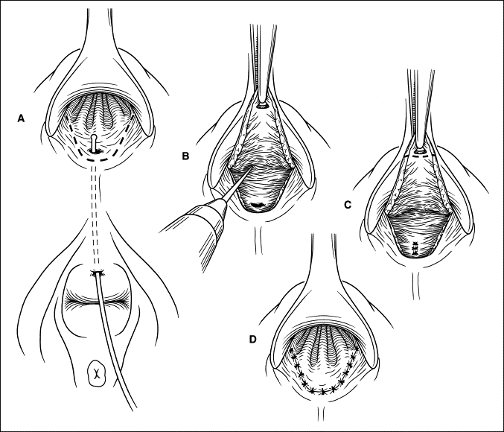
Fistula Management, Complex Fistulas
Endorectal Advancement Flap: -Avoids division of anal sphincter muscles
-Involves covering internal opening of fistula tract with healthy rectal mucosa flap identifying fistula tract inside intersphincteric space and dividing tract
-60-70% success rate
-most broadly applicable surgical option for complex anal fistulas

Slide 25
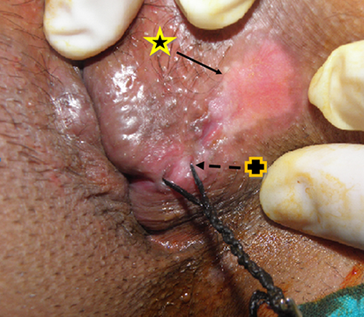
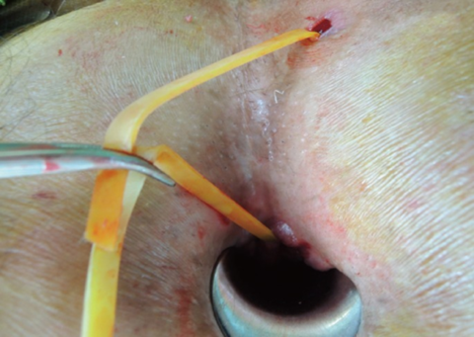
Anal Fistula Management Cont.
Cutting Seton - suture placed through fistula tract & tightened serially
- gradually cuts through sphincter muscle
-risk of fecal incontinence
- may be used as definitive treatment or leading up to sphincterotomy
Draining Seton: -vessel loop or pediatric feeding tube secured in place in fistula tract
-can be left in place as treatment for complex fistula not amenable to definitive surgery

Slide 26
Rectovaginal Fistula
Patent connection between Vagina and Rectum
Caused by: Obstetric Trauma > Infection, IBD, Radiation, CA, Complicated Diverticulitis
Low Fistulas: distal vaginal → distal rectum, near level of dentate line
High Fistulas: upper vagina or cervix → mid to upper rectum
Simple Fistulas: Low to mid-vagina and caused by Trauma or Infection
Complex Fistulas: High in Vagina and / or caused by Radiation or CA
Presentation depends or seize and location of fistula
Small / Low Fistulas → flatus from vagina
Large fistula → vaginal discharge, odor, recurrent UTIs, vaginitis
Diagnosis: usually on PE: DRE / Bimanual exam → feel defect
Difficult to locate: Anoscopy, Proctoscopy, REUA, methylene blue rectal enema w/ tampon insertion, contrast enema under fluoroscopy

Slide 27
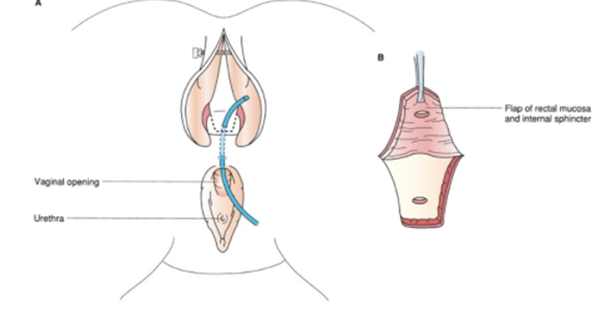
Rectovaginal Fistula, Treatment
Small fistulas from obstetrical trauma: observation for 3 to 6 months, spontaneous healing may occur
Low rectovaginal fistulas may be treated:
-Endorectal Advancement Flap or Vaginal Advancement Flap
Endorectal Advancement Flap

Slide 28
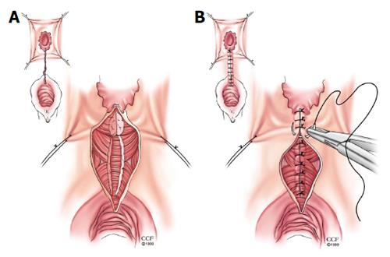
Rectovaginal Fistula Treatment
Low rectovaginal fistula associated w/ incontinence from defect in anal sphincter: Repair defect with Overlapping Sphincter muscle repair

Slide 29
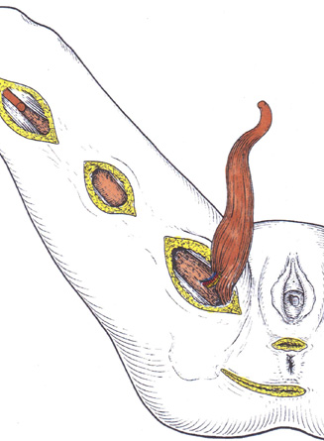
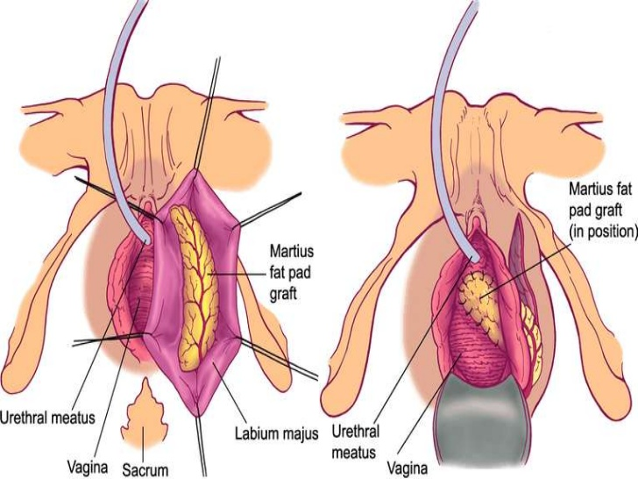
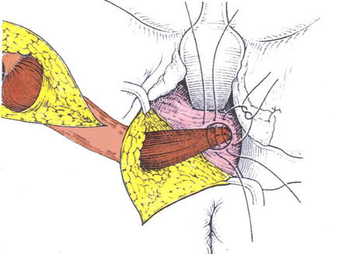
Rectovaginal Fistula Repairs, Complex
For patients w/ failed repairs or complex fistulas:
Closure w/ Interposition grafts: w/ well vascularized tissue between rectum & vagina: Gracilis Muscle, Bulbocavernosus Muscle (Martius flap)
-usually performed after creation of diverting ostomy

Slide 30
Rectovaginal Fistula Repairs, High Defect
Rectovaginal fistulas in higher rectum, transabdominal repair
Simple Fistulas w. healthy surrounding tissue: mobilize rectovaginal septum, division of fistula, layered closure of defect
Larger Fistulas or Crohn’s or Radiation: Resection of rectum to below fistula site w/ LAR or Coloanal anastomosis w/ placement of omentum or muscular flap between rectum & vagina
Pts w/ complex fistulas may require diverting colostomy prior to or with repair
Elderly patients or severe crohn’s pts may be better served w/ permanent colostomy

Slide 31
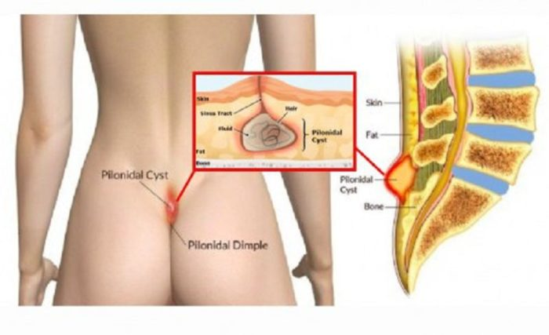
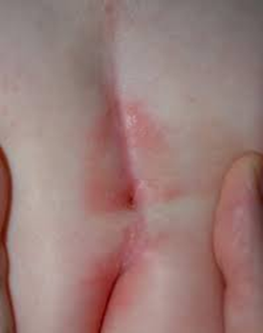
Pilonidal Disease
Subcutaneous infection in sacrococcygeal area, gluteal cleft
Abscesses develop from infection within hair follicle or as reaction to hair imbedded in skin
Presents: young pts, men > women, hirsute pts
Symptoms: pain swelling gluteal cleft, erythema of gluteal cleft, pain w/ sitting
Abscess: painful fluctuant mass, cellulitis
Chronic disease: develop pilonidal sinuses or pits in gluteal cleft

Slide 32
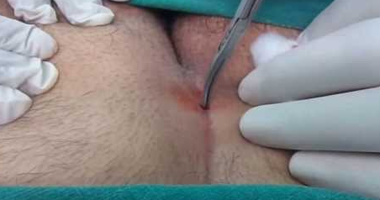
Pilonidal Disease, Treatment
Acute Pilonidal Abscess: Incision & drainage
-usually done in office or ED w/ local anesthesia, abx for cellulitis only
Chronic Pilonidal Sinuses:
Medical: shaving, laser hair removal, good hygiene
Surgical - Wide Local Excision: removal of pilonidal sinus & associated pitts
- wound left open, closed primarily or “marsupialized”
- marsupialization: suture wound edges to base of wound
- primary closure: significantly higher rates of post-op infection
Large Defect Coverage: rhomboid rotational flap, gluteus maximums rotational flap, Z-plasty

Slide 33
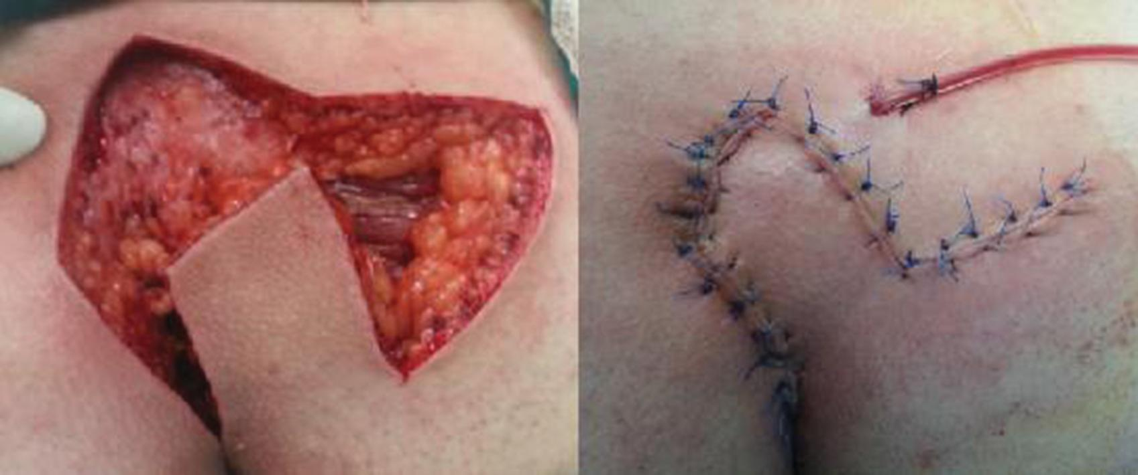
Z- Plasty
Marsupialization
Rhomboid Flap

Slide 34
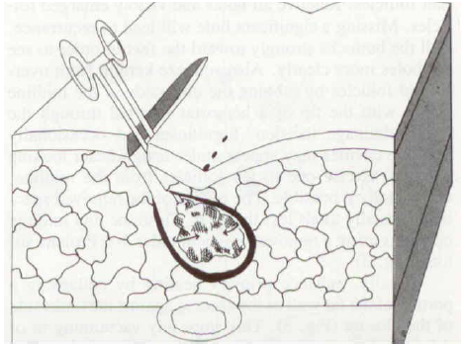
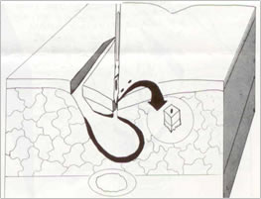
Pilonidal Disease Treatment, Boscom Procedure
Boscom Procedure: remove pilonidal disease, avoid removal of normal tissue
Technique: -vertical incision 1cm+ off midline adjacent to chronic cavity
-sinus tracts leading to pits probed & curetted, remove granulation tissue
-midline pits excised & closed -lateral incision left open
-great results reported w/ faster healing but no comparative trials

Slide 35
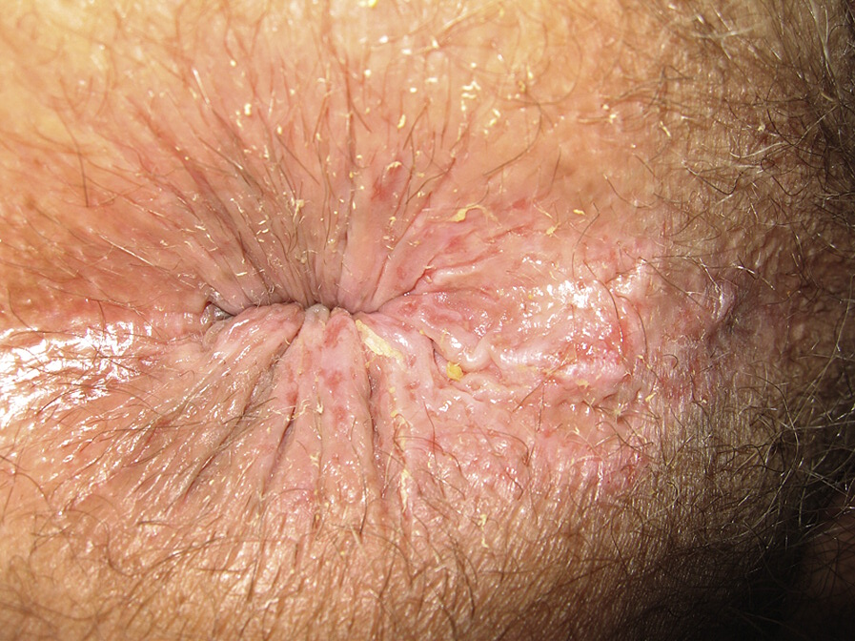
Pruritis Ani ( Anal Itching)
Unpleasant sensation of the skin around the anus that produces desire to scratch
Affect up to 5% of US population, men>women
Primary pruritis ani: no underlying cause, positive feedback loop of irritation → scratching → skin breakdown → worsening irritation
Secondary pruritis ani – caused by underlying identifiable cause: hemorrhoids, skin tags, fissure, infection (bacteria or viral), dermatologic (eczema, contact, atopic dermatitis etc.)
Physical Examination: perform focused rectal examination and evaluation of other skin sites - axilla, groins & gluteal cleft
Treatment: start with trial of conservative measures for 4-6 weeks
Conservative treatment: restoration of the integrity of perianal skin
-avoid excessive soaps, wipes, creams or other irritants
-keeps area dry
-eliminate irritating foods: coffee, chocolate, etol, citrus
-Zinc based barrier cream (Calmoseptime cream)
Trial of Steroids Cream: 1% hydrocortisone cream BID for 2 weeks
Failure of Conservative management or concern for undelying cancer → biopsy
-skin punch biopsy of affected skin & normal skin
-biopsy will rule out cancer, help identifying underlying treatable cause

Slide 36
Rectal Prolapse (Procidentia)
Protrusion of rectum through anal canal
Females > Males
Pts may have history of chronic straining & constipation
Associated w/ urinary incontinence, voiding disorders, cystoceles
Commonly found in patients w/ dementia, schizophrenia, developmental disability
Represents chronic progression of intussusception from rectosigmoid infoldings w/ pulling of rectal wall away from attachments to sacrum and pelvic sidewalls
Often associated w/ impaired resting and voluntary anal squeeze pressures, decreased rectal capacity, impaired continence
Causes chronic injury to anal sphincters & pudendal nerves → decreased anal canal sensation
Can result in full thickness rectal prolapse or redundant mucosa prolapsing through anus known as mucosal prolapse

Slide 37
Rectal Prolapse, Evaluation
Diagnosis, made on history and physical exam
Must distinguish between full thickness rectal prolapse, mucosal prolapse and prolapsing hemorrhoids
DRE: decreased sphincter done, ring protruding through anus
-if prolapse not obvious, evaluate w/ patient straining on commode
Anoscopy: may show inflamed mucosa or ulceration
-Colonoscopy should be performed to rule out pathologic leadpoint as cause for rectal prolapse and to evaluate colon and rectum for other pathology

Slide 38
Rectal Prolapse, Treatment
Gold Standard treatment is surgical
Pts that are poor surgical candidates: pelvic floor strengthening
Perineal Surgery: -Altemeir Procedure -Delorme Plication
-ideal for elderly patients, not tolerate major abdominal surgery
-recurrence rate 30%
Abdominal Procedures: Good for younger pts, need durable repair
-Lower recurrence, 12% -Higher operative morbidity
-Rectopexy, w or w/o Sigmoid Resection

Slide 39
Altemeier Procedure
Perineal Rectosigmoidectomy: transanal surgery, prolapsed rectum & sigmoid excised through rectum
Complications: recurrence, fecal urgency, tenesmus, anastomotic stricture, anastomotic leak

Slide 40
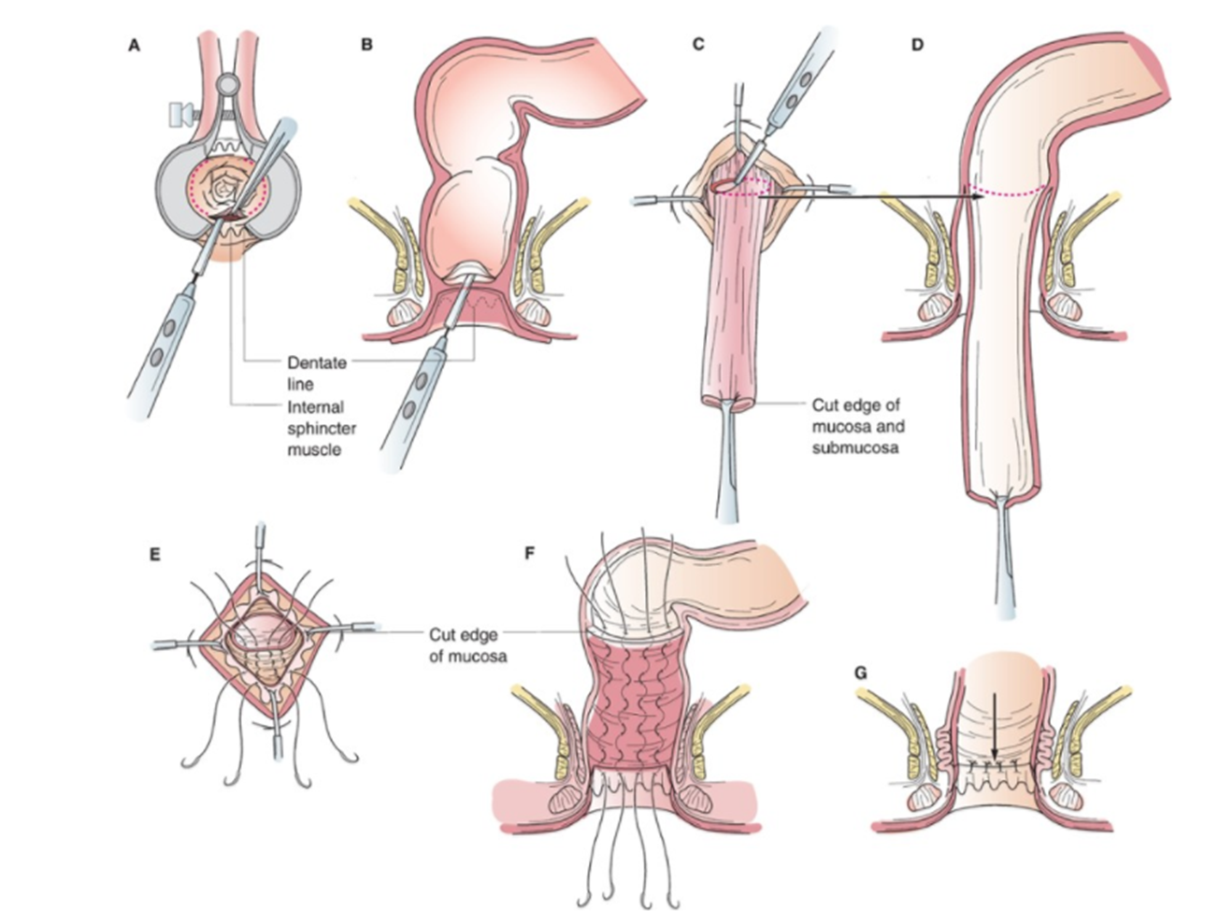
Delorme Procedure or Delorme Plication
Useful for prolapse < 5cm or mucosal only prolapse
-Low associated morbidity
-Good for frail, older patients

Slide 41
Rectal Prolapse, Rectopexy
Durable - Good for acceptable surgical candidates, Recurrence rates < 10%
Improves continence but can cause constipation
Usually performed laparoscopically or robotically
Combined with sigmoid resection w/ Rectopexy for pts w/ chronic constipation

Slide 42
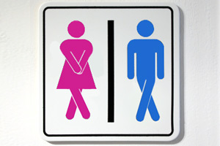
Fecal Incontinence (FI)
Effects 18% of population, 50% of nursing home residents
Fecal continence requires complex integration of anal sphincters & pelvic floor muscles, compliance of rectum, appropriate volume & consistency of stool, pelvic nerve function
Causes of incontinence: anal sphincter injury, large volume loose stool entering rectum, IBD, radiation proctitis, CNS pathology
Damage to sphincter complex: obstetric & non-obstetric trauma, fistulotomy, sphincterotomy, chronic stretching from rectal prolapse
Women > Men, obstetric tears may not cause symptoms for 10-20 yrs following injury
Evaluation and treatment should focus on patient’s quality of life

Slide 43
Fecal Incontinence, Evaluation
General medical history, obstetric history, surgical history
Ask about: -quantify, frequency & degree of fecal incontinence
-urinary incontinence, rectal prolapse, vaginal prolapse etc.
Exam: -inspection of perianal skin for scars, injury, excoriation, other pathology
-DRE: resting tone, squeeze evaluation, sensation
Manometry: resting pressures, strength of sphincter muscles, rectal compliance, sensation
Endoanal Ultrasound: anatomic imaging of internal & external sphincters

Slide 44
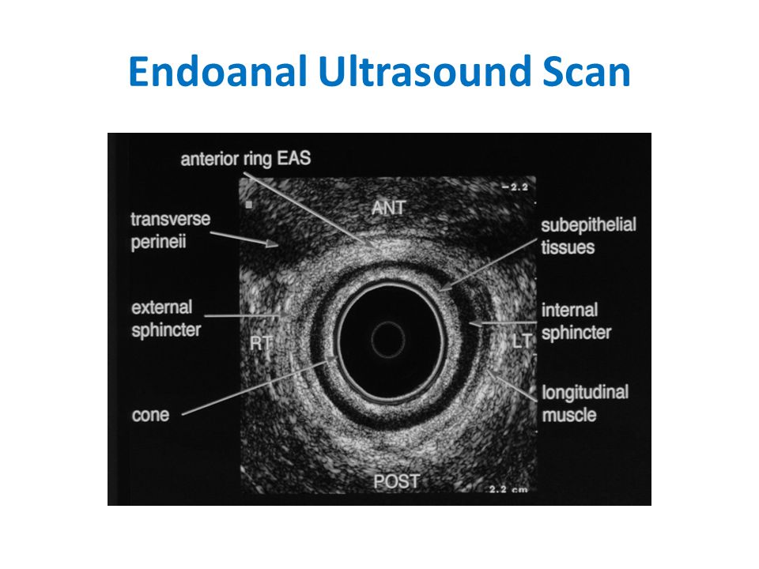
Anal Manometry

Slide 45
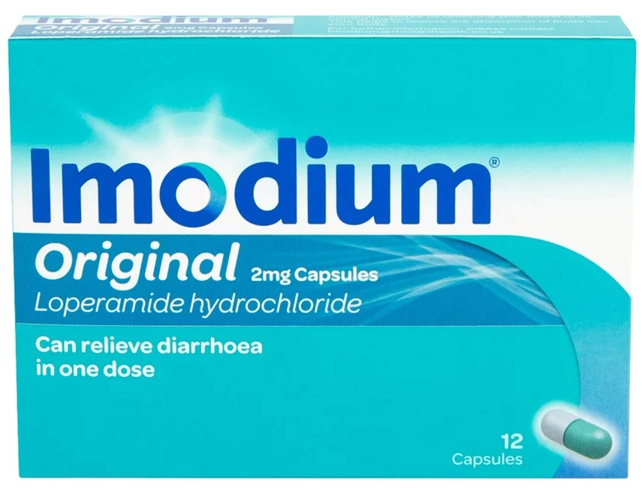
Fecal Incontinence, Medical Management
Best for: Chronic diarrhea, Neurologic conditions, Systemic illness
Medical treatment: regulation of bowel habits w/ goal of decreasing stool frequency
-Fiber supplements: add bulk / absorb fluid from stool
psyllium husk, 25g/day females, 38g/day males
-constipating agents: loperamide / Lomotil, decrease stool frequency & harden stool
-bile acid binders: cholestyramine, may help thicken stool in patients s/p cholecystectomy
-patients w/ constipation & overflow incontinence may paradoxically require daily stool softeners
Pelvic floor PT with strengthening -generally improves FI by strengthening anal sphincter muscles
Pelvic floor PT with Biofeedback - good for pts w/ FI & concominant pelvic floor disorders

Slide 46
FI, Operative Treatment: Sphincteroplasty
Historical gold standard for treatment of fecal incontinence in young women w/ sphincter injury from obstetric trauma
Multiple studies have demonstrated benefit to sphincteroplasty in patients w/ sphincter defects & FI from non-obstetric trauma
Only effective if sphincter defect is definitively identified
Repair deteriorates w/ time, by 10 years most patients will experience recurrent fecal incontinence

Slide 47
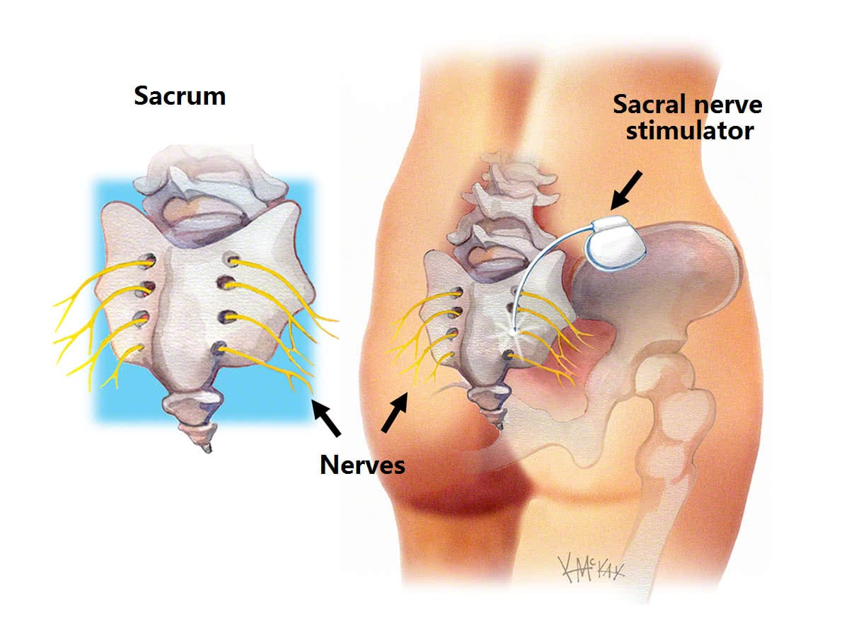
Sacral Neuromodulation (SNS)
FDA approved treatment for fecal incontinence
Considered as first line treatment or rescue therapy after sphincteroplasty
Works by modulating nerve impulses to S3 nerve roots & augmenting sphincter function
Demonstrated to be effective in treatment of fecal incontinence in patients with and without sphincter injury
69-83% of patients experience > 50% improvement in fecal incontinence symptoms on both short-term & long-term follow-up
35-40% of patients achieve full continence after therapy

Slide 48
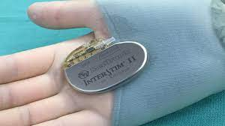
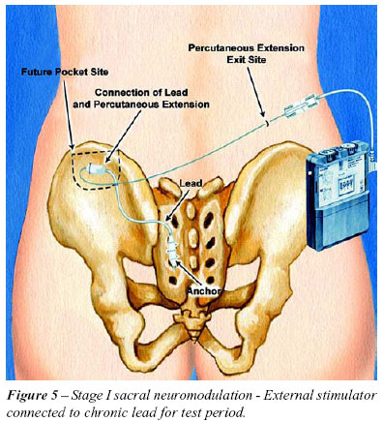
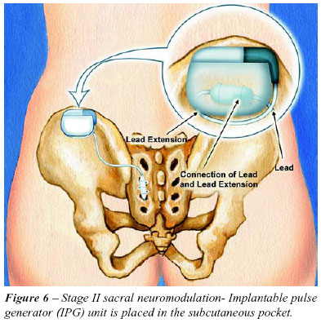
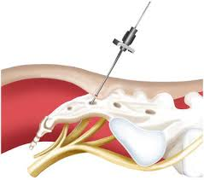
Sacral Neuromodulation (SNS) Cont.
Surgery: Performed in Two Stages
Fist Stage: -tined wire is placed in S3 nerve route under fluoroscopy
-connected to external neurostimulator for trial
-Trial is conducted for 1-2 weeks w/ external neurostimulator
-If patient has 50% or greater improvement in FI symptoms → 2nd Stage
Second Stage: -permanently implantation of SNS into fat pad of flank

Slide 49
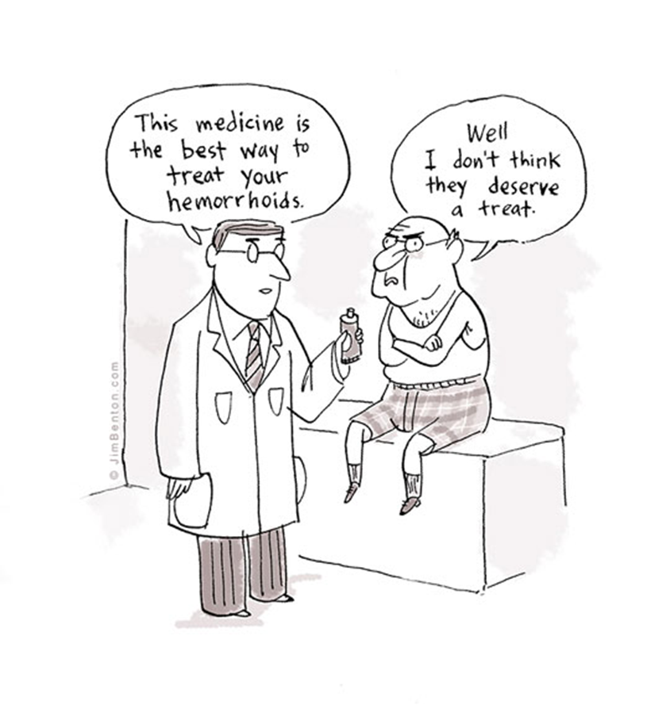
References
Beck D. Handbook of Colorectal Surgery, Third Edition. 2013
Brouwer R, Duthie G. Sacral nerve neuromodulation is effective treatment for fecal incontinence in the presence of a sphincter defect, pudendal neuropathy, or previous sphincter repair. Dis Colon Rectum. 2010;53(3):273-8.
Brunicardi C, et al. Schwartz’s Principles of Surgery, Tenth Edition. 2015
Goetz L, Lowry A. Overlapping Sphincteroplasty: Is it Standard of Care. Clinics in Colon and Rectal Surgery. 2005; 18(1): 22-31.
Steele S, et al. The ASCRS Textbook of Colon and Rectal Surgery, Third Edition. 2016.

