Slide 1


Colorectal cancer prevention in the Alaska Tribal Health System
Diana Redwood, PhD, MPH

Slide 2


Disclosures
CDC and NIH funding
Exact Sciences Investigator Award

Slide 3

Land Acknowledgement
Thank you to the Dena’ina people, on whose traditional lands I live. Thanks for their past and present stewardship of the waters, plants, animals and spiritual practices of this place.

Slide 4
Why is CRC Screening Important?
Notes:
CRC is one of the few cancers that can be screened for,
Treated if found early,
And prevented through the removal of precancerous polyps
One of the few cancers that we can do something about

Slide 5
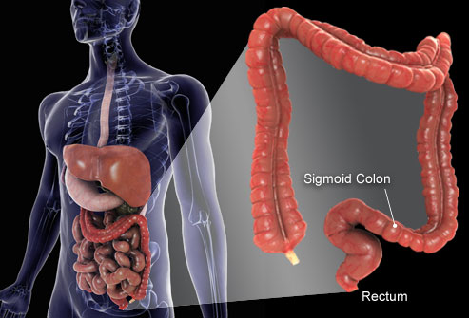
Photo Source: www.medicalinfo-y3n.blogspot.com
Notes:
Most CRCs begin as small growths in the colon which progress very slowly into cancers
This long lead time presents a window of opportunity for screening and intervention

Slide 6
Five-Year Survival Rates (%)
Stage
I and II
Stage
III
Stage IV
Data Source: American Cancer Society. Colorectal Cancer Facts & Figures 2020-2022.
Notes:
While 90% of individuals with cancer limited to the bowel wall are still alive 5 yrs after diagnosis, It decreases to 71% with regional spread and plummets to 14% for metastatic disease
ACS Facts & Figures 2020-2022

Slide 7
U.S. CRC incidence and death rates have fallen steadily over the past 35 years…
Source: ACS CRC Facts and Figures 2020-2022

Slide 8
“Notably, American Indian and Alaska Native people are the only racial and ethnic group for which CRC mortality rates are not declining.”
Source: ACS CRC Facts and Figures 2020-2022

Slide 9
2x
Notes:
AN people face a challenge and a burden – one of the world’s highest rates of CRC.
Alaska Native people not only 2x incidence (rate new cases of cancer), but also 2x mortality (deaths) AN vs. USW
This disparity in incidence and mortality has persisted for over 40 years.

Slide 10
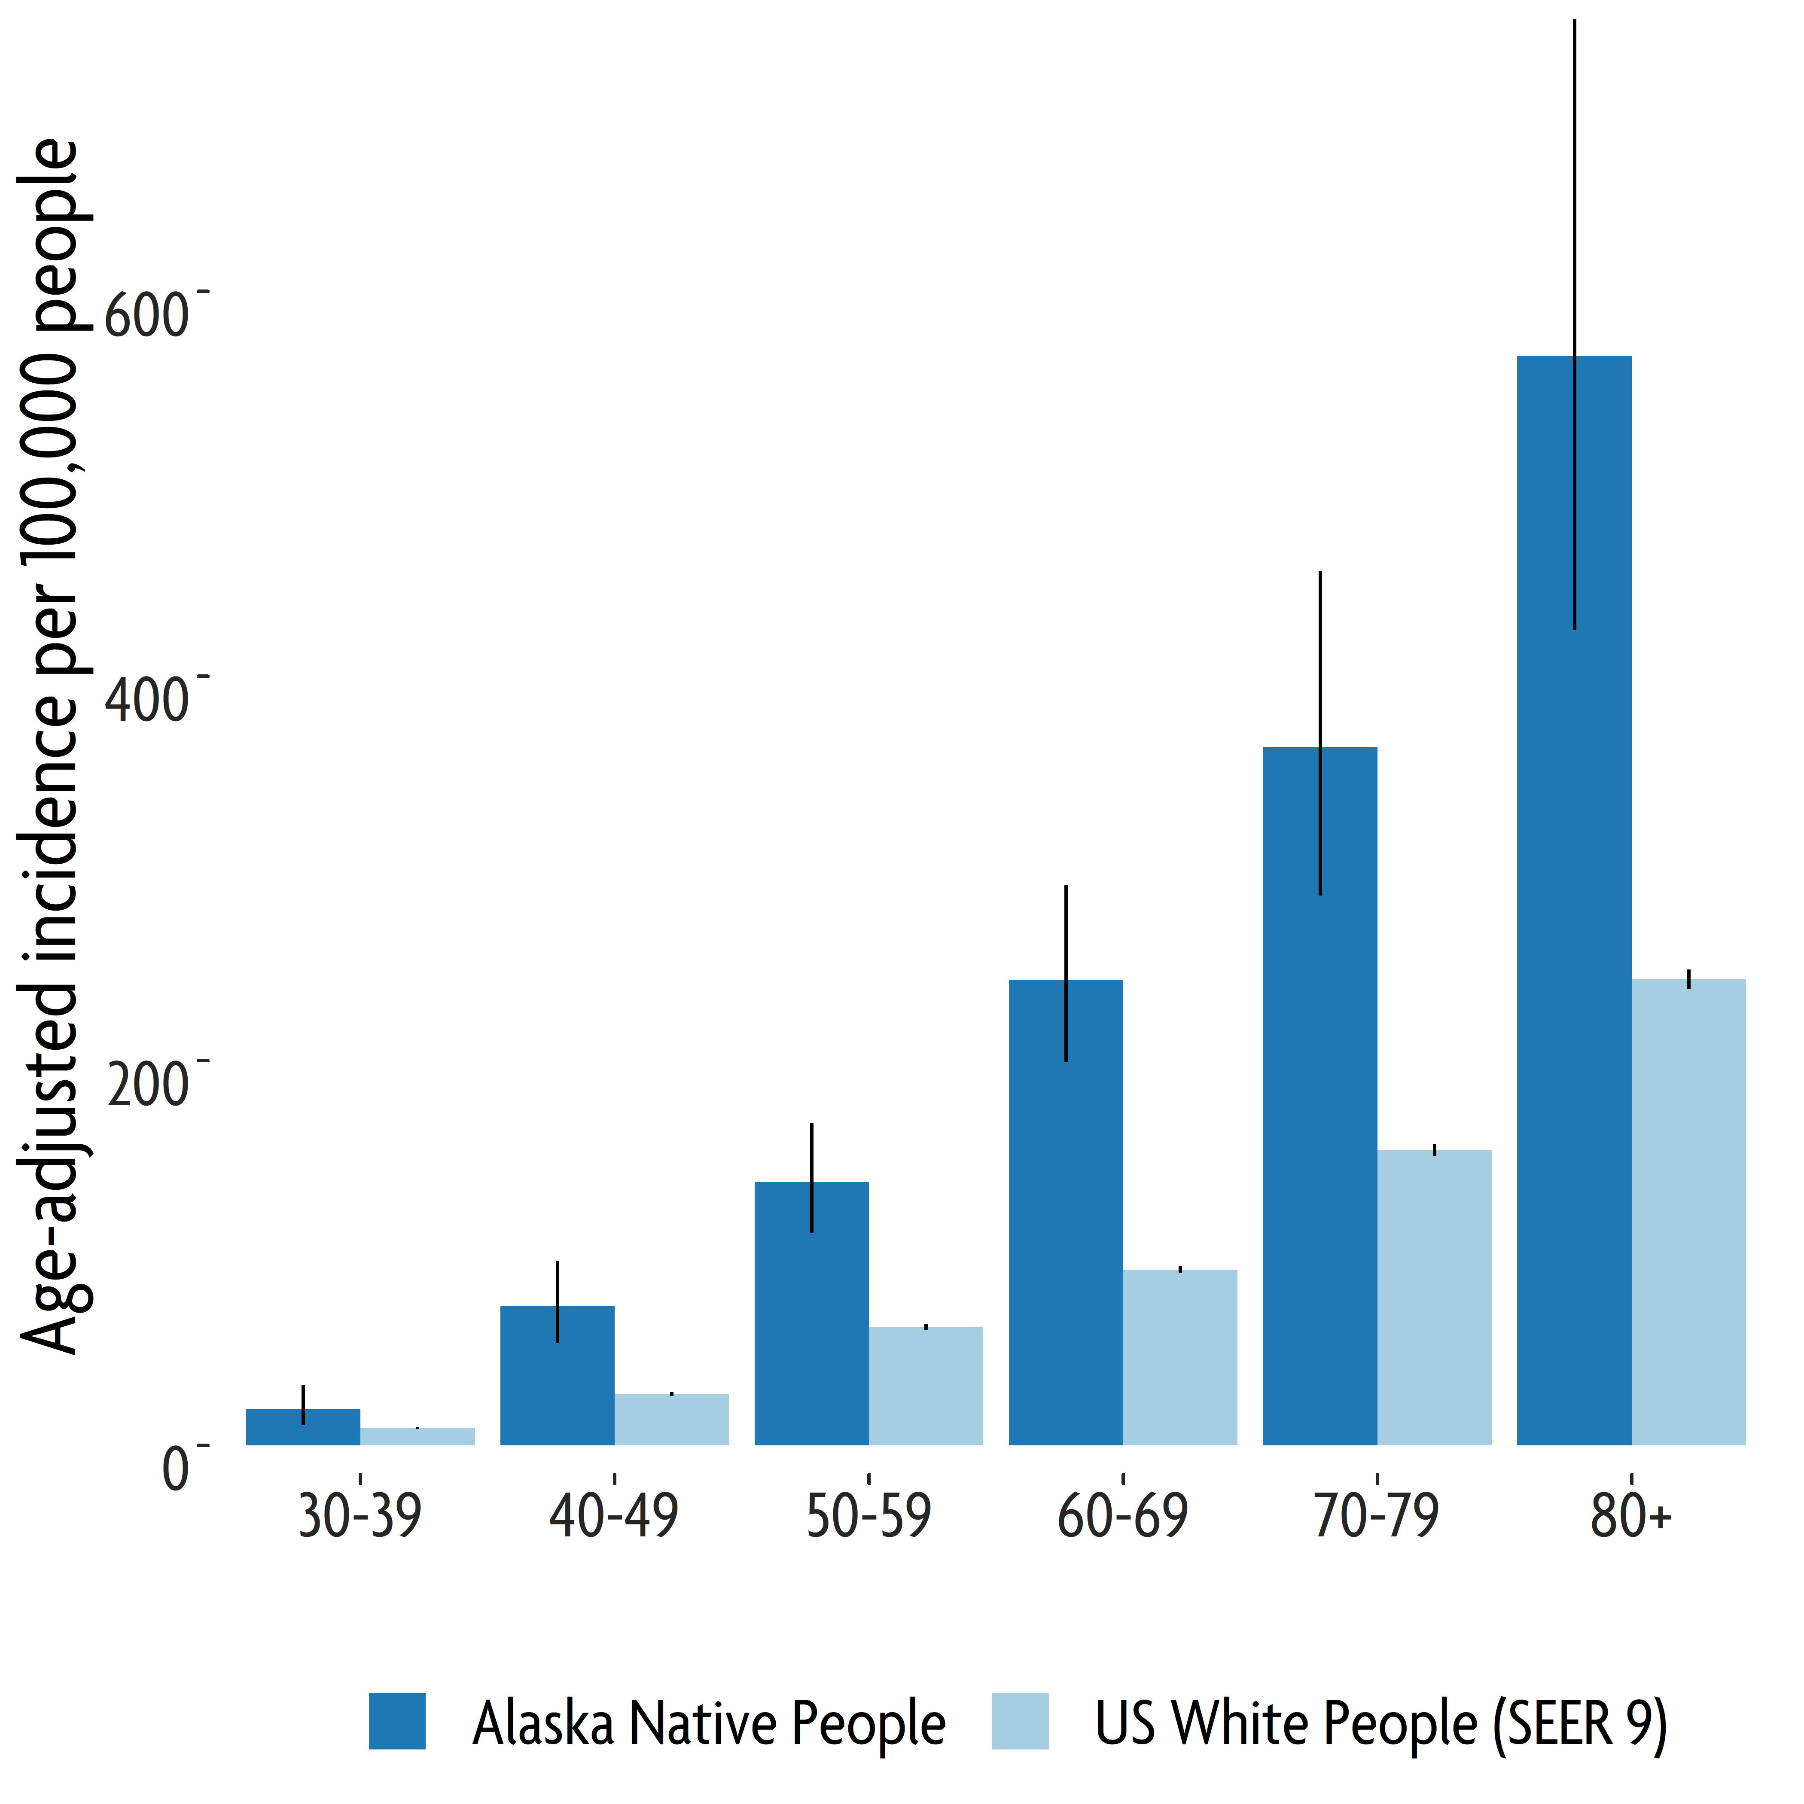
CRC incidence is higher among Alaska Native people at every age group.
Source: Alaska Native 50 Year Report, Alaska Native Tumor Registry, 2021
Notes:
Zimpelman G.L., Miller K.N., Carlo D.D., et al. Cancer in Alaska Native People: 1969–2018, The 50-year Report. Anchorage, AK: Alaska Native Tumor Registry, Alaska Native Epidemiology Center, Alaska Native Tribal Health Consortium 2021.

Slide 11
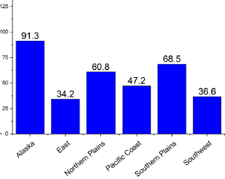
CRC incidence per 100,000 by IHS Area, 2014-2018
Source: Kratzer et al. Cancer Statistics for AI/AN, 2022.

Slide 12
Risk Factors
Non-modifiable: Age, family history
Notes:
Also some specific conditions, like diabetes increase risk of CRC

Slide 13
Risk Factors
Modifiable: Physical inactivity, obesity, high consumption of red or processed meats, low consumption of fruits and vegetables, alcohol use, tobacco use
Notes:
Physically active can reduce the risk of developing colon cancer by 40 to 50%
CRC Risk Factors: Diet
• High in animal fats
• Low in fiber
• Low in fresh fruits and
vegetables
Smokers are 30% more likely to die from colon cancer

Slide 14
Possible signs of CRC
Blood in stool
Diarrhea or constipation that lasts for more than a few days
Frequent gas pains or bloating
Always tired
Losing weight for no reason
Notes:
PUT IN CHAT: Which do you think is the most common sign of CRC?

Slide 15
Colon cancer often starts quietly, with no signs or symptoms.

Slide 16
USPSTF screening recommendations for average risk adults
Starting at age 45 (Alaska guidelines: age 40 for Alaska Native people)
  Screening colonoscopy every 10 years
  Annual screening with high-sensitivity stool tests (FIT)
  Sigmoidoscopy every 5 years, with high-sensitivity FOBT every 3 years

Slide 17
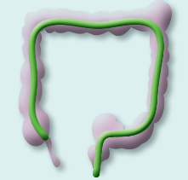


Screening Test Pros and Cons: Colonoscopy
More invasive and more risk of complications
Resource intensive
Not always available
Not all patients will do
Only required every 5-10 years
Can detect and remove precancerous growths

Slide 18

Advantages of Stool
Tests
Quick to use, done at home
No dietary or medication restrictions
No bowel preparation
Non-invasive – no risk of pain, bleeding, perforation
No need for patient travel, time off work, help getting home after the procedure
Reduces need for colonoscopies – required only if stool testing is abnormal

Slide 19
Why to include stool tests in screening programs?
Can screen more people
Many patients face colonoscopy barriers or not willing
Allows patients more choice in screening options, and can be done at home
Focus on colonoscopy along is associated with low screening rates in a number of studies
Notes:
McQueen A, Bartholomew LK, Greisinger AJ, et al. Behind Closed Doors: Physician-Patient Discussions About Colorectal Cancer Screening. Journal of General Internal Medicine. 2009;24(11):1228-1235. doi:10.1007/s11606-009-1108-4.

Slide 20
Reminders
Stool tests should NOT be given to:
  Symptomatic patients
  Patients who are already up to date with screening
  Patients with family history of CRC
Abnormal stool tests should be followed up with a colonoscopy, NOT another stool test

Slide 21
Why don’t people get screened?

Slide 22
Personal factors
Fear
Discomfort/unpleasant procedure
Feel healthy/don’t know it’s important
Don’t want to travel/too expensive
Too busy
Notes:
Notes from CHAP Forum 2008
discomfort, lack of knowledge/information about the importance of screening, financial issues (travel costs), and logistic issues (time away from family, need for escort for screening colonoscopies due to sedation).

Slide 23
System factors
Screening not available in community
No tracking system for screening
Provider didn’t know patient was due
No strong recommendation from provider
Notes:
Having a provider who recommends
screening has been shown to be the
STRONGEST predictor of screening in
multiple studies in multiple populations

Slide 24
Cancer Screening Continuum
Enabling Health System
Access to Care
Willing Patient
Screening Completion

Slide 25
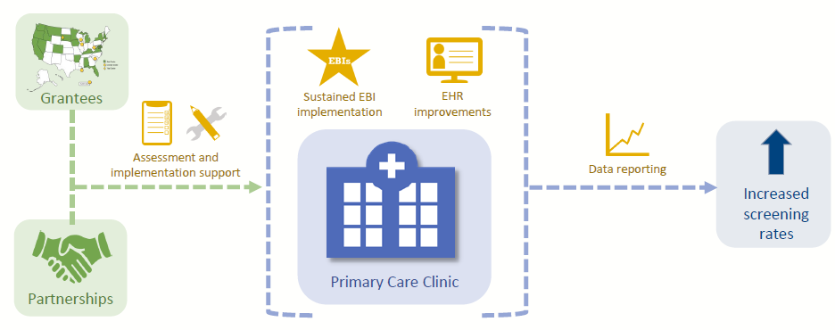
Alaska Native Tribal Health Consortium Colorectal Cancer Control Program
2020-2025
Funding source: Centers for Disease Control and Prevention #1NU58DP006748
Notes:
We received CDC funding for a multicomponent program to improve CRC screening and help patients to navigate through the screening process. The focus of this program is on primary care clinics and sustainable improvements in screening.

Slide 26
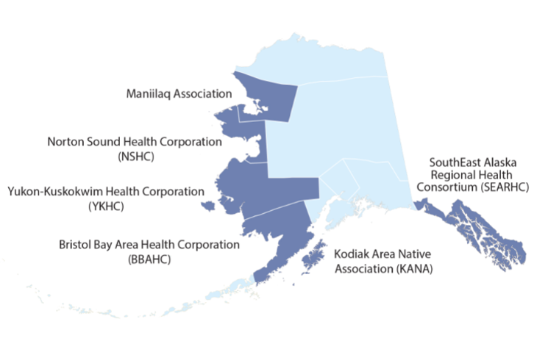
ANTHC CRCCP Partners

Slide 27
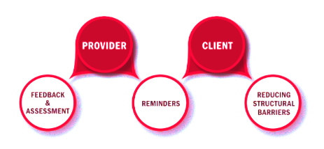
Evidence-based interventions (EBIs) for CRC screening

Slide 28
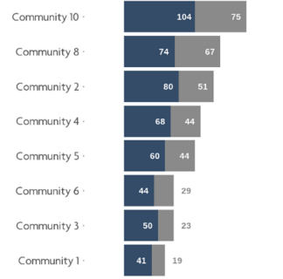
Provider Assessment and Feedback
Internal provider score cards or financial incentives
Quarterly review of EHR dashboard with providers teams
Notes:
EBIs Provider assessment/ feedback, Provider reminders, Patient reminders, reducing structural barriers, small media

Slide 29
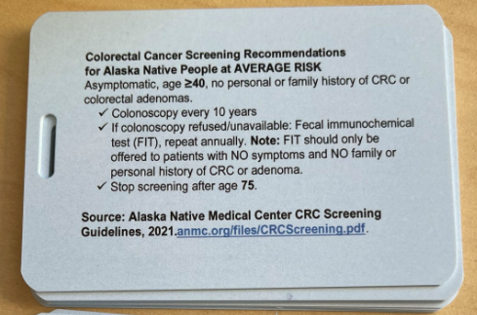

Provider Reminders
Provider reminder badge cards
Alaska Native Medical Center CRC Screening Guidelines
Electronic health record tools
Notes:
Improving clinical workflow
EHR patient and provider reminders- cleaning up the data, increasing sharing of data between EHRs
Requires Patient Navigators/other staff to clean data and use reminders

Slide 30
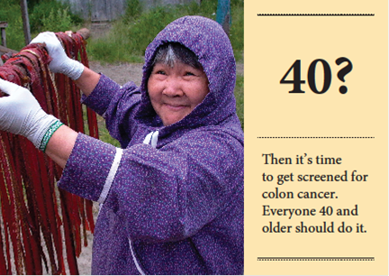
Patient Reminders
Reminder letters, postcards, text messaging

Slide 31
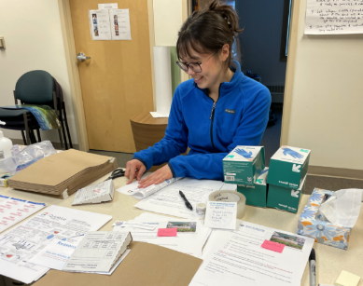
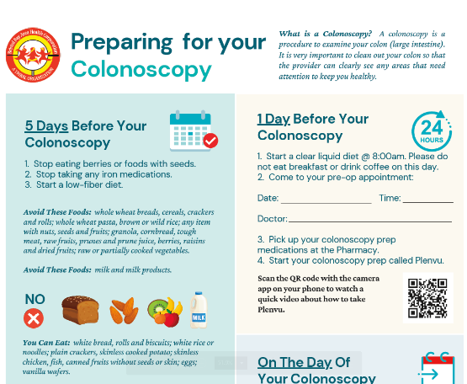
Reducing Structural Barriers
Mailed stool test outreach campaigns
Photo courtesy of YKHC CRC Control Program
Bowel prep instructions

Slide 32
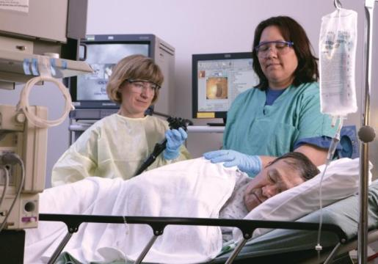
Systems & EHR Changes
Notes:
Improving clinical workflow
EHR patient and provider reminders- cleaning up the data, increasing sharing of data between EHRs
Requires Patient Navigators/other staff to clean data and use reminders

Slide 33
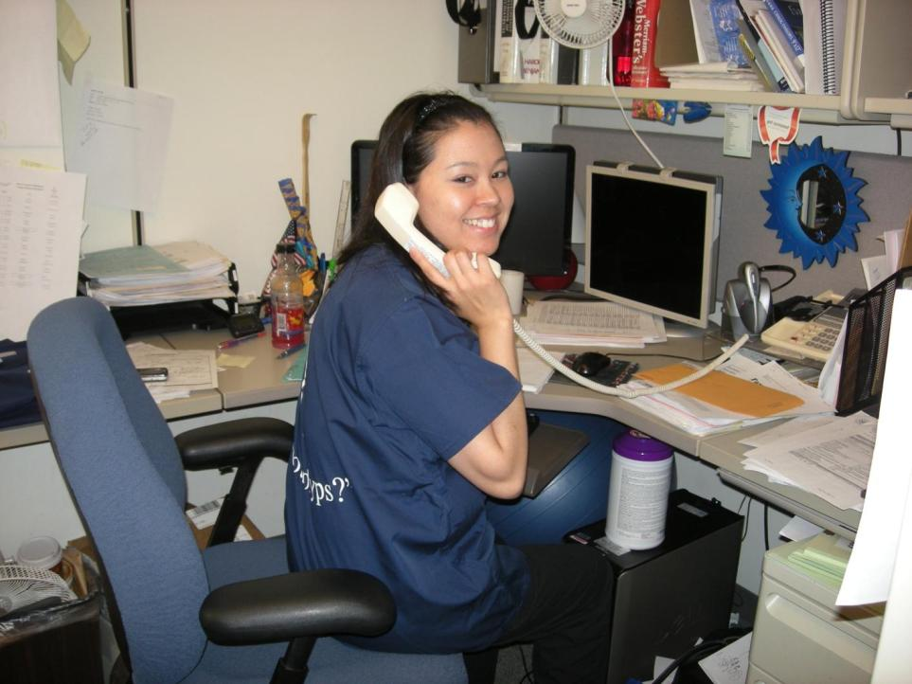
Photo courtesy of Bristol Bay Area Health Corporation
Notes:
Patient navigation and outreach most important part of efforts

Slide 34

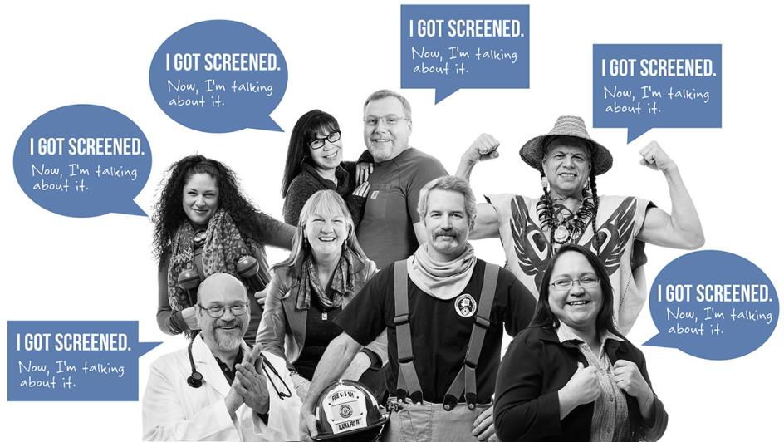
Notes:
Community campaigns include “The Cancer I Can Prevent” multimedia campaign, featuring previously screened Alaskans sharing their screening stories.
Campaign includes small media, such as patient reminder cards, brochures, posters, newsletters, videos, and digital stories.
Materials available from the ANTHC Cancer Program, cancer@anthc.org

Slide 35
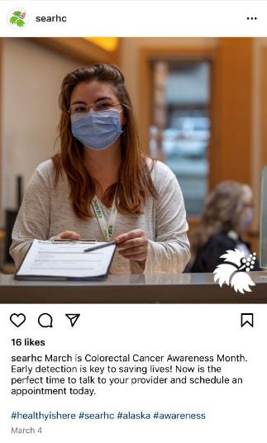

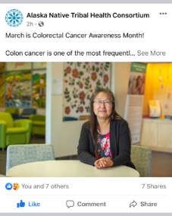
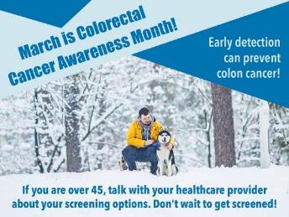
Small media
Notes:
Community campaigns include “The Cancer I Can Prevent” multimedia campaign, featuring previously screened Alaskans sharing their screening stories.
Campaign includes small media, such as patient reminder cards, brochures, posters, newsletters, videos, and digital stories.
Materials available from the ANTHC Cancer Program, cancer@anthc.org

Slide 36



Slide 37

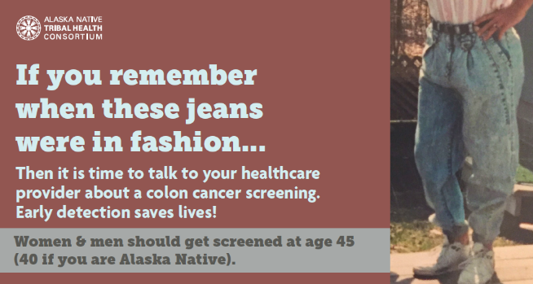

Slide 38
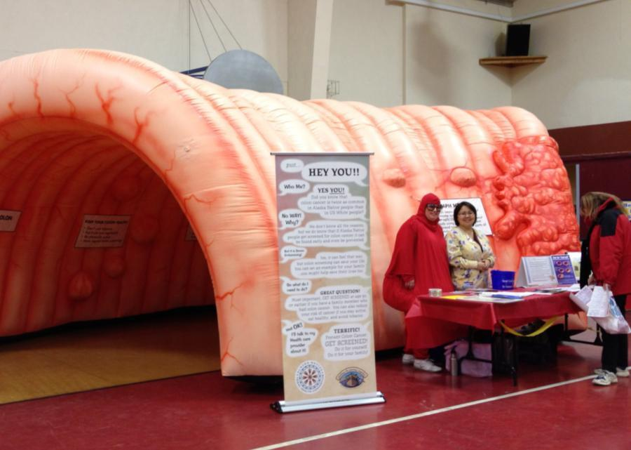

Photo courtesy of Norton Sound Health Corporation
Notes:
We heard that people wanted more humor and light heartedness in the cancer prevention message
Giant inflatable colons with colon screening info which travel the state, named Nolan the Colon, available for use from the ANTHC Cancer Program
Collaborated with the Alaska Tribal CCCP in use of ‘Nolan the Colon’, a giant inflatable colon
Study of giant colon- found significant increase in community member knowledge of CRC screening, intention to screen, and comfort talking about screening with friends and family.
Polypman costumes

Slide 39
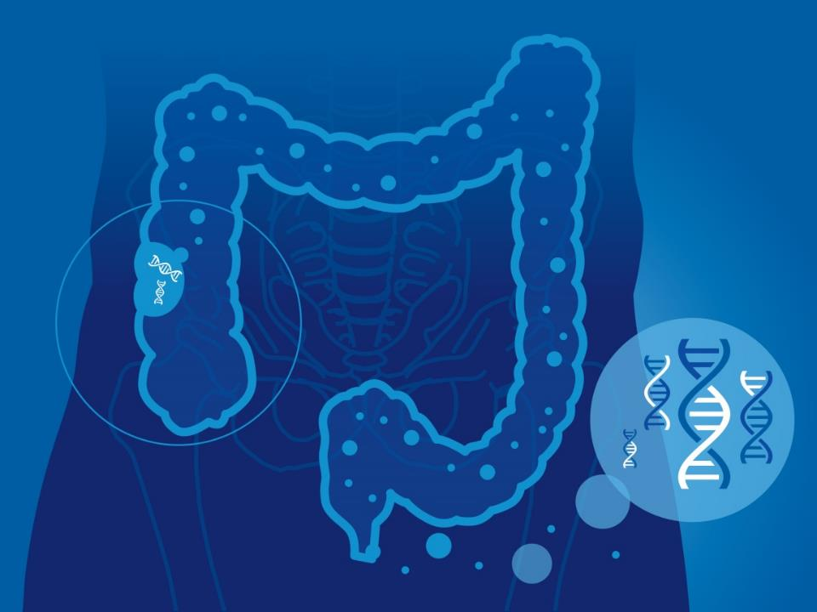
Randomized controlled trial of the stool DNA test to improve colorectal cancer screening among Alaska Native people
NIH R01CA247642
Notes:
5 year R01 study, began April 2020
Test the hypothesis that multi-level high and medium intensity MT-sDNA community-based interventions, as compared with usual care, will increase CRC screening rates among AN people in rural/remote communities.

Slide 40

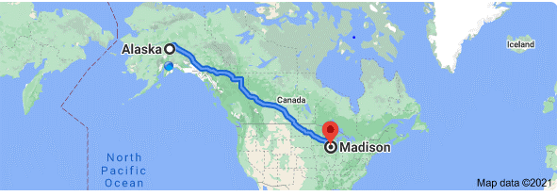
Notes:
We are working with Exact Sciences Laboratories a laboratory in Madison, Wisconsin to see if their at-home stool DNA test, Cologuard, will help increase screening rates. The challenge is that after a patient collects their sample, it needs to get to Madison, Wisconsin for processing within 72 hours.
As you might guess, this is impossible from rural Alaska Native communities. So we are testing the feasibility of setting up a pre-processing lab in Alaska, so that the samples just have to get to Anchorage in 72 hours.
Photo by Roy Muz on Unsplash

Slide 41
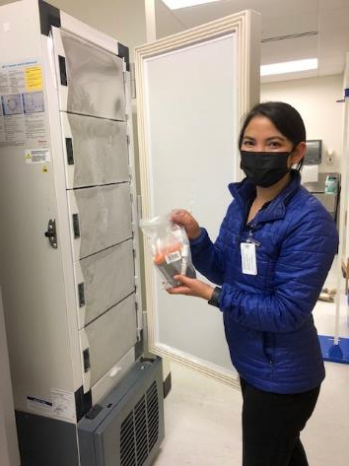
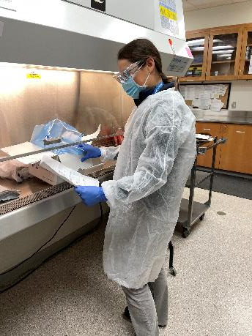
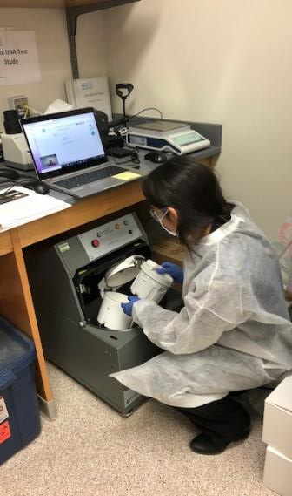
Notes:
This is the first time that a Cologuard a colorectal home screening test pre processing lab had been set up, which was quite the undertaking. Here you can see our little corner in the Public Health State Lab, who were incredibly kind in providing space for the study.
Once the kits arrive back from patients we homogenize the stool in a fancy paint mixer. Samples are processed, frozen, and shipped on dry ice to Madison. This first year we set up the lab and have just started doing outreach and getting kits back from patients. We will find out whether Cologuard this colorectal home screening test can actually work in the Alaska setting, and whether patient navigation or mailed outreach help to increase screening.

Slide 42
76%
of CRC deaths occurred in people who were not up to date with screening
Source: Doubeni et al. Gastroenterology 2019

Slide 43
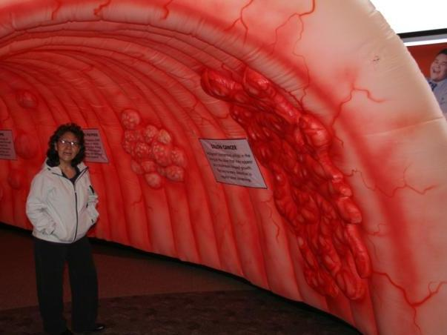
How can you help?
If you are a provider, strongly recommend CRC screening
Talk to friends, family, and community members about importance of screening
Get screened if you are due
Photo courtesy of ANTHC Comprehensive Cancer Program
Notes:
Request resources and help from ANTHC CRCCP
Encourage your patients and community members to get screened
If you are over age 45 (40 if Alaska Native) you can get screened yourself so that you act as a role model for others

Slide 44



Slide 45

Notes:
By working together to get people screened, we will do all we can to ensure that fewer people die from this preventable disease, now and in the future.

Slide 46

Notes:
Questions?

Slide 47


Slide 48


Slide 49
Colorectal Cancer (CRC)
3rd most common cancer and 2nd leading cause of cancer death in the US. In 2020:
    147,950 new cases
    53,200 deaths
1.5 million Americans living with CRC
Source: CRC Facts and Figures 2020-2022

