Slide 1
Respiratory Virus Surveillance in Alaska – Update 2023
State of Alaska Division of Public Health, Section of Laboratories
Alaska State Virology Laboratory – Fairbanks
Anchorage State Public Health Laboratory – Anchorage
Jayme Parker, HCLD(ABB), PhD, MSPH, MB(ASCP)^{CM}
Health Program Manager 4, Chief of Laboratories, Clinical Director

Slide 2

pandemic aftermath
healthcare
workforce

Slide 3
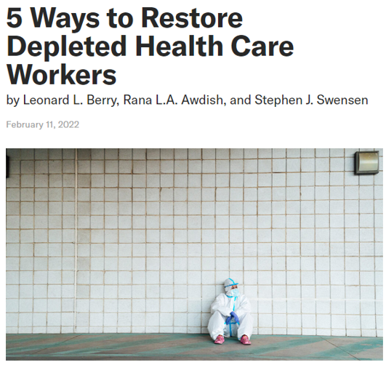
Five Ways to Restore Depleted Health Care Workers
Make the most of extended teams.
Be a reliable advocate.
Lead with kindness.
  Include
  Inform
  Inquire
  Develop
  Recognize
Offer access to emotional support resources.
Allow time for what matters.
Notes:
Include: Treat everyone with respect and nurture a culture where all are welcome and feel psychologically safe.
Inform: Transparently share what you know with the team.
Inquire: Consistently solicit input from the people you lead.
Develop: Nurture and support the professional development and aspirations of staff.
Recognize: Express appreciation and gratitude to employees in an authentic way.

Slide 4
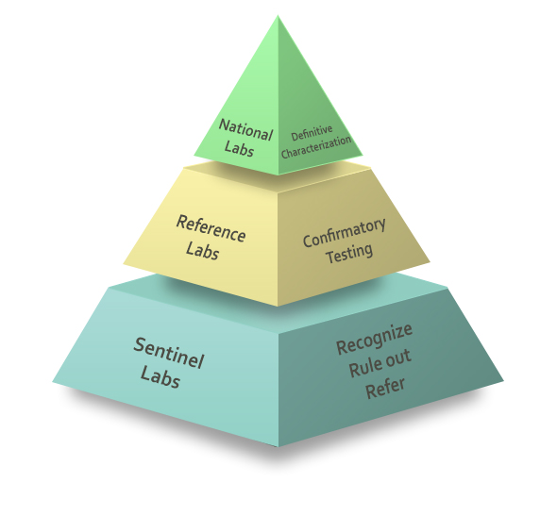
Conceptualizing a new collaborative relationship
https://emergency.cdc.gov/lrn/biological.asp

Slide 5
Challenges to Respiratory Virus Surveillance
Poor Surveillance
Low Prevalence
Lack of specimens
Improper handling and shipping of specimens
Poorly associated metadata
Lost shipments
Problematic testing methods
Lack of personnel
Lack of interest
Pandemic Fatigue
Too much paperwork
Lack of purpose

Slide 6
Outline
Purpose of respiratory virus surveillance
Current capabilities and capacities
Data and future plans
New methods of surveillance
Importance of clinical partnerships

Slide 7

What pathogen is currently causing respiratory disease?

Slide 8
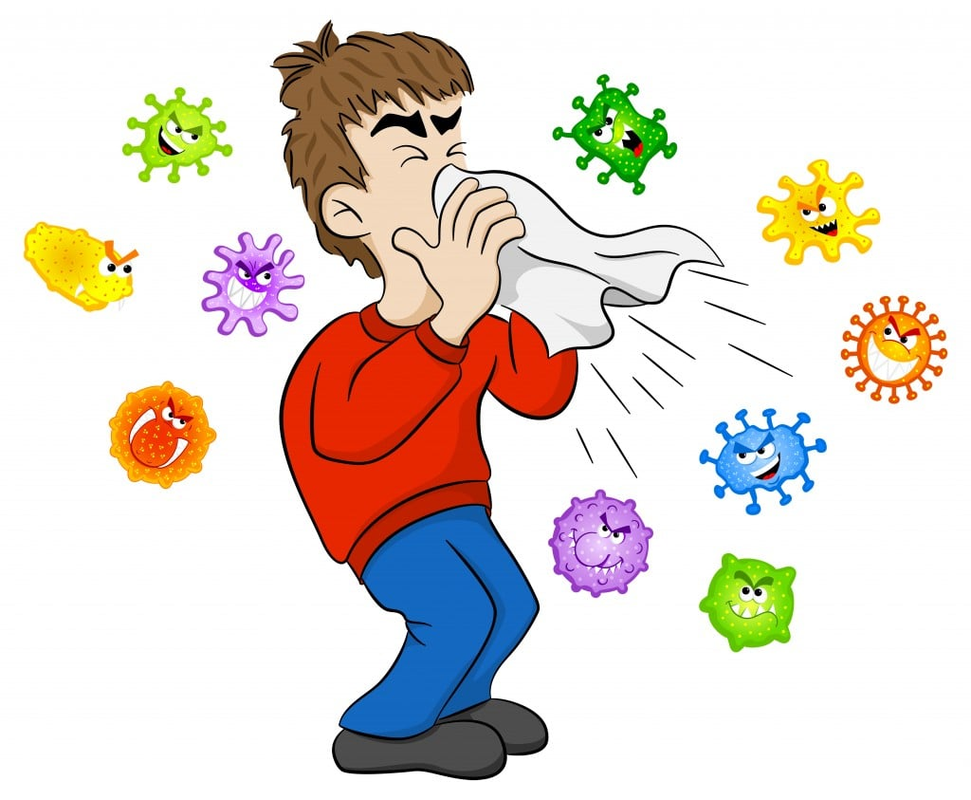
So many viruses…
Parainfluenza 4
Rhinovirus
Enterovirus
Parainfluenza 2
Human coronavirus NL63
Parainfluenza 3
Human metapneumovirus
Human coronavirus HKU1
Influenza A/H3
Human coronavirus 229E
Influenza B/Victoria
RSV
SARS-CoV-2
Human coronavirus OC43
Adenovirus
Parainfluenza 1
Influenza A/H1N1

Slide 9
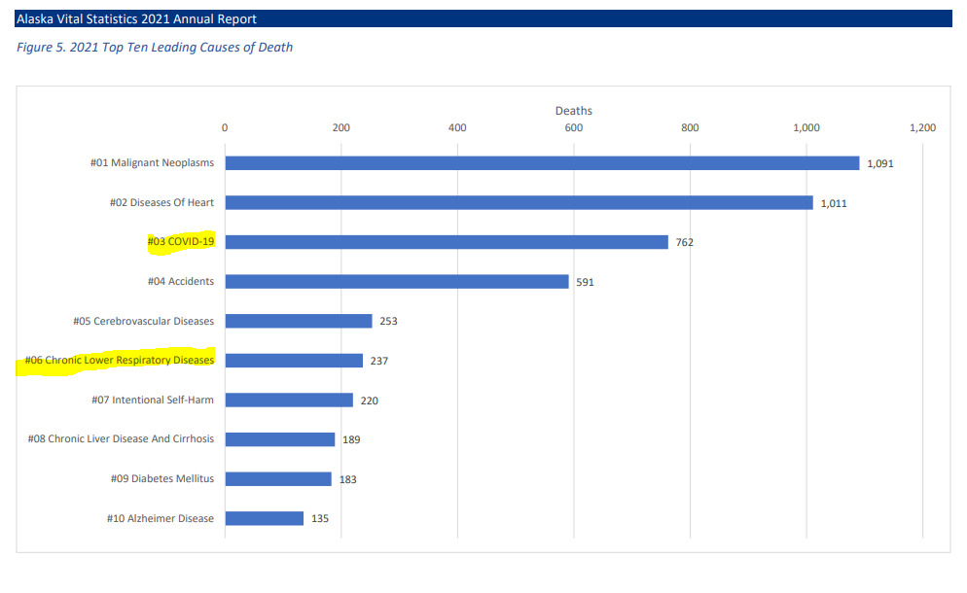
Burden of Respiratory Illness in Alaska
https://health.alaska.gov/dph/VitalStats/Documents/PDFs/VitalStatistics_Annualreport_2021.pdf

Slide 10
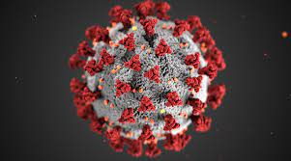
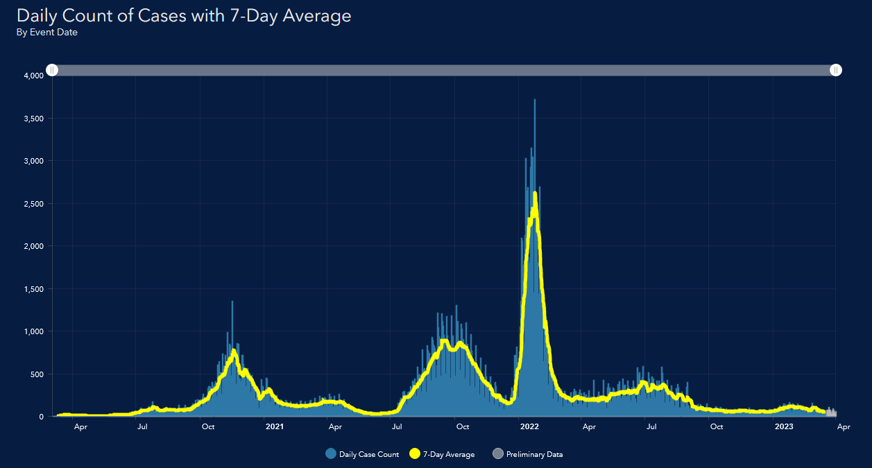
SARS-CoV-2
https://experience.arcgis.com/experience/af2efc8bffbf4cdc83c2d1a134354074/

Slide 11
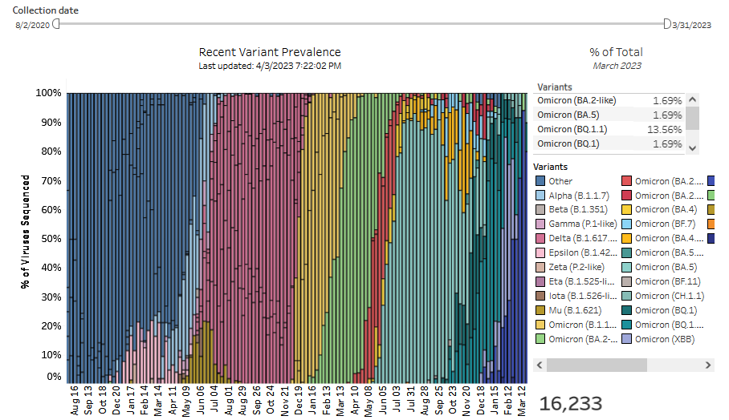
Genomic Surveillance of SARS-CoV-2
https://experience.arcgis.com/experience/af2efc8bffbf4cdc83c2d1a134354074/

Slide 12
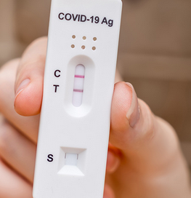
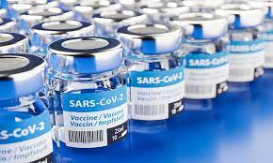
Continued Surveillance for SARS-CoV-2
Evaluate the performance of diagnostic tests
Evaluate the effectiveness of therapies (i.e., monoclonal antibodies and antivirals)
Evaluate the vaccine effectiveness of various vaccine manufacturers
https://covid19.nih.gov/news-and-stories/how-rapid-antigen-tests-perform-against-viral-variants
https://publichealth.jhu.edu/2020/a-top-vaccine-expert-answers-important-questions-about-a-covid-19-vaccine

Slide 13

Alaska State Laboratory SARS-CoV-2 Testing
Testing occurs primarily at the Alaska State Virology Laboratory in Fairbanks. Surge capacity is available at the Anchorage State Public Health Laboratory.
SARS-CoV-2 PCR diagnostics are available, TAT 1-3 days
SARS-CoV-2 sequencing for positive SARS submissions
  Sequences passing quality thresholds are posted to GISAID (gisaid.org)
  University of Alaska takes qualified sequence data to update in-state genomic dashboard https://akvariants.github.io/
  Guidance for submitting positive SARS-CoV-2 specimens to the public health labs for sequencing: https://health.alaska.gov/dph/Labs/Documents/COVID_NGS_infographic.pdf

Slide 14
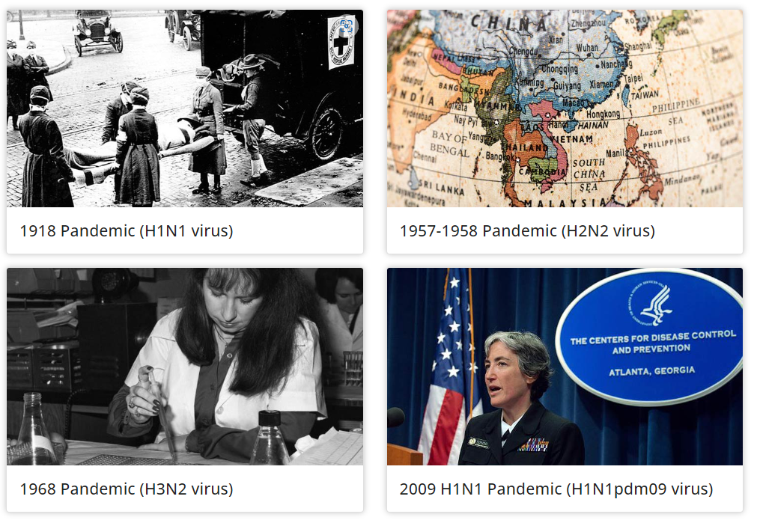
Influenza
https://www.cdc.gov/flu/pandemic-resources/basics/past-pandemics.html
Notes:
1918 pandemic = 50 million dead worldwide; 675K in the US
1957 pandemic = 1.1 million dead worldwide; 116K in the US
1968 pandemic = 1.0 million dead worldwide; 100K in the US mostly >65yo
2009 pandemic = 575K died worldwide in first year, ~12K in US, mostly <65yo

Slide 15
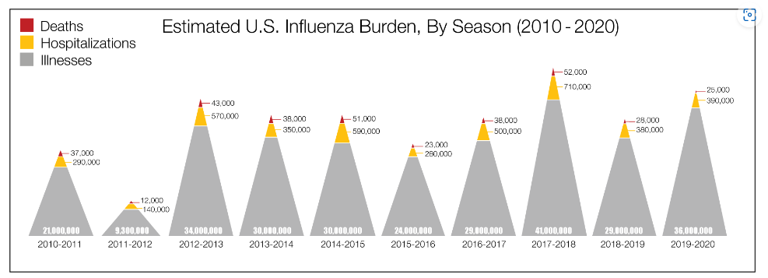
Estimated U.S. Influenza Burden
https://www.cdc.gov/flu/about/burden/index.html

Slide 16
Pathway of influenza clinical specimens
Hospital Lab 1
Hospital Lab 3…
Hospital Lab 2
Alaska State Virology Lab - Fairbanks
California – antigenic and genetic characterization
New York – Antiviral resistance testing
Wisconsin – Summer surveillance
CDC
Vaccine Strain Selection
CDC Atlanta - Diagnostic
Northern Hemisphere February
Southern Hemisphere August

Slide 17
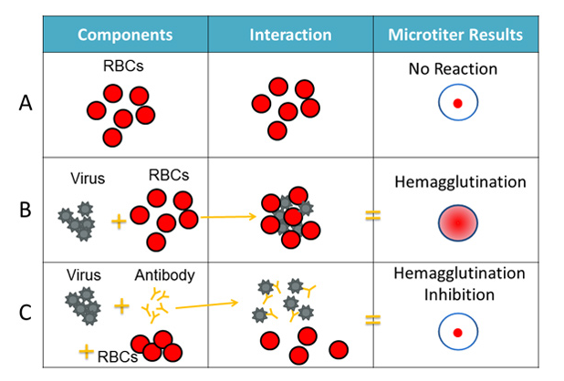
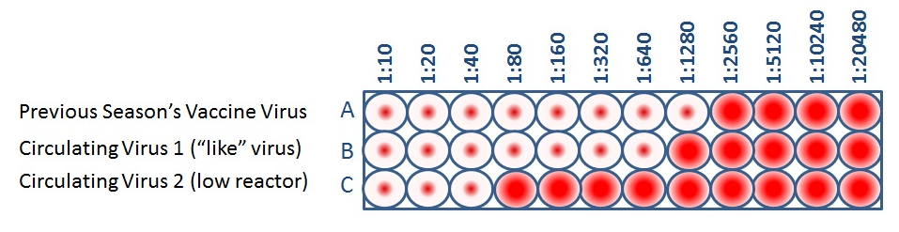
Antigenic Characterization of Influenza
Assesses the degree of antigenic similarity between two viruses using a scale based on antibody dilution
This test helps to select candidate vaccine viruses (CVVs), which can then be included in seasonal flu vaccines.
https://www.cdc.gov/flu/about/professionals/antigenic.htm
Notes:
When CDC antigenically characterizes influenza viruses to inform decisions on the formulation of the seasonal flu vaccine, the HI test is used to compare currently circulating viruses (rows B and C) with vaccine viruses (row A). This allows scientists to quickly determine if a virus used in the seasonal flu vaccine is antigenically similar to circulating influenza viruses and therefore capable of producing an immune response against them.

Slide 18
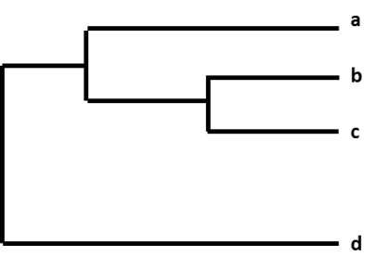
Genetic Characterization of Influenza
Determine how closely “related” or similar influenza viruses are to one another genetically
Monitor how influenza viruses are evolving or changing over time
Identify genetic changes that affect the virus’ properties. For example, to identify the specific changes that are associated with influenza viruses spreading more easily, causing more severe disease, or developing resistance to antiviral drugs.
Assess how well a flu vaccine might protect against a particular influenza virus based on its genetic similarity to the virus
Monitor for genetic changes in influenza viruses circulating in animal populations that could enable them to infect humans.
https://www.cdc.gov/flu/about/professionals/genetic-characterization.htm

Slide 19
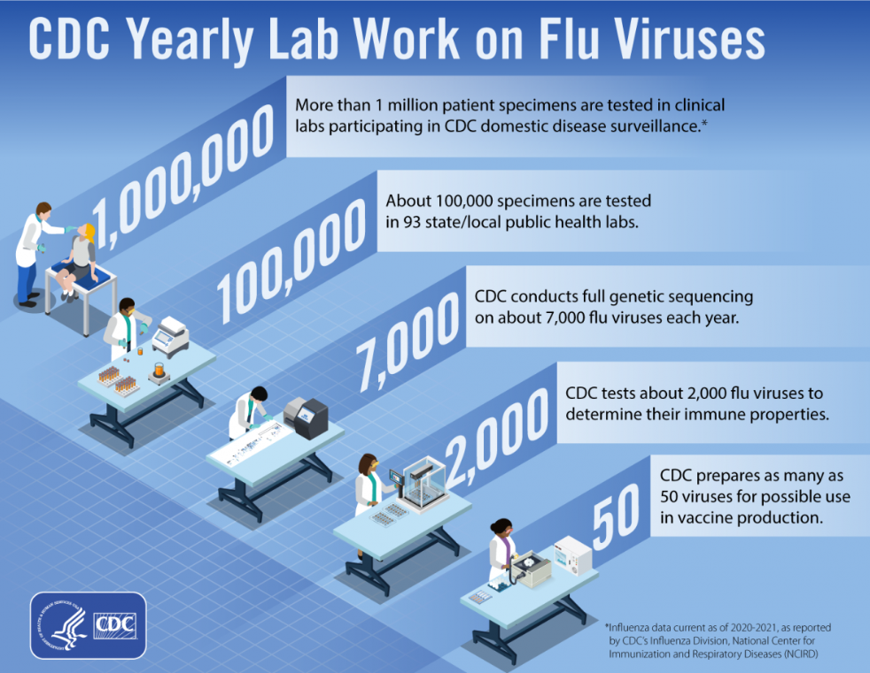
Beyond subtyping
https://www.cdc.gov/flu/resource-center/freeresources/graphics/infographic-lab-work.htm

Slide 20
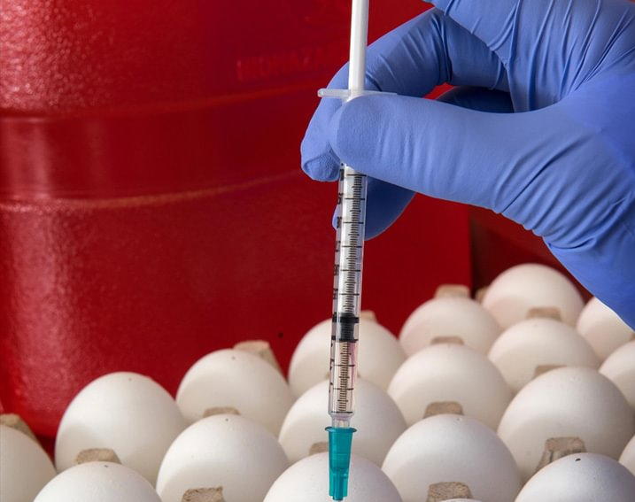
Viable virus is required for vaccine production
https://phil.cdc.gov/Details.aspx?pid=23203
Egg-Based Flu Vaccines
Cell-Based Flu Vaccines
Recombinant Flu Vaccine

Slide 21
Alaska State Laboratory Influenza Testing
Testing occurs primarily at the Alaska State Virology Laboratory in Fairbanks. Surge capacity is available at the Anchorage State Public Health Laboratory.
The Virology Lab offers free shippers, collection materials, ice packs, and postage to participating sentinel laboratories to submit clinical specimens.
Influenza A viruses are subtyped and influenza B viruses are genotyped.
Selected specimens are shared with CDC reference centers for antigenic and genetic characterization as well as antiviral resistance testing
Appropriate viable viruses are selected as candidate vaccine viruses (CVVs)
Alaska State Public Health Labs have the capability to test patients for H5 and H7 avian influenza

Slide 22
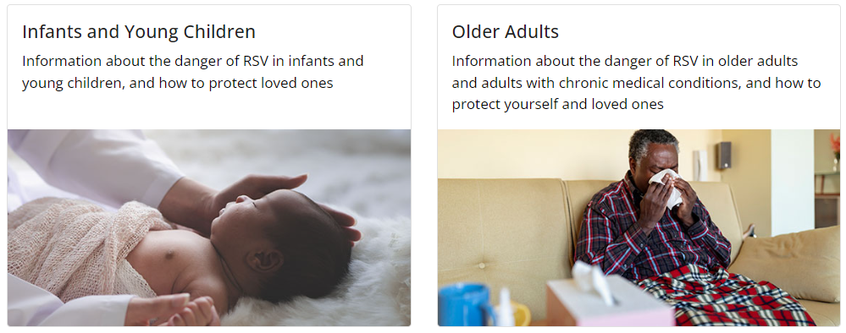
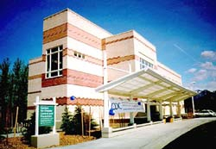
Respiratory Syncytial Virus (RSV)
https://www.cdc.gov/rsv/high-risk/index.html
https://www.cdc.gov/ncezid/dpei/aip/index.html
Notes:
Infant pneumonia, 3x hospitalization rate in Yukon-Kuskokwim region for native infants. AIP in Anchorage is focused on monitoring this virus as one of their priority activities.

Slide 23
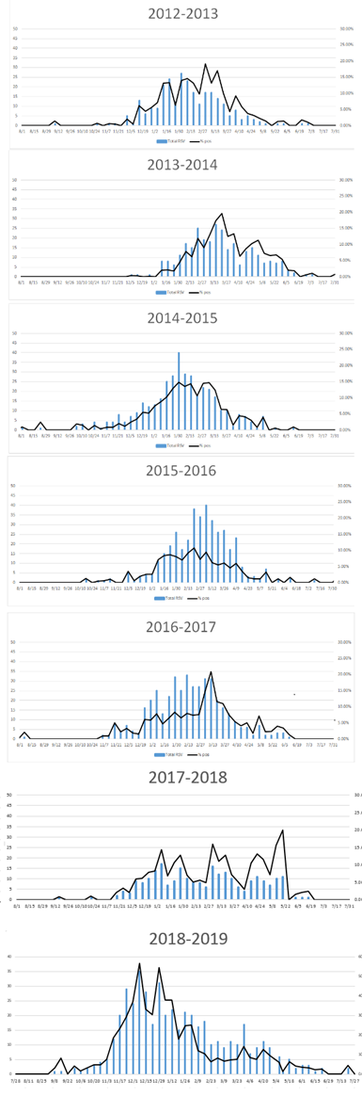
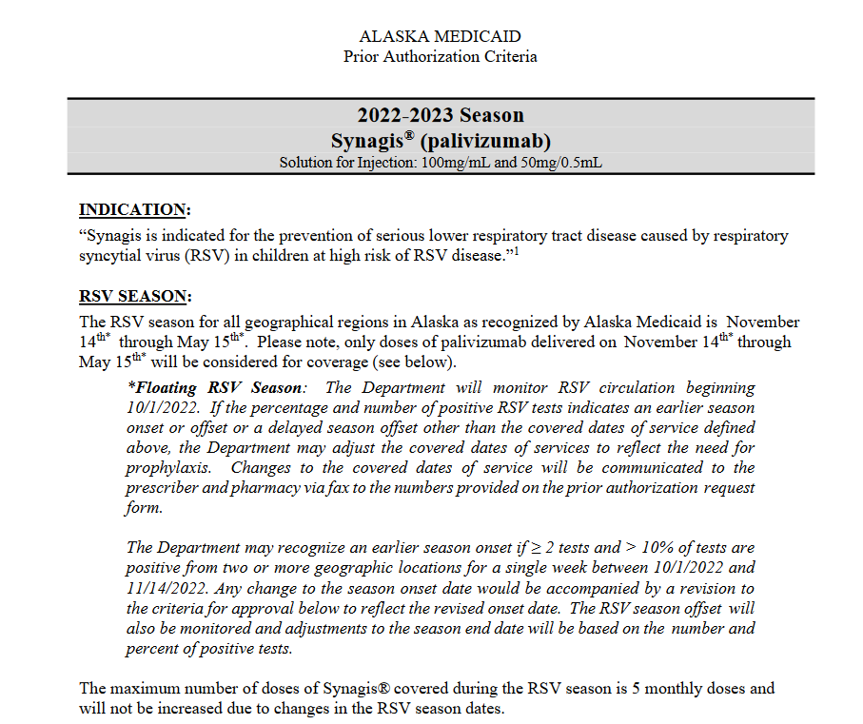
RSV Surveillance
Synagis start
End November
Synagis end
May 15
https://health.alaska.gov/dhcs/Documents/pharmacy/Criteria/CCFU_Synagis_2022-2023.pdf

Slide 24
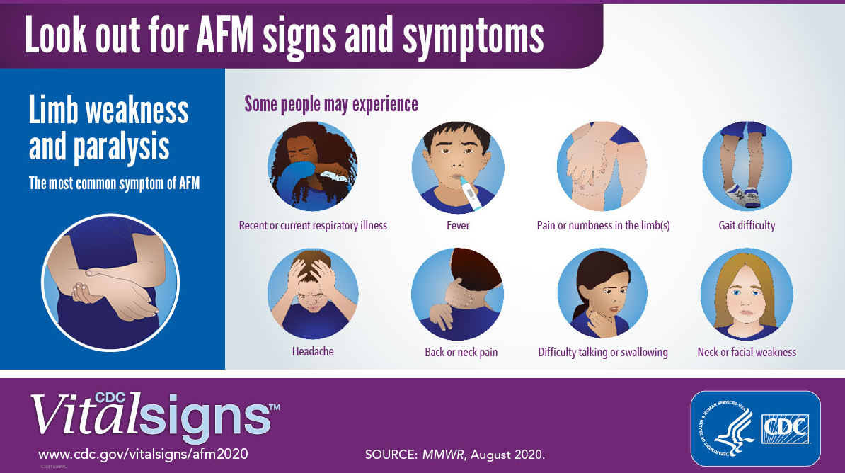
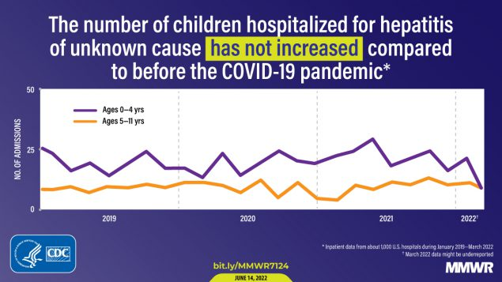
Other viruses
Adenovirus
Human metapneumovirus
Parainfluenza 1
Parainfluenza 2
Parainfluenza 3
Parainfluenza 4
Rhinovirus
Enterovirus
Human coronavirus OC43
Human coronavirus NL63
Human coronavirus 229E
Human coronavirus HKU1
coxsackievirus A16, EV-A71, and EV-D68 ?
adenovirus type 41 ?
Notes:
For which there are no treatments or vaccination programs – why do we monitor?

Slide 25
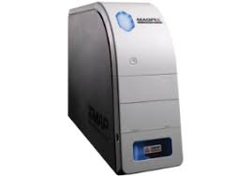
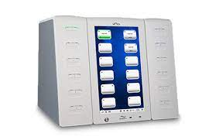
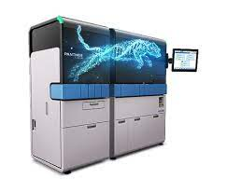
Respiratory Panel testing
Luminex MagPix
Genmark Diagnostics – ePlex System
Hologic Panther Fusion

Slide 26
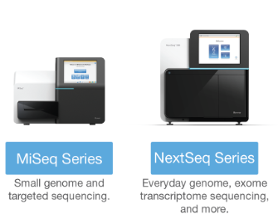
Further Characterization of Respiratory Viruses
SARS-CoV-2
Influenza
Adenovirus
Enterovirus
Rhinovirus

Slide 27
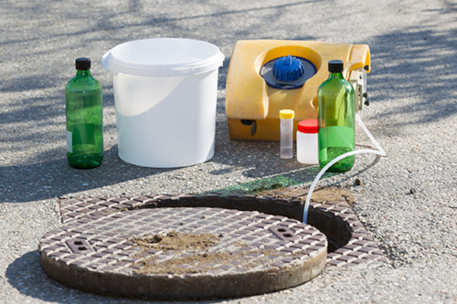
Wastewater surveillance for respiratory viruses
Key Principles:
Wastewater surveillance data are most useful when used with other data.
Early warning systems, such as wastewater surveillance, can detect small changes as a signal for early action.
More data over time can give better, more reliable trends.
https://www.cdc.gov/nwss/wastewater-surveillance.html
Notes:
https://www.cdc.gov/nwss/wastewater-surveillance.html

Slide 28
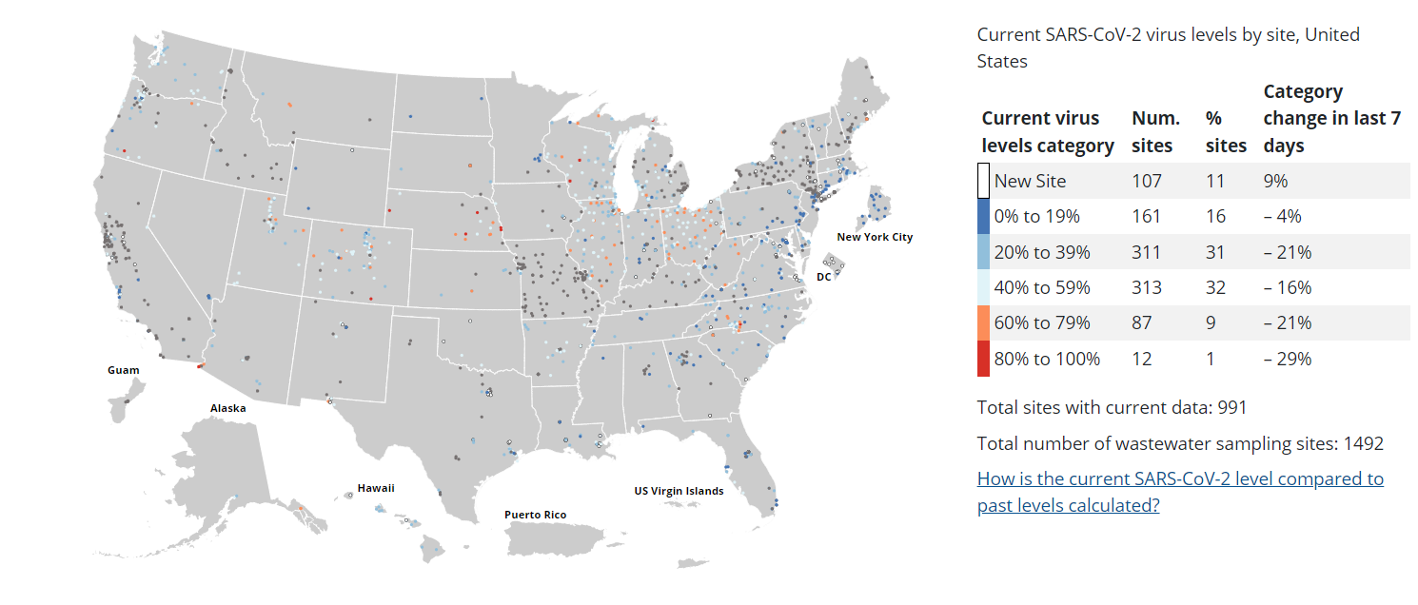
U.S. Wastewater Surveillance for SARS-CoV-2
https://covid.cdc.gov/covid-data-tracker/#wastewater-surveillance

Slide 29
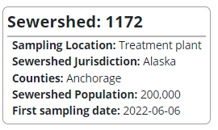
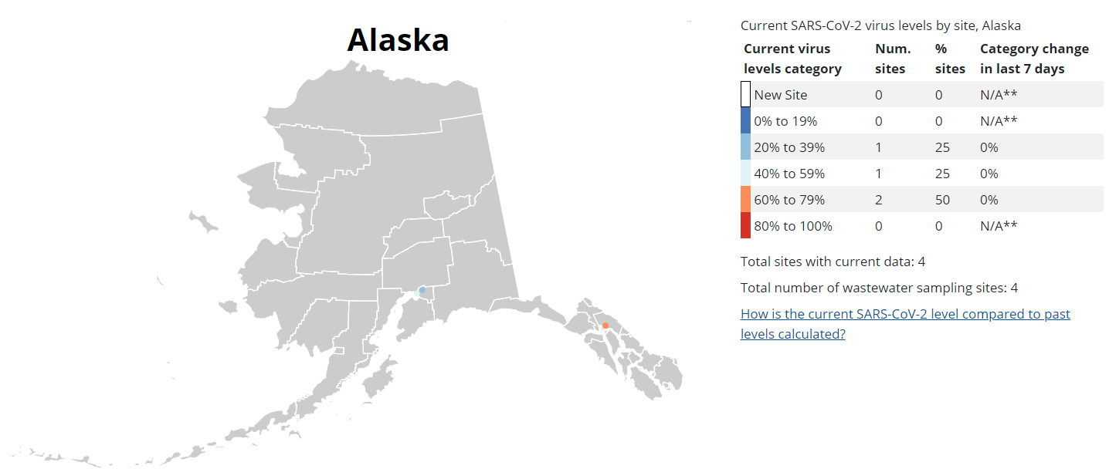
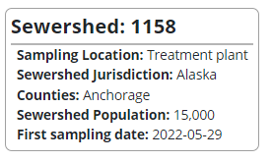
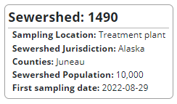
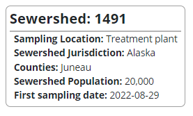
Alaska Wastewater Surveillance for SARS-CoV-2
https://covid.cdc.gov/covid-data-tracker/#wastewater-surveillance

Slide 30


WWS is a Interdepartmental Collaboration in Alaska

Slide 31
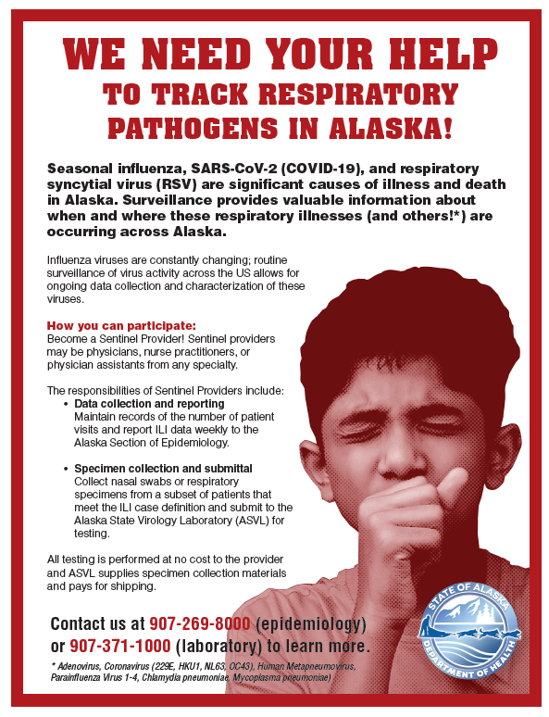
How can you get involved? 1 of 5
Make the most of extended teams.
  Contact us to get started!
  Become a sentinel provider
  Become a member of the state clinical listserv to become aware of notifications and changes happening across the state
  Be on the look out for Zoom calls in the fall that outline current surveillance activities

Slide 32
Interested in Participating? Become a Sentinel Provider!
Providers of any specialty (e.g. family practice, internal medicine, pediatrics) in any type of practice (e.g. private practice, urgent care center, university student health center) are eligible to be sentinel providers.
How it Works
Data collection and reporting
Sentinel Providers report the number of patients seen with ILI in five age categories (0-4 years, 5-24 years, 25-64 years, and ≥65 years) and the total number of patients seen for any reason.
Submit reports to Section of Epidemiology on a weekly basis
Virologic Testing
Submit 10 specimens (nasal, throat, or nasopharyngeal swabs in UTM/VTM) collected from patients to ASVL weekly. Testing is performed at no cost to the provider and ASVL supplies specimen collection materials and pays for shipping.
Specimens should be collected from patients with ILI, especially those with any of the following: severe disease, recent overseas travel, recent swine exposure, occurring in an outbreak setting, individuals who have received this season’s influenza vaccine
Participating providers will receive individual test results for specimens submitted to ASVL and receive weekly updates of state and national disease activity.
Case Definition for Influenza-Like Illness
Any illness with fever (≥100°F or 37.8°C) AND
Cough and/or sore throat

Slide 33

Connecting with Clinical Laboratorians in Alaska
*New Clinical Laboratory Network Listserv*
To join: https://list.state.ak.us/mailman/listinfo/clinical.lab.net
To connect with others: clinical.lab.net@list.state.ak.us
The clinical.lab.net listserv provides a forum to connect clinical laboratorians in Alaska for the purposes of distributing notifications from the Alaska State Public Health Laboratories, Division of Public Health, Department of Health. It also serves as a forum for members to collaborate on laboratory issues such as biosafety, biosecurity, laboratory methods, quality management, staff competency, training, equipment, vendors, and other clinical laboratory-related topics.

Slide 34
How can you get involved?
2. Be a reliable advocate.
Talk about surveillance of respiratory disease with your organization’s physicians, nurses, infection preventionists, and others to spread information.
Partner with clinical laboratorians across the state and make an effort to get to know one another. Talk about your efforts to collaborate with state partners.
Submit up to 10 specimens weekly to the Alaska State Virology Laboratory that represent your ILI patient population. Pretested positives are acceptable. Specimen data is most relevant when collection dates are within a 2-week window.

Slide 35
How can you get involved? 3 of t
3. Lead with kindness.
We are interconnected when it comes to respiratory disease.
  Include – include all age groups, races, ethnicities, etc. that represent your patient population.
  Inform – discuss how important specimen testing and sharing is with staff and patient populations
  Inquire – ask questions and build honest interest in the viruses that are circulating in Alaska
  Develop – grow relationships with the people who make up our public health workforce and extended healthcare workforce
  Recognize – acknowledge when you can’t meet goals, be honest with your own capacities and limitations, and recognize your role to collect specimens and share data

Slide 36
How can you get involved? 4 of 5
4. Offer access to emotional support resources.
Another form!!??? Connect us with your IT to determine if automated transfer of information will work for your organization.
Why do you report data to us when we already pretested!? We can stop if you’d prefer not to have individualized reports back.
Too busy for this!! We understand this might not be a good time to start for you, but don’t forget about us! Let us know when you are ready.

Slide 37
How can you get involved? 5 of 5
5. Allow time for what matters.
Pandemics can be better controlled and more predictable when we work together. Consistent and meaningful surveillance of common pandemic viruses (i.e., influenza and coronaviruses) can make a huge difference for our future.
Respiratory surveillance is critical and is dependent on strong and reliable clinical networks.

Slide 38
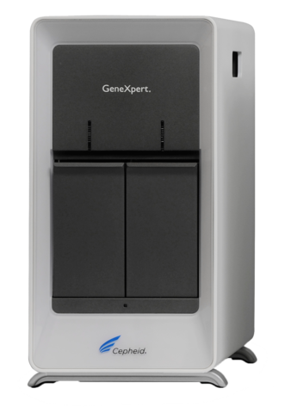
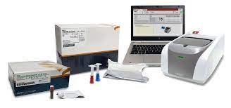
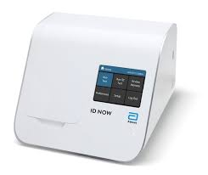
Other ways to contribute
Influenza is reportable in Alaska – please report positives to the Section of Epidemiology
https://health.alaska.gov/dph/epi/pages/pubs/conditions/crforms.aspx
Are you using a multiplex testing platform (ex. BioFire, Cepheid, Abbott ID NOW, etc.)?
  Consider participating in NREVSS

Slide 39
What is NREVSS?
The National Respiratory and Enteric Virus Surveillance System (NREVSS) is a laboratory-based system that monitors temporal and geographic circulation patterns (patterns occurring in time and place) of respiratory syncytial virus (RSV), human parainfluenza viruses (HPIV), human metapneumovirus (HMPV), respiratory adenoviruses, human coronavirus, rotavirus, and norovirus.
In this surveillance system, participating U.S. laboratories voluntarily report weekly to CDC the total number of weekly aggregate tests performed to detect these viruses, and the weekly aggregate positive tests. They also report the specimen type, location, and week of collection. NREVSS allows for timely analysis of data to monitor viral seasons and circulation patterns.
https://www.cdc.gov/surveillance/nrevss/index.html
https://www.cdc.gov/surveillance/nrevss/email.html

Slide 40
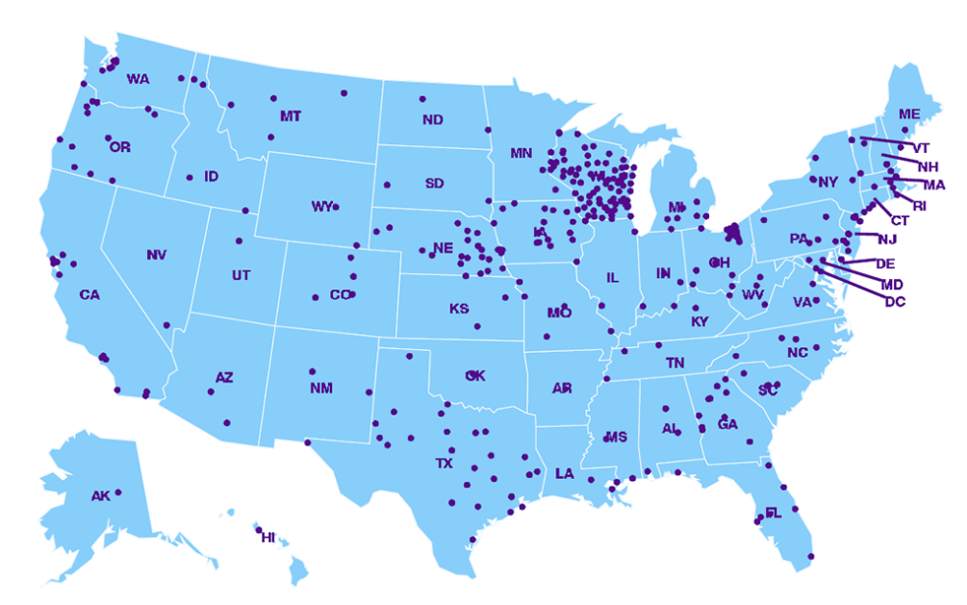
Participating Labs in NREVSS
Alaska
Alaska Department of Health, Fairbanks, AK
Eielson AFB, AK
https://www.cdc.gov/surveillance/nrevss/labs/map.html

Slide 41
Summary
The Alaska State Virology Laboratory in Fairbanks handles respiratory virus surveillance in Alaska.
Surveillance helps us predict pathogen dynamics, respond appropriately, and continually evaluate our diagnostic, therapeutic, and vaccine strategies.
Recent dynamics related to the pandemic and other factors is detrimental to respiratory surveillance.
Building positive connections within our broader clinical laboratory network will strengthen our workforce, increase resilience, and create employee retention.
Engaged clinical partners are key to strengthening and bringing meaning to our surveillance systems.

Slide 42
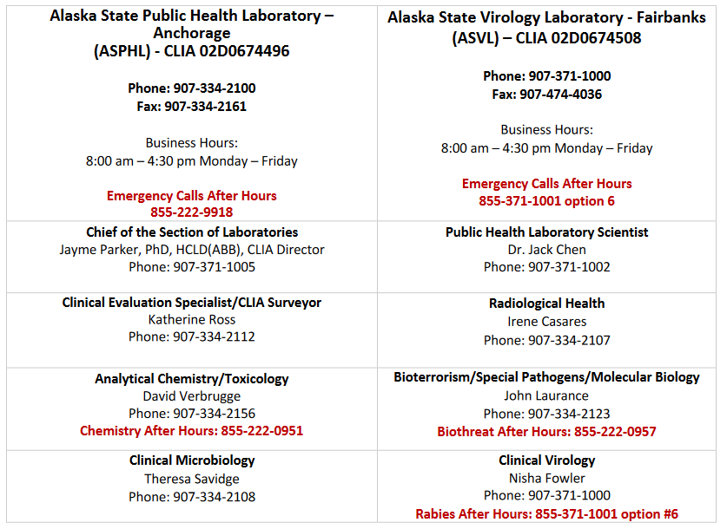
Contacts at Alaska State Public Health Laboratories

