Slide 1
Management of Cirrhosis for the Primary Care Provider
Nicholas Lim, MD Associate Professor of Medicine Alaska Tribal Health Webinar Series May 5th 2022

Slide 2
Disclosures
No Financial Relationships
No Discussion of Off-label Medication Use or Investigational Drugs

Slide 3
Learning Objectives
Upon completion of this activity, participants should be better able to:
Describe the diagnosis and natural history of cirrhosis
Identify screening needs for patients with cirrhosis
Summarize the indications for liver transplant evaluation in patients with cirrhosis

Slide 4
Overview
Cirrhosis Basics
Screening in Patients with Cirrhosis
Liver Transplantation

Slide 5
Cirrhosis Basics

Slide 6
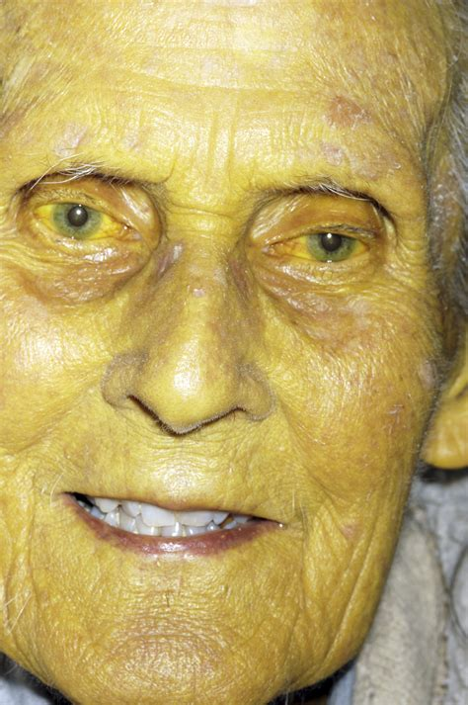
Definition
Cirrhosis (Greek)- “yellow/tawny”
“Clinico-pathologic syndrome characterized by diffuse hepatic fibrosis resulting in nodule formation, disruption of hepatic architecture resulting in altered hepatic function and blood flow”¹
~40% patients asymptomatic from cirrhosis
In 2021, 9th leading cause of death in the US²
Mortality increasing since 2009³
Zakim and Boyer’s Hepatology 6th ed
Xu et al. NCHS Data Brief 2022
Tapper & Parikh. BMJ 2018

Slide 7
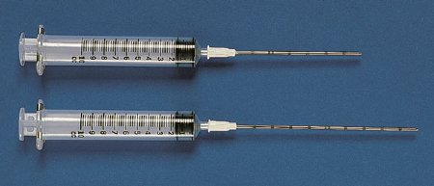
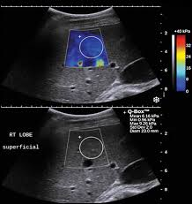
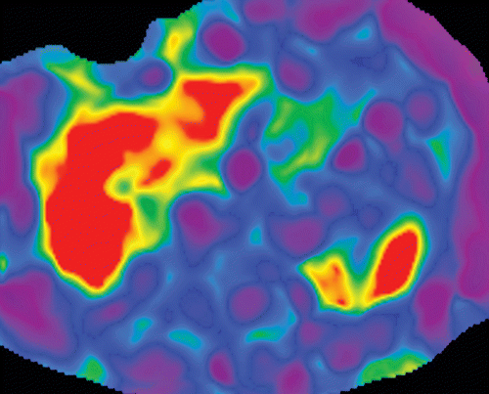
Diagnosis
Liver biopsy
Percutaneous/transjugular/intraoperative
Elastography
Ultrasound (“FibroScan”)
MRI
“Clinical”
Composite of symptoms, imaging and lab data

Slide 8
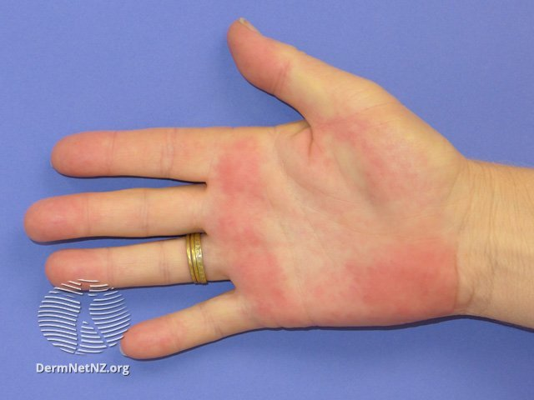
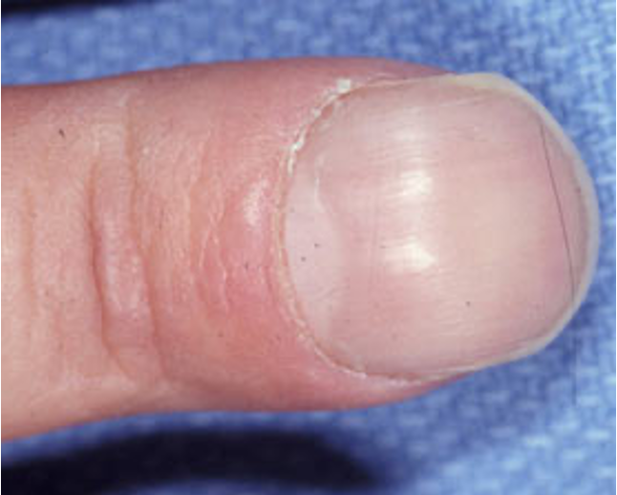
Hints at Cirrhosis
Blood work
Thrombocytopenia
Hypoalbuminemia
Abnormal LFTs
Physical Exam
Hepatomegaly
Hands
Imaging
“nodular contour”
“splenomegaly”
“ascites”
“venous collaterals”
Notes:
Thrombocytopenia- hematologist, bone marrow, “ITP”

Slide 9
Etiologies of Cirrhosis
Viral | Metabolic | Genetic* | Drug-related
HBV | ETOH | Hemochromatosis | Methotrexate**
HCV | NAFLD | Wilson’s disease | Amiodarone
HBV/HDV |  | A1-AT deficiency | Vitamin A
 |  | Cystic Fibrosis | Methyldopa
Autoimmune | Biliary | Vascular | Cryptogenic
AIH | Biliary atresia | Budd-Chiari syndrome
PBC | Biliary strictures | Veno-occlusive disease
PSC |  | Cardiac
Adapted from Gines et al. Lancet 2021

Slide 10
Natural History of Cirrhosis
Jaundice
Variceal bleeding
Ascites
Hepatic encephalopathy
Compensated Cirrhosis
Decompensated Cirrhosis
Death
Liver Transplantation
Chronic Liver Disease
Complications

Slide 11
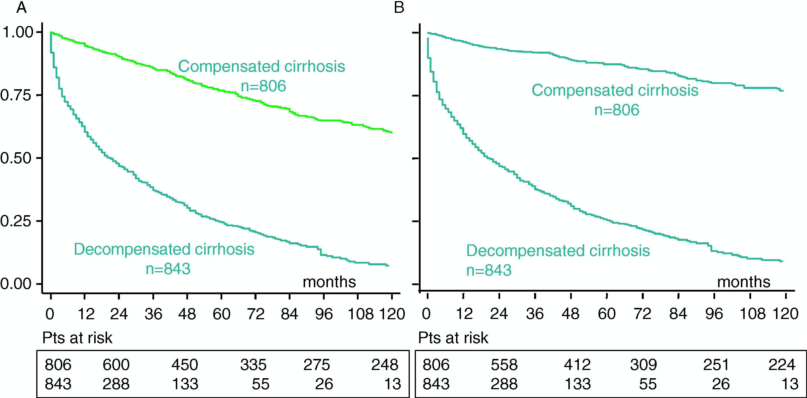
Survival According to Disease State
D’Amico et al. J Hepatol 2006
Notes:
These are survival curves from an old Meta-analysis. This is the paper that came up in board review earlier this morning.
What you can see here is that the majority of patients who presents with compensated disease do OK over time and those with decompensated do not.
Panel B is when you stay in the same group that you presented with, so if you meet someone and they are compensated and they remain compensated, their survival is really good.

Slide 12
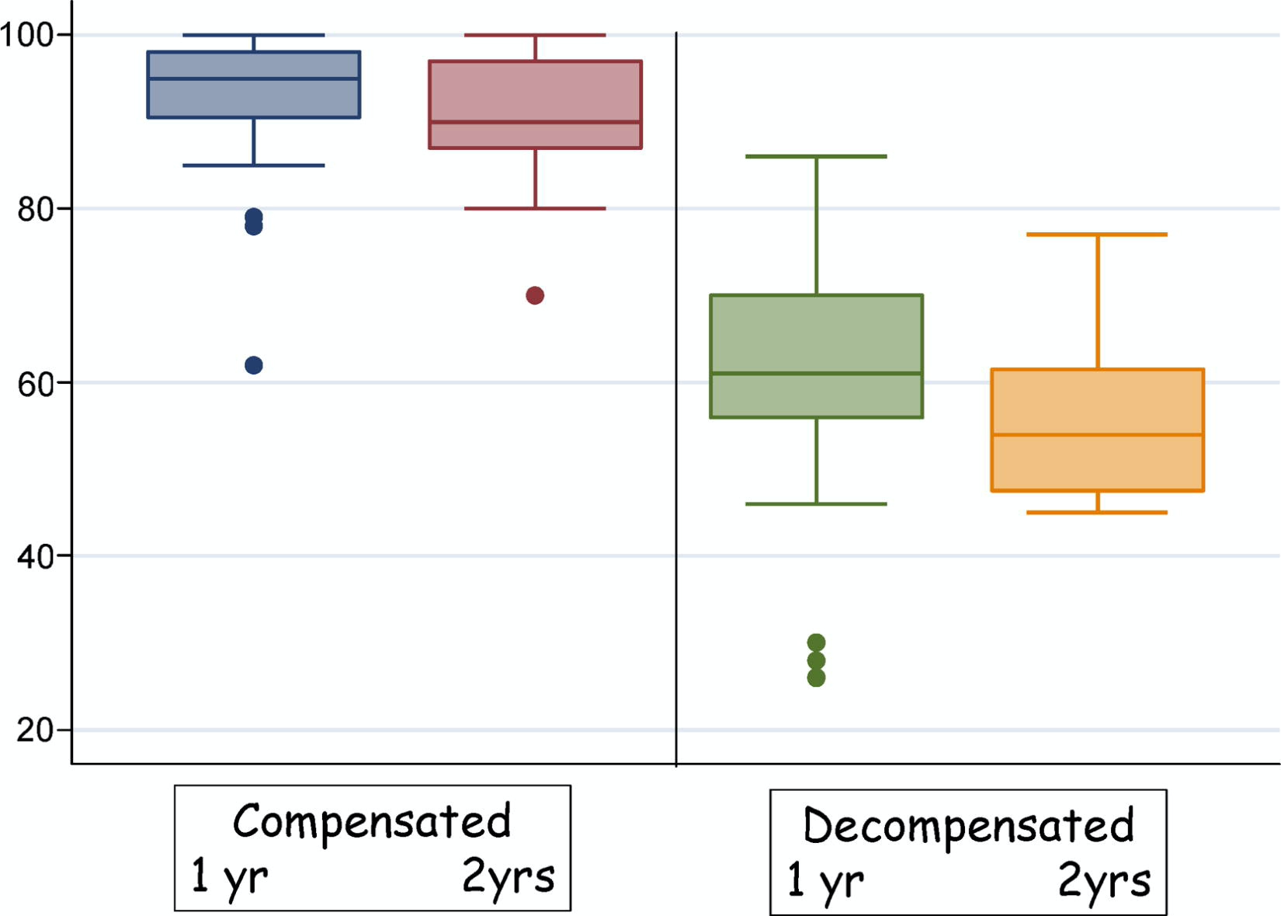
D’Amico et al. J Hepatol 2006
Notes:
This is similar data in a different form. What I was taught as a fellow by Nick Ferrentino, and data that I still use to this day when counseling my patients, although this is probably slightly different now that HCV is treatable
That is why we transplant patients with cirrhosis- it helps to alter the natural history of decomp cirrhosis

Slide 13
Screening in Patients with Cirrhosis

Slide 14
Screening
Hepatocellular Carcinoma (HCC)
Esophageal Varices
Osteoporosis

Slide 15
HCC Risk
Cirrhosis is a major risk factor for HCC¹
80% cases of HCC related to cirrhosis
Annual risk of HCC estimated 1-8% per year¹
Etiology of liver disease
Increased mortality due to HCC from 1999-2016²
+2.1%
Women, most races
Marrero et al. Hepatology 2018
2. Tapper et al. BMJ 2018
Notes:
This to me is another argument why we should be considering sending our patients for LT evaluation.
Lifetime risk of colon cancer is ~4%

Slide 16
HCC Screening
HCC screening improves overall survival¹
Novel biomarkers (AFP-L3%, DCP) for HCC screening promising but not yet ready for primetime³
AASLD 2018 HCC Practice Guidance²
1A. The AASLD recommends surveillance of adults with cirrhosis because it improves overall survival (OS)
1B. The AASLD recommends surveillance using US, with or without AFP, every 6 months.
1C. The AASLD recommends not performing surveillance of patients with cirrhosis with Child's class C unless they are on the transplant waiting list, given the low anticipated survival for patients with Child's C cirrhosis.
Singal et al. PLOS One 2014
Marrero et al. Hepatology 2018
Zhou et al. Medicine 2021
Notes:
AFP discovered in 1963!
AFP-L3%- lens culinary agglutinin-reactive fraction of AFP
DCP- des-gamma-carboxy prothrombin

Slide 17
Management of HCC
Curative | Disease Control
Surgical | Locoregional therapy (IR)
- Liver transplantation | - Chemoembolization (“TACE”)
- Hepatic resection | - Radioembolization (“Y-90”)
IR | Radiation therapy
- Microwave ablation | Systemic therapy

Slide 18
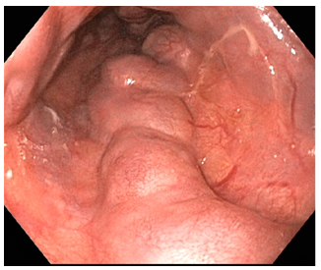
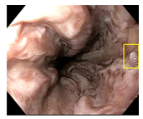
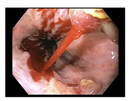
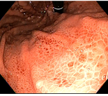
Esophageal Varices
Present in ~50% patients with cirrhosis
Compensated ~30-40%
Decompensated ~85%
Variceal bleeding occurs at rate of 10-15% per year
5-year mortality 20-80%
AASLD recommendation
Before- all patients with cirrhosis need EGD
Now- LS>20kPa & platelet <150k

Slide 19
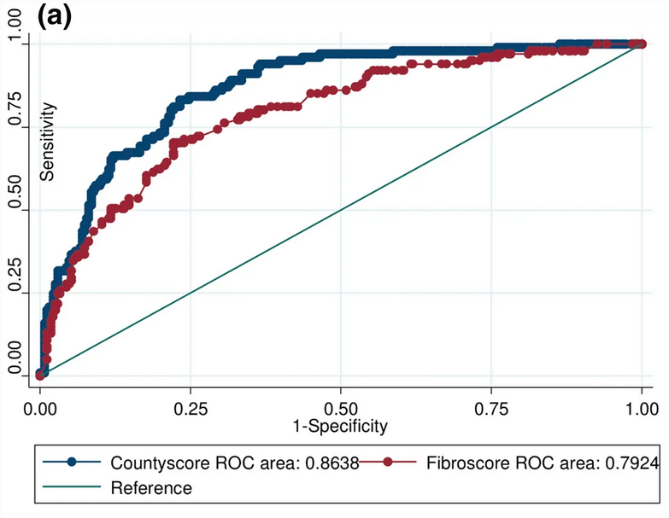
Esophageal Varices in the Rural Setting
Not everyone has easy access to EGD
Not everyone needs EGD
Access to endoscopy is variable across the US
Risk prediction scores
Cook County Score
EVendo Score
Kotwal et al. DDS 2021
Notes:
Decompensated- everyone agrees to do EGD on all patients with decomp disease

Slide 20
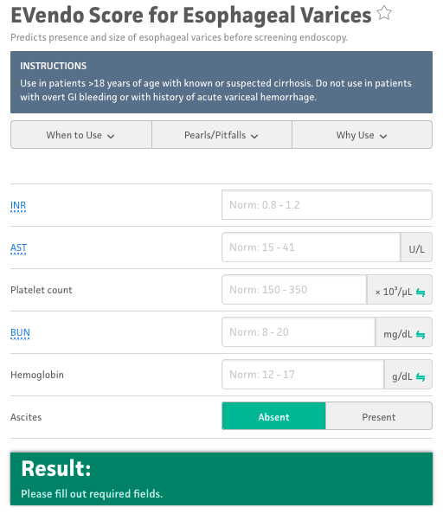
https://www.mdcalc.com/calc/10175/evendo-score-esophageal-varices#evidence
Notes:
Evendo score
<3.9- consider deferring EGD
>3.9 consider EGD as >5% probability of finding varices that need treatment

Slide 21
Alternative Strategy to Endoscopy
Non-selective beta-blockers prevent first variceal hemorrhage in patients with medium to large EV¹
EGD with band ligation may have an edge
No difference in overall mortality
Carvedilol
Better tolerated, more potent, once daily dosing
Other indications for beta-blocker?
Two-for-one
?Prevention of decompensation²
Ascites, VH, HE, liver-related mortality
d’Amico et al. Semin Liver Dis 1999
Serper et al. Hepatology 2022

Slide 22
Osteoporosis
Osteoporosis affects up to 30% of patients with cirrhosis¹
Imbalances in bone remodeling, inflammatory cytokines and nutritional deficiencies
Higher risk in patients with PBC and PSC
Patients with cirrhosis ~2X higher risk of osteoporosis-related fractures²
Higher rates of infections, surgical complications
Higher rates of post-fracture mortality
Merli et al. J Hepatol 2019
Luxon et al. Curr Gastro Rep 2011

Slide 23
Osteoporosis
Current USPSTF and endocrinology society practice guidelines do not make specific recommendations for patients with cirrhosis^{1,2}
AASLD^{3,4}
Screen liver transplant candidates
Screen patients with PBC and PSC
Patients with other liver diseases?
What I do
Screen all patients with cirrhosis at least once
USPSTF 2018
AACE/ACE 2016
Lindor et al. Hepatology 2019
Martin et al Hepatology 2014

Slide 24
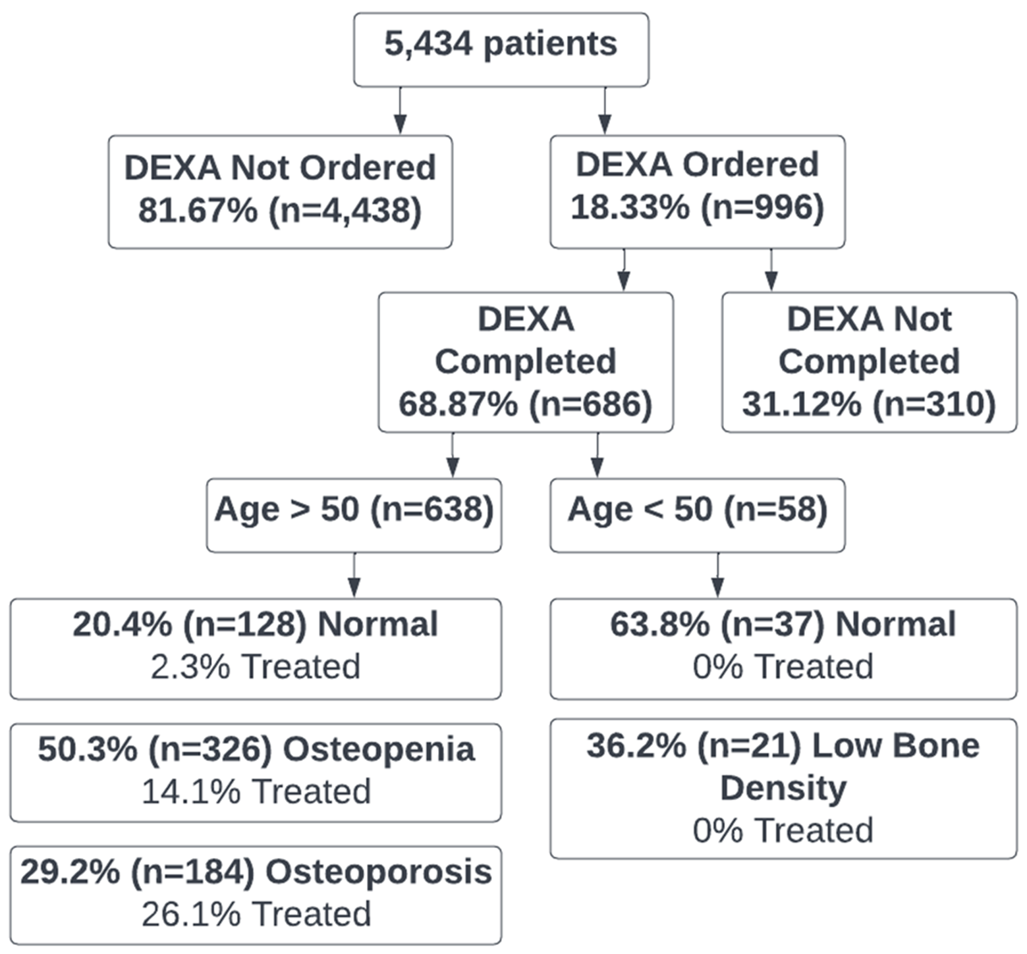
Osteoporosis
Screening practices at “M Health Fairview”
Majority of patients with cirrhosis not getting DEXAs
Those that do more likely to have traditional risk factors
Low rates of treatment
Low rates of treatment side effects/adverse events

Slide 25
Liver Transplantation

Slide 26
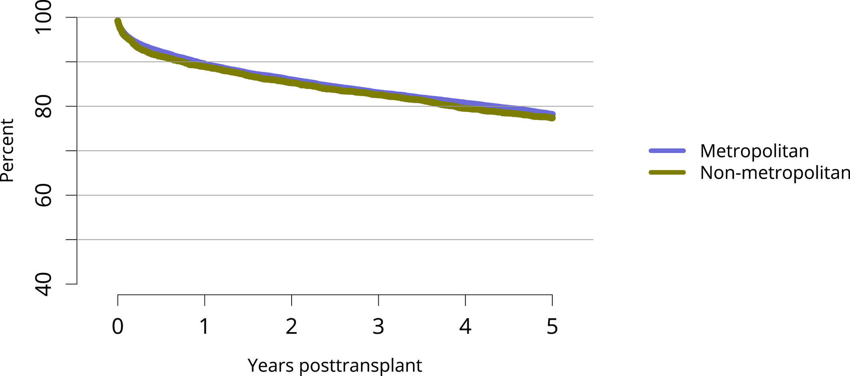
Survival Benefit of LT
Kwong et al. AJT 2022
Notes:
As I said earlier, we transplant patients to alter the natural history of cirrhosis.
This slide is from the latest Annual Report from SRTR (Scientific Registry of Transplant Recipients, who gather outcomes data on all SOT patients)
Here are the latest Average 1-year survival (the metric all programs are judged by) is 90% and 80% at 5-years, showing that LT results in good patient outcomes and saves lives

Slide 27
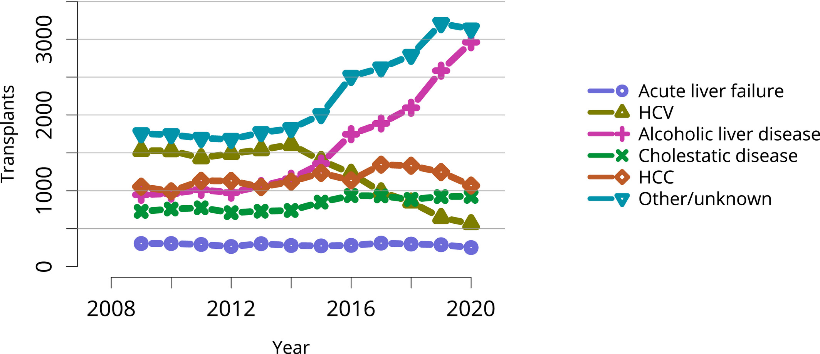
Changing Indications for LT
Kwong et al. AJT 2022
Notes:
I do want to take a minute to highlight how LT in the US continues to evolve…
As I mentioned earlier, the revolution in HCV treatment has resulted in less HCV cirrhosis and we are definitely seeing that here.
In parallel, the rise in ETOH liver disease in general has resulted in an increase in LT for ETOH liver disease. That has also been facilitated by changes in center attitudes, particularly to ETOH hepatitis.
Finally, under “other” you can see another sharp uptick and that mostly represents NASH

Slide 28
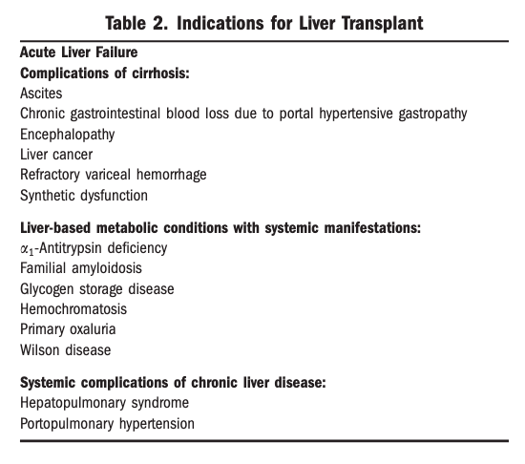
LT Referrals
AASLD recommend referral to LT center when MELD-Na≥15
Any form of decompensation
Refractory to medical therapy
Martin et al. Hepatology 2014
Notes:
Now when should patients with cirrhosis be referred to a LT center?

Slide 29
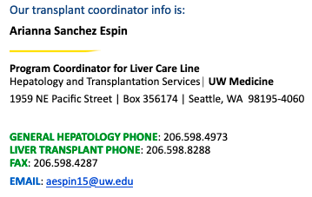
LT Referrals to U of W
Closest LT program to Alaska
3rd busiest living donor LT program in the US
33 LDLT in 2022
Low MELD-Na patients welcome!
“When in doubt, refer!”

Slide 30
Summary
Cirrhosis is a multifactorial disease with a clinical course that varies greatly with disease state
HCC screening improves overall survival in patients with cirrhosis
Variceal bleeding is a serious but preventable complication of cirrhosis which presents added challenges when screening in the rural setting
Osteoporosis is common in patients with cirrhosis but screening recommendations remain lacking
LDLT facilitates LT and saves lives in patients with decompensated disease and lower MELD-Na scores

Slide 31
Thank You

Slide 32
Questions

