Slide 1
Overview
Interagency Recovery Coordination (IRC)
DR-4672-AK
Notes:
Interagency Recovery Coordination Group

Slide 2
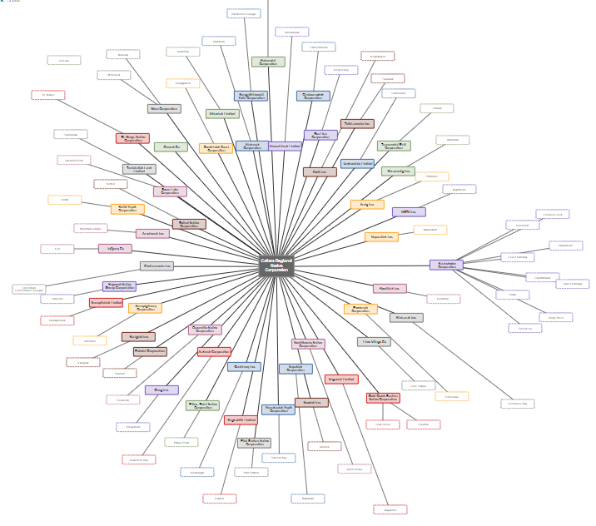
Interagency Recovery Coordination (IRC)
Brings federal and national partners together for opportunities to add value to local and state recovery priorities and build the capacity to achieve outcomes
Goes beyond traditional disaster recovery programs; helps interagency and non-govt partners align resources to support recovery
Leverages subject matter expertise, as well as funding and technical assistance resources to help communities recover from disasters

Slide 3
Interagency Recovery Coordination (IRC) Services
What can we help with?
Facilitating Community Discussions on Recovery
Developing a Long-term Recovery Plan
Identifying, Navigating, and Managing Resources
Addressing Funding Gaps
Notes:
What sorts of services do we provide? You may know already exactly what you want for your community, wholistically, but if you don’t yet IRC has community planners who can support you in making your long-term outcomes possible. The next step we might help you with is putting that into a plan and finding resources to fill any gaps. We can bring resource providers to the table. We can identify other examples from communities in the country were successful. We want to maximize the use of federal resources.
We have some technology tools to help us identify among the full range of federal programs, funding and technical expertise that can use used for this disaster.
The IRC function provides a flexible and scalable approach to conducting all federally-supported disaster operations.
The Interagency Recovery Coordination approach works with community governments to first determine the resilient outcomes the community would like for their recovery. Then, works with federal partners to determine the most efficient and effective use of available federal resources to achieve those outcomes. Federal field leaders establish the framework to support community partners in achieving identified outcomes.
IRC uses an integrated approach between response and recovery; and across the federal family and NGOs. A major benefit of this approach is that it provides a consistent recovery approach across all disaster’s field operations.
A really important point is that IRC does not redesign disaster recovery programs. It is an operational approach focused on recovery outcomes that drives integration across federal programs.

Slide 4
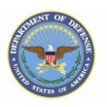
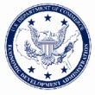
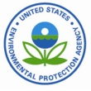
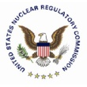
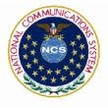
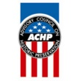
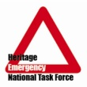
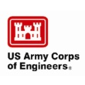
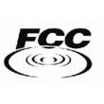
Other Federal Agencies
Holistically supports recovery needs and objectives of communities
Coordinates recovery resources and programs from over 30 other federal agencies
IRC & RSFs activated based on the specific recovery needs of impacted communities
Notes:
IRC holistically supports recovery needs and objectives of communities and coordinates recovery resources and programs from over 30 other federal agencies
IRC & RSFs are activated based on the specific recovery needs of impacted communities

Slide 5
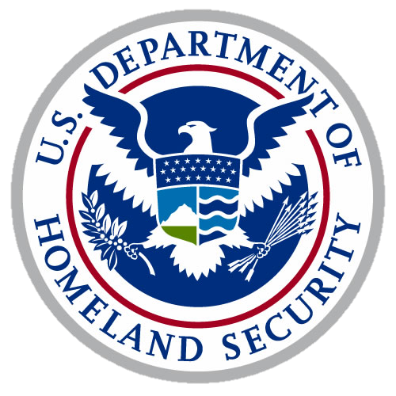
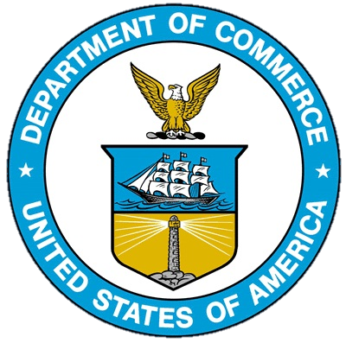
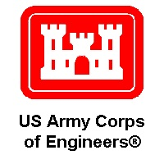
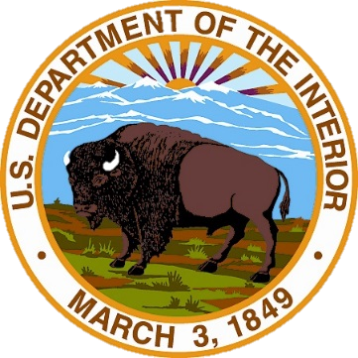
Federal Coordinating Agencies
6 Recovery Support Functions (RSFs) | Coordinating Agencies
Economic Recovery | Dept. of Commerce / Economic Development Administration (EDA)
Health and Social Services (HSS) | Dept. of Health and Human Services (HHS)
Housing | Dept. of Housing and Urban Development (HUD)
Infrastructure Systems | Dept. of Defense / Army Corps of Engineers (USACE)
Natural and Cultural Resources (NCR) | Dept. of the Interior (DOI)
Community Assistance (CA) | Dept. of Homeland Security / FEMA
Notes:
These are the six RSFs and the primary coordinating agency.
Review each RSF and its agency

Slide 6
Benefits of IRC Function
Why incorporate Interagency Recovery Coordination into our recovery processes?
Improve Equitable Outcomes
Emphasize the Whole Community Approach
Ensure the effective use of resources
Reduce duplication of effort
Encourage coordination and information sharing
6
Notes:
IRC is not a program, which means we don’t have funding in the same way Individual Assistance, Public Assistance and Hazard Mitigation do. What we do have is the ability to assist you with planning what you want for your community and connecting you with other resources to fill resources gaps.
Why incorporate Interagency Recovery Coordination into our recovery processes?
The IRC function provides a foundation for collaboration and problem-solving. Bringing together jurisdictional governments, federal, and nongovernmental partners to work together on long-term recovery solutions that benefit those impacted by disaster.
Integration of the IRC in operations produces several benefits – which we will cover from left to right
The first on your left is Encouraging coordination and information sharing – Integrated operations encourages FEMA Program staff and interagency partners to regularly coordinate efforts to support community recovery and shares the information they collect as part of their day-to-day operations. In many cases, this is already done. Integrated operations simply confirms the need for information sharing and coordination.
With increased coordination and information sharing, we benefit from the Reduction of duplication of effort. For example, sharing information internally among the FEMA programs will help reduce duplications of requests for the same information, which overwhelms and frustrates community officials.
Reducing the duplication of effort also leads to Ensuring the effective use of resources - As noted earlier, integrated operations focuses on identifying recovery outcomes and aligning processes and resources to fit jurisdictional governments’ goals from the outset. This ensures more effective use of available resources.
Targeting outcomes and aligning resources with communities’ recovery goals Emphasizes the whole community approach. This ensures that the federal government is supporting an inclusive and holistic response and recovery effort that meets the needs of the whole community.
* Finally, integrated operations provides an opportunity to work collectively to see how FEMA and federal interagency partners can use their insight, data and resources to Improve equitable outcomes by identifying and addressing potential barriers to assistance and identifying impacted areas that may need targeted assistance and capacity building.

Slide 7
Contact Information
Sarah Reynolds
Interagency Recovery Coordination (IRC) Group
DR-4672-AK
(771) 217-7026
Sarah.Reynolds@FEMA.DHS.GOV

