Slide 1
Extrapulmonary TB
Michelle M. Rothoff, M.D.
Alaska TB Program

Slide 2
Disclosures
none

Slide 3
overview
Rates of EP TB in AK
When to suspect extrapulmonary TB
How to diagnose extrapulmonary TB
Case Reviews
TB transmission prevention: pulmonary vs extrapulmonary

Slide 4
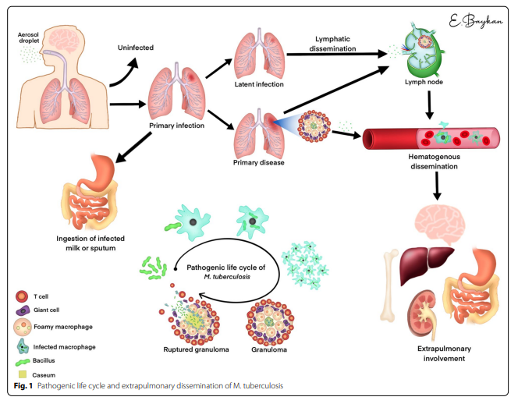
pathogenesis
Baykan et al. Insights into Imaging (2022) 13:39 https://doi.org/10.1186/s13244-022-01172-0
Notes:
TB infection typically starts in the lung, but can spread to any part of the body excluding hair/teeth/nails
Can spread by lymphatic/hematogenous/contiguous routes

Slide 5
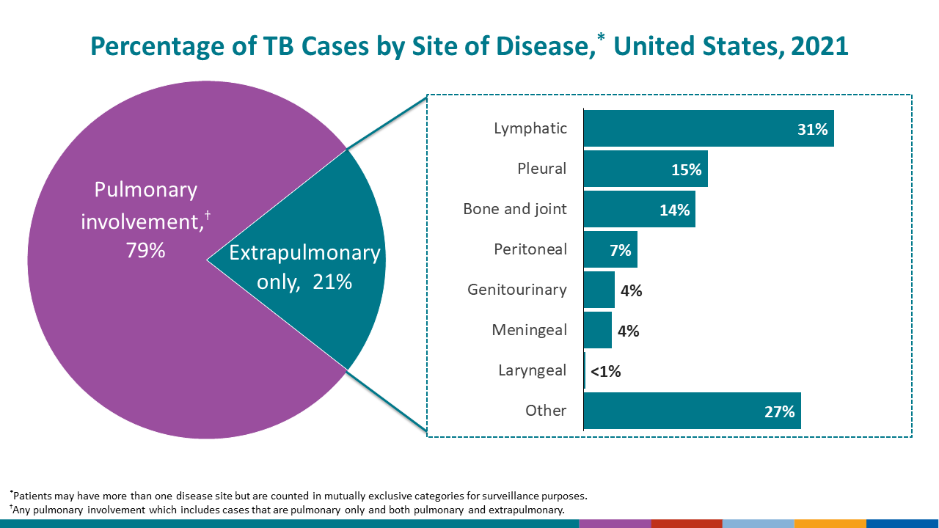
Rates of Extrapulmonary TB in the U.S.
U.S. 2021 rates by site
Lymphatic (31%)
Other (27%)
Pleural (15%)
Bone/Joint (14%)
Peritoneal (7%)

Slide 6
Rates of extrapulmonary tb in Alaska
Pleural (9)
Lymphatic (8)
Other (8)
Peritoneal (4)
Bone/Joint (3)
GU (3)
During this time period, 37 out of 179 total TB cases in AK had an extrapulmonary component
Other includes paraspinous, blood, skin, spine

Slide 7
Extrapulmonary tb general points
Can involve any organ
Need a high index of suspicion
Always evaluate for pulmonary involvement
Chest 2008 study: 72 EPTB cases; 49% abnormal CXR, AFB smear pos sputum 9%, Mtb Cx pos sputum 21%
Dx: clinical suspicion→imaging→sampling→mycobacteriology
Negative smear, lack of granulomas, negative culture do not r/o dx; IGRA sensitivity only 69-86% in EP TB
In general, treat the same as pulmonary TB (RIPE for 6 mos) except:
CNS/meningeal: 9-12 mos
Bone/Joint: 6-9 mos
Consider adjunctive steroids for TB meningitis and pericarditis
Generally not infectious unless: pulmonary or laryngeal involvement
Notes:
Transmission from EP sites has been reported to occur during aerosol-producing procedures such as tissue irrigation
Do not formalin fix tissue samples

Slide 8
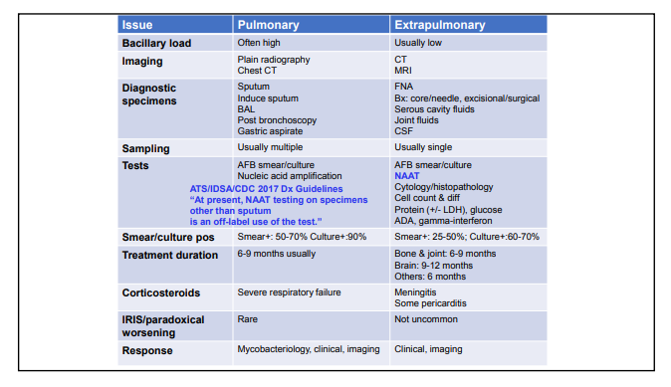
Extrapulmonary TB
Michelle Haas, M.D., Tuberculosis Clinical Intensive
Notes:
ASPHL NAAT validated for sputum, bronchial, body fluids, tissue, NOT urine/blood/CSF
TB-IRIS is well known among HIV-positive patients receiving ART, but it is less common and understood among HIV-uninfected patients.¹ ² ⁵ ⁶ TB-IRIS in HIV-negative patients receiving antituberculosis therapy is estimated to affect 2%–23%.
In HIV-negative patients, TB-IRIS occurs more often in extrapulmonary TB,² in particular in pleural and lymph node forms.² ¹² Median time to onset after initiation of antituberculosis therapy varies in a wide range, but IRIS usually occurs within 3 months.
No standard tx for IRIS—can range from mild to severe. Obs/NSAIDs/steroids

Slide 9
When to suspect extrapulmonary tb
From American Family Physician Volume 72, Number 9; November 1, 2005

Slide 10
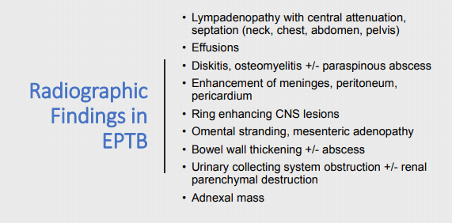
When to suspect extrapulmonary tb
Michelle Haas, M.D., Tuberculosis Clinical Intensive

Slide 11
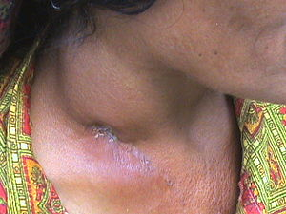
Case 1
29 yo female presents to PCP with c/o lump on R side of neck for 3 mos and intermittent F/C X 1 week
ROS: No cough, hemoptysis, weight loss, fatigue
PMH: Had a positive PPD in 1992 and took INH for 9 mos; otherwise negative
SH: emigrated from Philippines as a young child in 1992
PE: 3 cm firm mass on R neck lateral to thyroid
US and CT imaging done: 3.6 X 2.3 cm soft tissue mass in R lower neck with peripheral enhancement and central areas of decreased enhancement, smaller soft tissue nodules in R IJ chain measuring approx 1 cm; chest CT was normal
Notes:
Cases are based on true cases with some modifications; images are representative

Slide 12
Case 1 (cont.)
Excisional biopsy done by ENT
Final path: benign necrotizing lymphadenitis, negative for malignancy
Tissue: AFB smear negative
12/2018: tissue Mtb culture positive
IGRA positive, sputa collected (smear, PCR, culture negative)
Dx: TB lymphadenitis (scrofula)
12/2018: started DOT with RIF/INH/PZA/EMB
1/2019: isolate found to be INH-resistant. INH stopped, DOT continued with RIF/PZA/EMB
2/2019: developed nausea, LFTs elevated (AST 846/ALT 1563); all meds stopped. Felt to be d/t PZA hepatotoxicity.
3/2019: LFT’s normalized; started on RIF/EMB/MOX
4/2019: some enlargement of nodes reported, otherwise doing well on treatment; plan is to complete 6-month course of tx

Slide 13
Case 1 take-home points
Get tissue Mtb culture for diagnosis and sensitivities; everything else may be negative
More tissue = better chance of finding; excisional bx has higher yield than FNA
Beware resistance in patients with past h/o TB treatment
Lymphadenitis may worsen before improving on treatment (20% of pts)

Slide 14
Lymphatic TB
Cervical is most common, but can involve any lymph node
Peak onset 20-40 years; in U.S. more common in women and immigrants
HIV- usually present with chronic nontender LA
HIV+ usually present with fever, NS, weight loss
Nodes are discrete, firm, nontender, become matted with time; if untreated may become fluctuant and develop sinus tracts
Most have positive TST and negative CXR
Dx: excisional biopsy for histology, AFB smear and Mtb culture
During treatment, affected nodes may enlarge or new ones may appear

Slide 15
Case 2
29 yo AN female presents to ED with c/o LUQ pain
Pain just anterior to mid-axillary line with radiation around into back, worse with movement or deep breath
Was seen in another ED 3 weeks earlier and treated with Augmentin without improvement
Had a positive PPD (20 mm) at that time; AFB smear X 3 and PCR neg X 1; started on tx for LTBI with 3HP
ROS: occasional night sweat, chills, fatigue, weight loss, denies cough
PMH: Exposed to FIL with active TB
Chest CT: moderate loculated L pleural effusion with lingular and LLL atelectasis/infiltrate, LUL opacification with adjacent nodules
Elevated LFTs, WBC WNL

Slide 16
Case 2 (cont.)
Thoracentesis: lymphocytic exudate, ADA 35.3 (high)
VATS pleural bx: path showed granulomas
Sputa: neg smear/PCR/Cx
All samples negative except for a pleural bx pos for Mtb PCR and eventual Mtb pos culture
Dx: Pleural TB
Started on RIPE
INH stopped d/t neuropathy; switched to Levaquin
Levaquin stopped d/t tendinopathy
RIF, EMB, PZA to complete 9-month course

Slide 17
Case 2 Take-home points
May want to fully rule out active TB by waiting for cultures before starting LTBI tx in someone at higher risk
Get tissue! Fluid often negative

Slide 18
Pleural tb
Often present with acute illness (cough, pleuritic CP, fever, or dyspnea)
CXR typically shows small-moderate unilateral pleural effusion; 20% have associated pulmonary lesions
Pleural thickening >1 cm is common
Pleural fluid = exudative, may have initial neutrophil predominance, glucose/pH can be low or normal
AFB smear seldom positive, Cx sens only10-40%
PCR of pleural fluid 62-80% sens and 98-100% spec
Pleural fluid adenosine deaminase (ADA) level can be helpful (92% sens, 90% spec)
Pleural biopsy for histology (caseating granulomas, 50-80% sens), Mtb culture (55-85% sens)
Combined pleural bx histology and Mtb culture = 80-95% sens
Notes:
Typical cutoff ADA>40 (PPV 85%, NPV 99%)
Adenosine deaminase = enzyme crucial to cell-mediated immunity, level is elevated in TB infection

Slide 19
Case 3
73 yo AN male with 2-3 month history of low back pain, bilateral LE weakness
ROS: chronic ‘smoker’s’ cough with recent worsening, occasional sweats, weight loss
PMH: EtOH abuse, smoker, past exposure to TB in childhood (“father, brother, and whole village had TB”), CVA, CAD
9/6/15 admitted with CP, weight loss, hiccups, anemia
IGRA: positive
Chest CT: old granulomatous disease and apical scarring
T11-12 compression fractures, unchanged from previous imaging 2015
9/2015 seen several more times in ER for back pain, not admitted

Slide 20
Case 3 (cont.)
10/2/2015 admitted with worsening back pain, decreased functional ability
CT: severe burst deformities at T11, T12 with severe central canal narrowing, c/w osteo
MRI: T11-12 discitis, osteomyelitis, and compression fracture
10/16/15 Transferred to Seattle
Placed in airborne isolation, sputa collected, IR-guided biopsy of spine, started on empiric antibx for bacterial osteo
Develops acute paraplegia and goes to OR for spine surgery
Spine bx AFB smear and Mtb culture positive; sputa negative X 3; started on RIPE
Dx: Spinal TB (Pott’s Disease)
Treated to complete 9-month course
Notes:
MRI: Destruction of T10–T12 plus edematous intervertebral discs resulted in anterior collapse, multiple anterior and lateral paravertebral and epidural abscesses with a thin, contrast-enhanced membrane in a patient with Pott's disease.

Slide 21
Case 3 take-home points
Suspect TB in someone with risk factors (AN from North or SW regions; h/o TB exposure; cough; positive IGRA; abnormal chest imaging even if chronic)

Slide 22
Bone tb
Consider dx in pts with indolent clinical course with osteo of thoracic spine or monoarticular septic arthritis with negative bacterial cx
Bone/joint TB may account for up to 35% of EP TB; spine is most common site
Spine (Pott’s disease) most commonly involves thoracic spine
Pt presents with local pain, constitutional sx, paraplegia d/t cord compression
Often see destruction of anteroinferior aspect of vertebral body and disc
Joint TB may present as slowly progressive monoarthritis of hip or knee
Indolent presentation with pain, swelling, decreased ROM; systemic sx usually absent; XR nonspecific
Mycobacterial culture of fluid positive in up to 80% of pts
Extraspinal TB osteo presents with localized pain and can involve any bone
Bone bx for histology and Mtb cx required for dx of TB osteo
In absence of neuro impairment, unstable spine, or cord compression, medical therapy alone should be curative

Slide 23
Case 4
59 yo Filipino male presents with 20 lb weight loss over 3 months, gradual abdominal distention and discomfort
ROS: productive cough, negative for fevers/NS/hemoptysis
PMH: HTN, hypothyroid, no known h/o TB exposure
SH: moved from Philippines 20+ years ago, no tob/EtOH
Abdominal CT: ascites, mesentery grossly abnormal with edema/infiltration/small nodules
Chest CT: R pleural effusion and pleural thickening, bibasilar atelectasis, RLL consolidation
Ascites fluid: alb 3.4, >1000 WBCs; AFB smear and Mtb Cx negative
Notes:
Contrast enhanced abdominal CT of a 49 year-old male patient demonstrates mesenteric thickening, with loss of normal mesenteric architecture and increased vascularity (arrows). Thickened mesentery also shows contrast enhancement. Small volume of ascites in the left parietocolic gutter is also visible in this section (*).

Slide 24
Case 4 (cont.)
Peritoneal bx: noncaseating granulomas; AFB stain indeterminate, negative for bacteria; Mtb Cx not done
IGRA positive; sputum AFB/PCR/Cx neg
Peritoneal bx repeated: Mtb culture positive for pan-sensitive M Tb
Dx: Peritoneal TB
RIPE X 6 mos

Slide 25
Case 4 take-home points
Don’t forget to order Mtb CULTURE on all specimens; often necessary for diagnosis and sensitivities
Notes:
Peritoneal biopsy had to be repeated to confirm culture and to get sensitivities. If any of sputum had grown out TB, this wouldn’t have been necessary.

Slide 26
Peritoneal tb
Risk factors: HIV, cirrhosis, peritoneal dialysis
Present with insidious onset of ascites, abdominal pain, fever
Peritoneal fluid is exudative; lymphocytic predominance
AFB smear (<3% sens); Mtb Cx (20-83%); ADA (93-100%)
Peritoneal biopsy sensitivity 85-95%; should be strongly considered
Notes:
Fluid ADA level has high sensitivity and specificity (Cutoff 30-40)

Slide 27
Case 5
3 yo AN female presents to local clinic with low-grade fevers and decreased appetite, nonspecific pain complaints
ROS: fever, ear pain, cough, fatigue
PMH: none
SH: lives in rural SW AK, known contact to uncle with ATB
COVID test negative
Felt to have viral illness, supportive care advised

Slide 28
Case 5
Day 7: Positive TST, awaiting hub appt in a couple of weeks for CXR and TB eval
Day 9: Seen again in local clinic with fever, runny nose, cough
Continue supportive care; TB eval later as planned
Day 10 and 12: Seen again in local clinic with vomiting, fussiness, fatigue, decreased UOP

Slide 29
Case 5
Day 15: ER visit with fever, emesis, decreased intake, cough, runny nose
CXR: streaky perihilar opacities, peribronchial thickening, c/w viral vs RAD
Day 21: clinic visit for fever, emesis, abdominal pain
Day 23: ER for persistent vomiting, weight loss, intermittent fevers, weakness, HA, abdominal pain, intermittent cough

Slide 30
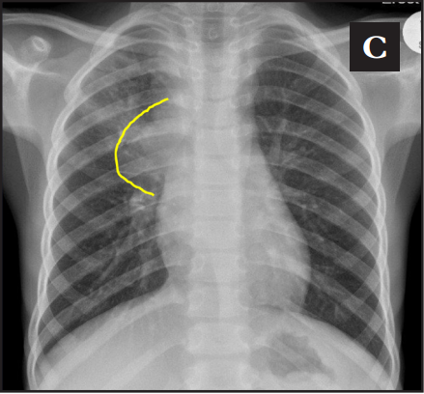
Case 5
CXR: diffuse hazy bilateral airspace opacities, R hilar prominence
Head CT: mildly prominent lateral ventricles, otherwise normal
CSF studies: glucose 18 (low), protein 239 (high), WBC 175 (high), negative gram stain

Slide 31
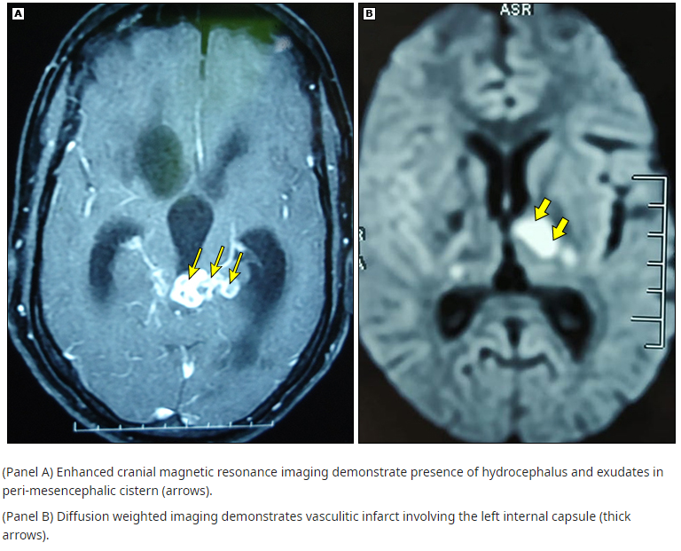
Case 5
Sputa AFB smear/PCR/culture positive, CSF AFB negative, Mtb culture positive
Dx: TB meningitis
Transferred to SCH
Acute encephalopathy, intubated, G-tube
Hospitalized approx 1.5 mos
RIPE, steroid taper

Slide 32
Case 5 Take-home points
Remember to Think TB
Look for TB risk factors
TB can present nonspecifically and subtly in kids
Get sputa and CSF TB studies if any suspicion
Expedited TB evaluation is crucial in young kids who are known contacts

Slide 33
TB Meningitis
Most commonly occurs as complication of primary TB infection in infants/young children or complication of reactivation disease in immunosuppressed adults
In contrast to bacterial meningitis, TB meningitis
presents in a more subacute manner (weeks vs. days)
more frequently causes neuro sx such as altered mental status, coma, cranial nerve palsies
TB meningitis usually has 3 clinical phases:
Early prodromal (1-3 weeks): malaise, HA, low-grade fever, personality change
Meningitic: stiff neck, protracted HA, vomiting, lethargy, confusion
Paralytic: stupor, coma, seizures, hemiparesis; death occurs within 5-8 weeks of onset in absence of treatment
Kids are less likely to have HA; more commonly have irritability, restlessness, decreased appetite, vomiting; seizures more common in kids and can occur early in course

Slide 34
TB Meningitis
Definitive diagnosis: CSF with positive AFB smear, Mtb culture, or TB PCR (BUT this can be difficult to obtain due to low sensitivities)
CSF AFB smear and Mtb culture sensitivity are fairly low; PCR is better. Sensitivities are increased with larger CSF sample volumes.
CSF PCR remains sensitive for approx. 1 month after treatment started (cf days for smear/culture)
Presumptive diagnosis: clinical findings and epi risks, typical CSF findings (lymphocytic pleocytosis, elevated protein, low glucose)
Typical brain MRI findings: hydrocephalus, basilar exudates, periventricular infarcts, parenchymal tuberculomas

Slide 35
Infection prevention
Initiate airborne infection isolation (AII) for all patients with suspected TB, pulmonary or EP, even if no cough
Continue AII if:
Pt has suspected pulmonary, laryngeal, or MDR-TB disease
For pts with other EP TB, continue AII if/until:
Pulmonary TB has been ruled out (ideally 3 neg sputum smears and 2 neg sputum PCRs)
TB of the oral cavity or larynx or EP TB disease that includes an open abscess or lesion with a high concentration of bugs
Criteria for noninfectiousness in pulmonary/laryngeal TB (release from AII for hospitalized and return to work/school/air travel for non-hospitalized):
3 consecutive AFB-negative sputum smears from specimens collected 8-24 hrs apart (at least one early morning) AND
Have demonstrated clinical improvement AND
Have received at least 2 weeks of standard multidrug antituberculosis therapy
Decisions on isolation, discharge plan, etc. should be made on case-by-case evaluation of potential infectiousness
Notes:
Surgery: Surgery should either be postponed (if feasible) until the TB patient is no longer considered infectious or scheduled to allow adequate ventilation of the room after surgery. Surgery is sometimes required in patients with multidrug-resistant or extensively drug-resistant TB, or to drain tuberculous abscesses. Because of the presence of infectious mycobacteria (and anaesthesia gases), the air supplied to the operating room should be exhausted to the outside and not exit the room to other patient care areas. HCPs should wear appropriate respirators (N95). Post-operative recovery of the patient with suspected or confirmed respiratory TB disease should take place in the operating room or in an AIIR.

Slide 36
take-home points
TB can infect any part of the body
Take risk factors into account and have high degree of suspicion to find
Always r/o pulmonary involvement before relaxing infection precautions
Get tissue Mtb culture for diagnosis and sensitivities; everything else may be negative
More tissue = better chance of finding; excisional bx has higher yield than FNA
Treatment is similar to pulmonary TB with a few exceptions

Slide 37
Thank You!

