Slide 1
IGAP STATE MONTHLY WEBINAR
Welcome Back!
Please put your name and your village/location in the chat.
MAY 2023
Hosted by ANTHC Tribal Capacity & Training

Slide 2
ICE BREAKER: Who knows what Green-Up Is?
Put in the chat your guess for the AVERAGE day of Green-Up in the Interior.
ALASKA CENTER for CLIMATE ASSESSMENT & POLICY
https://uaf-accap.org/event/green-up-2023/

Slide 3
EPA Updates
FY24 $10K GAP increase- Adam Baron
FY24 Revisions- mutual schedule for negotiating proposal revisions, EPA deadlines
Q&A on GAP FY24

Slide 4
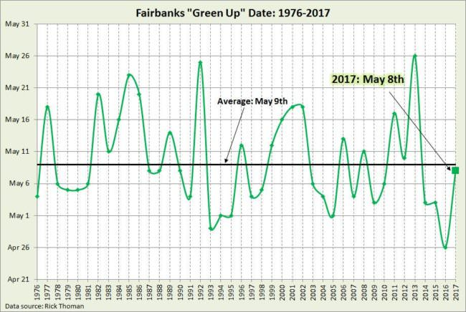
Green-Up Results
https://alaskapublic.org/2017/05/09/ask-a-climatologist-tracking-green-up-in-fairbanks/
(Graphic from Brian Brettschneider)

Slide 5
Training Schedule Updates
7 Generations (In-Person Anchorage, AK)
July 26-28
IGAP NEW STAFF (In-Person Anchorage)
August 29-31
7 Generations Climate Adaptation
(In-Person Anchorage, AK)
September 26-28

Slide 6
FY23 & FY24 SUBAWARDS
FALL 2023 RFP
SOLID WASTE AND RESILINECY PROJECTS!!!!

Slide 7
Native American Fish & Wildlife Society - Sean Cross
Hunter Education-
Safety Course
https://www.nafws.org/

Slide 8
Flooding Resources
• Trisha Bower, DEC State of Alaska
• Crane Johnson, NOAA, Alaska Pacific River Forecast Center
• Sarah Reynolds, FEMA
• Red Cross
Q/A

Slide 9
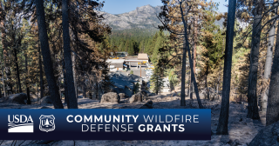
Wildfire Preparation
Community Wildfire Defense Grant Program
-Emma Kramer, State of Alaska Division of Forestry & Fire Protection
Q/A

Slide 10
See you again
June 21st for the next webinar!

