Slide 1
A Primary Care Approach to CKD Management
-Karthik Ramani MD,FASN,FASDIN

Slide 2
Disclosures
None
Notes:
No Financial disclosures.

Slide 3
Learning Objectives
Facilitate timely testing and intervention in patients at-risk for chronic kidney disease (CKD).
Apply appropriate clinical measures to manage risk and increase patient safety in CKD.
Co-manage and refer patients to nephrology specialists, when appropriate, in order to improve outcomes in CKD.

Slide 4


Case Question 1
A 50-year-old Hispanic female was diagnosed with type 2 diabetes at age 30. She has taken medications as prescribed since diagnosis. The fact that she has confirmed diabetes puts this patient at:
A. Higher risk for kidney failure and CVD
B. Higher risk for kidney failure only
C. Higher risk for CVD only
D. None of the above
Notes:
Answer A
Diabetes, an established CVD risk factor, is the leading cause of kidney failure

Slide 5
Case Question 2
A 55-year-old Caucasian-American man, with a history of type 2 diabetes (15 years), hypertension (3 years) dyslipidemia (5 years) and cardiovascular disease (myocardial infarction 3 years ago). He was recently diagnosed with CKD. His most recent labs reveal an eGFR of 45 ml/min/1.73m² and an ACR of 38 mg/g. Which of the following should be avoided?
ACE and ARB in combination
Daily low-dose aspirin
NSAIDs
Statins
A and C
Notes:
Answer: E

Slide 6
Case Question 3
A 42-year-old African American man with diabetic nephropathy and hypertension has a stable eGFR of 25 mL/min/1.73m². Observational Studies of Early as compared to Late Nephrology Referral have demonstrated which of the following?
A. Reduced 1-year Mortality
B. Increase in Mean Hospital Days
C. No change in serum albumin at the initiation of dialysis or kidney transplantation
D. Decrease in hematocrit at the initiation of dialysis or kidney transplantation
E. Delayed referral for kidney transplantation
Notes:
Answer: A
There are no randomized trials of early versus late nephrology referral in the literature. Interpretation of the approximately 50 published observational studies that assessed the timing of nephrology services and outcomes is complicated by heterogeneity in study design and variable definitions of early referral. The minimum of 3 months is probably less than the absolute amount of time required for assessment, education and preparation for RRT. A meta-analysis of 22 observational studies from 10 different countries found one year mortality was significantly reduced, 13 versus 29%, making answer A correct. This meta-analysis also showed early referral was associated with significantly fewer mean hospital days, higher serum albumin at initiation of RRT and higher hematocrit at RRT initiation. Thus, answers B, C, and D are incorrect, respectively. Greater choice of treatment options, including home hemodialysis, peritoneal dialysis and pre-emptive kidney transplantation, are associated with early initiation of nephrology services, making answer E incorrect.

Slide 7
Primary Care Providers –
First Line of Defense Against CKD
Primary care professionals can play a significant role in early diagnosis, treatment, and patient education
A greater emphasis on detecting CKD, and managing it prior to referral, can improve patient outcomes
CKD is Part of Primary Care

Slide 8
The Public Burden of CKD

Slide 9
CKD as a Public Health Issue
Increases risk for all-cause mortality, CV mortality, kidney failure (ESRD), and other adverse outcomes.
6 fold increase in mortality rate with DM + CKD
Disproportionately affects African Americans and Hispanics

Slide 10
The Role of CKD Recognition in Population Health
•Early recognition of CKD:
Offers opportunity to enhance kidney protective care by improving management of modifiable risk factors
Improves prediction of incident cardiovascular events beyond traditional risk factors1
Encourages appropriate and timely referral to nephrology
Can limit patient safety risk associated with CKD
Matsushita, K., J. Coresh, et al. "Estimated glomerular filtration rate and albuminuria for prediction of cardiovascular outcomes: a collaborative meta-analysis of individual participant data." The Lancet Diabetes & Endocrinology 2015;3(7): 514-525.

Slide 11
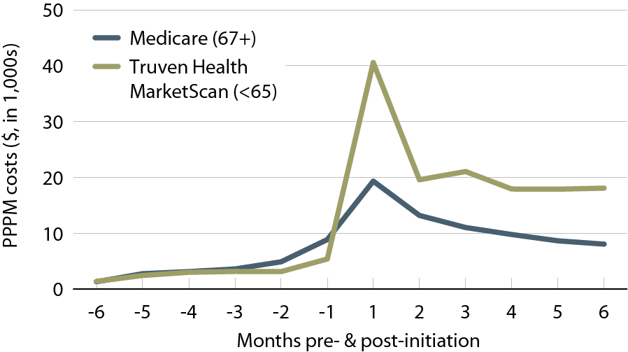
Per person per month (PPPM) expenditures during the transition to ESRD, by dataset, 2011
Preventing progression of CKD will help hold down costs as the treatment of kidney failure is expensive.
Incident Medicare (age 67 & older) & Truven Health MarketScan (younger than 65) ESRD patients, initiating in 2008.
USRDS ADR, 2013

Slide 12
Gaps in CKD Diagnosis
Szczech, Lynda A, et al. "Primary Care Detection of Chronic Kidney Disease in Adults with Type-2 Diabetes: The ADD-CKD Study (Awareness, Detection and Drug Therapy in Type-2 Diabetes and Chronic Kidney Disease)." PLOS One - In press (2014).

Slide 13
CKD Screening and Evaluation

Slide 14
Criteria for CKD
Abnormalities of kidney structure or function, present for >3 months, with implications for health
Either of the following must be present for >3 months:
  ACR >30 mg/g
  Markers of kidney damage (one or more*)
  GFR <60 mL/min/1.73 m²
*Markers of kidney damage can include nephrotic syndrome, nephritic syndrome, tubular syndromes, urinary tract symptoms, asymptomatic urinalysis abnormalities, asymptomatic radiologic abnormalities, hypertension due to kidney disease.m²

Slide 15
Screening Tools: eGFR
Considered the best overall index of kidney function.
Normal GFR varies according to age, sex, and body size, and declines with age.
The NKF recommends using MDRD and Cockroft Gault.
GFR calculators are available online at www.kidney.org/GFR.
Summary of the MDRD Study and CKD-EPI Estimating Equations:
https://www.kidney.org/sites/default/files/docs/mdrd-study-and-ckd-epi-gfr-estimating-equations-summary-ta.pdf
Notes:
Serum creatinine alone should not be used to estimate kidney function. A rise in blood creatinine levels is observed only after significant loss of functioning nephrons.
Estimates of GFR (eGFR) is considered a better way to measure kidney function. eGFR utilizes equations that use serum creatinine levels and some or all of the following variables: gender, age, weight, and race.
Glomerular filtration rate (GFR) is considered the best overall index of kidney function. Normal GFR varies according to age, sex, and body size, and declines with age. The National Kidney Foundation recommends using the CKD-EPI Creatinine Equation (2009) to estimate GFR.
No methods to estimate GFR unless patient is in steady state. All are of limited value for patients at extremes of age, over/underweight, amputees, non black/white racial groups.
MDRD
Cockroft Gault
CKD-EPI (Preferred)
The MDRD equation was the first and most widely used eGFRcr equation with a known calibration. Recommended by NKF KDOQI 2002.
The CKD-EPI (2009) equation improves on the MDRD Study equation, particularly in reducing bias at eGFR >60 allowing for reporting across the full range of eGFR. Recommended by KDIGO 2013
Adjust for body size for most accurate eGFR with MDRD and CKD-EPI Creatinine Clearance
GFR calculators are available online at www.kidney.org/GFR.
Summary of the MDRD Study and CKD-EPI Estimating Equations
https://www.kidney.org/sites/default/files/docs/mdrd-study-and-ckd-epi-gfr-estimating-equations-summary-ta.pdf
Calculators for Health Care Professionals
http://www.kidney.org/professionals/KDOQI/gfr_calculator

Slide 16
Old Classification of CKD as Defined by Kidney Disease Outcomes Quality Initiative (KDOQI) Modified and Endorsed by KDIGO
Stage | Description | Classification by Severity | Classification by Treatment
1 | Kidney damage with normal or increased GFR | GFR ≥ 90
2 | Kidney damage with mild decrease in GFR | GFR of 60-89 | T if kidney transplant
3 | Moderate decrease in GFR | GFR of 30-59 | recipient
4 | Severe decrease in GFR | GFR of 15-29 | D if dialysis
5 | Kidney failure | GFR < 15 | D if dialysis
Note: GFR is given in mL/min/1.73² m²
National Kidney Foundation. KDOQI Clinical Practice Guidelines for Chronic Kidney Disease:
Evaluation, Classification, and Stratification. Am J Kidney Dis 2002;39(suppl 1):S1-S266
KDIGO, Kidney Disease: Increasing Global Outcomes

Slide 17
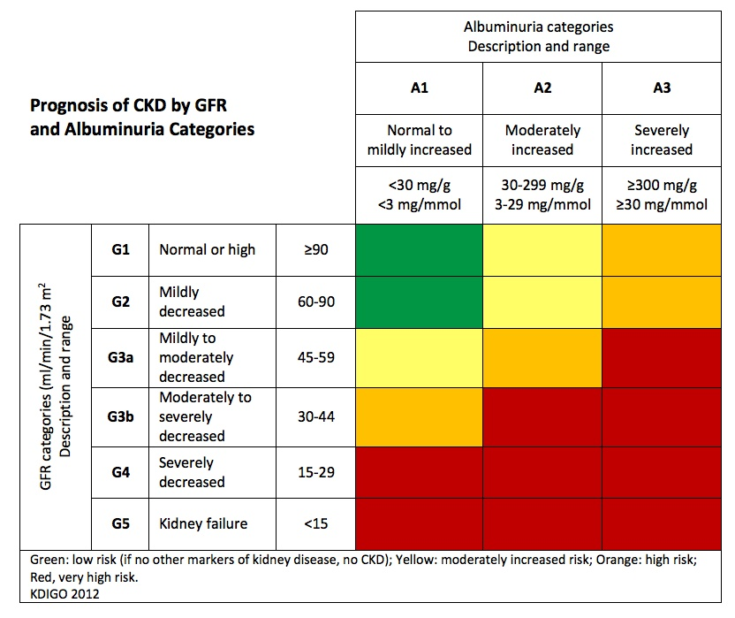
Classification of CKD Based on GFR and Albuminuria Categories: “Heat Map”
Kidney Disease: Improving Global Outcomes (KDIGO) CKD Work Group. Kidney Int Suppls. 2013;3:1-150.
Notes:
Colors: Represents the risk for progression, morbidity and mortality by color from best to worst. Green: low risk (if no other markers of kidney disease, no CKD); Yellow: moderately increased risk; Orange: high risk; Red, very high risk.

Slide 18
Improved Diagnosis…
Studies demonstrate that clinician behavior changes when CKD diagnosis improves. Significant improvements realized in:¹⁻³
  Increased urinary albumin testing
  Increased appropriate use of ACEi or ARB
  Avoidance of NSAIDs prescribing among patients with low eGFR
  Appropriate nephrology consultation
Wei L, et al. Kidney Int. 2013;84:174-178.
Chan M, et al. Am J Med. 2007:120;1063-1070.
Fink J, et al. Am J Kidney Dis. 2009,53:681-668.
Notes:
Studies demonstrate that clinician behavior changes when CKD diagnosis improves (1-3).
Wei, L., MacDonald, T. M., Jennings, C., Sheng, X., Flynn, R. W., & Murphy, M. J. (2013). Estimated GFR reporting is associated with decreased nonsteroidal anti-inflammatory drug prescribing and increased renal function. Kidney In, 84(1), 174-8
Chan, M. R., Dall, A. T., Fletcher, K. E., Lu, N., & Trivedi, H. (2007). Outcomes in patients with chronic kidney disease referred late to nephrologists: a meta-analysis. Am J Med, 120(12), 1063-1070.
Fink, Jeffrey C. et al. “Chronic Kidney Disease as an Under-Recognized Threat to Patient Safety.” American journal of kidney diseases : the official journal of the National Kidney Foundation 53.4 (2009): 681–688. PMC. Web. 27 Jan. 2015.

Slide 19
CKD Risk Factors*
Non-Modifiable
Family history of kidney disease, diabetes, or hypertension
Age 60 or older (GFR declines normally with age)
Race/U.S. ethnic minority status
Modifiable
Diabetes
Hypertension
History of AKI
Frequent NSAID use

Slide 20
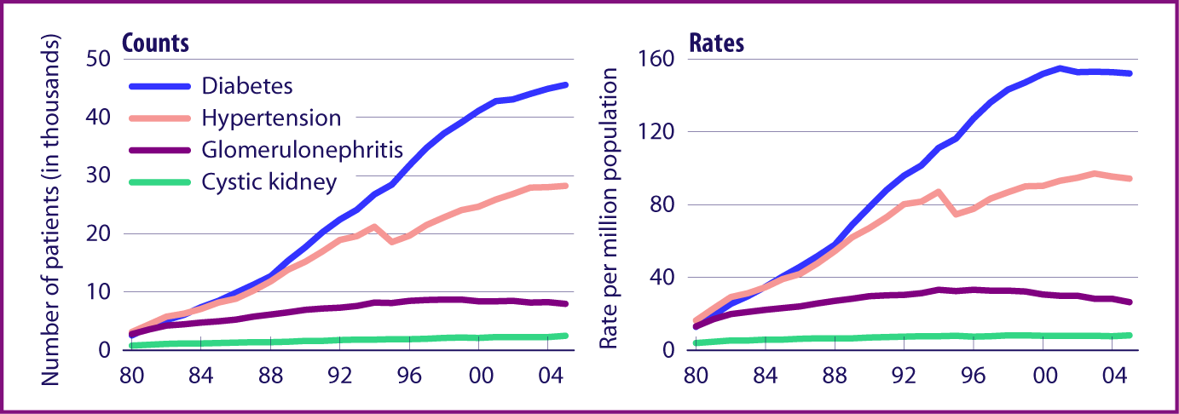
Diabetes and hypertension are
leading causes of kidney failure
Incident ESRD rates, by primary diagnosis, adjusted for age, gender, & race.
ESRD, end stage renal disease
USRDS ADR, 2007

Slide 21
Steps to CKD Patient Care
Does the patient have CKD?
Assess GFR, albuminuria.
Determine etiology.
Assess for evidence of progression.
Assess for associated complications.
Patient education.
Assess life expectancy and patient wishes for dialysis/transplantation.

Slide 22
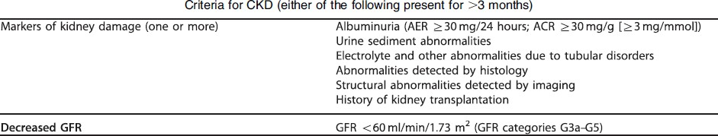
Definition of Chronic Kidney Disease
CKD is defined as abnormalities of kidney structure or function, present for >3 months, with implications for health.
Kidney Disease: Improving Global Outcomes (KDIGO) CKD Work Group.
Kidney Int Suppls. 2013;3:1-150.

Slide 23
Assign Albuminuria Category
Albuminuria Categories in CKD
Category | ACR (mg/g) | Terms
A1 | <30 | Normal to mildly increased
A2 | 30-300 | Moderately increased*
A3 | >300 | Severely increased**
*Relative to young adult level. ACR 30-300 mg/g for >3 months indicates CKD. **Including nephrotic syndrome (albumin excretion ACR >2220 mg/g).
Kidney Disease: Improving Global Outcomes (KDIGO) CKD Work Group.
Kidney Int Suppls. 2013;3:1-150.

Slide 24
Assign GFR Category
GFR Categories in CKD
Category | GFR | Terms | Clinical Presentations
G1 | ≥90 | Normal or high | Markers of kidney damage (nephrotic syndrome, nephritic syndrome, tubular syndromes, urinary tract symptoms, asymptomatic urinalysis abnormalities, asymptomatic radiologic abnormalities, hypertension due to kidney disease)
G2 | 60-89 | Mildly decreased*
G3a | 45-59 | Mildly to moderately decreased | Mild to severe complications: Anemia Mineral and bone disorder Elevated parathyroid hormone Cardiovascular disease Hypertension Lipid abnormalities Low serum albumin
G3b | 30-44 | Moderately to severely decreased
G4 | 15-29 | Severely decreased
G5 | <15 | Kidney failure | Includes all of the above Uremia
GFR = mL/min/1.73m² *Relative to young adult level In the absence of evidence of kidney damage, neither GFR category G1 nor G2 fulfill the criteria for CKD. Refer to a nephrologist and prepare for kidney replacement therapy when GFR <30 mL/min/1.73m².
Kidney Disease: Improving Global Outcomes (KDIGO) CKD Work Group.
Kidney Int Suppls. 2013;3:1-150.

Slide 25
Use These Equations Cautiously, if at all in ….
Patients who have/are:
  Poor nutrition/loss of muscle mass
  Amputation
  Chronic illness
  Not African American or Caucasian
  Changing serum creatinine
  Obese
  Very elderly, young

Slide 26
Goals of Care in CKD
Slow decline in kidney function
Blood pressure control¹
  ACR <30 mg/g: ≤140/90 mm Hg
  ACR 30-300 mg/g: ≤130/80 mm Hg*
  ACR >300 mg/g: ≤130/80 mm Hg
  Individualize targets and agents according to age, coexistent CVD, and other comorbidities
  ACE or ARB
*Reasonable to select a goal of 140/90 mm Hg, especially for moderate albuminuria (ACR 30-300 mg/g.)²
Kidney Disease: Improving Global Outcomes (KDIGO) Blood Pressure Work Group. Kidney Int Suppl. (2012);2:341-342.
KDOQI Commentary on KDIGO Blood Pressure Guidelines. Am J Kidney Dis. 2013;62:201-213.

Slide 27
Clinical Evaluation of Patients with CKD
Blood pressure
HbA1c
Serum creatinine
Use a GFR estimating equation or clearance measurement; don’t rely on serum creatinine concentration alone.
Be attentive to changes in creatinine over time--even in “normal” range.
Urinalysis
Urine sediment
Spot urine for protein-to-creatinine or albumin-to-creatinine ratio.
Albuminuria/Proteinuria
Electrolytes, blood glucose, CBC

Slide 28
Clinical Evaluation of Patients with CKD
Depending on stage: albumin, phosphate, calcium, iPTH
Renal imaging
Depending on age and H&P
  Light chain assay, serum or urine protein electrophoresis (SPEP, UPEP)
  HIV, HCV, HBV tests
  Complements, other serologies—limited role unless specific reason

Slide 29
Clinical Evaluation of Patients with CKD
Standard urine dipsticks detect total protein >30 mg/dL - not sensitive enough for “microalbuminuria” screening.
Untimed, random “spot” urine for albumin-to-creatinine or protein-to-creatinine ratio (first morning void preferred).

Slide 30
Definitions: Albuminuria and Proteinuria
Normal Albuminuria
Albumin-to-creatinine ratio <30 mg/g creatinine
Moderately Increased Albuminuria
Albumin-to-creatinine ratio 30-300 mg/g creatinine
24-hour urine albumin 30-300 mg/d
Severely Increased Albuminuria
Albumin-to-creatinine ratio >300 mg albumin/g creatinine
24-hour urine albumin >300 mg/d
Proteinuria
(+) urine dipstick at >30 mg/dl
>200 mg protein/g creatinine
24-hour urine protein >300 mg/d

Slide 31
Slowing Progression of CKD

Slide 32
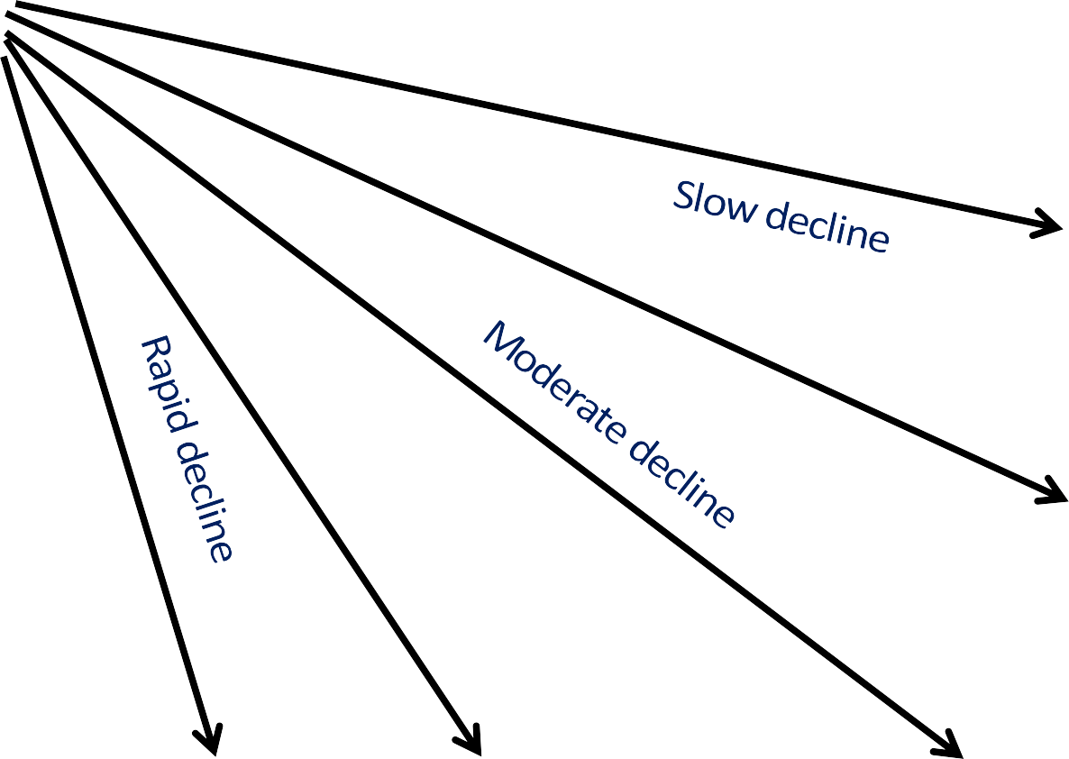
CKD- Progression of Kidney Failure Concept
Variable depending on several factors including (1) type of disease and (2) how well it is treated
GFR
100
90
80
Stage 2
70
60
50
Stage 3
40
30
20
Stage 4
10
Stage 5 (Dialysis)
0
1
2
3
4
5
6
7
Years

Slide 33
Blood Pressure and CKD Progression
Control of BP more important than exactly which agents are used.
  Avoidance of side-effects is important.
With proteinuria: diuretic + ACEi or ARB.
No proteinuria: no clear drug preference
  ACEi or ARB ok to use.
Fujisaki K, et al. Impact of combined losartan/hydrochlorothiazide on proteinuria in patients with CKD and hypertension. Hypertens Res. 2014;37:993-998.

Slide 34
Slowing CKD Progression: ACEi/ARB
Check
Check labs after initiation.
If less than 25% SCr increase, continue and monitor.
If more than 25% SCr increase, stop ACEi and evaluate for RAS.
Continue
Continue until contraindication arises, no absolute eGFR cutoff.
Better
Better proteinuria suppression with low Na diet and diuretics.
Avoid
Avoid volume depletion.

Slide 35
Goals for Renoprotection
Target blood pressure in non-dialysis CKD.¹
o ACR <30 mg/g: ≤140/90 mm Hg.
o ACR 30-300 mg/g: ≤130/80 mm Hg.*
o ACR >300 mg/g: ≤130/80 mm Hg.
  Individualize targets and agents according to age, coexistent CVD, and other comorbidities.
Avoid ACEi and ARB in combination.^{3,4}
  Risk of adverse events (impaired kidney function, hyperkalemia).
*Reasonable to select a goal of 140/90 mm Hg, especially for moderate albuminuria (ACR 30-300 mg/g).²
Kidney Disease: Improving Global Outcomes (KDIGO) Blood Pressure Work Group. Kidney Int Suppl. (2012);2:341-342.
KDOQI Commentary on KDIGO Blood Pressure Guidelines. Am J Kidney Dis. 2013;62:201-213.
Kunz R, et al. Ann Intern Med. 2008;148:30-48.
Mann J, et al. ONTARGET study. Lancet. 2008;372:547-553.

Slide 36
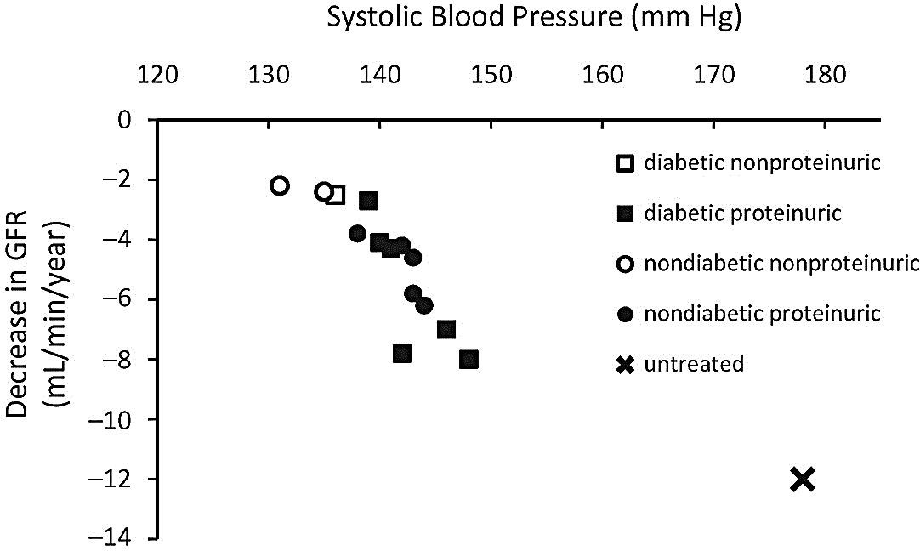



Relationship Between Achieved BP and Decline in Kidney Function from Primary Renal Endpoint Trials
Nondiabetes
MDRD. N Engl J Med. 1993
AIPRI. N Engl J Med. 1996
REIN. Lancet. 1997
AASK. JAMA. 2002
Hou FF, et al. N Engl J Med. 2006 Parsa A et.al. NEJM 2013
Diabetes
Captopril Trial. N Engl J Med. 1993
Hannadouche T, et al. BMJ. 1994 Bakris G, et al. Kidney Int. 1996 Bakris G, et al. Hypertension. 1997 IDNT. NEJM. 2001
RENAAL. NEJM. 2001
ABCD. Diabetes Care (Suppl). 2000
Normal decline in GFR
Update from Kalaitzidis R and Bakris GL In: Handbook of Chronic Kidney Disease. Daugirdas J (Ed.) 2011.

Slide 37
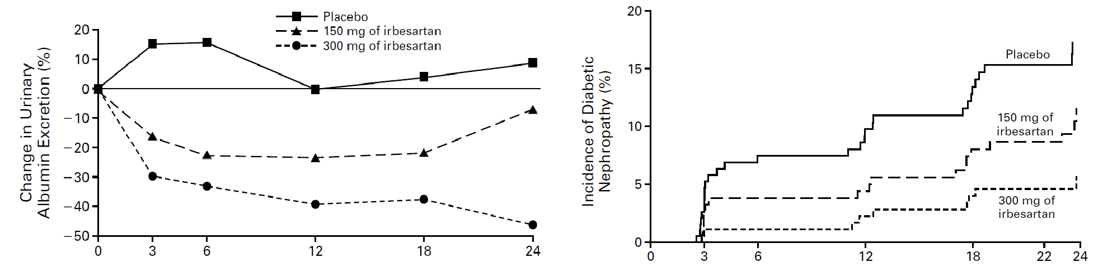
ARBs and Progression
of Diabetic Nephropathy
Most placebo-controlled studies in type 2 DM have been in patients with either moderate albuminuria (A2) or established nephropathy treated with ARB.
ARB and ACEi appear to be equivalent for moderate albuminuria (A2) and proteinuria reduction.
Parving HH, et al. N Engl J Med. 2001

Slide 38
Managing Hyperglycemia
Hyperglycemia is a fundamental cause of vascular complications, including CKD.
Poor glycemic control has been associated with albuminuria in type 2 diabetes.
Risk of hypoglycemia increases as kidney function becomes impaired.
Declining kidney function may necessitate changes to diabetes medications and renally cleared drugs.
Target HbA1c ~7.0%.
o Can be extended above 7.0% with comorbidities or limited life expectancy, and risk of hypoglycemia.
NKF KDOQI. Diabetes and CKD: 2012 Update.
Am J Kidney Dis. 2012;60:850-856.

Slide 39
Other Goals of CKD Management
NSAID avoidance
Limit sodium intake to <90 mmol (2 gm sodium; or 5 gm sodium chloride or salt) per day.
CVD management: lipids, ASA (secondary prevention), etc.

Slide 40
Lipid Disorders in CKD
Use statin alone or statin + ezetimibe in adults >50 yrs with CKD 3-5(ND).
Use statin alone in adults >50 yrs with CKD 1-2.
In adults <50 yrs use statin alone if history of known CAD, MI, DM, stroke.
Treat according to a “fire and forget” rather than “treat to target” strategy.
o Treat CKD patients (Non dialysis) with statins or Statin/exterminate combinations without the need for follow up blood tests.
Kidney Disease: Improving Global Outcomes (KDIGO) Lipid Work Group. Kidney Int Suppl. 2013;3:259-305. http://kdigo.org/home/2013/11/04/kdigo-announces-publication-of- guideline-on-lipid-management/

Slide 41
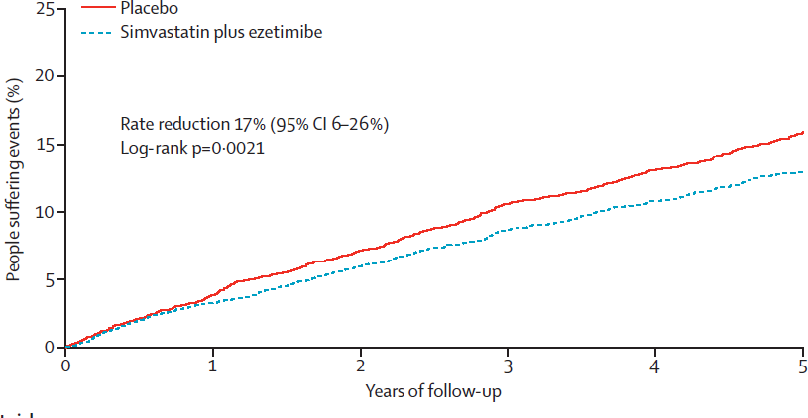
Lipid Disorders in CKD
A 32% reduction in LDL➔17% reduction in primary outcome (nonfatal MI, coronary death, nonhemorrhagic stroke, arterial revascularization).
No reduction in CKD progression, overall or CAD mortality, other individual CAD end-points.
Baigent C, et al. Study of Heart and Renal Protection (SHARP). Lancet. 2011;11:60739-60743.

Slide 42
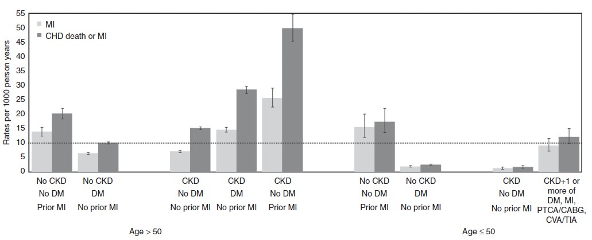
10-Year Coronary Risk Based on Age and Other Patient Characteristics
Future 10-year coronary risk based on various patient characteristics. Data are unadjusted rates from 1,268,029 participants in the Alberta Kidney Disease cohort.^{1,2}
CABG, coronary artery bypass grafting; CHD, coronary heart disease; CKD, chronic kidney disease; CVA, cerebrovascular accident; DM, diabetes mellitus; MI, myocardial infarction; PTCA, percutaneous transluminal coronary angioplasty; TIA, transient ischemic attack.
Kidney Disease: Improving Global Outcomes (KDIGO) Lipid Work Group. Kidney Int Suppl. 2013;3:259-305.
Hemmelgarn BR, et al. Overview of the alberta kidney disease network. BMC Nephrol. 2009:30:10.

Slide 43
Complications of Kidney Failure Start in Stage 3 and Progress
Fluid Overload Water Overload
Acid Base Imbalance Acidic Blood
Electrolyte Abnormalities
Malnutrition
Kidney Failure
Bone Disease Brittle bones and fractures
Hypertension Cardiac Disease Vascular Disease
Anemia/blood loss Decrease production of red blood cells

Slide 44
Detect and Manage CKD Complications
Anemia
Initiate iron therapy if TSAT ≤ 30% and ferritin ≤ 500 ng/mL (IV iron for dialysis, Oral for non-dialysis CKD)
Individualize erythropoiesis stimulating agent (ESA) therapy: Start ESA if Hb <10 g/dl, and maintain Hb <11.5 g/dl. Ensure adequate Fe stores.
Appropriate iron supplementation is needed for ESA to be effective
CKD-Mineral and Bone Disorder (CKD-MBD)
Treat with D3 as indicated to achieve normal serum levels
2000 IU po qd is cheaper and better absorbed than 50,000 IU monthly dose.
Limit phosphorus in diet (CKD stage 4/5), with emphasis on decreasing packaged products - Refer to renal RD
May need phosphate binders

Slide 45
Detect and Manage CKD Complications
Metabolic acidosis
  Usually occurs later in CKD
  Serum bicarb >22mEq/L
  Correction of metabolic acidosis may slow CKD progression and improve patients functional status^{1,2}
Hyperkalemia
  Reduce dietary potassium
  Stop NSAIDs, COX-2 inhibitors, potassium sparing diuretics (aldactone)
  Stop or reduce beta blockers, ACEi/ARBs
  Avoid salt substitutes that contain potassium
Mahajan, et al. Kidney Int. 2010;78:303-309.
de Brito-Ashurst I, et al. J Am Soc Nephrol. 2009;20:2075-2084.
Notes:
Correction of metabolic acidosis may slow CKD progression and improve patients functional status^{1,2}
1) Mahajan A, Simoni J, Sheather S, Broglio K, Rajab M, Wesson D. Daily oral sodium bicarbonate preserves glomerular filtration rate by slowing its decline in early hypertensive nephropathy. Kdney Int. 2010;78:303-309.
2) de Brito-Ashurst I, Varagunam M, Raftery M, Yaqoob M. Bicarbonate supplementation slows progression of CKD and improves nutritional status. J Am Soc Nephrol. 2009;20:2075-2084.
Hyperkalemia can usually be controlled with the measures above, but if not use Kayexelate, or other diarrhea inducing laxative (lactulose).

Slide 46
Vaccination in CKD
Annual influenza vaccine for all adults with CKD, unless contraindicated.
Polyvalent pneumococcal vaccine when eGFR <30 ml/min/1.73m² and at high risk of pneumococcal infection (e.g., nephrotic syndrome, diabetes, receiving immunosuppression), unless contraindicated. Offer revaccination within 5 years.
Hepatitis B immunization when GFR <30 ml/min/1.73m². Confirm response with appropriate serological testing.
Use of a live vaccine should consider the patient’s immune status (e.g., immunosuppression).
Kidney Disease: Improving Global Outcomes (KDIGO) CKD Work Group. Kidney Int Suppls. 2013;3:1-150.

Slide 47
Malnutrition and CKD
Malnutrition or protein energy wasting (PEW) is common in CKD, and is associated with poor patient outcomes.
Malnutrition in CKD begins as early as stages 3 and 4. Risk increases with progression of the disease.
Preventing PEW or malnutrition may require clinical interventions to assess nutritional status, individualize strategies for prevention and treatment, provide patient instruction, and promote patient adherence.
A specialty-trained registered dietitian can help address the nutritional aspects so that protein wasting can be diminished.
NKF KDOQI. Am J Kidney Dis. 2000;35(suppl 2):S1-S3. NKF KDOQI. Am J Kidney Dis. 2007;49(suppl 2):S1-S179.

Slide 48
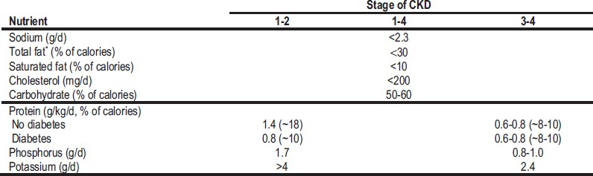
A Balanced Approach to Nutrition in CKD: Macronutrient Composition and Mineral Content*
Adapted from DASH (dietary approaches to stop hypertension) diet.
*Adjust so total calories from protein, fat, and carbohydrate are 100%. Emphasize such whole-food sources as fresh vegetables, whole grains, nuts, legumes, low-fat or nonfat dairy products, canola oil, olive oil, cold-water fish, and poultry.
*(CKD Stages 1-4) NKF KDOQI. Am J Kidney Dis. 2007;49(suppl 2):S1-S179.

Slide 49
Education and Counseling
Ethical, psychological, and social care (e.g., social bereavement, depression, anxiety).
Dietary counseling and education on other lifestyle modifications (e.g., exercise, smoking cessation).
Involve the patient, family and children if possible.
Offer literature in both traditional and interactive formats.
Use educational materials written in the patient’s language.
Assess the need for low-level reading materials.
Use internet resources and smartphone apps as appropriate.
Use visual aids such as handouts, drawings, CDs, and DVDs.
Involve other health care professionals in educating patients/families.
Be consistent in the information provided.

Slide 50
Co-Management, Patient Safety, and Nephrology Specialist Referral

Slide 51
Who Should be Involved in the
Patient Safety Approach to CKD?
Kidney
damage and normal or ↑ GFR
Kidney
damage and
mild ↓
GFR
Moderate
↓ GFR
Severe
↓ GFR
Kidney
failure
Stage 1 Stage 2 Stage 3 Stage 4 Stage 5
GFR 90 60 30 15
Primary Care Practitioner
Nephrologist
Consult?
Patient safety
The Patient (always)
and other subspecialists (as needed)

Slide 52
Impact of primary care CKD detection with a patient safety approach
Patient Safety
Following
CKD detection
Improved diagnosis creates opportunity for strategic preservation of kidney function
Fink et al. Am J Kidney Dis. 2009,53:681-668
Notes:
Sequalae of the disease that are improperly managed to consequences of misguided therapeutic interventions
Jeff Fink
52

Slide 53
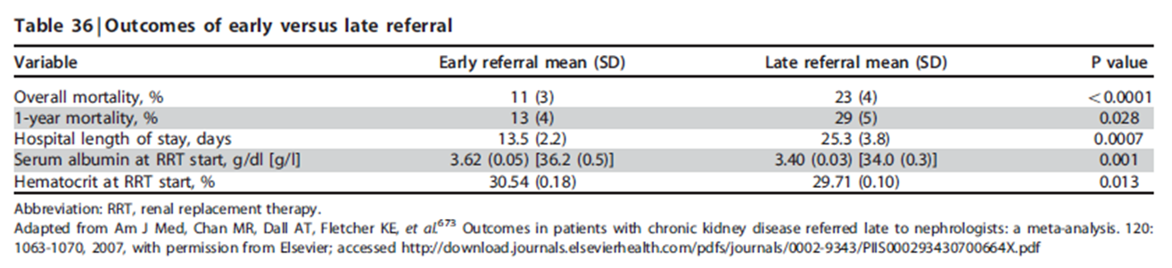
Observational Studies of Early vs. Late
Nephrology Consultation
Chan M, et al. Am J Med. 2007;120:1063-1070.
http://download.journals.elsevierhealth.com/pdfs/journals/0002-9343/PIIS000293430700664X.pdf
KDIGO CKD Work Group. Kidney Int Suppls. 2013;3:1-150.
Notes:
Overall there are more than 50 studies in the published literature and a meta-analysis of 22 of these studies from 10 different countries serves to underline some of the key messages (Table), giving an indication of the size of the differences in mortality and hospital length of stay and also highlighting the significantly lower serum albumin level in late referred patients.1,2
1. Kidney Disease: Improving Global Outcomes (KDIGO) CKD Work Group. Kidney Int Suppls. 2013;3:1-150.
2. Chan MR, Dall AT, Fletcher KE et al. Outcomes in patients with chronic kidney disease referred late to nephrologists: a meta-analysis. Am J Med. 2007; 120: 1063-1070.
http://download.journals.elsevierhealth.com/pdfs/journals/0002-9343/PIIS000293430700664X.pdf

Slide 54
What can primary care providers do?
Recognize and test
Recognize and test at-risk patients
Educate
Educate patients about CKD and treatment
Manage
Manage blood pressure and diabetes
Address
Address other CVD risk factors
Monitor
Monitor eGFR and ACR (encourage labs to report these tests)

Slide 55
What can primary care providers do?
Evaluate and manage
Evaluate and manage anemia, malnutrition, CKD-MBD, and other complications in at-risk patients
Refer
Refer to dietitian for nutritional guidance
Consider
Consider patient safety issues in CKD
Consult or team
Consult or team with a nephrologist (co-management)
Refer
Refer patient to nephrology when appropriate

Slide 56
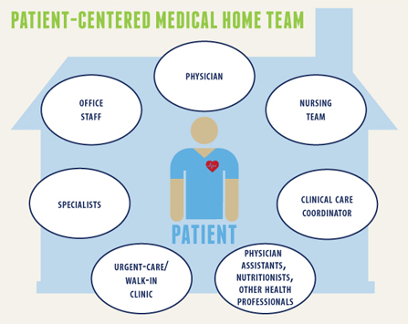
Co-Management Model
Collaborative care
  Formal arrangement
  Curbside consult
Care coordination
Clinical decision support
Population health
  Development of treatment protocols

Slide 57
CKD Patient Safety Issues
Medication errors
Toxicity (nephrologic or other)
Improper dosing
Inadequate monitoring
Electrolytes
Hyperkalemia
Hypoglycemia
Hypermagnesemia
Hyperphosphatemia
Miscellaneous
Multidrug-resistant infections
Vessel preservation/dialysis access
Fink JC, Brown J, Hsu, VD, et al. Am J Kidney Dis 2009;53:681-668.
Notes:
Sequalea of the disease that are improperly managed to consequences of misguided therapeutic interventions
Fink
57

Slide 58
CKD Patient Safety Issues
Diagnostic tests
Iodinated contrast media: AKI
Gadolinium-based contrast: NSF
Sodium Phosphate bowel preparations: AKI, CKD
CVD
Missed diagnosis
Improper management
Fluid management
Hypotension
AKI
CHF exacerbation
AKI = acute kidney injury; CHF = congestive heart failure; NSF = nephrogenic systemic fibrosis.
Fink JC, Brown J, Hsu, VD, et al. Am J Kidney Dis 2009;53:681-668..
Notes:
Sequalea of the disease that are improperly managed to consequences of misguided therapeutic interventuions
Fink
58

Slide 59
Key Points on Medications in CKD
CKD patients at high risk for drug-related adverse events
Several classes of drugs renally eliminated
Consider kidney function and current eGFR (not just SCr) when prescribing meds
Minimize pill burden as much as possible
Remind CKD patients to avoid NSAIDs
No Dual RAAS blockade
Any med with >30% renal clearance probably needs dose adjustment for CKD
No bisphosphonates for eGFR <30
Avoid GAD for eGFR <30

Slide 60
Common Medications Requiring Dose
Reduction in CKD
Renally cleared beta blockers
  Atenolol, bisoprolol, nadolol
Digoxin
Some Statins
  Lovastatin, pravastatin, simvastatin. Fluvastatin, rosuvastatin
Antimicrobials
  Antifungals, aminoglycosides, Bactrim, Macrobid
Enoxaparin
Methotrexate
Colchicine
Allopurinol
Gabapentin
  CKD 4- Max dose 300mg qd
  CKD 5- Max dose 300mg qod
Reglan
  Reduce 50% for eGFR< 40
  Can cause irreversible EPS with chronic use
Narcotics
  Methadone and fentanyl best for ESRD patients
    Lowest risk of toxic metabolites

Slide 61
Indications for Referral to Specialist Kidney Care Services for People with CKD
Acute kidney injury or abrupt sustained fall in GFR
GFR <30 ml/min/1.73m² (GFR categories G4-G5)
Persistent albuminuria (ACR > 300 mg/g)*
Atypical Progression of CKD**
Urinary red cell casts, RBC more than 20 per HPF sustained and not readily explained
Hypertension refractory to treatment with 4 or more antihypertensive agents
Persistent abnormalities of serum potassium
Recurrent or extensive nephrolithiasis
Hereditary kidney disease
*
Notes:
Late nephrology referral before the onset of chronic kidney failure remains common. U.S. data from 2011 reveal 42.1% of new dialysis starts had no prior nephrology care.*
*USRDS 2013 Annual Data Report
www.usrds.org

Slide 62
Notes:
Know the criteria for chronic kidney disease (CKD).
• Abnormalities of kidney structure or function, present for >3 months, with implications for health
• Either of the following must be present for >3 months:
• Markers of kidney damage (one or more)
• GFR <60 ml/min/1.73 m2 Screen for CKD with two simple tests.
• “Spot” urine for albumin-to-creatinine ratio (ACR) to detect albuminuria
• Serum creatinine to estimate glomerular filtration rate (GFR)
What if CKD is detected?
• Classify CKD based on cause, GFR category, and albuminuria category
• Implement a clinical action plan based on patient’s CKD classification (see flip side)
• Consider co-management with a nephrologist if the clinical action plan cannot be carried out
• Refer to a nephrologist when GFR <30 mL/min/1.73 m2
or ACR >300 mg/g

Slide 64

Take Home Points
PCPs play an important role
Identify risk factors
Know patient’s GFR using appropriate screening tools
Help your patient adjust medication
Modify diet
Partner and refer to specialist

Slide 65
Additional Online Resources for CKD Learning
National Kidney Foundation: www.kidney.org
United States Renal Data Service: www.usrds.org
CDC’s CKD Surveillance Project: http://nccd.cdc.gov/ckd
National Kidney Disease Education Program (NKDEP): http://nkdep.nih.gov

Slide 66
