Slide 1
TB Infection and Preventive Therapy Michelle M. Rothoff, MD State of Alaska TB Program

Slide 2
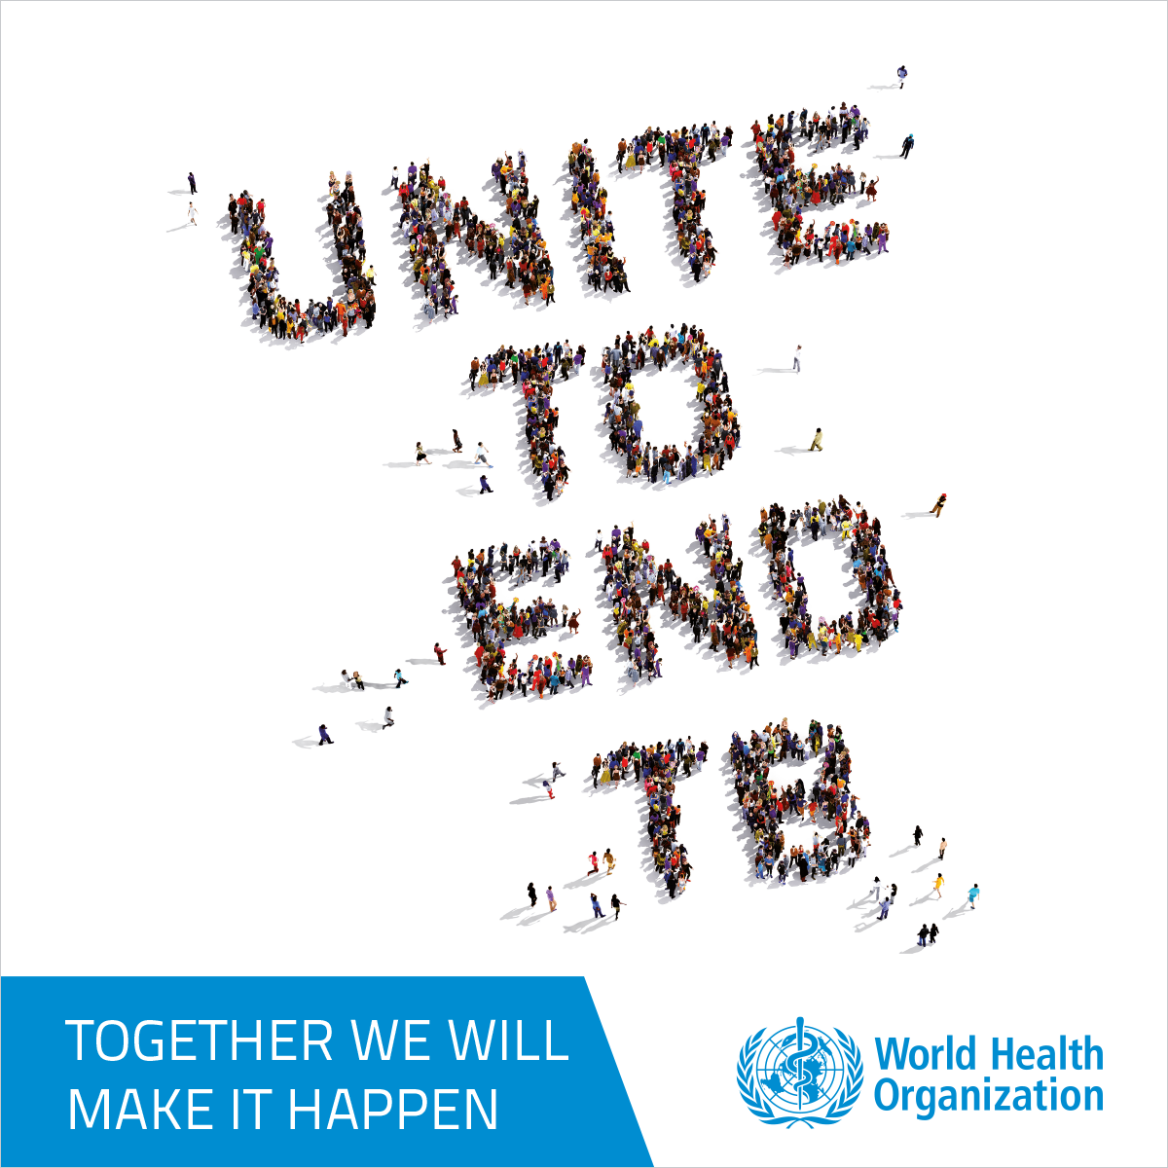
Disclosures
none

Slide 3
Key Points
TB infection
Who to test
How to test
How to treat
TB window prophylaxis
Who needs it
Why is it needed
Treatment regimens

Slide 4
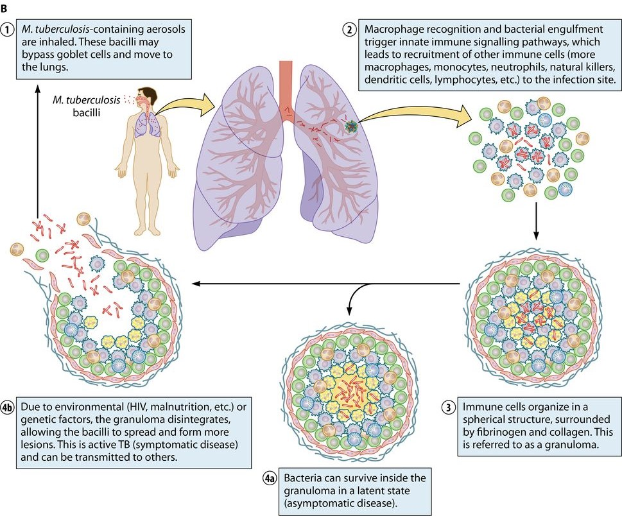
Tb infection and disease: a continuum
Laneke Luies and Ilse du Preez, Clinical Microbiology, 16 September 2020
Notes:
TB is one of oldest known human pathogens.
It is very good at what it does because it has developed ways to evade elimination by the immune system.
It takes a Trojan horse approach by entering the body in a stealthy manner and lying low biding its time until the opportune time arises for it to re-activate and cause disease.
TB is an airborne disease; highly aerobic bacterium, small droplets
Typically infects the lungs but can infect any part of the body
Granuloma = balance between bug and immune system; if the balance shifts and a breach occurs, the bug escapes and causes active disease

Slide 5
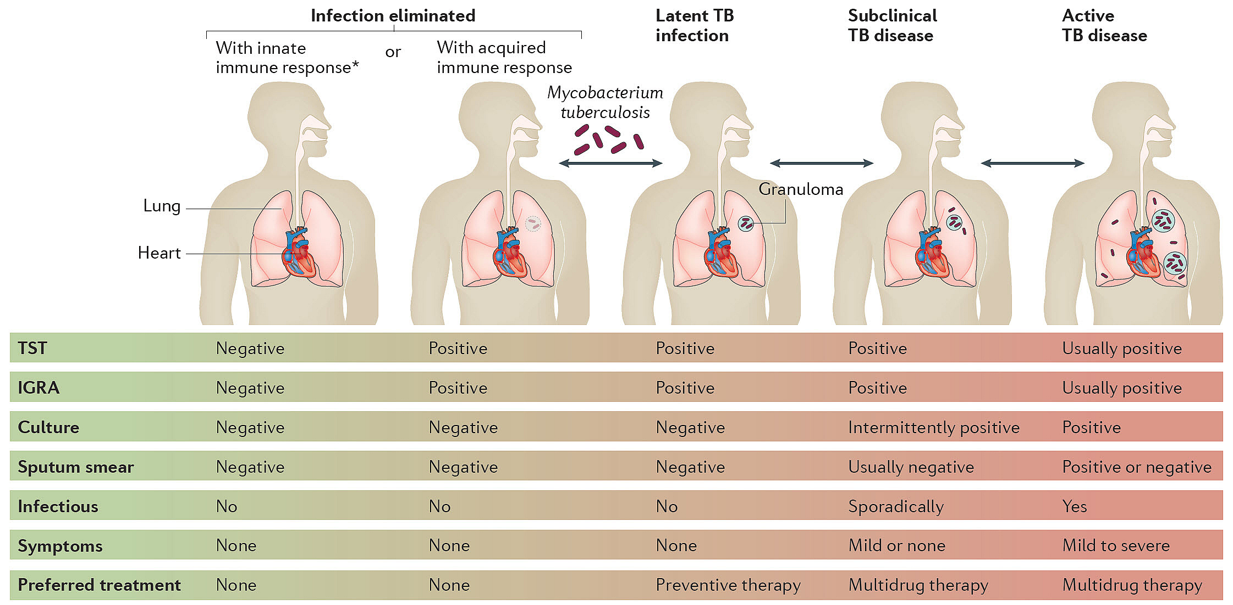
Tb infection and disease: a continuum
Notes:
We think of TB as existing in 2 discrete phases: TBI and ATB
TBI: no symptoms or radiographic/micro findings, not contagious

Slide 6
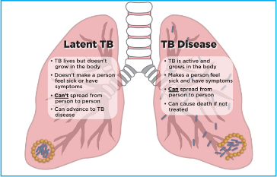
Tuberculosis—Infection vs. Disease
TB Infection (Latent) | TB Disease (Active)
No symptoms | Symptoms (cough, bloody sputum, sweats, weight loss)
Not contagious | Contagious
Positive TB test (TST or IGRA) | Positive TB test (TST or IGRA)
Normal chest X-ray | Abnormal chest X-ray
Negative sputum tests | Positive sputum tests
Treatment: 3-4 months with 1-2 drugs (~$500) | Treatment: 4-9+ months with 4+ drugs (~$20,000)
Notes:
Most infections result in latent/inactive infection which can last for years
5-10% lifetime risk of converting to active disease
Higher in people with immunocompromise, diabetes, other comorbidities, kids <5 years old
Most active TB disease is the result of “re-activation” of longstanding latent infection

Slide 7
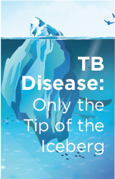
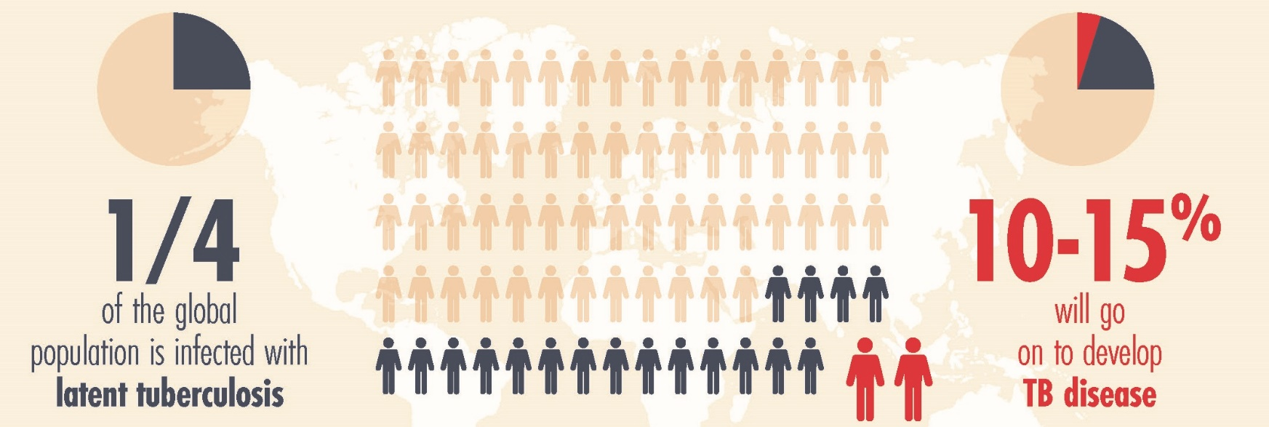
TB Infection
Estimated AK LTBI prevalence: 32,601
Source: Mirzazadeh A, Kahn JG, Haddad MB, Hill AN, Marks SM, Readhead A, et al. (2021) State-level prevalence estimates of latent tuberculosis infection in the United States by medical risk factors, demographic characteristics and nativity. PLoS ONE 16(4): e0249012. https://doi.org/10.1371/journal.pone.0249012
Notes:
Some estimates are as high as 1/3 of global population
With increasing global mobility and living in a state like Alaska which is a crossroads for visitors, workers, immigrants, and refugees, this is important.

Slide 8
LTBI: find it and treat it
80% of active TB cases in the U.S. are the result of longstanding (untreated) LTBI
Screening, testing, and treating for LTBI should be part of routine preventive care
USPSTF: recommends screening for LTBI in asymptomatic adults at increased risk for TB infection
AAP: Assessment at the first visit and annually for TB risk factors and testing of children with defined risk factors is standard of care
Notes:
USPSTF: no optimal screening frequency; can range from 1-time for low-risk to annual for those at continued risk of exposure

Slide 9
LTBI—Targeted Testing Why use targeted testing? Why not screen everyone?
 | Prevalence of latent TB infection | Proportion of positive tests that are false
U.S. born | 2.8% | 46%
Non-U.S. born | 16% | 12%
Notes:
In the past, there was a lot of routine universal screening for TB, but we are now moving away from that.
CDC recommends targeted testing for LTBI.
Testing people who do not have TB risk and are unlikely to be infected yields many false-positive test results. PPV depends on both test specificity (high) and prevalence.
Specificity and PPV depend quite a bit on prevalence/pretest likelihood.
These are CA data. AK prevalence is probably somewhere in between these 2 numbers.
Based on Sensitivity of 80% and Specificity of 98% (estimated for TST and IGRA; estimates limited by lack of gold standard for LTBI diagnosis)

Slide 10
LTBI—Who to test
Which of your patients would you consider testing for TBI?
5 yo healthy AN female from Nome
34 yo male originally from Fairbanks
28 yo female nurse who was born in the Philippines
46 yo homeless male with heavy alcohol use
52 yo female with DM2
78 yo AN male from Savoonga
All of the above
Notes:
Anyone on this list you wouldn’t test?
Why?

Slide 11
Who is at risk for TB?
Risk for Exposure
Close contacts
Persons who live in areas with high rates of TB
PEH, substance use
Work or live in congregate setting (homeless shelters, correctional facilities, nursing homes, etc.)
Risk for Infection/Progression
Immunocompromise
Children under 5
HIV
Diabetes
Immunosuppressive meds
Severe kidney disease
Malnutrition/low body weight
Substance use

Slide 12
Who is at risk for TB in Alaska?
Alaska Native individuals from N or SW regions
Birth, travel, or residence in a country with an elevated TB rate
Immunocompromise
Close contact to someone with infectious TB disease
Reside or work in congregate setting

Slide 13
Who is at MOST risk for progression to TB Disease?
Notes:
Once we identify those who are at risk for TB infection, we also want to take in consideration who among these people are at greatest risk to progress to active TB disease once they’re infected because we want to prioritize finding and treating these people before that happens.
People with treated HIV have a lower risk of progression than untreated, but still higher than non-HIV even with preserved CD4 counts. ARV reduces TB risk by about 2/3, but long-term recovery of TB-specific immune function is incomplete. Risk is highest early in infection, possibly before ARV initiated.
This is why we do yearly screening for TB in many of our HIV pts.

Slide 14
LTBI—Who to test What about age?
No upper limit of age for TB screening
Consider individual TB risks, comorbidities, and life expectancy
LTBI prevalence increases with age
14% of 2021 AK TB cases in 65+ age group
Older age is a risk factor for death if active TB develops
CDC Annual Report, 2015 2015
Notes:
Is age a consideration in testing and treatment?
The risks and benefits for those with limited life left and higher toxicity risk should be factored into each decision in the older age group.

Slide 15
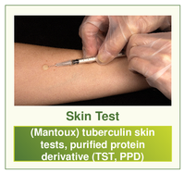
LTBI—How to test TST Vs. IGRA
Notes:
There are 2 diagnostic tests we have available to us:
The tuberculin skin test or TST
And the interferon gamma release assays also called IGRAs
Both of these are indirect tests that measure the body’s immune response to TB antigens.
Because they are indirect tests, they have significant limitations and it’s important that these results are used as a piece of the larger diagnostic puzzle.
Both the TST and IGRAs are surrogate markers for LTBI as they cannot distinguish between LTI and active TB disease. You will still need to use other clinical parameters including chest x-rays and symptom review.
NTM not a significant cause of false positive IGRAs and not TSTs unless in high-NTM prevalence area
IGRA now recommended down to age of 2 (AAP/Red Book)
Booster: occurs in someone sensitized to TB whose immunity has waned but is boosted by the TST; 2-step test helps distinguish booster (-,+) from infection (+). Helps to provide accurate baseline for those who will be repeatedly tested who were infected a long time ago so that they are not thought to be new converters.

Slide 16
LTBI—How to test
TST and IGRA are both acceptable in most situations
IGRA is preferred in foreign-born and those who might not return for TST read
TST is currently preferred in children <2 years old

Slide 17
LTBI—How to test Test limitations
TST/IGRA are tests for TB infection; they CAN NOT be used to rule in/out active TB disease
Negative IGRA or TST does NOT rule out active TB!!!
TST and IGRA are indirect tests (of immune response); abnormalities of immune system can affect the results
Sensitivity/specificity and reproducibility are not 100%--Pretest probability is important in interpreting the results
They do not discriminate between infection/active disease or past/present/resolved infection/disease
Notes:
IGRA/TST are NOT great tests, but they’re what we’ve got
IGRA/TST sens 80%, spec 95%
19% of all confirmed TB cases have a negative skin test and 39% of all HIV+ TB cases have a negative skin test
False negative rates for IGRA are lower, but still not zero.
So neither a negative IGRA or TST rules out TB.

Slide 18
LTBI—How to test
When to consider repeating a test:
High-risk individuals (in whom you don’t want to miss diagnosis) who have an initial negative test
r/o initial false-negative with a repeat test; consider infected if ONE of the tests is positive
Low-risk individuals tested for other reasons (i.e., job entry) who have an initial positive test
r/o initial false-positive with a repeat test; consider infected only if BOTH tests are positive
Someone who may have received BCG (foreign-born) and has an initial positive skin test
r/o false-positive TST d/t BCG with an IGRA
IGRA may also be used to help convince a pt in this scenario that they are infected
Notes:
Generally not recommended to use both TST and IGRA or to repeat testing. However, there are certain scenarios in which you might consider using both in order to increase either the sensitivity or specificity of the testing.
Think of TST and IGRA results as more of a probability of TB infection rather than a definitive answer.

Slide 19
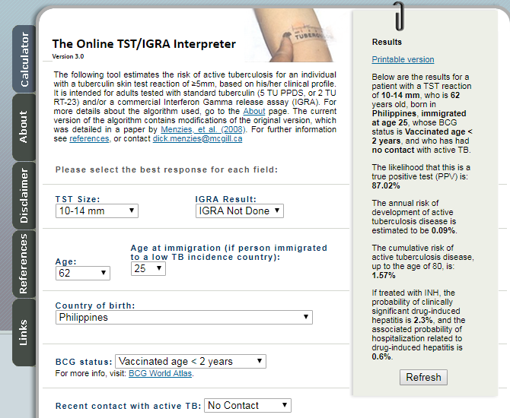
LTBI—How to test
tstin3d.com
Notes:
Link to BCG World Atlas

Slide 20
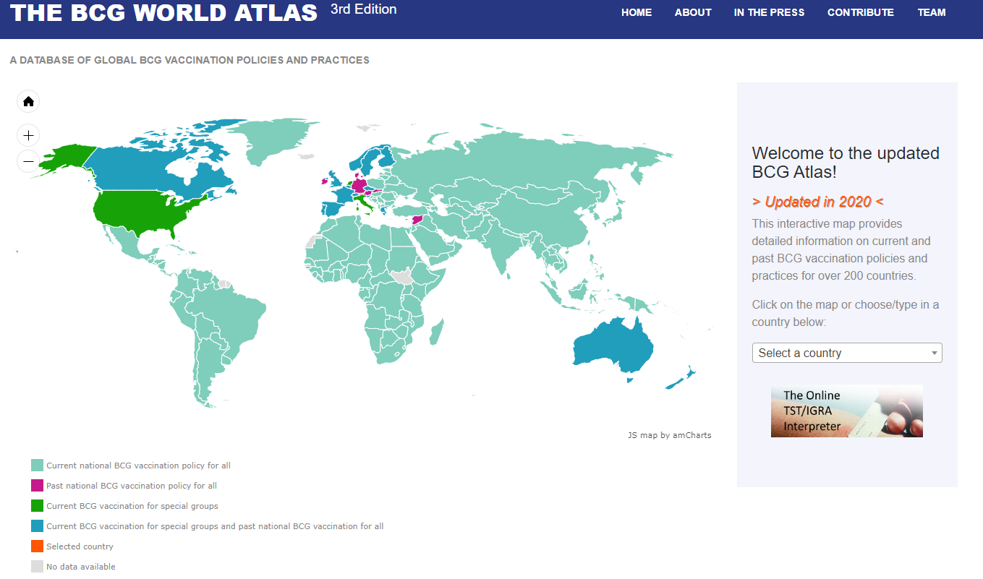
TBI—How to test
bcgatlas.org
Notes:
Sea green = current national BCG vax policy for all; note that it’s most of the world

Slide 21
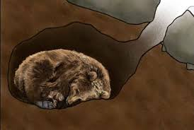
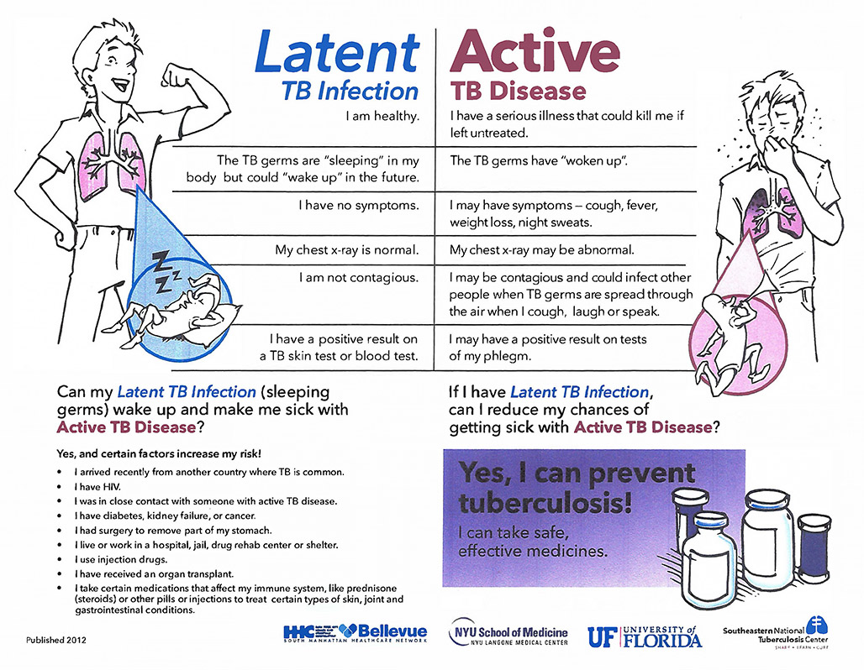
LTBI—Who to treat
Decision to test = decision to consider treatment
Rule out active TB first!
How to deliver diagnosis (language)
Notes:
How to r/o active: good history and physical, CXR; +/- sputa if any doubt. If sx or abnormal CXR, must have neg culture X 3 prior to starting LTBI tx.
How do we present this info to the pt & engage them?
Use “you are infected with TB” rather than “you have latent or inactive TB”
Decision to test is a decision to consider treatment.

Slide 22
LTBI treatment
Notes:
We as primary care providers can and should be testing for and treating LTBI!

Slide 23
LTBI—How to treat
Medication(s) | Frequency | Duration | Doses
Isoniazid/ Rifapentine | Weekly | 3 months | 12
Isoniazid/ Rifampin | Daily | 3 months | 90
Rifampin | Daily | 4 months | 120
Isoniazid | Daily | 6-9 months | 180-270
Notes:
The good news is that LTBI is now much easier to treat than it used to be.
There are now regimens that are shorter, better tolerated, and just as effective.
Currently four regimens are approved for use in the U.S. The focus is on shorter treatment regimen due to increased completion and less toxicity
INH plus Rifapentine given weekly for 3 months (12 weeks)
INH plus Rifampin daily for 3 months
Rifampin daily for 4 months
INH daily for 6-9 months
6 months daily is strongly recommended for HIV-negative adults and children of all ages and conditionally for HIV-positive adults and children of all ages and 9 months daily is conditionally recommended for adults and children of all ages, both HIV-negative and HIV-positive

Slide 24
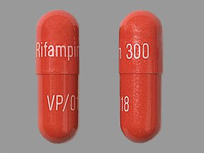
LTBI—How to treat
Rifampin daily X 4 mos
300 mg caps, usual adult dose = 600 mg (2 pills qd)
Not recommended in: potential for drug interactions
Notes:
RIF should be given on an empty stomach to aid absorption

Slide 25
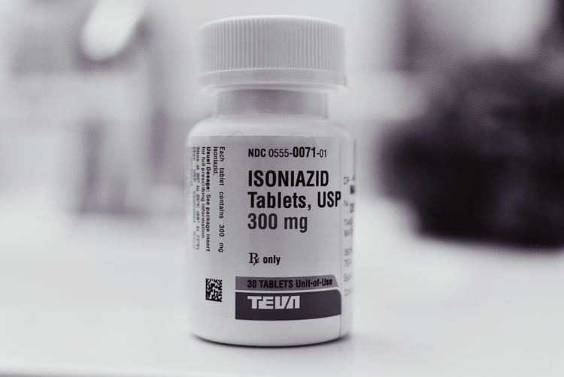
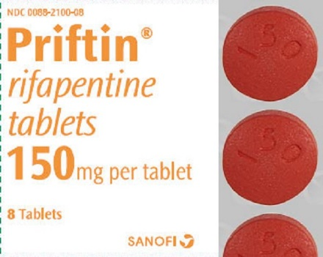
LTBI—How to treat
3HP regimen (12 weekly doses of INH/RPT)
Isoniazid (INH) 300 mg tabs, normal adult dose = 900 mg (3 tabs q week)
Rifapentine (RPT) 150 mg tabs, normal adult dose = 900 mg (6 tabs q week)
+/- Pyridoxine 50 mg/week (conditions associated with neuropathy)
Not recommended for: children <2, pregnant women, potential drug interactions (RFM/ARV)
Notes:
Not a low pill burden (9-10 pills for most people)
INH should be taken on empty stomach
Drug-resistance

Slide 26
LTBI—How to treat
3-month INH/RIF regimen
Isoniazid 300 mg tabs, normal adult dose = 300 mg (1 tab qd)
Rifampin 150 mg caps, normal adult dose = 600 mg (4 tabs qd)
+/- Pyridoxine 25 mg/day (pregnant, breastfeeding, conditions associated with neuropathy)
Not recommended for: potential drug interactions (e.g., RIF-ARV)
Notes:
Not used as much in the U.S. (increased toxicity with daily INH/RIF, less experience, less RCT data)

Slide 27
LTBI—How to treat
Isoniazid daily for 9 mos
300 mg tabs, usual adult dose = 300 mg (1tab qd)
+/- Pyridoxine 25 mg/day (pregnant, breastfeeding, conditions associated with neuropathy)

Slide 28
LTBI—How to treat
Medication side effects
INH: elevated liver enzymes/hepatitis, peripheral neuropathy
Rifapentine/Rifampin: hyperbilirubinemia, hepatitis (when combined with INH), GI upset, pruritus/rash, orange body fluids, hypersensitivity reaction with RPT (flu-like sx)
Med interactions
INH: phenytoin, carbamazepine, some BZD’s, others
Rifapentine/Rifampin
Decrease hormonal contraceptive efficacy! All women should be counseled to use barrier method
Can interact with certain HIV meds, other meds (warfarin, cardiac meds, methadone)
Notes:
INH: 10-20% LFT elevation; usually resolves even with continued tx; 0.1% risk hepatitis; neuropathy 0.2%
Stop INH if LFT’s >3X normal with sx or >5X normal w/o sx
RFM: rare hypersensitivity (hypotension, fever, thrombocytopenia)

Slide 29
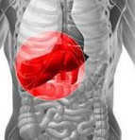
LTBI—How to Monitor
Consider hepatitis/HIV/pregnancy screens if status unknown
Baseline lab testing (AST, ALT, bilirubin, CBC) only needed in certain conditions
Past or current liver disease or risks for chronic liver disease
Regular alcohol or drug use
Pregnancy or immediate postpartum period (3 mos)
HIV
Repeat testing during treatment only needed if
Liver disease
Abnormal labs at baseline
Hepatitis symptoms develop (jaundice, fatigue, weakness, abdominal pain, N/V, pale stools, dark urine, etc.)
Notes:
If you don’t already know your pt’s pregnancy, HIV, hepatitis status, you may want to check these first as they may influence your choice of treatment and need for monitoring.
CDC recs only LFTs, other experts rec CBC at baseline as well
RFM can cause leukopenia, thrombocytopenia
Increased risk of hepatotoxicity during pregnancy and immediate PP period

Slide 30
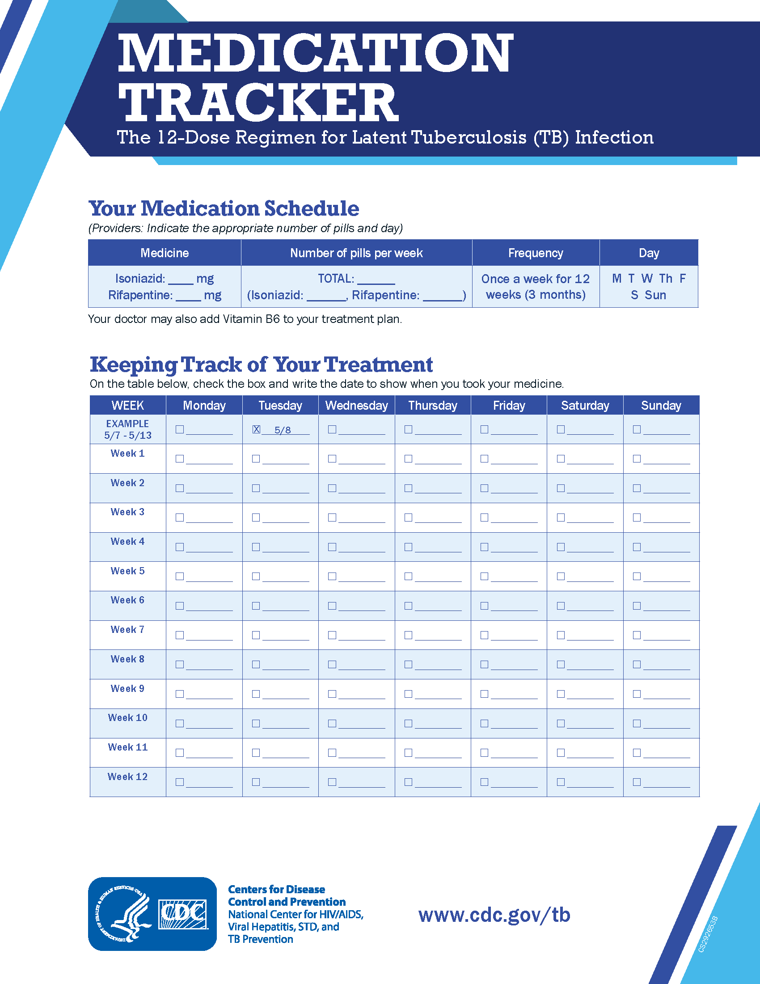
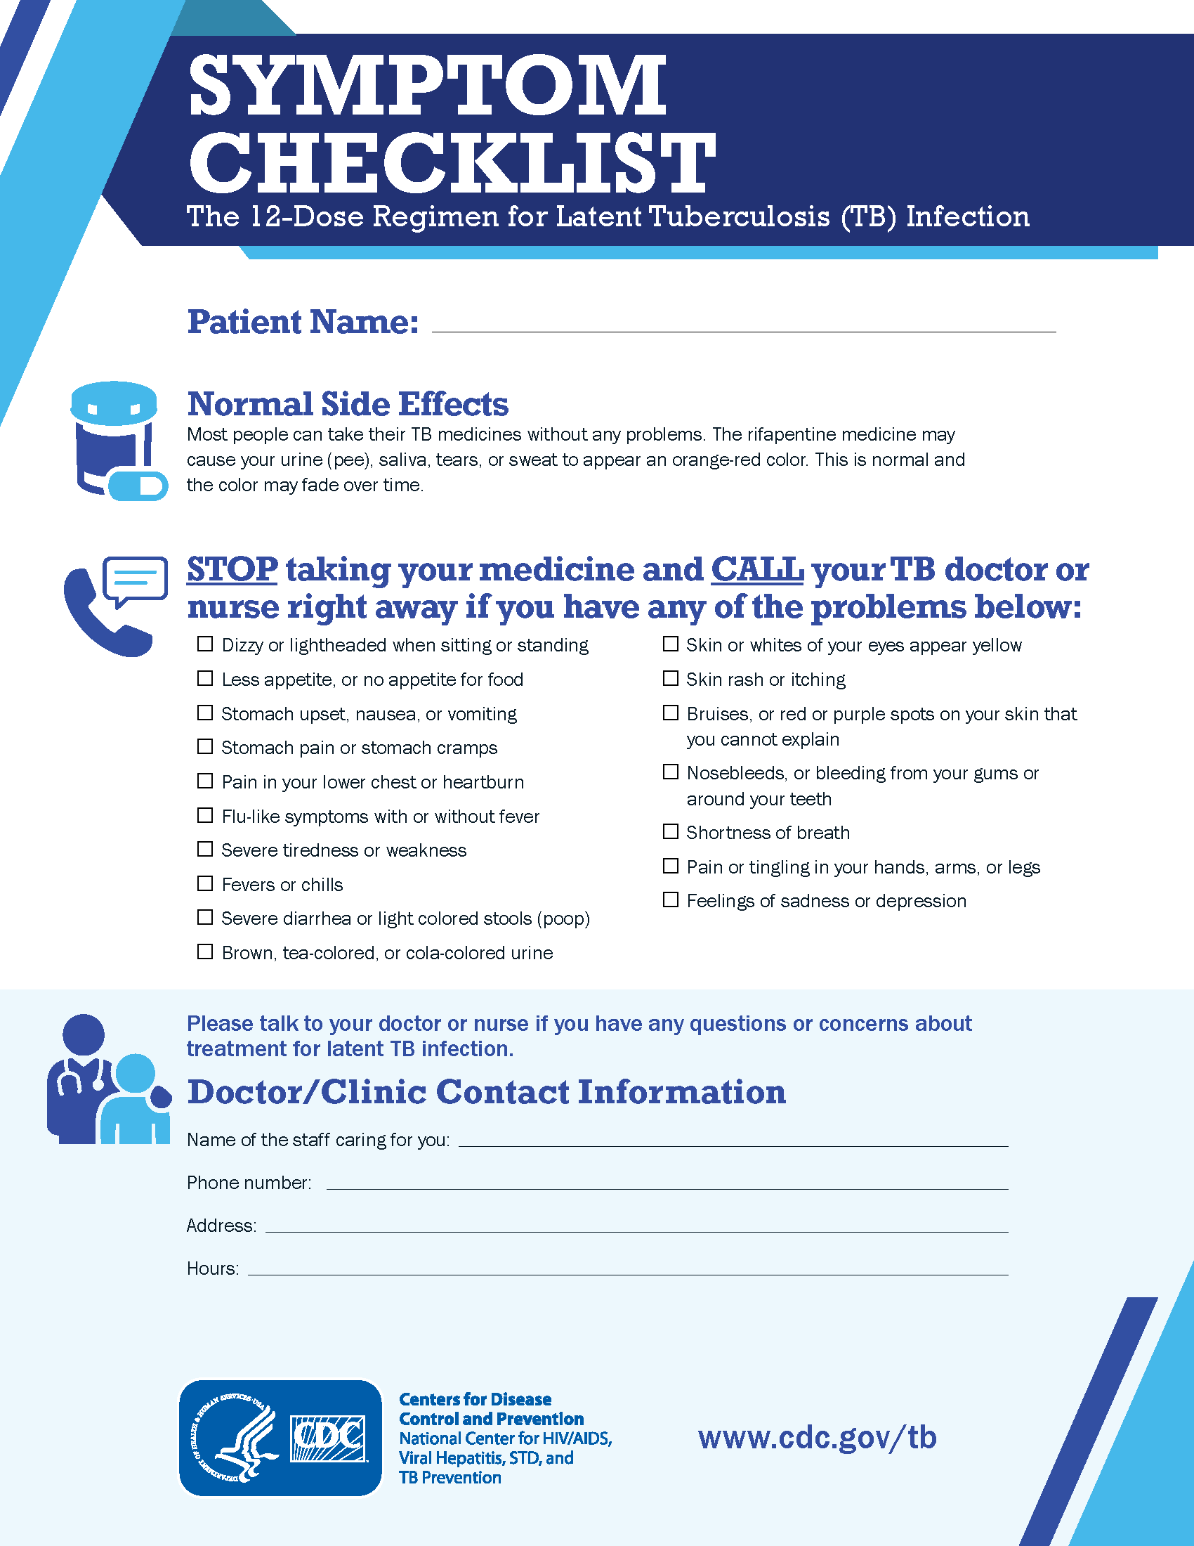
LTBI—How to Monitor
Monthly visits
Check adherence
Check for med side effects
Check for sx active TB
All of the regimens can be self-administered

Slide 31
What is the TB window period?
TB window period = time between TB exposure/infection and development of a positive TB test
2-8 weeks
Notes:
TB is slow-growing
Tests for TB infection test for immune response, takes time to develop
If someone has a positive test during the window period, this indicates TB infection and they should be evaluated and treated for LTBI.
If they have a negative TB test during the window period, we don’t know if it means that the person is truly uninfected or that it’s just too early for the test to be positive

Slide 32
What is TB window prophylaxis?
TB Window Prophylaxis = prophylactic TB infection treatment of high-risk close contacts while awaiting 2nd TB test at 8-10 weeks after exposure
8-10 weeks

Slide 33
What is the purpose of TB window prophylaxis?
To protect high-risk contacts against TB infection during the window period
8-10 weeks
Notes:
High-risk contacts are at higher risk of getting sick with active TB disease after exposure, developing it more rapidly, and getting worse forms of it. Goal is to abort early infection.

Slide 34
Eval and treat for LTBI
Complete treatment for LTBI
Window prophylaxis
Stop meds if all criteria met
8-10 weeks
High-risk contacts

Slide 35
Who are the high-risk contacts that need window prophy?
Children under 5 years of age*
Immunocompromised individuals
HIV
Immunosuppressive therapy
Transplant pts, TNF-α blockers, >15 mg/d prednisone
8-10 weeks
Notes:
High-risk contacts are at higher risk of getting sick with active TB disease after exposure, developing it more rapidly, and getting worse forms of it
Loeffler recommends consideration of window prophy on a case-by-case basis in kids >5 also (HH or prolonged exposure, sm+ index case, etc.)

Slide 36
Why do high-risk contacts need window prophylaxis?
It can take 2-8 weeks after TB infection for TB test to become positive
High-risk contacts have a higher risk of progressing to active disease
Progression can occur quickly (within weeks of infection)
Higher risk of developing life-threatening forms of TB disease
TB can be more difficult to diagnose in these contacts

Slide 37
Why do kids under 5 need window prophylaxis?
Risk of pulmonary and extra-pulmonary disease in children following infection with MTB
Most disease occurred in the first year following infection.
Adapted from Marais et al. 2004 ²⁹
Notes:
Data from a 2004 review of pediatric TB outcomes from the pre-chemo era.
Kids under 5 are at high risk for bad forms of TB and they can develop it quickly. Approx 50-60% of kids <1 and 25% of kids 1-2 developed TB disease.

Slide 38
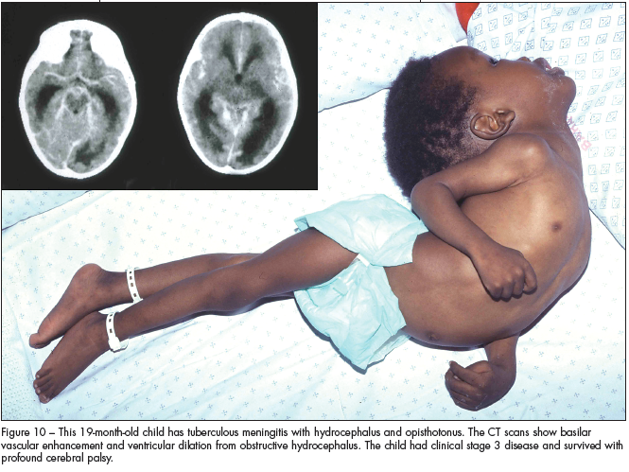
Why do kids under 5 need window prophylaxis?
50% of pediatric TB meningitis cases end in mortality or long-term neurologic sequelae

Slide 39
What are the criteria for starting window prophylaxis?
Close contact to an infectious TB case
Active TB has been ruled out
Initial TB test is NEGATIVE
Last contact was <8 weeks ago
Child < 5 or immunocompromised

Slide 40
What are the criteria for starting window prophylaxis?
Close contact to an infectious TB case
Active TB has been ruled out
Initial TB test is NEGATIVE
Last contact was <8 weeks ago
Child < 5 or immunocompromised
8-10 weeks

Slide 41
What are the criteria for starting window prophylaxis?
Close contact to an infectious TB case
Active TB has been ruled out
Initial TB test is NEGATIVE
Last contact was <8 weeks ago
Child < 5 or immunocompromised
8-10 weeks
Notes:
Important to rule out active TB prior to starting meds for window prophylaxis. H&P, CXR in kids <5 or IC. Immediate eval, don’t wait for TB test result. (Sx review OK for most kids >5).
Ruling out active TB is the first step!
For non-high-risk→eval for symptoms and TB test
For high-risk→need CXR as part of initial eval regardless of presence or absence of sx, TB test result, and time since exposure

Slide 42
What are the criteria for starting window prophylaxis?
Close contact to an infectious TB case
Active TB has been ruled out
Initial TB test is NEGATIVE
Last contact was <8 weeks ago
Child < 5 or immunocompromised
8-10 weeks
Notes:
Positive test at any point during window period indicates the presence of TB infection. Proceed with LTBI treatment once active TB ruled out.

Slide 43
What are the criteria for starting window prophylaxis?
Close contact to an infectious TB case
Active TB has been ruled out
Initial TB test is NEGATIVE
Last contact was <8 weeks ago
Child < 5 or immunocompromised
8-10 weeks
Notes:
If last contact to infectious index was 8 or more weeks ago, they are no longer in the window period and we can trust the test results, IF the child is 6 mos of age or older.

Slide 44
What are the criteria for starting window prophylaxis?
Close contact to an infectious TB case
Active TB has been ruled out
Initial TB test is NEGATIVE
Last contact was <8 weeks ago
Child < 5 or immunocompromised
8-10 weeks
Notes:
Why do these groups need window prophy?

Slide 45
Ruling out active TB in high-risk contacts
 | Non-high-risk contact | High-Risk Contact
Initial eval* | Symptom screen and TB test | Symptom screen, CXR, and TB test
CXR needed? | Only if +sx or +TB test | ALL
Repeat TB test at end of window period? | Yes | Yes
Treat for TB infection during window period? | No | YES
Non-high-risk contact: age ≥5, immunocompetent
High-risk contact: age <5, immunocompromised
*This initial eval should be done regardless of time since exposure. Symptom screen and CXR should be done in high-risk contacts immediately without waiting for results of TB test.
Notes:
Ruling out active TB is the first step!
For non-high-risk→eval for symptoms and TB test
For high-risk→need CXR as part of initial eval regardless of presence or absence of sx, TB test result, and time since exposure
Only difference for IC is to consider completing LTBI treatment even if f/u TB test is negative d/t possibility of anergy

Slide 46
Window prophylaxis
Can treat with any of the regimens used for LTBI
Short course regimens preferred
3HP only approved for kids ≥ 2 years old
Base choice on susceptibilities of index case if known
Notes:
If their f/u test is positive and no active TB, you will continue regimen to complete LTBI treatment course.

Slide 47
Window prophylaxis
Give parents/child a big pep talk at the beginning of treatment
Explain the benefits of treatment and the consequences of active TB in kids
Explain that these meds are safe for kids and that kids usually tolerate them better than adults
Consider using incentives to encourage treatment completion and follow-up testing

Slide 48
Window prophylaxis
Getting kids to take the meds
Open capsules or crush tablets
Hide in yummy soft foods (Nutella, maple syrup, whipped cream, pudding, etc.)
Layer vehicle and med on spoon; encourage kids to swallow it without chewing
Minimize GI side effects by giving med with snack and/or at bedtime
Give the dose when the child is a little hungry
Never let the child think the dose is optional
Provide calendar/stickers/other incentives
Notes:
Avoid suspension if possible—larger volumes and sorbitol more likely to cause diarrhea.
Frequent check-ins (weekly) are a good idea
Remember dose adjustments for weight gain

Slide 49
When can Window Prophylaxis be stopped (kids<5)?
Criteria:
Child is at least 6 months of age AND
Second TB test result is negative AND
Second TB test was performed at least 8 weeks after last exposure
Notes:
Infants under 6 mos may be anergic
May choose to continue and complete LTBI treatment in IC adults (may be anergic and 2nd test might be false negative).
What if repeat testing is delayed? Continue LTBI treatment either to f/u test or completion. Nothing magic about 8 weeks—NEED f/u test to stop.

Slide 50
Scenario 1
2 yo female is a close contact to her grandmother who was diagnosed with active pulmonary TB 2 weeks ago
Last exposure was 1 week ago
Child has no symptoms
Child resides in a village where CXR is not available. It is unknown how soon she will be able to get a CXR done.
What if CXR is not immediately available—should window prophy still be started?
???
Notes:
<5 CXR is strongly recommended; case-by-case, have to balance risk of undertreating active TB with delaying treatment. >5 and no sx, probably OK to start.
Whether initial TB test is positive or negative in this case—active TB must be ruled out and treatment for TB infection should be started.

Slide 51
Scenario 2
3 yo male is a close contact to his uncle who was diagnosed with active pulmonary TB 2 weeks ago
Last exposure was 1 week ago
Child has no symptoms and CXR is normal
Initial TB test (1 week after exposure) is negative
Child is started on window prophylaxis but is unable to undergo his repeat TB test at 8-10 weeks due to weather delays.
What if repeat testing is delayed? Should window prophylaxis be continued?
???
Notes:
Continue LTBI treatment either to f/u test or completion. 8 weeks of 1 or 2 meds doesn’t treat anything—NEED f/u test to stop.

Slide 52
Scenario 3
4 yo female is a close contact to her mother who was diagnosed with active pulmonary TB 2 weeks ago
Child has no symptoms and CXR is negative
Initial TB test is negative
Child is started on window prophylaxis.
Child lives in the same household as mother who is still infectious
What if there is ongoing exposure?
???
Notes:
Need to extend window prophy and f/u testing to 8 weeks after LAST exposure, in this case, when mother ceases to be infectious.
Do not seem to be recs to repeat CXR or other eval once already on treatment unless sx arise (?)

Slide 53
Scenario 4
1 yo male is a close contact to his father who was diagnosed with active pulmonary TB 2 weeks ago
Last contact was 1 week ago
Child has no symptoms and CXR is negative
Initial TB test (1 week after exposure) is negative
Child is started on window prophylaxis. Mom reports that child has missed many doses due to refusing the meds
After 4 weeks on treatment, he develops decreased energy level and loss of appetite
What if potential TB symptoms arise during window prophy period?
???
Notes:
Needs immediate re-evaluation for TB disease (H&P, CXR, etc.)
Remember that the sx of active TB in young kids and immunosuppressed persons can be atypical and nonspecific

Slide 54
Scenario 5
4 yo male is a close contact to his aunt who was diagnosed with active pulmonary TB 2 weeks ago
Last contact was 1 week ago
Child previously completed treatment for active TB at 2 years of age
What eval and/or treatment are needed in a high-risk close contact with prior history of TB infection or disease?
???
Notes:
Needs immediate re-evaluation for TB disease (H&P, CXR, etc.)
Remember that the sx of active TB in young kids and immunosuppressed persons can be atypical and nonspecific
Contacts who are immunocompromised or otherwise susceptible are recommended for diagnostic testing to exclude TB disease and for a full course of treatment for latent M. tuberculosis infection after TB disease has been excluded, regardless of their previous TB history and documentation.

Slide 55
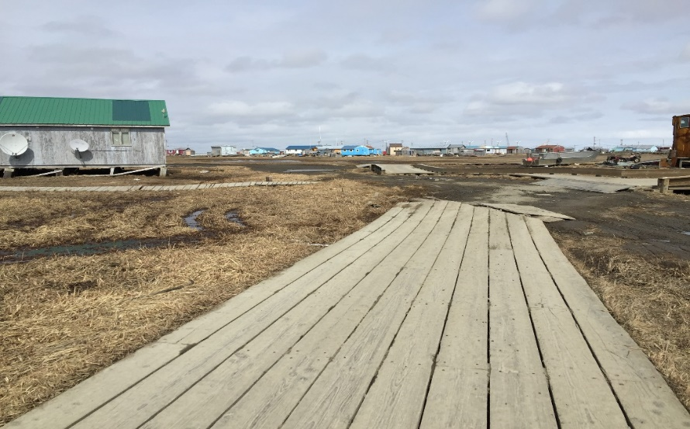
Alaska TB Program
Call 907-269-8000
http://dhss.alaska.gov/dph/Epi/id/Pages/tb.aspx
Or google “Alaska TB Program”
Notes:
CONCLUSIONS: While progress has been made in controlling the rate of TB in Alaska over the past decades, much work remains to be done. Alaska faces significant challenges related to geography, health care infrastructure, health disparities, and a remarkable history of TB in Alaska Native people which continues to make TB control in Alaska a challenging job

Slide 56
Where to get help: LTBI assist
https://globaltb.njms.rutgers.edu/educationalmaterials/LTBI-ASSIST%20-%20Storyline%20output/story.html

Slide 57
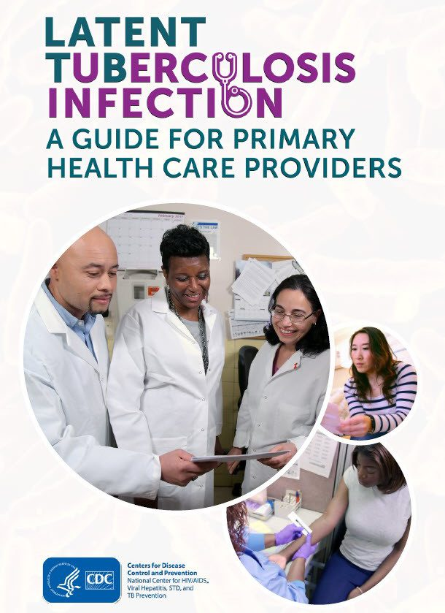
Where to get help: CDC
https://www.cdc.gov/tb/publications/ltbi/ltbiresources.htm
https://www.cdc.gov/tb/publications/ltbi/default.htm

Slide 58
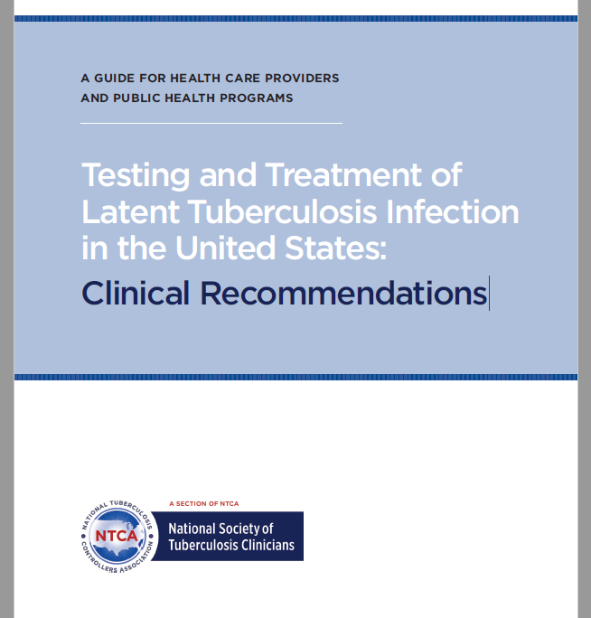
Where to get help: NTCA
https://www.tbcontrollers.org/resources/tb-infection/clinical-recommendations/

Slide 59
Take-Home Points
Look for TB risk factors in your patients
Use shorter-course regimens (3-mo INH/RPT, 3-mo INH/RIF, or 4-mo RIF) to treat LTBI for most. Rule out active TB first!
Remember window prophylaxis for high-risk TB contacts
Don’t forget to call the Alaska TB Program to report suspected active cases and to get help/resources!
269-8000

Slide 60
Resources
https://www.cdc.gov/mmwr/preview/mmwrhtml/rr5415a1.htm#top
https://www.currytbcenter.ucsf.edu/product/guide/pediatric-tuberculosis-an-online-presentation
Alaska TB Manual

Slide 61
Thank You!

