Slide 1
Tribal Capacity & Training
GAP Statewide Monthly Webinar
December 18, 2024

Slide 2
Agenda
Welcome
ANTHC Updates
EPA Updates-GAP Draft Proposals due 1/21/2025
Guests & Presentation:
  Katherine Brown, EPA GAP Tribal Coordinator/Project Officer
Open Discussion / Questions
Next GAP Statewide Call:
  January 15, 2025, 1:00 pm-2:30 pm (Indoor Air Quality)

Slide 3
ANTHC
Resource Opportunities
Training Opportunities
Tribal Capacity & Training Updates

Slide 4


Slide 5


Slide 6
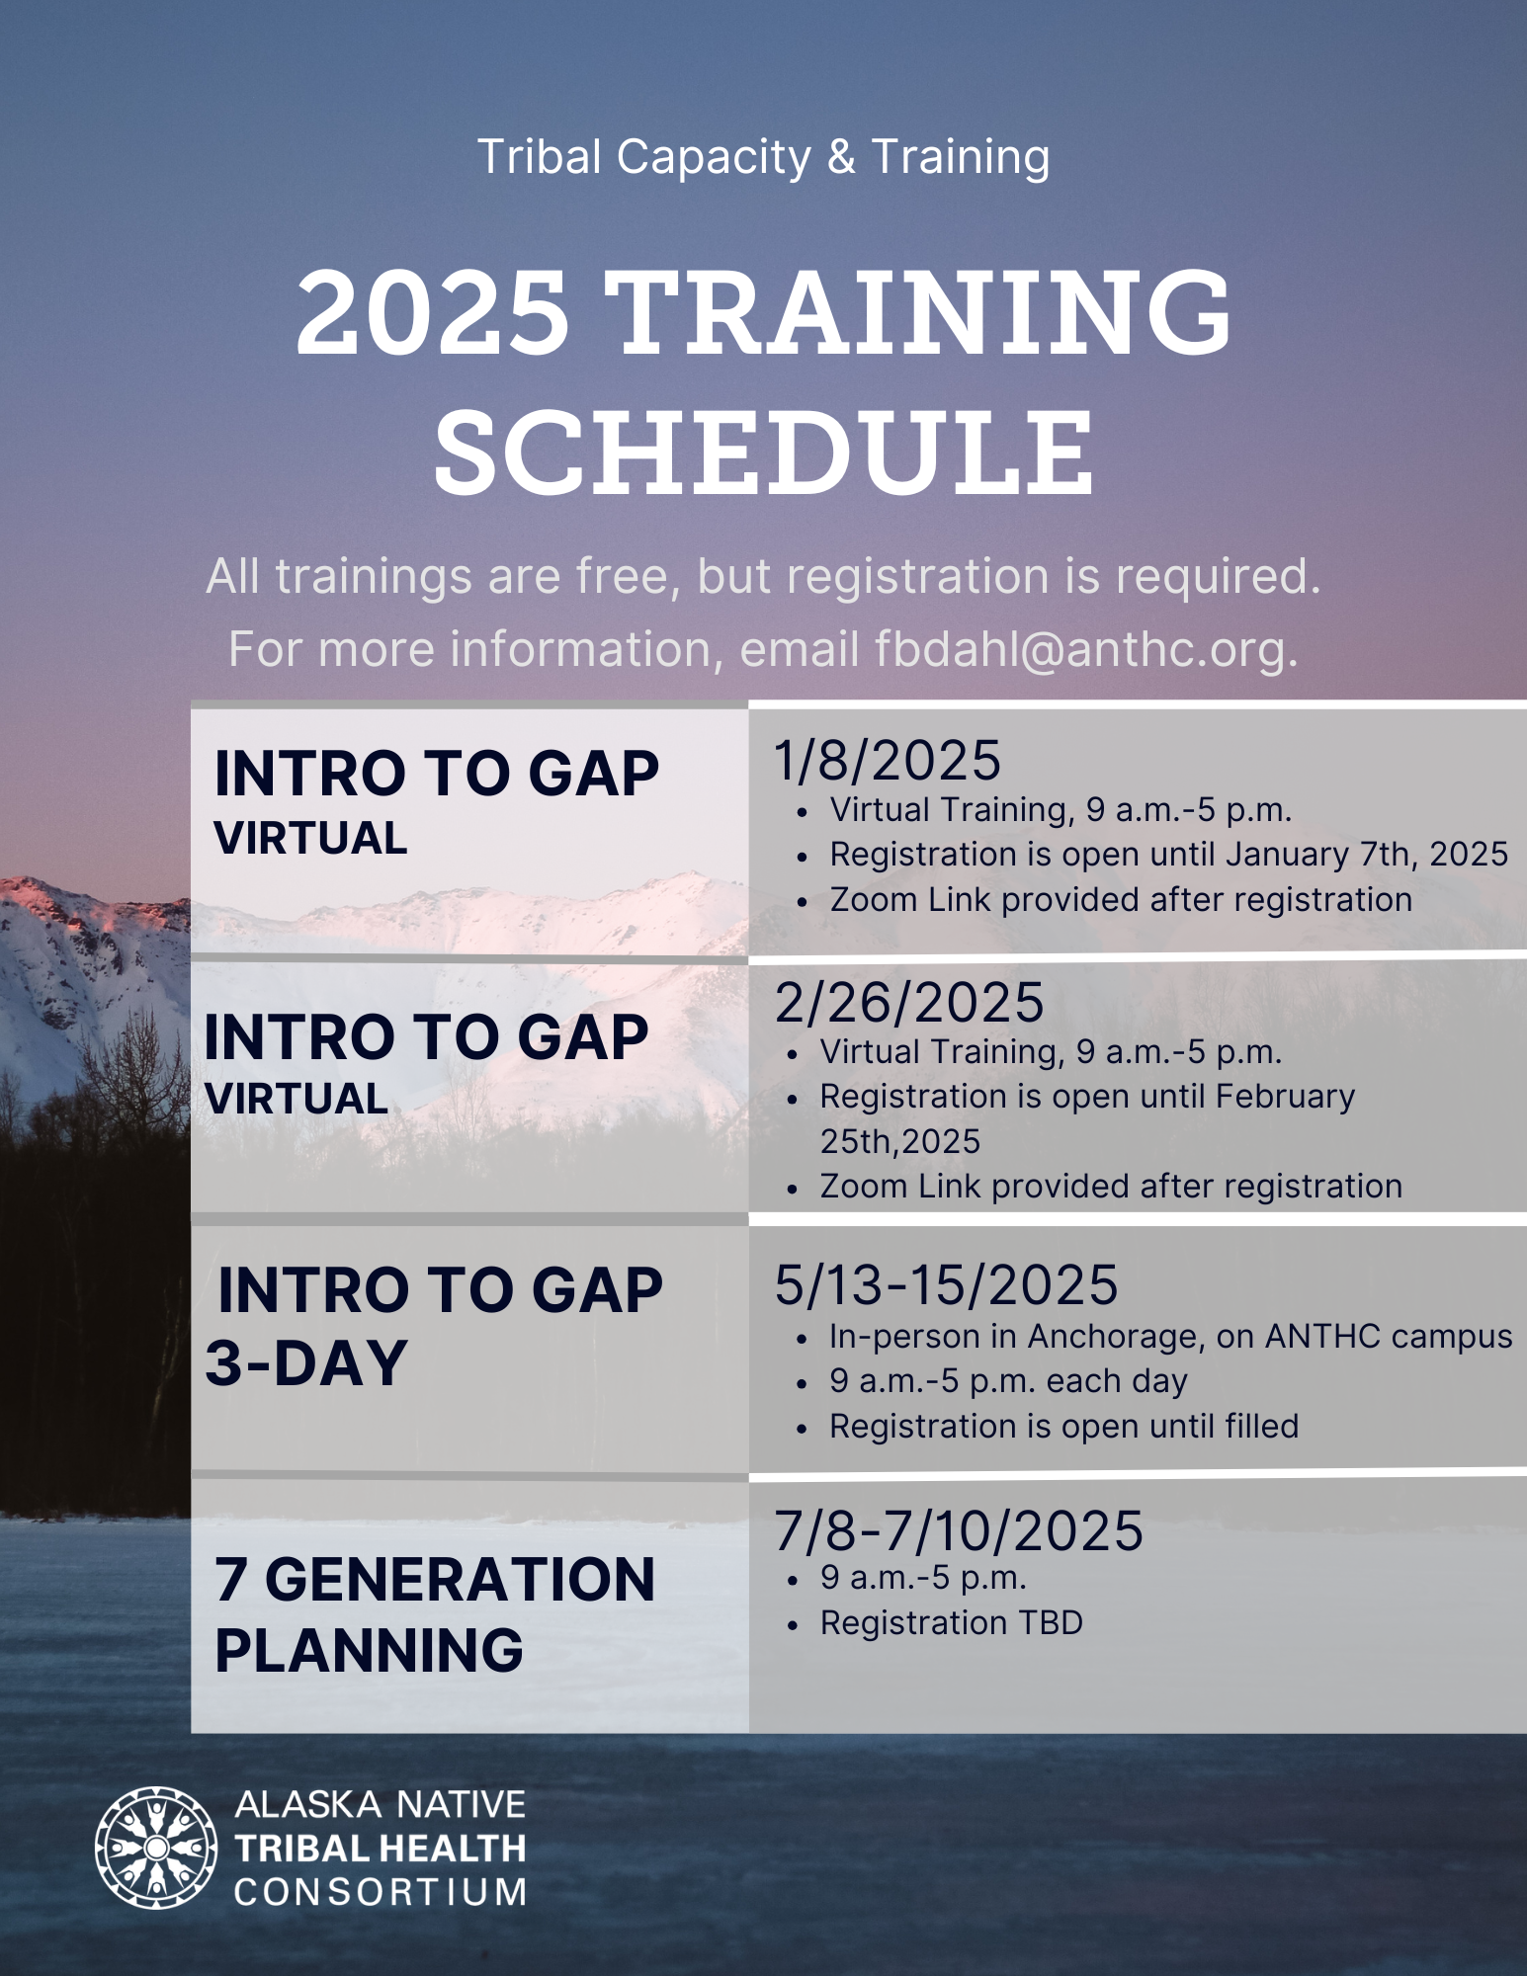

Slide 7

ATCEM – SAVE THE DATE!!
www.atcemak.com
https://www.facebook.com/ANTHC.ATCEM/

Slide 8

ATCEM PLANNING COMMITTEE

Slide 9
ANTHC Tribal Capacity & Training
1st Quarter 2025
Provide Statewide GAP workshop
Release FY25 Training Schedule
Continue ATCEM planning
Release FY25 Subaward Applications
Release FY25 Technical Assistance Call Schedule
Begin ANTHC/EPA/APU project – Environmental Certification Program

Slide 10
Environmental Protection Agency
Updates
Grant Opportunities
GAP announcements

Slide 11
Partner Sharing

Slide 12

Open Discussion /
Questions

