Slide 1
Tribal Capacity & Training
GAP Statewide Monthly Webinar
February 19, 2025

Slide 2
Agenda
Welcome
ANTHC Updates
EPA Updates
Have you registered/updated SAM.gov?
Guests & Presentation:
  Adam Baron-Director, Tribal Trust and Assistance Division
    EPA Remarks and Planning for FY25
  Santina Gay-EPA GAP Tribal Coordinator/Project Officer
    EPA Updates
  Sherry Davis-EPA GAP Tribal Coordinator/Project Officer
    GAP Federal Forms presentation
Open Discussion / Questions
Next GAP Statewide Call:
  March12, 2025, 1:00 pm-2:30 pm (Youth Engagement)

Slide 3
ANTHC
Resource Opportunities
Home | Grants.gov
Home | SAM.gov
Training Opportunities
Tribal Capacity & Training Updates

Slide 4


Slide 5


Slide 6
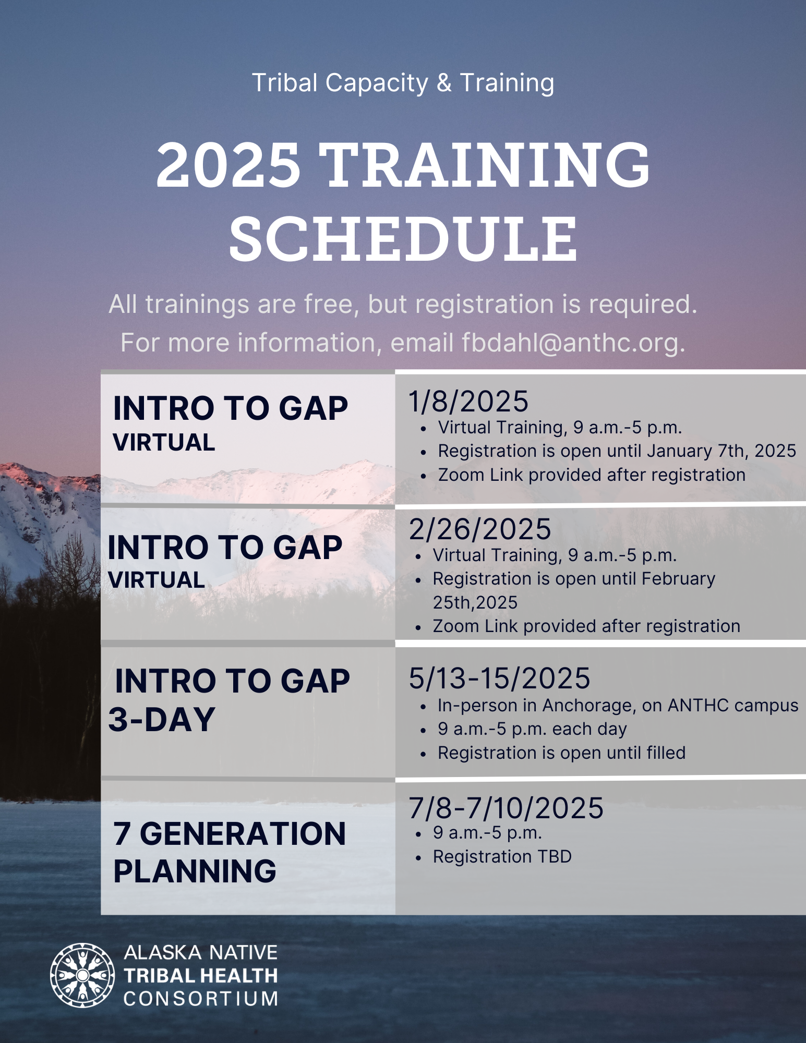



Slide 7


Slide 8

ATCEM – SAVE THE DATE!!
www.atcemak.com
https://www.facebook.com/ANTHC.ATCEM/

Slide 9
ANTHC Tribal Capacity & Training
2nd Quarter 2025
1. Provide two virtual Introduction to GAP Management trainings in January and February.
2. Provide Monthly Statewide GAP Calls and one Quarterly Regional Provider call in January.
3. Host ATCEM at the downtown Sheraton on March 25-28, 2025.
4. Maintain communication with communities receiving Solid Waste Equipment.
5. Process subaward agreements for the FY25 Solid Waste/Resilience Subaward projects and kickoff projects.

Slide 10
Environmental Protection Agency
Updates
Grant Opportunities
GAP announcements

Slide 11
Partner Sharing

Slide 12

Open Discussion /
Questions

