Slide 1
Tribal Capacity & Training
GAP Statewide Monthly Webinar
April 16, 2025

Slide 2
Agenda
Welcome
ANTHC Updates
EPA Updates
Have you completed your Drawdowns?
Quarterly reports due 4/30/2025
FY26 GAP Negotiations deadline 5.16.2025
Guests & Presentation:
  Santina Gay-EPA GAP Tribal Coordinator/Project Officer
    EPA Updates
  Lars Flora – LEO Network
  Jeffrey Luther – Native Village of Noatak
  Dakota Badawy – US Army Corps of Engineers Project Manager
Open Discussion / Questions
Next GAP Statewide Call:
  May 21, 2025, 1:00 pm-2:30 pm (Ambient Air Quality)

Slide 3
ANTHC
Resource Opportunities
Community Environment & Health | Alaska Native Tribal Health Consortium
Training Opportunities
  3-Day Introduction to EPA/GAP in person training
  RCAC Environmental Justice Summit
Tribal Capacity & Training Updates

Slide 4


Slide 5


Slide 6
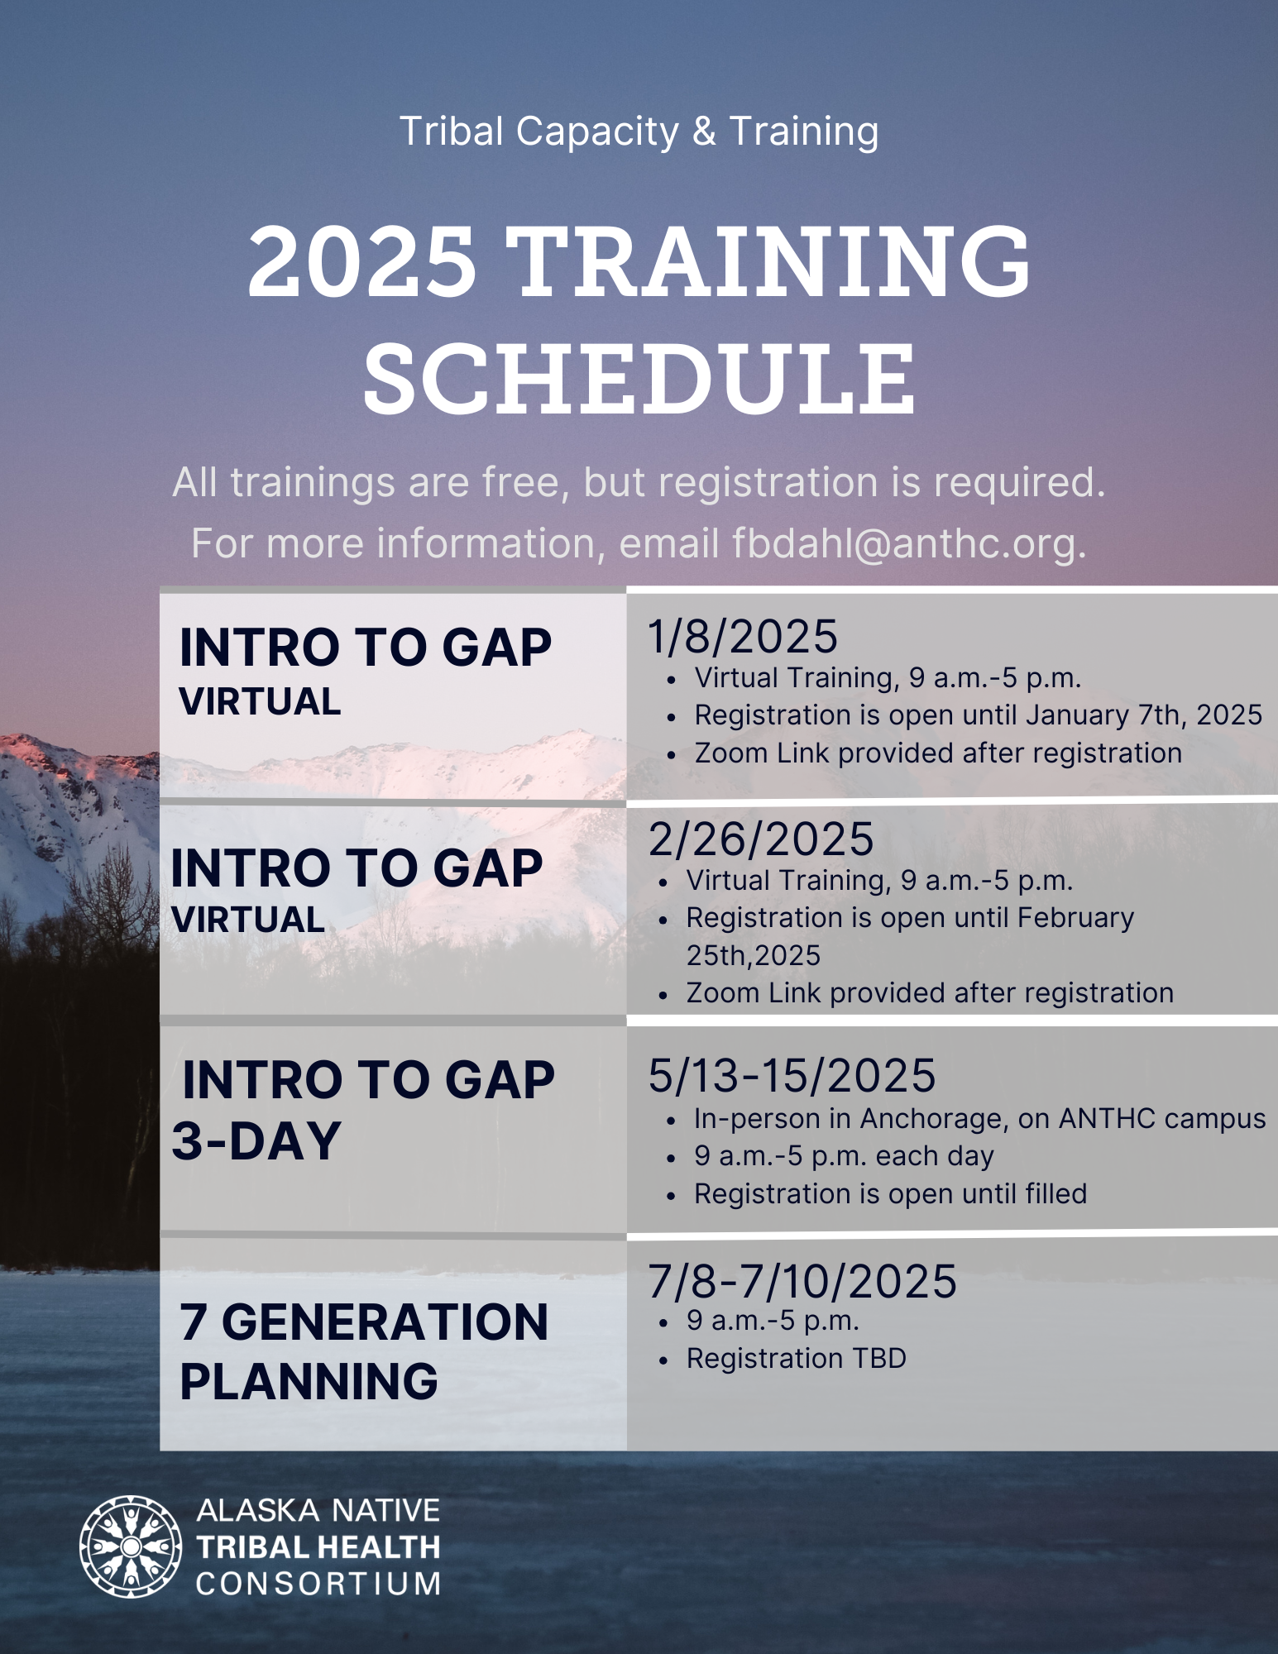





Slide 7

3-Day Intro To GAP
REGISTRATION NOW OPEN
3-Day Introduction to EPA/GAP in person training

Slide 8
ANTHC Tribal Capacity & Training
3rd Quarter 2025
Provide Monthly Statewide GAP Calls and one Quarterly Regional Provider call in April.
Provide a 3-Day Intro to GAP training in May.
Maintain communication with communities receiving Solid Waste Equipment.
Process subaward agreements for the FY25 Solid Waste/Resilience Subaward projects and kickoff projects.

Slide 9
Environmental Protection Agency
Updates
Grant Opportunities
GAP announcements
1. FY26 GAP Negotiations May 16th deadline (PO approved workplan/budgets, federal forms, consortia support documentations are all due); FY26 funding will stress the need for timely 4-year closeouts, and how lack of responsiveness can lead to GAP denials for FY26; importance of timely withdrawals; good overall grants management (GAP attrition).
2. Model EPA GAP erosion workplan component/EPA resources (attached). This was just revised to remove language in conflict to the EPA Five Pillars. Would you please replace this new workplan component with the one that is currently on ANTHC’s website?
3. Reference to EPA Five Pillars: https://www.epa.gov/newsreleases/epa-administrator-lee-zeldin-announces-epas-powering-great-american-comeback
4. FY25 Budget modifications for erosion work this field season (baseline monitoring (qualified sampler training), time lapse camera purchasing, All Haz Mitigation Plan development, CERT Training thru AK Forum, etc.

Slide 10
Partner Sharing

Slide 11

Open Discussion /
Questions

