Slide 1
ANTHC Air & Healthy Homes Program
Presented by:
Melissa Castaneda
Air & Healthy Homes Program Manager
Notes:
1:20PM Welcome and Read Slide

Slide 2
Alaska Native Tribal Health Consortium
Alaska Native Medical Center
Consortium Business Support Services
Division of Community Health Services
Division of Environmental Health and Engineering
Notes:
1:21PM to 1:23PM
Share about ANTHC. Emphasis Statewide tribal health organization.

Slide 3
Tribal Air Quality Concerns Include:
Road Dust Mitigation
Ventilation and Mold
Wildfire Smoke and Woodstove Smoke
Notes:
1:23PM to 1:25PM
Tribal Air Quality concerns include three buckets and overlap between indoor and outdoor air quality.

Slide 4
ANTHC Healthy Homes Program
Education and Outreach including:
Residential cleaning products
Safer Choice EPA Label
Household Green Cleanings kits include:
CO Monitors
Microfiber cleaning cloths
White Vinegar
Notes:
1:25PM to 1:28PM Green Cleaning Kits

Slide 5
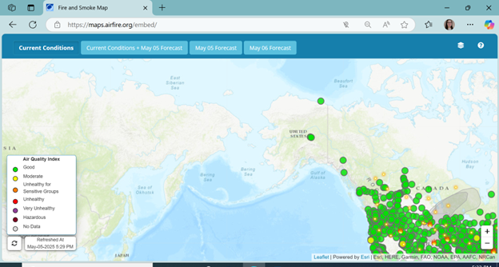
Fire and Smoke Map
Notes:
1:28PM to 1:30PM Fire & Smoke Map Tool
Note: Link to Fire & Smoke Map included within slide

Slide 6
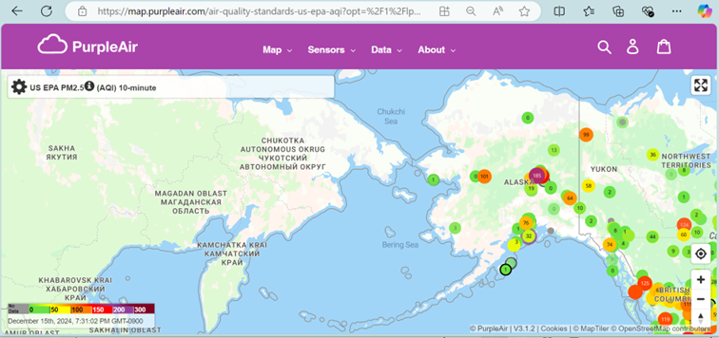
Purple Air Sensor Network
FY2025 work to expand the tribal Purple Air Sensor Network
Notes:
1:30PM to 1:33PM
Note: 12.15.2024: 7:30PM to 7:35PM Snapshot from Purple Air Sensor Map

