Slide 1
MOU Between the Tribe and City
Adding the Tribe to the Landfill Permit

Slide 2
Why do an MOU?
City has dissolved and the tribe has taken over management
Use IGAP funds to manage the landfill
Make it official on paper makes it easier to obtain funding to manage the landfill
Keeps the Landfill Permitted as there is someone for ADEC to work with to keep it permitted, inspections, compliance issues
Why do you want to keep it permitted
  Illegal dumping otherwise and liability issues
  Obtain funding to deal with problems such as floods, fire, spills; the landfill can be used to accept waste

Slide 3
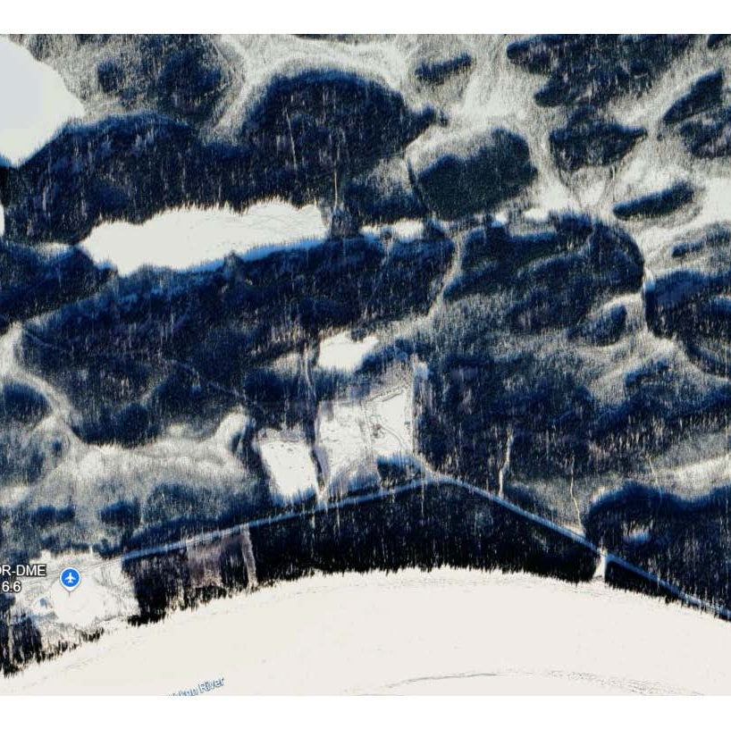
Tanana’s MOU
1st they wrote an MOU to manage a grant the city had
The City gave the Tribe $22,800 to clean up the Landfill by January 1st, 2026
To use IGAP funds and make it official they also wrote ADEC a letter and requested that the Tribe be added to the Landfill Permit

Slide 4
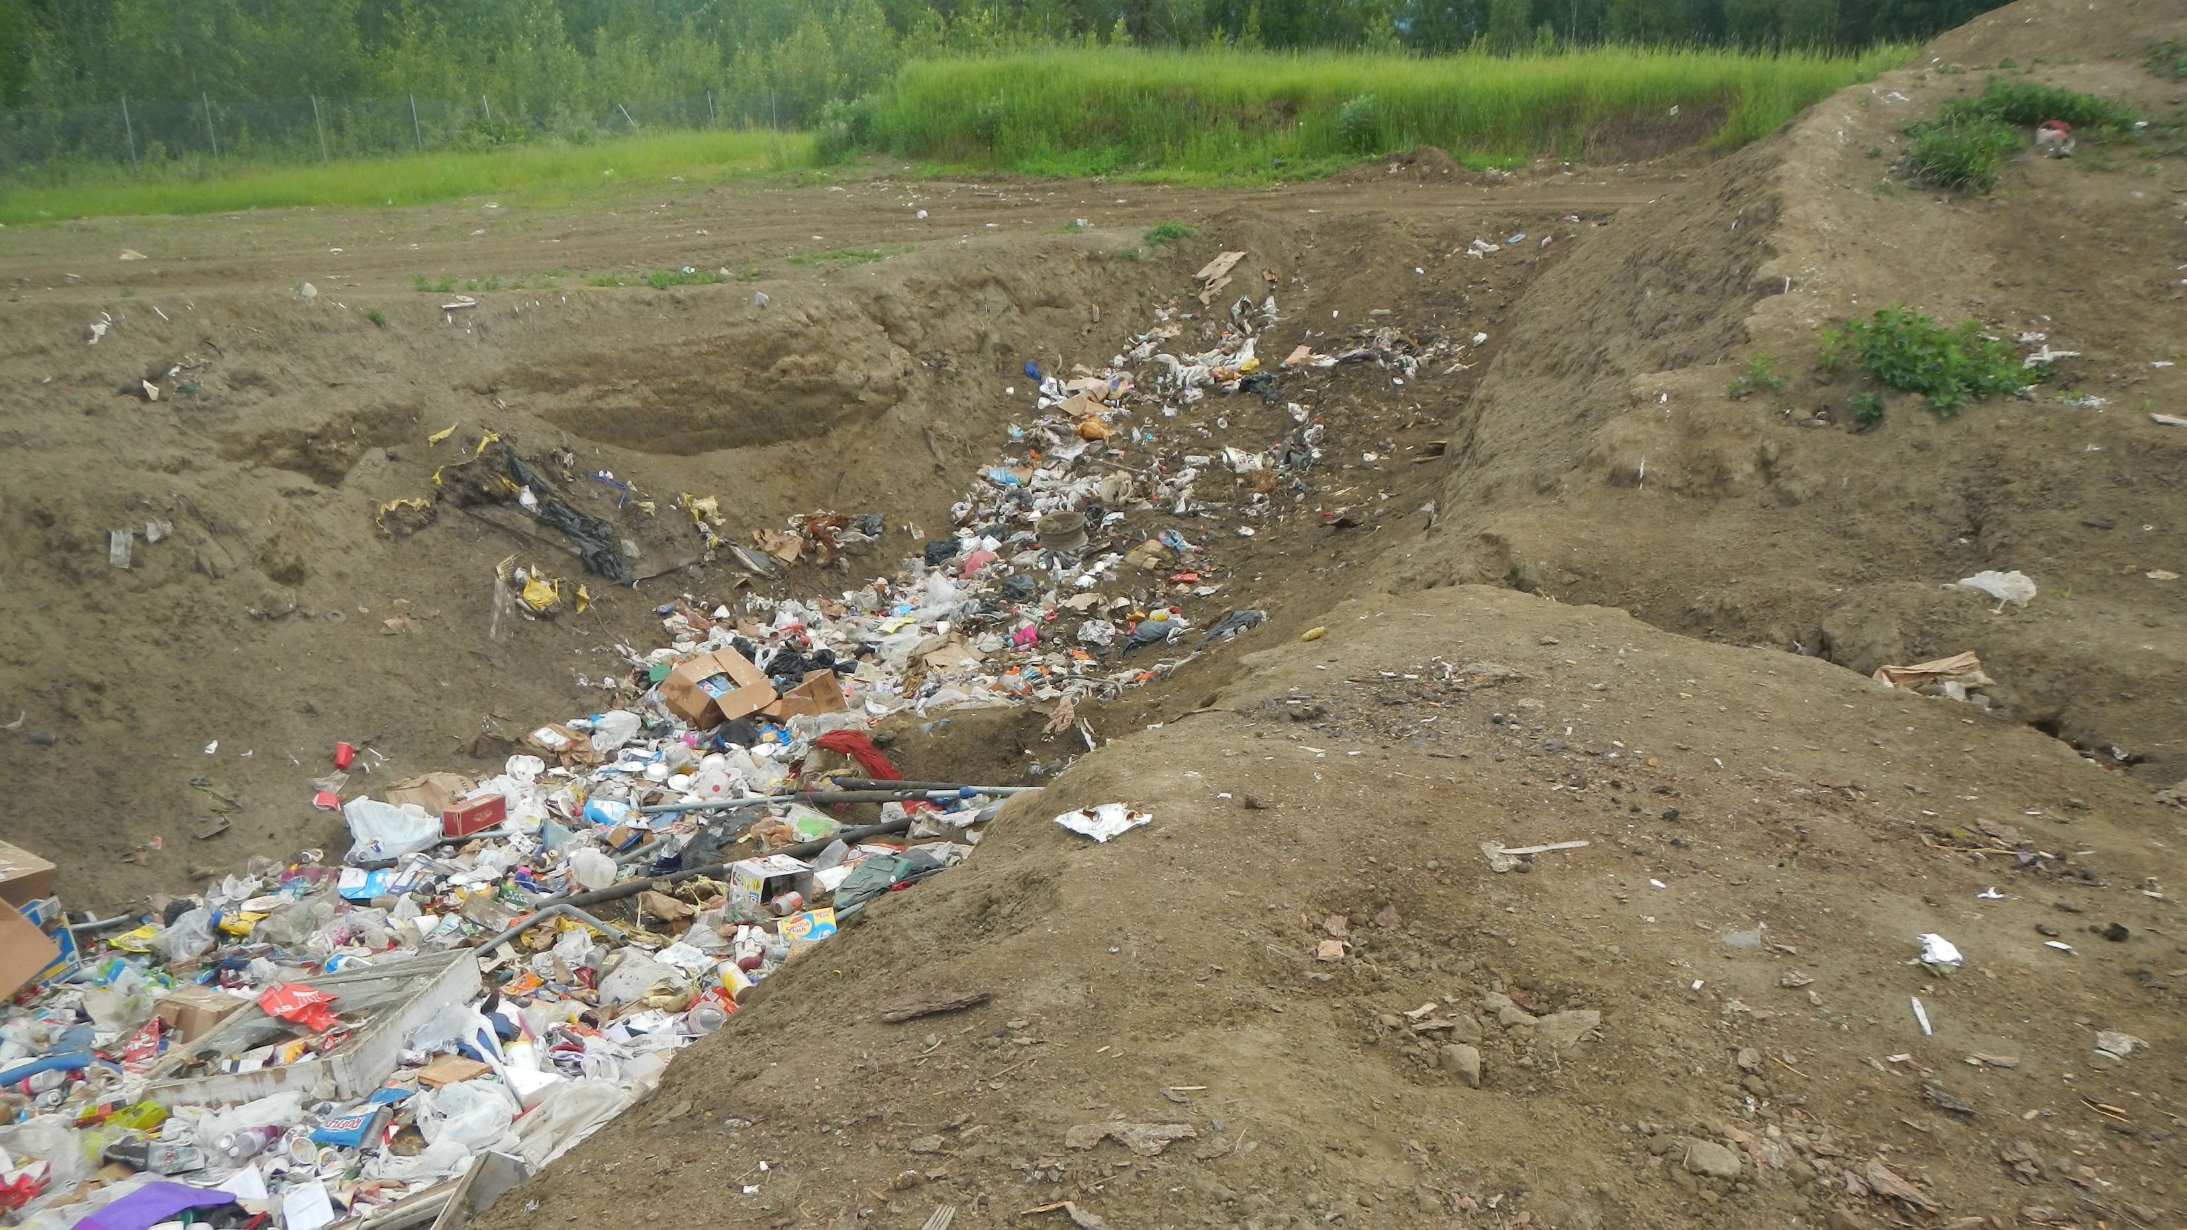
Tanana Landfill

Slide 6
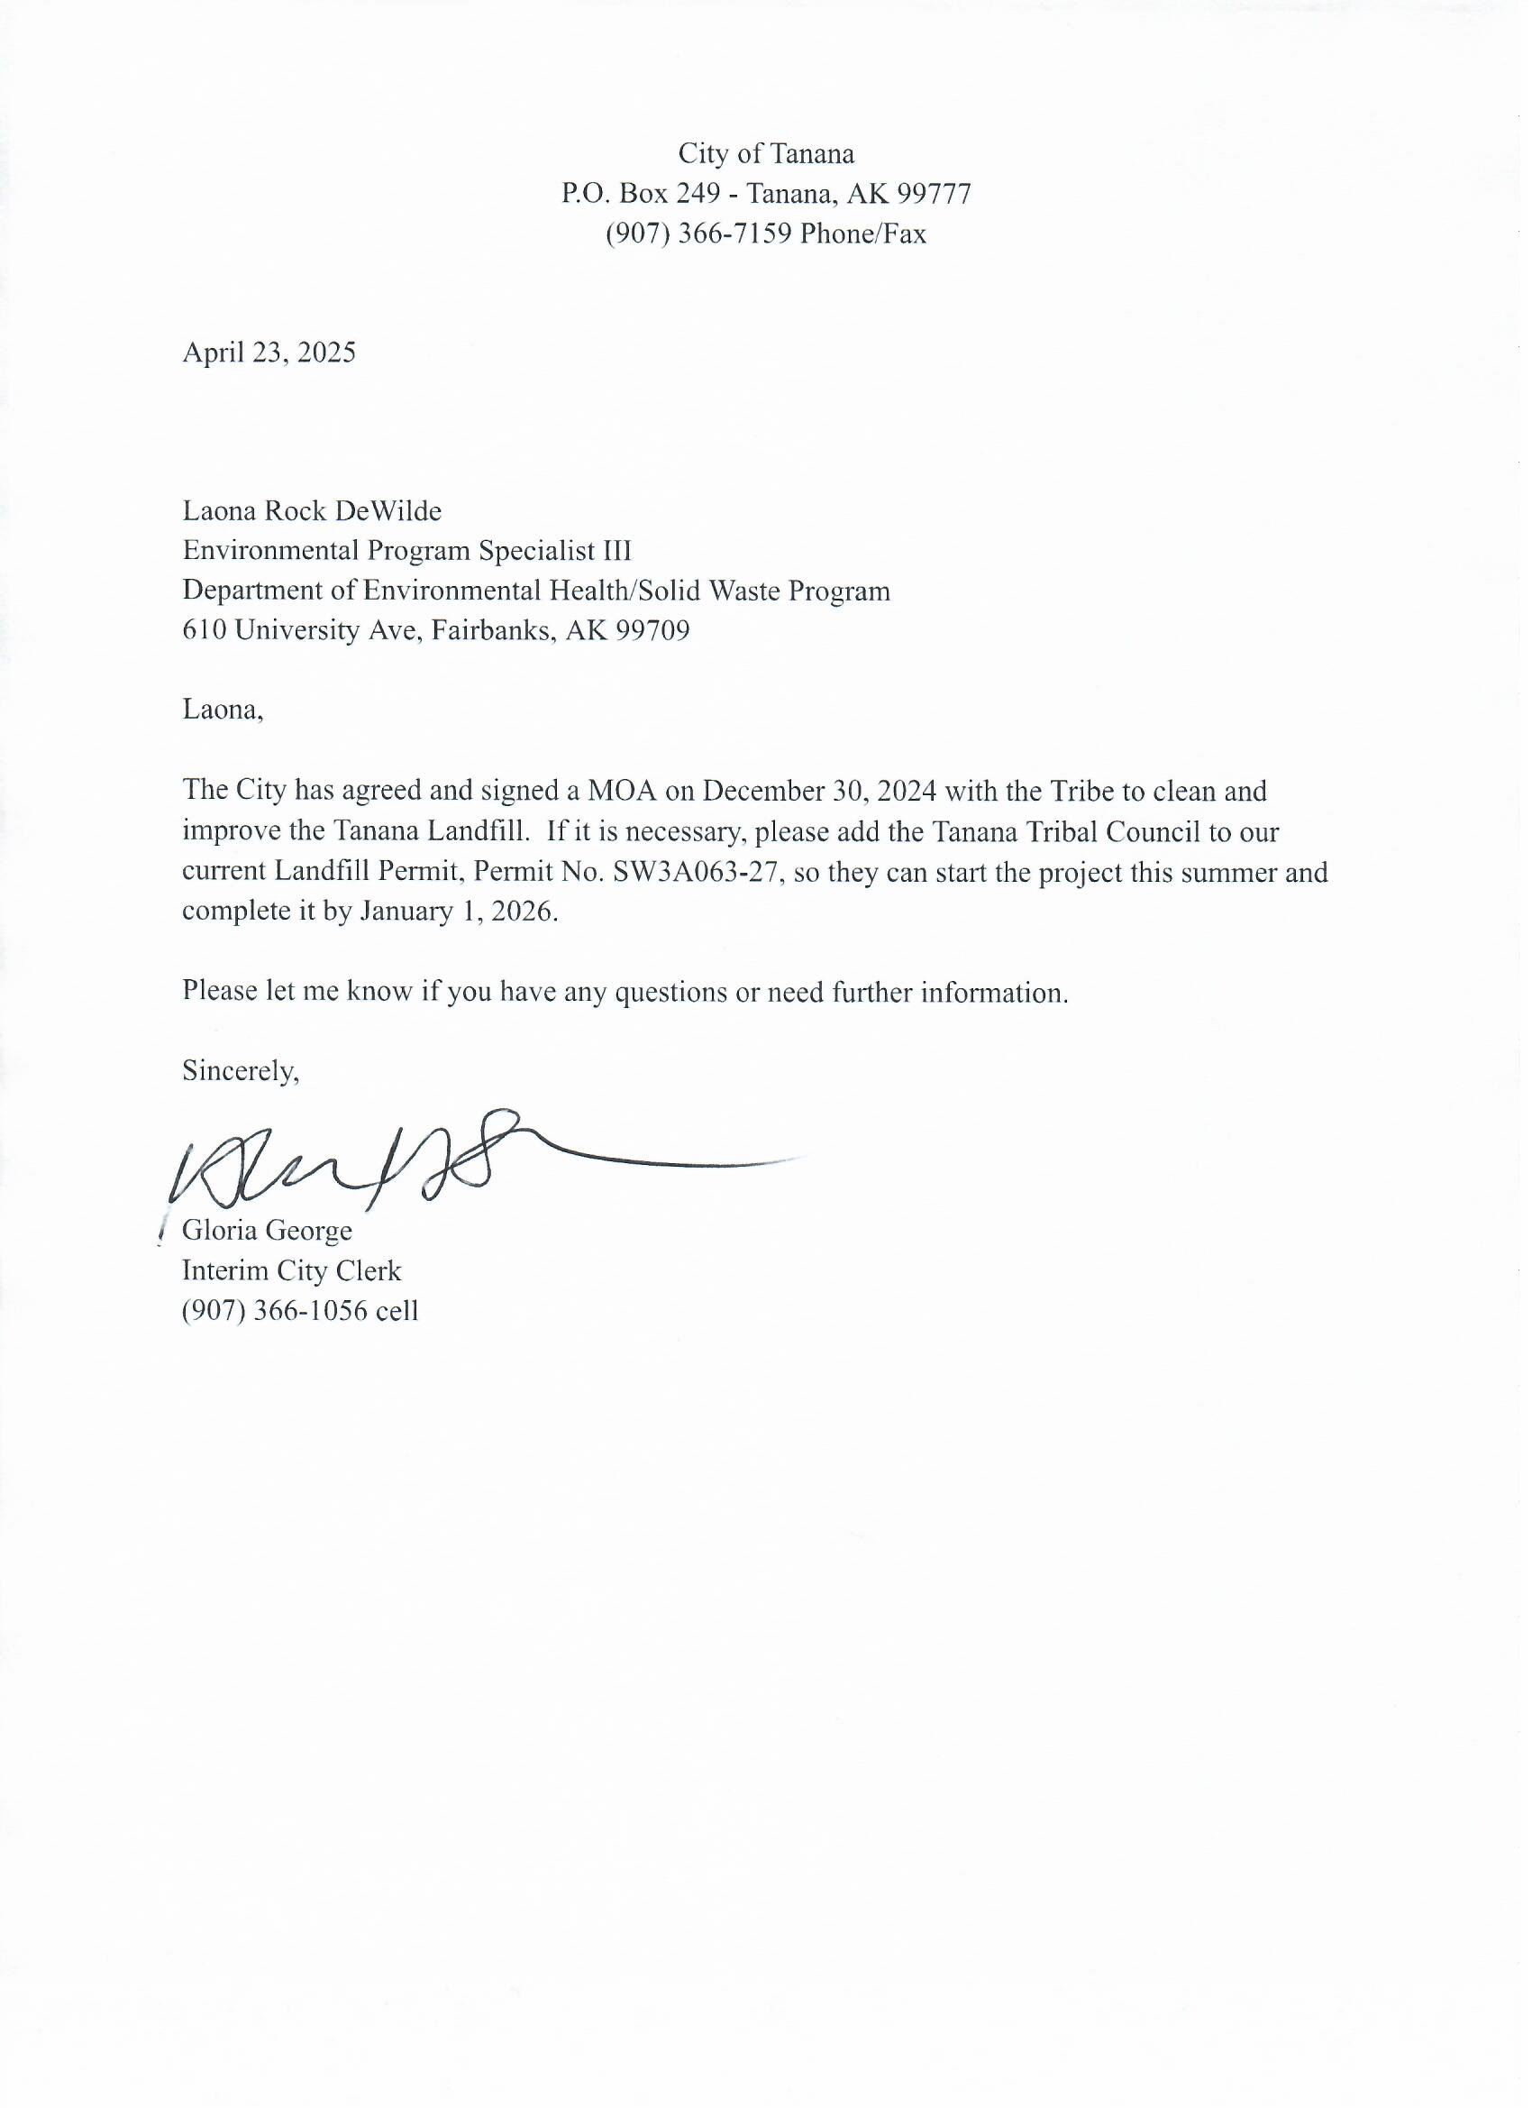

Slide 7
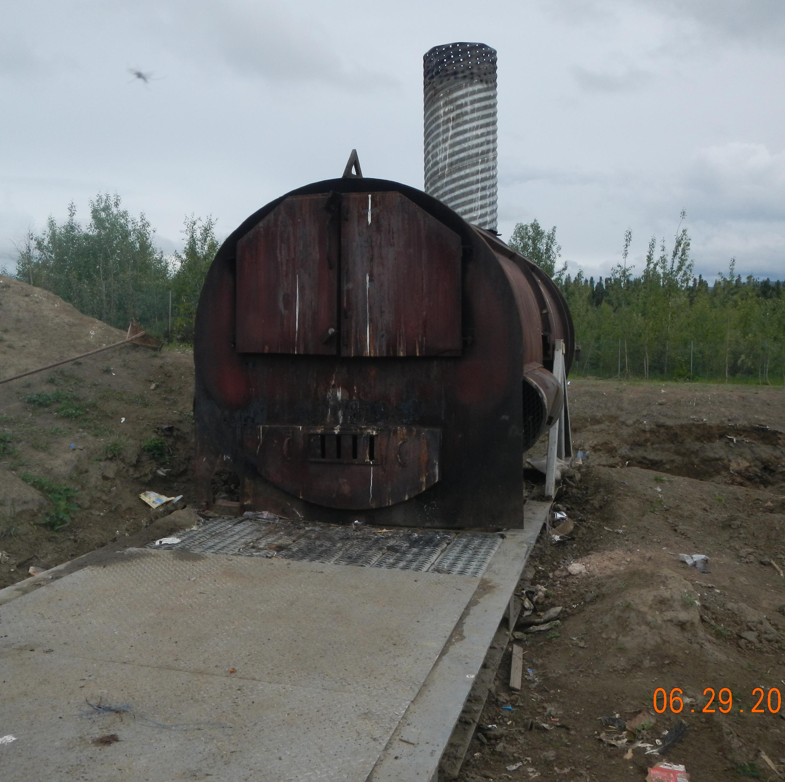
Old Permit
The Alaska Department of Environmental Conservation (ADEC), under authority of AS 46.03 and 18 AAC 60, issues a solid waste disposal permit to:
City of Tanana
P.O. Box 181
Tanana, Alaska 99777

Slide 8
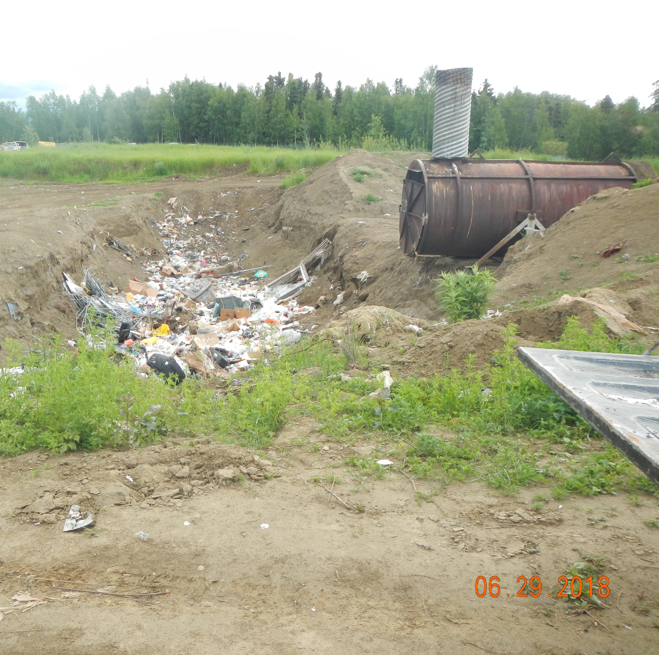
New Permit
Dear Ms. George and Ms. Kennedy:
The Alaska Department of Environmental Conservation received a formal request from the City of Tanana on April 23, 2025 to add the Tanana Tribal Council to their permit because they had entered into a memorandum of understanding with the Tanana Tribal Council on management of the landfill. The City of Tanana provided written confirmation of this collaboration between the two entities and as such, this permit is being re-issued to include the Tanana Tribal Council.

Slide 9
New Permit
The Alaska Department of Environmental Conservation (ADEC), under authority of AS 46.03 and 18 AAC 60, issues a solid waste disposal permit to:
City of Tanana
P.O. Box 181
Tanana, Alaska 99777
And
Tanana Tribal Council
P.O. Box 130
Tanana, AK 99777

Slide 10
What Happened after the MOU
City official retired so there was no more contact for the city
Tribe is the main contact for upcoming inspection and work on the Landfill so they keep it legally permitted.
The MOU is recorded as a deliverable for the Tanana IGAP grant
Had to call them to deal with problems with construction debris and fires
Plan to present about C&D and Fires in Tanana to help deal with this problem
  Education and Outreach

